Slide 1


Welcome to our Year 6
MacMillan Coffee Afternoon

Slide 2
Staff
Our class teachers are: Mrs Hill (6S) and Mr Grant (6L).
Support staff within classes Mrs Burns, Ms Cowell and Ms Green

Slide 3
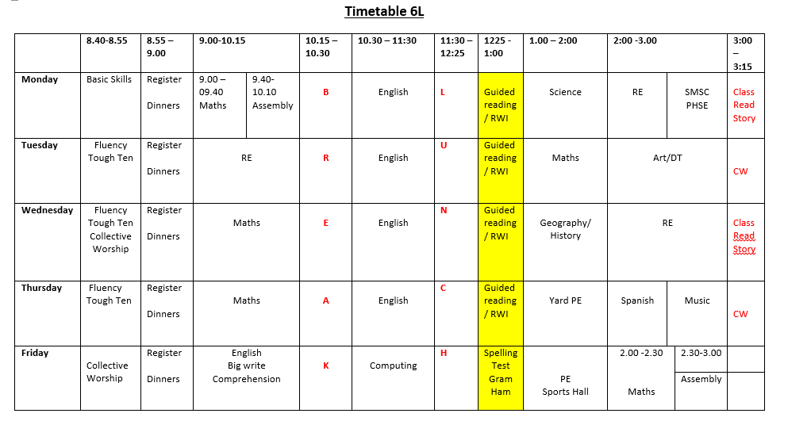
Year 6 Timetable

Slide 4
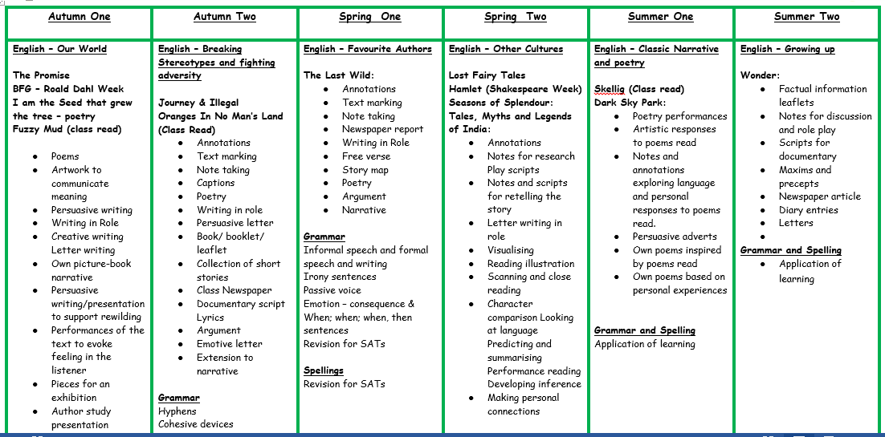
Year 6 Curriculum

Slide 5

RSHE
Year 6 - The wonder of God's love in creating new life.
The scheme focuses on friendship, family, community, relationships and spirituality; a guide to the children’s development as young people. The content is age appropriate and is taught with sensitivity, taking into account the children’s level of maturity in regard to the delivery of the lessons.
The programme is delivered through a series of developmental activities and reflections which focus on physical, social, emotional, intellectual and spiritual development. Opportunities to discuss questions form part of the lessons and again these are treated with care and understanding

Slide 6

Come and See
Prayer & Liturgy
Other faith weeks
Loving | Vocation and Commitment | Expectations | Sources | Unity | Death and New Life | Witnesses | Healing | Common Good
Pupils from Year 1 - Year 6 will learn about Judaism each year.
They will also learn in addition to Judaism, another faith which will be chosen from: Hinduism, Islam or Sikhism.

Slide 7
Key Expectations
Times tables up to 12 x 12
Statutory Words
Reading Books
Homework
Roles and responsibilities

Slide 8
Attendance and Punctuality
Attendance: Our target for this year is 96%.
Punctuality: Every morning from 8:40am - 8.55am we have maths morning challenges. It is incredibly important that your child is in promptly and on time to allow them the opportunity to complete our morning challenge and deepen their understanding of maths concepts.
Rewards - Books, Pizza Party, McDonalds, Sweet/treats

Slide 9
Homework
6L All homework, including reading books, goes out on a Monday and are to be returned on Friday. (Reading to be completed three times a week - little and often)
*6S All homework, including reading books, goes out on a Friday and are to be returned on Friday. (Reading to be completed three times a week - little and often)
If any homework or reading not complete, children catch up on a Friday lunchtime
Spellings.
Times Tables.
Any additional homework can be given out at the discretion of the teacher.
SATs CGP books and file - after Christmas

Slide 10
PE Kits and Days
6S - PE day is , children to attend school wearing their PE kit.
6L - PE day is , children to attend school wearing their PE kit.
Swimming dates:
6L Monday 17th November - Thursday 27th November
6S Monday 3rd November - Thursday 13th November

Slide 11
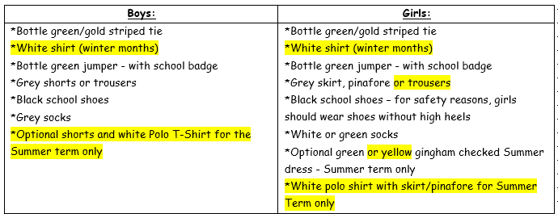
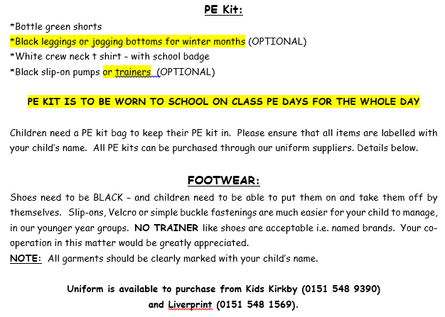
Uniform

Slide 12
Trips and key dates
Cinema Trip:
Residential: Ormside - Early July
Visits to library - .
Local study visit to Liverpool city centre TBC.
Play in a day –
Scoot Fit -
Year group liturgies- Topic – Courage - Monday 13th October 14.30pm

Slide 13
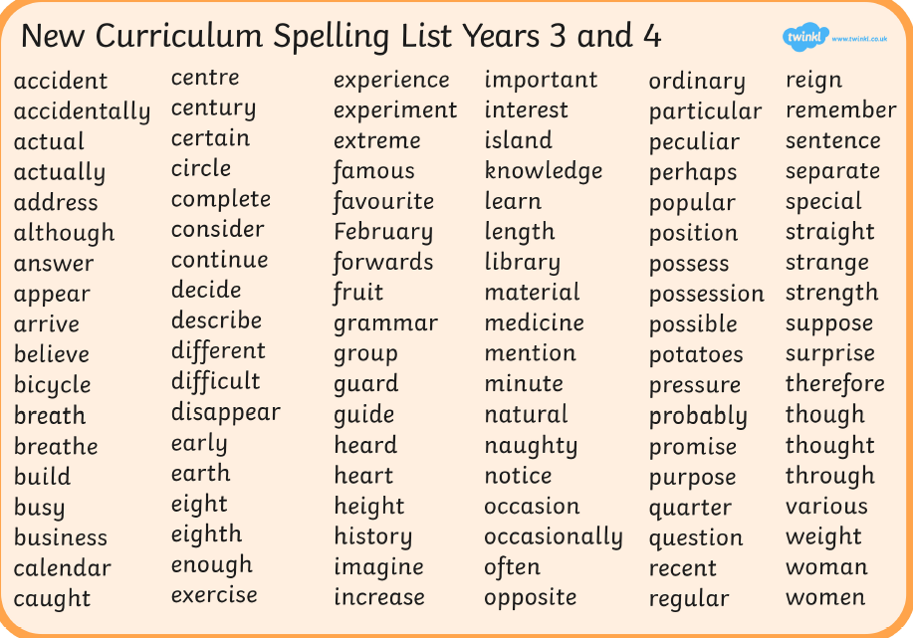

Slide 14
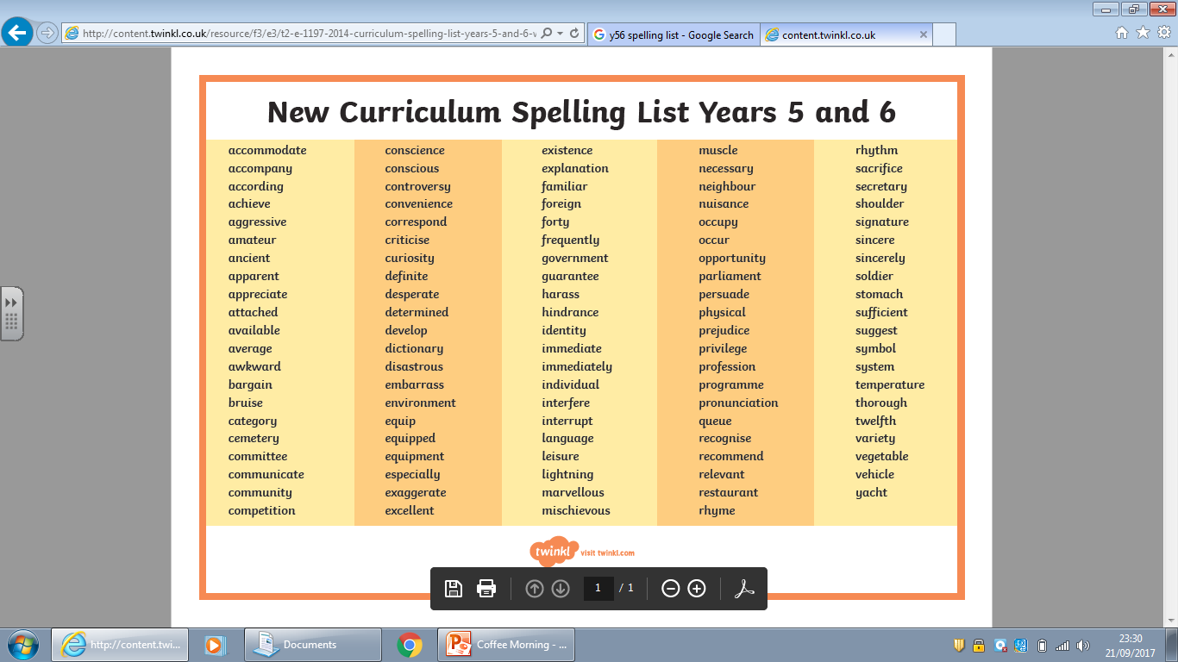

Slide 15

SATs 11th -14th May 2026
Preparation
Teaching and Learning
Seesaw App
Expectations
Pace
Question Types
Curriculum
Revision
Homework
Files
Parent’s SATs meeting December at 3.30pm TBC

Slide 16
Funding
Free School Meals ( Complete Forms)
PTFA - End of year celebrations

Slide 17



Communication
School Spider
St Laurences in App Store
@slaurences
Newsletters - E-mail addresses

Slide 18
Social Media
Age
Guidance
Issues
Role models

Slide 19
Thank You
Coffee
Questions

