Slide 1

RSE Consultation
Little Heaton CE Primary School
Parents and Carers.

Slide 2

School and home partnership
We aim to inform you of:
the school’s legal obligations on Relationships and Sex and Health Education (from April2021)

Slide 3
Relationships
Education
What should children know about relationships, including friendships, and why?
What a positive, healthy, caring, safe relationship looks and feels like
How to speak up and get help when a relationship does NOT feel healthy/positive/safe
How to make and maintain positive relationships
(Online and offline relationships)

Slide 4

What does the government say is the aim of Relationships Education?
‘Today’s children and young people are growing up in an increasingly complex world and living their lives seamlessly on and offline….children and young people need to know how to be safe and healthy, and how to manage their academic, personal and social lives in a positive way’
DfE Guidance on Relationships Education, Sex Education and Health Education 2019

Slide 5
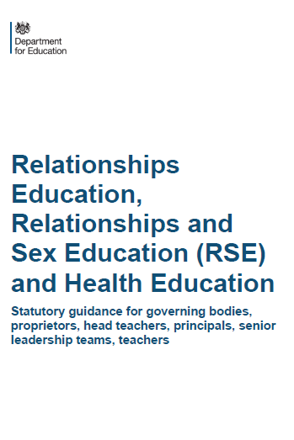

What have schools got to teach?
PRIMARY
RELATIONSHIPS EDUCATION IS COMPUSLORY
HEALTH EDUCATION IS COMPULSORY
But Sex Education is at school’s discretion
SECONDARY
RELATIONSHIPS EDUCATION IS COMPULSORY
SEX EDUCATION IS COMPULSORY
HEALTH EDUCATION IS COMPULSORY
Guidance does not apply to: Sixth Forms colleges, 16-19 academies or FE colleges
© Jigsaw PSHE

Slide 6

What are the expectations to be covered within the Primary Health Education?
Mental wellbeing
Internet safety and harms
Physical health and fitness
Healthy eating
Drugs, alcohol and tobacco
Health and prevention
Basic First Aid

Slide 7
What are the expectations to be covered within Primary Relationships Education?
Families and people who care for me
Caring friendships
Respectful relationships
Online relationships
Being safe

Slide 8
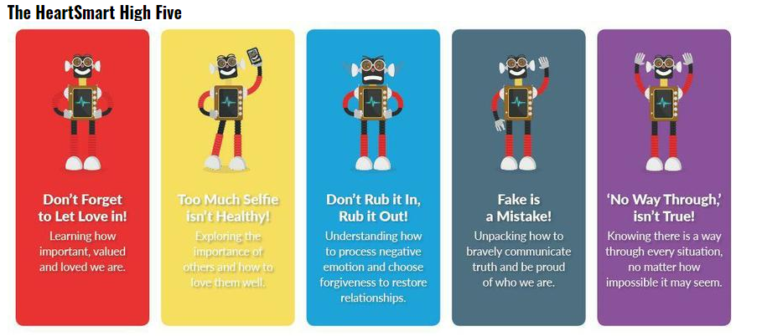
Our RSHE curriculum will be taught through our Heartsmart Programme. See the overview document to find out more.

Slide 9
Sex
Education is discretionary at Primary…what exactly does the guidance say?
The Department continues to recommend that all primary schools should have a sex education programme tailored to the age and physical and emotional maturity of the pupils…drawing on knowledge of the human life cycle set out in National Curriculum Science- how a baby is conceived and born’

Slide 10
National Curriculum Science
The following are aspects of the National Curriculum and are covered as part of Science lessons within school. Parents do not have the right to withdraw their child/ children from these elements.
Key Stage 1
Identify, name draw and label the basic parts of the human body and say which parts of the body is associated with each sense
Notice that animals, including humans, have offspring which grow into adults
Describe the importance of hygiene for humans

Slide 11
National Curriculum Science
The following are aspects of the National Curriculum and are covered as part of Science lessons within school. Parents do not have the right to withdraw their child/ children from these elements.
Key Stage 2
Describe the differences in the life cycles of a mammal, an amphibian, an insect and a bird
Describe the life process of reproduction in some plants and animals
Describe the changes as humans develop to old age

