Slide 1
Phonics workshop.
Reception
Mrs O’Grady and Miss Jackson

Slide 3
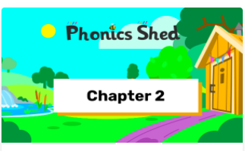

Slide 4
In Chapter 2 and 3 of the ‘Phonics Shed ’ scheme the children are taught 44+ different sounds, (this is the most common way of spelling each speech sound)some of these sounds contain 2 or even 3 letters.
We then ask children to blend and segment these sounds to read and write words.

Slide 5
Pronunciation
When we teach children the sounds in words we teach them using the correct pronunciation.
As children we were taught to add an ‘uh’ sound to many letters eg huh, cuh, fuh.
There is lots of research that this impedes children’s learning.
We teach the children pure sounds eg mmm, ssss, fff, so they can hear the sound as it would be spoken.
https://www.youtube.com/watch?v=UCI2mu7URBc

Slide 6
Phonics Shed
Chapter 1 is all about listening to and tuning into sounds and consists of 9 aspects.
By the end of nursery we would expect children to be secure at chapter 1.
We spend the first part of reception ensuring that children can orally blend and segment and then begin chapter 2.

Slide 7
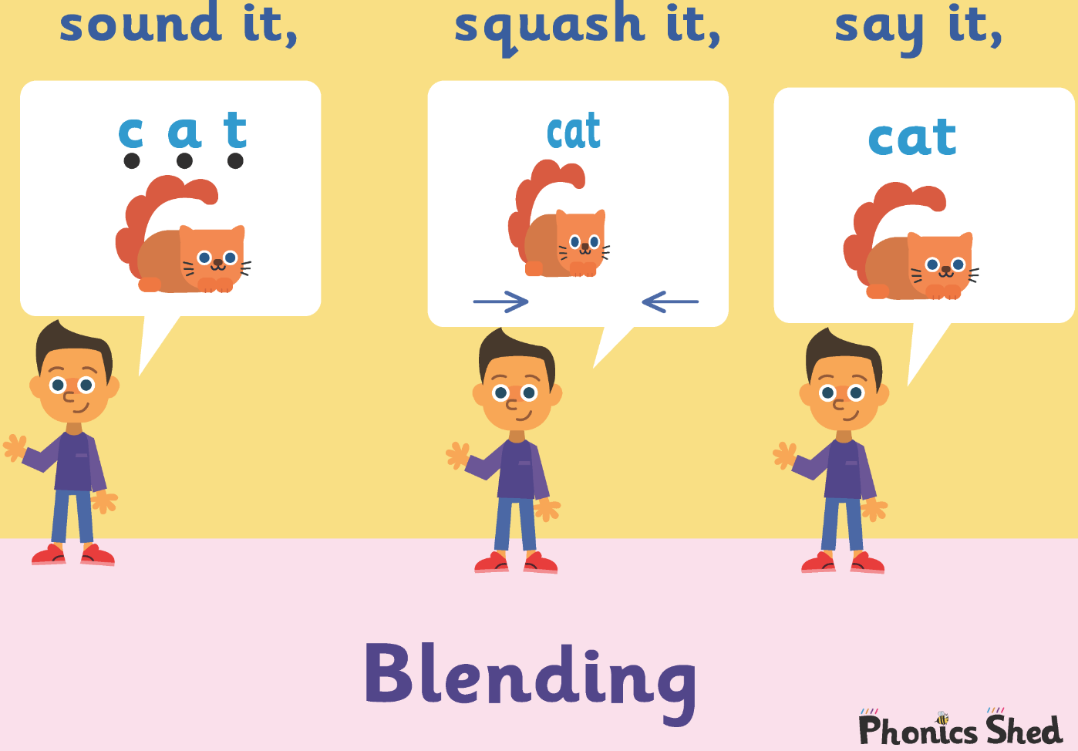
Blending
Blending is the skill of putting sounds together to read a word.
We begin this process with CVC words.
Generally children begin by listening to you orally blend a CVC word, sound it out and then blend it together.
They would then move onto doing this independently. It is really important that children can do this orally before we introduce letter sounds.
After we have taught some letter sounds, the children will be able to blend the sounds in the words to read them.

Slide 8
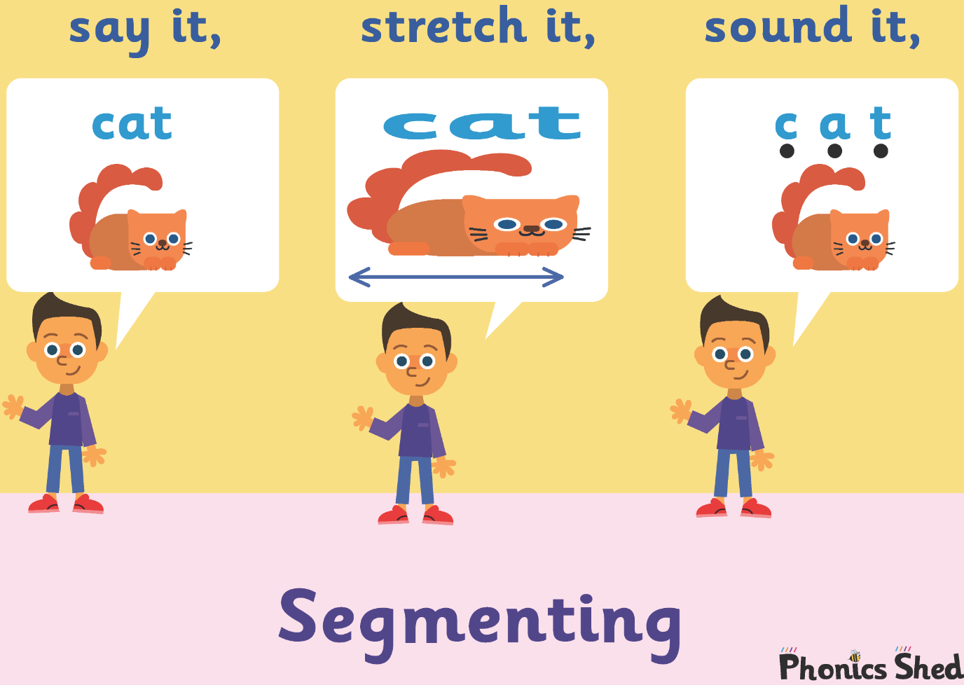
Segmenting
Segmenting is the skill of breaking a word up in order to write it. Segmenting is for spelling. We use pure sounds not letter names.
Again we begin this process with CVC words.
Generally children hear the initial sound first.
Then the initial and final sounds.
Eventually they’ll hear the initial, medial and final sounds.

Slide 9
What does a phonics lesson look like?
Each lesson is split into sections and all phonics lessons follow this sequence.

Slide 10
What does a phonics lesson look like?
Recap
Introduction
Whole group work
Independent activities
Plenary

Slide 11

Once we have introduced all of the Chapter 2 sounds and tricky words, we assess, consolidate and then once the majority of children are secure at Chapter 2 we move onto Chapter 3.
Chapter 3 introduces more sounds and some of these maybe digraphs ( 2 letters that make 1 sound) or trigraphs ( 3 letters that make 1 sound).

Slide 12
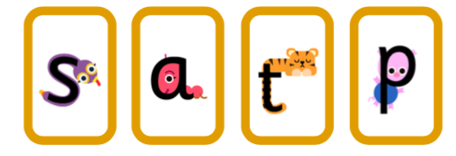
We start by introducing a sound alongside an action which helps the children to remember the sound.
Each sound has a character, song and a story.
We teach 4 sounds per week. We will add the sounds to the website each week so you can keep practicing them at home.

Slide 13
Blending and segmenting
We start with very simple CVC words.
cat pig
dog sat
We move onto longer, two syllable words.
laptop fusspot
We play games like robot talk and clap the sounds to ensure children are hearing all of the sounds in these words.

Slide 14
We continue to blend and segment CVC words this time using digraphs and trigraphs.
ship ring
rain right

Slide 15
Sound buttons
We put a button (or a zip) under each sound in the word to make it easier to sound out.
pat

Slide 16
Let’s have a go. Write the word hat on your paper. Sound it out.
What is the first sound you can hear?
What next?
Sound out what you have written. Finished?
What do you need at the end?
Can you add the sound buttons underneath each sound?

Slide 17
hat
How many sounds?

Slide 18
Let’s have a go.
Write the word fish on your paper.
Can you add the sound buttons (or zips!) underneath each sound?
A zip is used for digraphs (2 letters) or trigraphs (3 letters) making one sound.
It may help to count the sounds too.

Slide 19
fish
How many sounds?
How many letters?

Slide 20
Let’s have a go.
Write the word shock on your board.
Can you add the sound buttons (or zips!) underneath each sound?
It may help to count the sounds too.

Slide 21
shock
How many sounds?

Slide 22
Let’s have a go. Write the word armchair on your board.
Can you add the sound buttons (or zips!) underneath each sound?
It may help to count the sounds too.

Slide 23
armchair
How many sounds?

Slide 24
Phoneme frames
Phoneme frames are another strategy used to support segmenting.
Each box has to have 1 sound. ( 1 sound can be made up of 2 or 3 letters)

Slide 25
Phoneme frames
Try the word cat in your phoneme frame.
c
t
a

Slide 26
Phoneme frames
Try the word king in your phoneme frame.
k
ng
i

Slide 27
Phoneme frames
Try the word brown in your phoneme frame.
b
r
ow
n

Slide 28
Tricky words
There are some words that we can’t segment or blend. These are called tricky words and children need to be able to read them on sight.
no go so
As we teach our phonics, we also teach reading and spelling of tricky words.

Slide 29
Helping your child at home.
Please read with your child as much as possible.
Ask questions about what they are reading.
Allow your child to use the pictures to help.
Show your child you as a reader to help positive attitudes towards reading.
Point out words as you are out and about.
Learn the tricky words off by heart. This sight vocab really helps to build up fluency when reading.
Play games – snap and matching pairs, secret agent passwords.

Slide 30
Helping your child at home.
Your child will bring a reading book home each Monday and Friday.
Some may have a purple book with no words. This is to promote understanding and speaking and listening. There will be a letter emailed with the book to give you ideas.
Reading books – Monday and Friday
Library books – Monday (alternate)

Slide 31
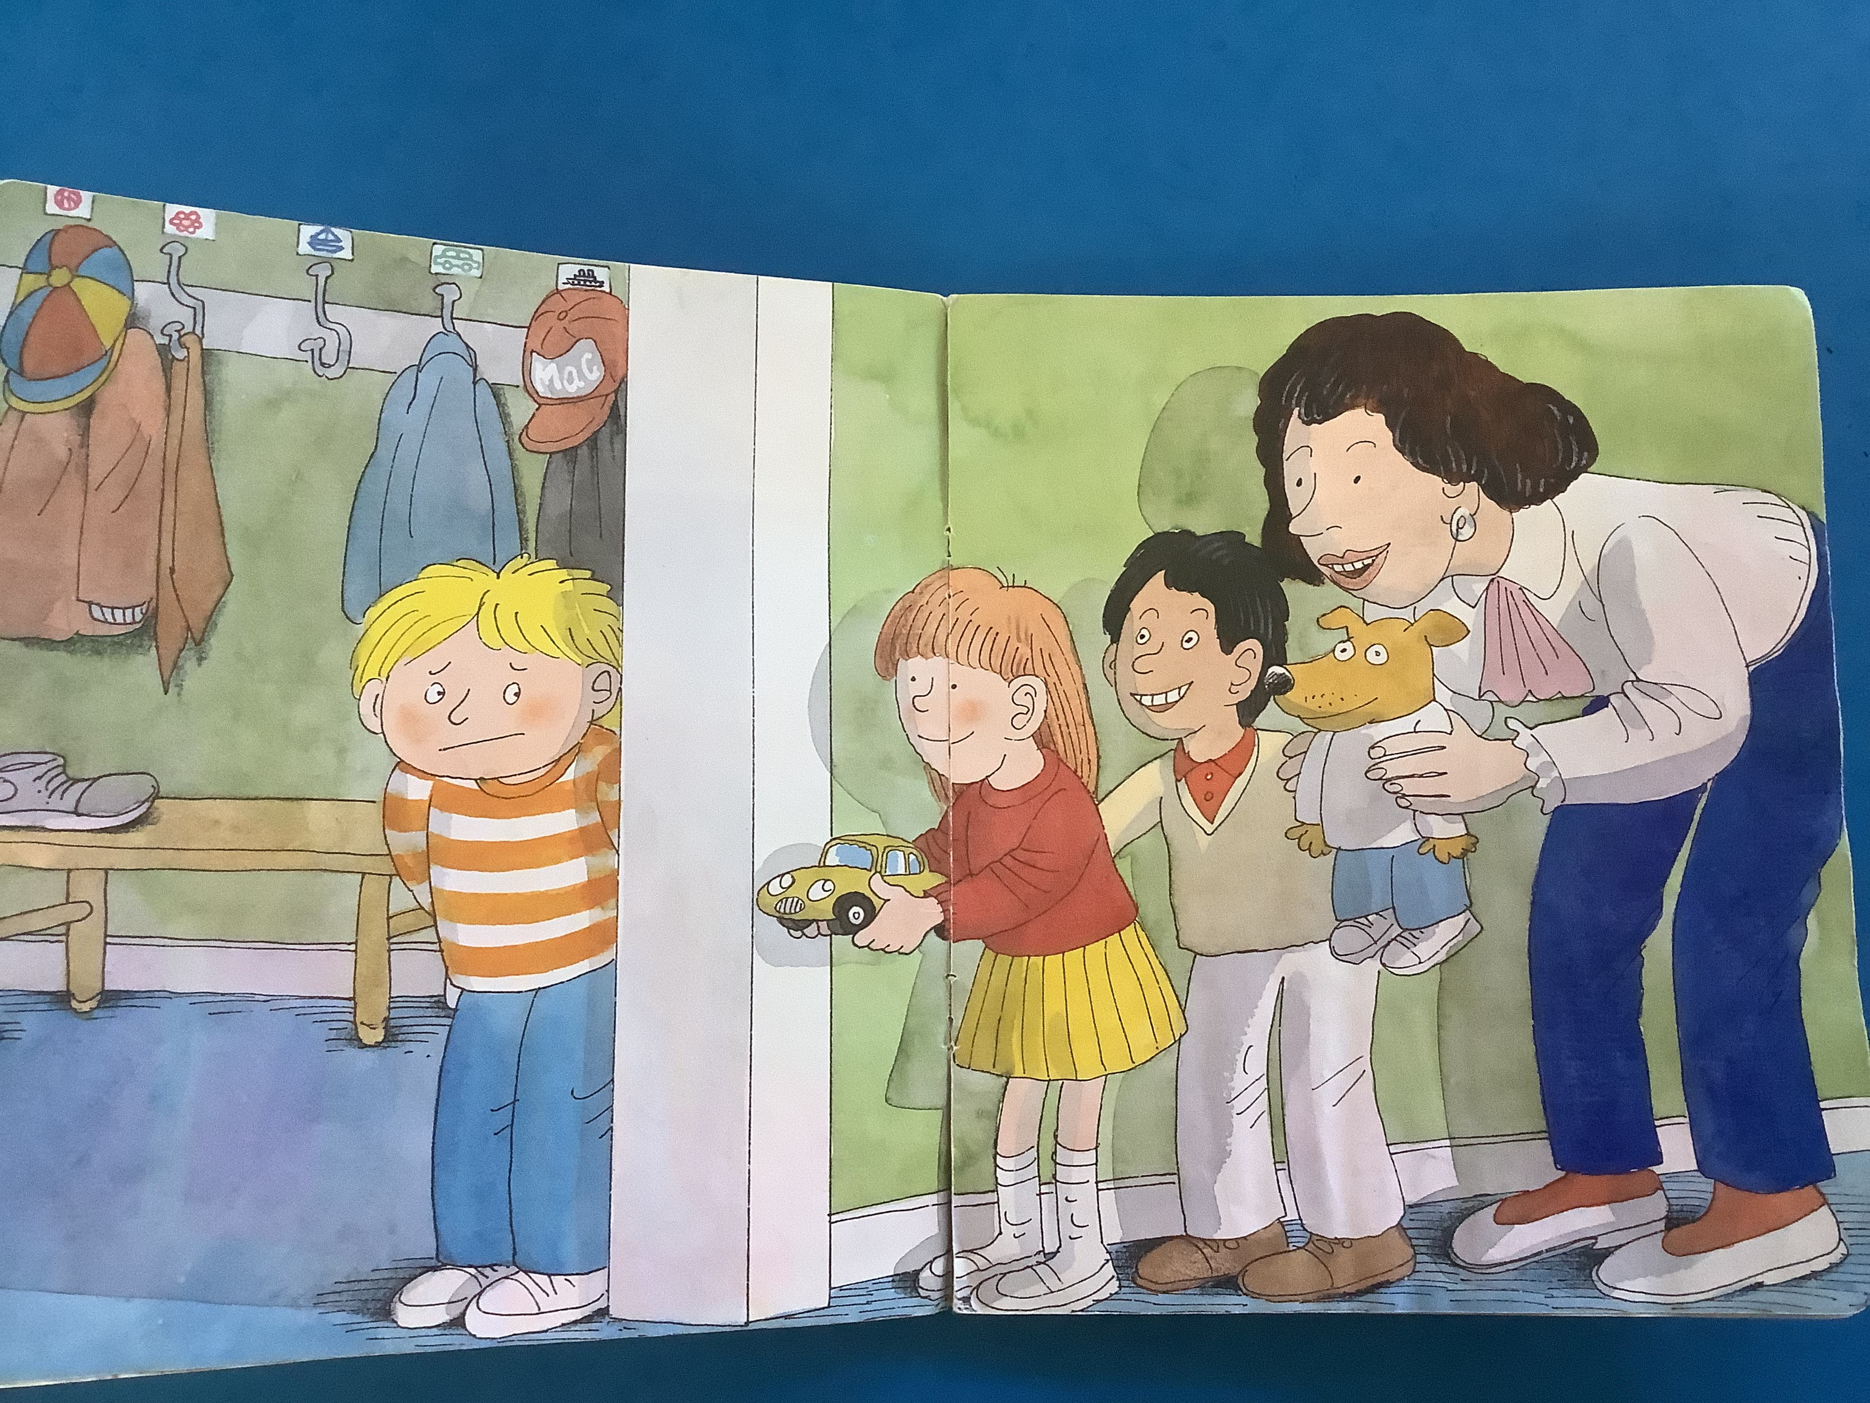
Why are books with no word important?

Slide 32
They give you the opportunity to create a routine without the pressure of ‘reading’ the book.
You can model how we look after books, holding it correctly and turning the pages carefully.
You can discuss the different parts of a book – the spine, the title, front and back cover.
They improve oracy skills- you can focus on discussing the the illustrations and the story.

Slide 33
They are a great way to expand vocabulary.
You can support developing your child’s phonological awareness eg can you see something that starts with l? Can you see something that rhymes with .. in the picture.
You could pick a picture and clap the syllables in the word.

Slide 34
Story structure
Even though there is no text, the story will still have a beginning, middle and end.
This will help to support your child’s comprehension skills.
They can make simple predictions based on what has already happened.
They can retell the story using words like first, next, finally.
Look at the facial expressions of the characters – how do you think they might be feeling? This will support their inference skills which are hugely important in reading.

Slide 35
Early Learning Goals for reading and writing.
ELG :Comprehension
Children at the expected level of development will:
- Demonstrate understanding of what has been read to them by retelling stories and narratives using their own words and recently introduced vocabulary.
-Anticipate - where appropriate- key events in stories;
-Use and understand recently introduced vocabulary during discussions about stories, non-fiction, rhymes and poems and during role-play.

Slide 36
ELG: Word Reading
Children at the expected level of development will:
-say a sound for each letter in the alphabet and at least 10 digraphs.
-Read words consistent with their phonic knowledge by sound-blending.
-Read aloud simple sentences and books that are consistent with their phonic knowledge, including some common exception words.

Slide 37
ELG: Writing
Children at the expected level of development will:
-Write recognisable letters most of which are correctly formed.
-Spell words by identifying sounds in them and representing the sounds with a letter or letters.
-Write simple phrases and sentences that can be read by others.

Slide 38
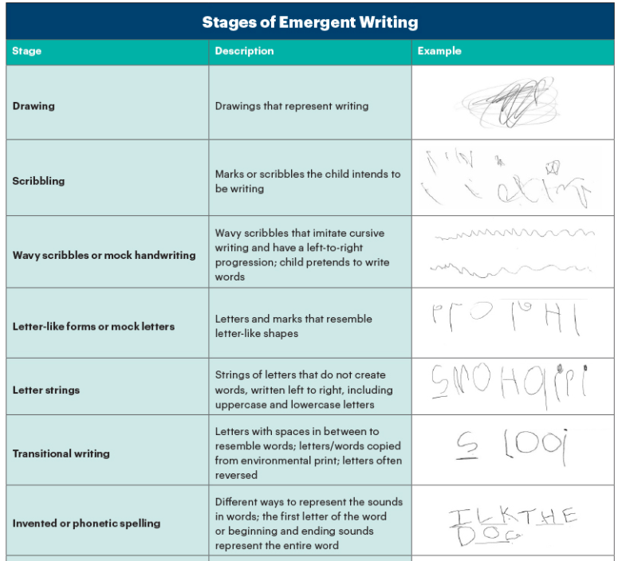

Slide 39
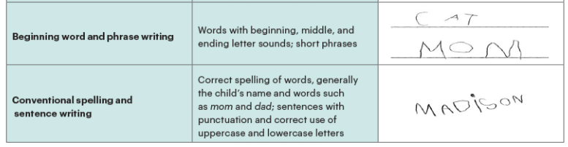

Slide 40
Useful Information
School website – Class pages on the website – we will add the sounds we have learnt each week.
Log in for phonics shed

Slide 41
