Slide 1

Nursery Welcome Meeting
Flixton Primary School
July 2026

Slide 2
Aims Of The Meeting
To give you an opportunity to meet the staff.
To give you some important information before
your child starts in September.
To answer any questions that you might have.

Slide 3
Staff
The staff in Nursery are:
Mrs Young- Class teacher (Mon- Thurs)
Mrs Wilson- Class teacher (Thurs PM,Fri)
A learning assistant
Mrs Harris- Reception teacher (EYFS lead)

Slide 4
Transition
We will email transition information to you next week.
If your child is finding it difficult to settle, we can discuss a flexible transition.
We will be speaking to all of the children’s current settings and will use the information they have given us to help them settle.
Please let us know if you have any concerns or questions about transition.

Slide 5
Times of the day
Full time children 8.40am-3.20pm
Morning children 8.40am-11.40am
Afternoon children 12.20pm-3.20pm

Slide 6
Your child’s first day
We have a slightly staggered intake so that we can give the children the attention they need whilst they settle in.
On your child’s first day, you will enter nursery by the nursery door, to the right of the main reception.
We will help the children to find their own peg (with their photo and name on), hang up their belongings and enter nursery.
If your child seems settled please feel free to leave them at the door.

Slide 7
Uniform
This year will be the second year that the children have worn uniform, they will need…..
Navy joggers or leggings
A white t-shirt
A navy jumper (Jumpers with logo’s will be available from reception.)
Shoes with fastenings that they can manage.
Please name all items of clothing.

Slide 8
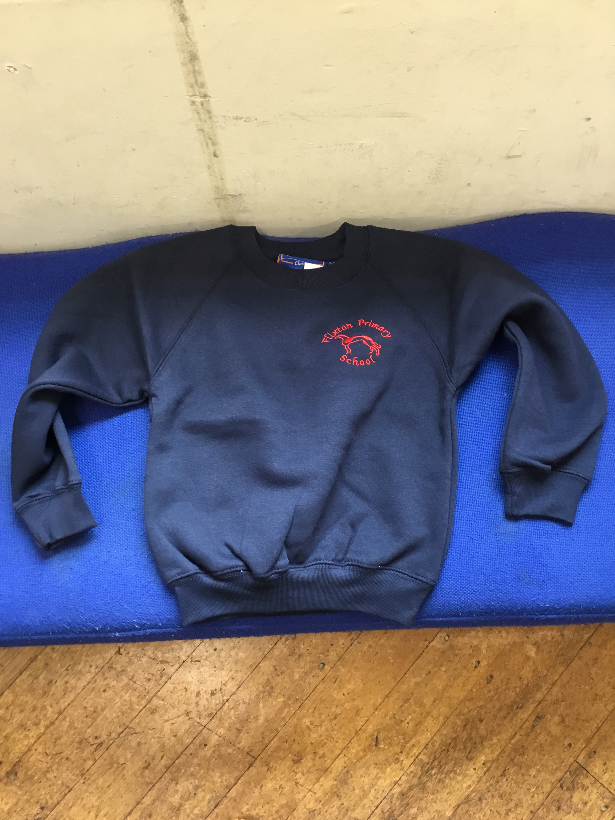

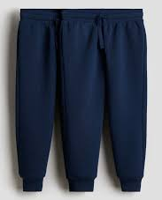
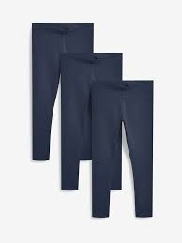

Slide 9
Your child will need a bag of spare clothes that will stay in school, a drawstring bag that will fit on their peg is perfect.
They will need spare trousers, T-shirt, underwear and socks.
It would be really helpful if they could have a cheap pair of crocs/ shoes incase they have an accident.
Please name all clothing.
Spare clothes

Slide 10
Bags
Please make sure your child has a named book bag.
Book bags are available from reception.
Bring their book bag to school everyday.
It allows the children to safely bring home
letters, information, books and things they have
made.

Slide 11
Snack
One piece of fruit will be provided every day.
The children are entitled to milk daily if they want it.
We have Tasting Tuesdays.
We have a morning snack (toast, breadsticks etc.)
Please let us know about any dietary requirements or things you would like us to taste.
We ask for a voluntary donation of £1 a week towards tasting and toast, payable on Monday morning or in one go.

Slide 12
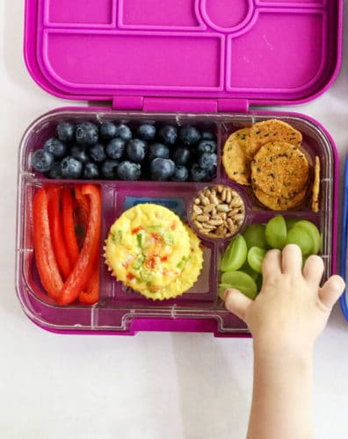
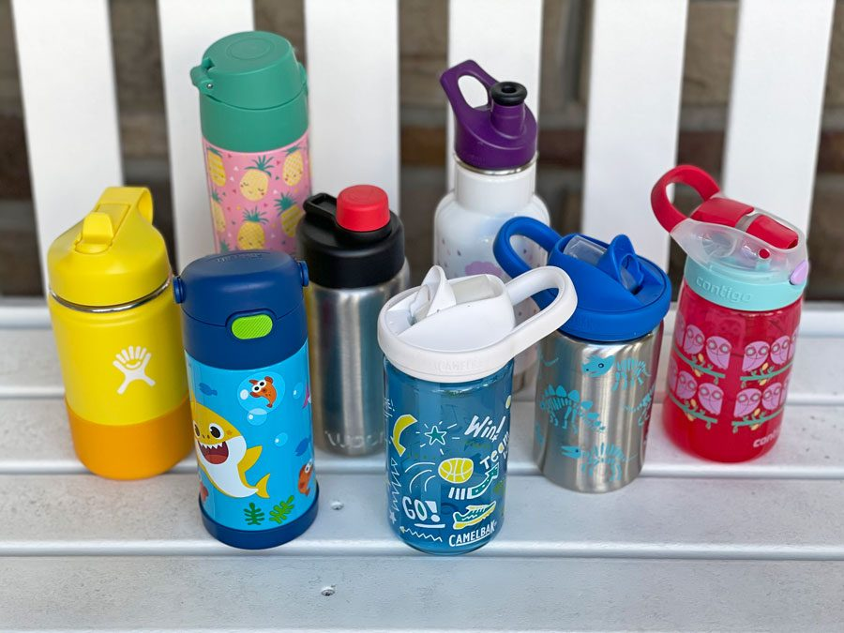
Lunchtime
We are a nut free school.
Please make sure any small items are cut up eg. grapes, olives.
Please do not pack an adult sized lunch!
Please label their bottles and packed lunch.
The children eat their lunch in the classroom at tables, they are looked after by the midday assistants.

Slide 13
Collection Arrangements
Parents line up at the door and the teacher will shout through to the classroom for each child.
We ask that if there is anything you need to discuss, that you wait until all of the children have been dismissed.
Make sure you have filled in a collection arrangement sheet for your child if you haven’t already completed one.
Please always let us know if someone other than the person we are expecting is collecting your child.

Slide 14
If your child has an accident at school
It is part and parcel of life in the EYFS that children will occasionally experience the odd bump or scrape. We value risky play (risky, not hazardous). Children are encouraged to make decisions about their play in a safe environment, rather than being wrapped in cotton wool.
Risky play offers thrilling challenges that children can identify, assess, and manage themselves, helping to build independence, resilience, and motor skills. In contrast, hazardous play involves hidden, unpredictable dangers that children cannot foresee or manage, potentially leading to avoidable injury.
If your child has an accident and requires first aid, they will receive treatment from a first aider and you will receive notification, currently via an accident slip but soon to be via email, that day. This will detail what happened, where it happened, how it happened and how it was treated.
If your child receives a more significant injury or a bump to the head, we will call you to let you know what has happened and we can discuss whether or not your child might need to go home or go and get checked by a medical professional.

Slide 15
If your child has a toileting accident at school
As part of school readiness, we would hope that all children are toilet trained before starting school, unless there is a medical reason why this is not possible.
However, toileting accidents do happen with young children, and this is developmentally appropriate. If your child requires support following a toileting accident, a member of staff will support them and talk them through wiping and changing themselves. We will let you know at the end of the day if your child has had a toileting accident.
If your child requires more assistance than this then we would aim to meet with you so that you can sign to give us permission to change your child.
If you know your child needs reminders and/or support with toileting, it is essential you let us know as soon as possible.

Slide 16
Outdoor Provision
Always send your child to school with a warm coat (preferably waterproof), even if it looks sunny.
Outdoor provision takes place in all weathers.
We have a mud kitchen and a water area, the children will get muddy and wet.
Please send in a pair of wellies and some waterproof trousers.
Please name all items of clothing.

Slide 17
Messages
Please give the staff on the door any written messages in the mornings.
Alternatively, you can send an email to the school email address.
parentcontact@flixtonprimaryschool.org.uk

Slide 18
Curriculum
We plan and assess using the Early Years Foundation Stage Statutory Framework and Development Matters.
We begin to teach maths and phonics in nursery. We will provide more information on this later in the year.
The planning is based around themes and takes account of the children’s interests.
We try to go on a trip every year to enhance the curriculum.

Slide 19
School Website
www.flixtonprimaryschool.org.uk
There will be a class page that will be regularly updated with pictures and information about your child’s time in school.

Slide 20
Helping your child get ready for school.
Practise putting on their coat and zipping it up.
Practice getting changed into a clean set of clothes.
Play turn taking games.
Encourage your child to go to the toilet on their own and
wash their hands.

Slide 21
Other information
Please send a family photo and an individual
photo of your child to parentcontact@flixtonprimaryschool.org.uk
Please put your child’s name in the subject
and new nursery.

Slide 22
Thank you and any questions?

