Slide 1
Fonix… or Phonics Workshop Reception Mrs Harris and Miss Jackson 2025

Slide 2
Phonics Shed
Chapter 1 is all about listening to and tuning into sounds and consists of 9 aspects.
By the end of nursery we would expect children to be secure at chapter 1.
We spend the first part of reception ensuring that children can orally blend and segment and then begin chapter 2.

Slide 3
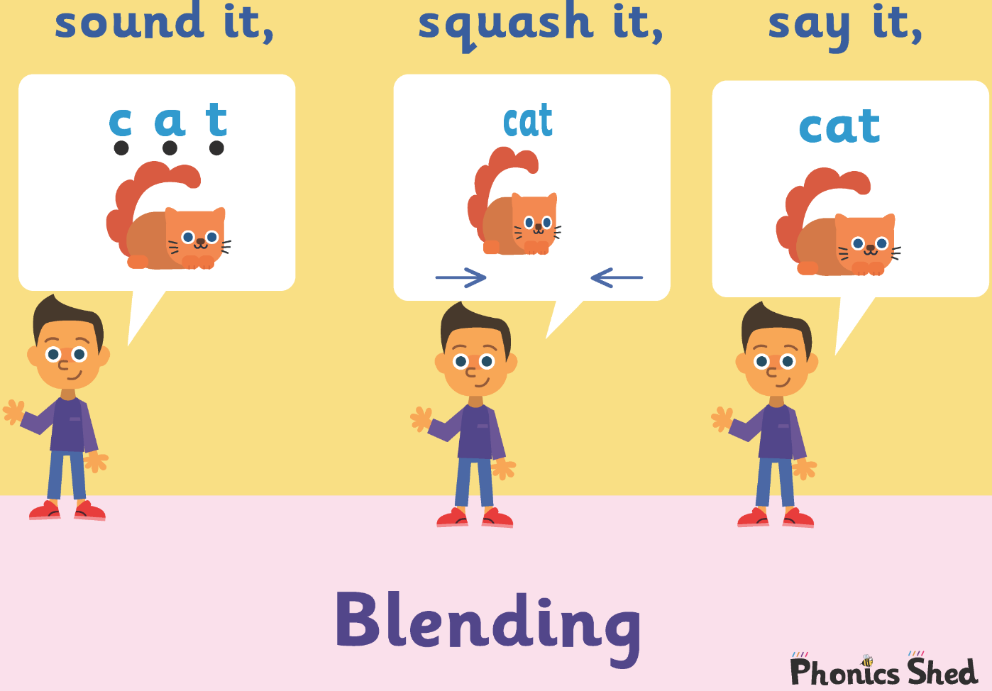
Blending
Blending is the skill of putting sounds together to read a word.
We begin this process with CVC words.
Generally children begin by listening to you orally blend a CVC word, sound it out and then blend it together.
They would then move onto doing this independently. It is really important that children can do this orally before we introduce letter sounds.
After we have taught some letter sounds, the children will be able to blend the sounds in the words to read them.

Slide 4
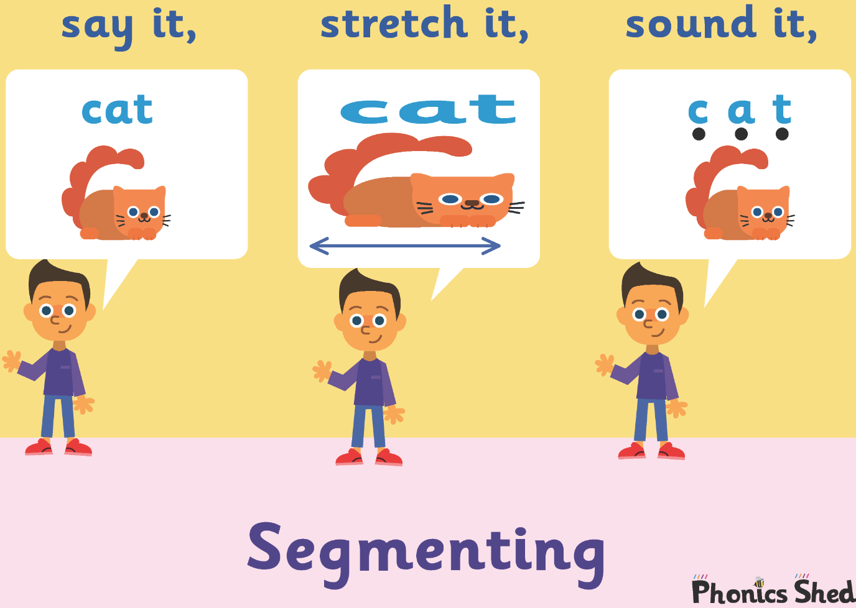
Segmenting
Segmenting is the skill of breaking a word up in order to write it. Segmenting is for spelling. We use pure sounds not letter names.
Again we begin this process with CVC words.
Generally children hear the initial sound first.
Then the initial and final sounds.
Eventually they’ll hear the initial, medial and final sounds.

Slide 5
Pronunciation
When we teach children the sounds in words we teach them using the correct pronunciation.
As children we were taught to add an ‘uh’ sound to many letters eg huh, cuh, fuh.
There is lots of research that this impedes children’s learning.
We teach the children pure sounds eg mmm, ssss, fff, so they can hear the sound as it would be spoken.

Slide 6
What does a phonics lesson look like?
Each lesson is split into sections and all phonics lessons follow this sequence.

Slide 7
What does a phonics lesson look like?
Recap
Introduction
Whole group work
Independent activities
Plenary

Slide 8

We start by introducing a sound alongside an action which helps the children to remember the sound.
Each sound has a character, song and a story.
We teach around 4 sounds per week.

Slide 9
Blending and segmenting
We start with very simple CVC words.
cat pig
dog sat
We move onto longer, two syllable words.
laptop fusspot
We play games like robot talk and clap the sounds to ensure children are hearing all of the sounds in these words.

Slide 10

Once we have introduced all of the Chapter 2 sounds and tricky words, we assess, consolidate and then once the majority of children are secure at Chapter 2 we move onto Chapter 3.
Chapter 3 introduces more sounds and some of these maybe digraphs ( 2 letters that make 1 sound) or trigraphs ( 3 letters that make 1 sound).

Slide 11
We continue to blend and segment CVC words this time using digraphs and trigraphs.
ship ring
rain right

Slide 12
Sound buttons
We put a button (or a zip) under each sound in the word to make it easier to sound out.
pat

Slide 13
Let’s have a go. Write the word hat on your paper. Sound it out.
What is the first sound you can hear?
What next?
Sound out what you have written. Finished?
What do you need at the end?
Can you add the sound buttons underneath each sound?

Slide 14
hat
How many sounds?

Slide 15
Let’s have a go.
Write the word fish on your paper.
Can you add the sound buttons (or zips!) underneath each sound?
A zip is used for digraphs (2 letters) or trigraphs (3 letters) making one sound.
It may help to count the sounds too.

Slide 16
fish
How many sounds?
How many letters?

Slide 17
Let’s have a go.
Write the word shock on your board.
Can you add the sound buttons (or zips!) underneath each sound?
It may help to count the sounds too.

Slide 18
shock
How many sounds?

Slide 19
Let’s have a go. Write the word armchair on your board.
Can you add the sound buttons (or zips!) underneath each sound?
It may help to count the sounds too.

Slide 20
armchair
How many sounds?

Slide 21
Tricky words
There are some words that we can’t segment or blend. These are called tricky words and children need to be able to read them on sight.
no go so
As we teach our phonics, we also teach reading and spelling of tricky words.

Slide 22
Helping your child at home.
Please read with your child as much as possible.
Ask questions about what they are reading.
Allow your child to use the pictures to help.
Show your child you as a reader to help positive attitudes towards reading.
Point out words as you are out and about.
Learn the tricky words off by heart. This sight vocab really helps to build up fluency when reading.
Play games – snap and matching pairs, secret agent passwords.

Slide 23
Helping your child at home.
Your child will bring a reading book home each Monday and Friday.
Some may have a purple book with no words. This is to promote understanding and speaking and listening.
Reading books – Monday and Friday
Library books - tbc

Slide 24
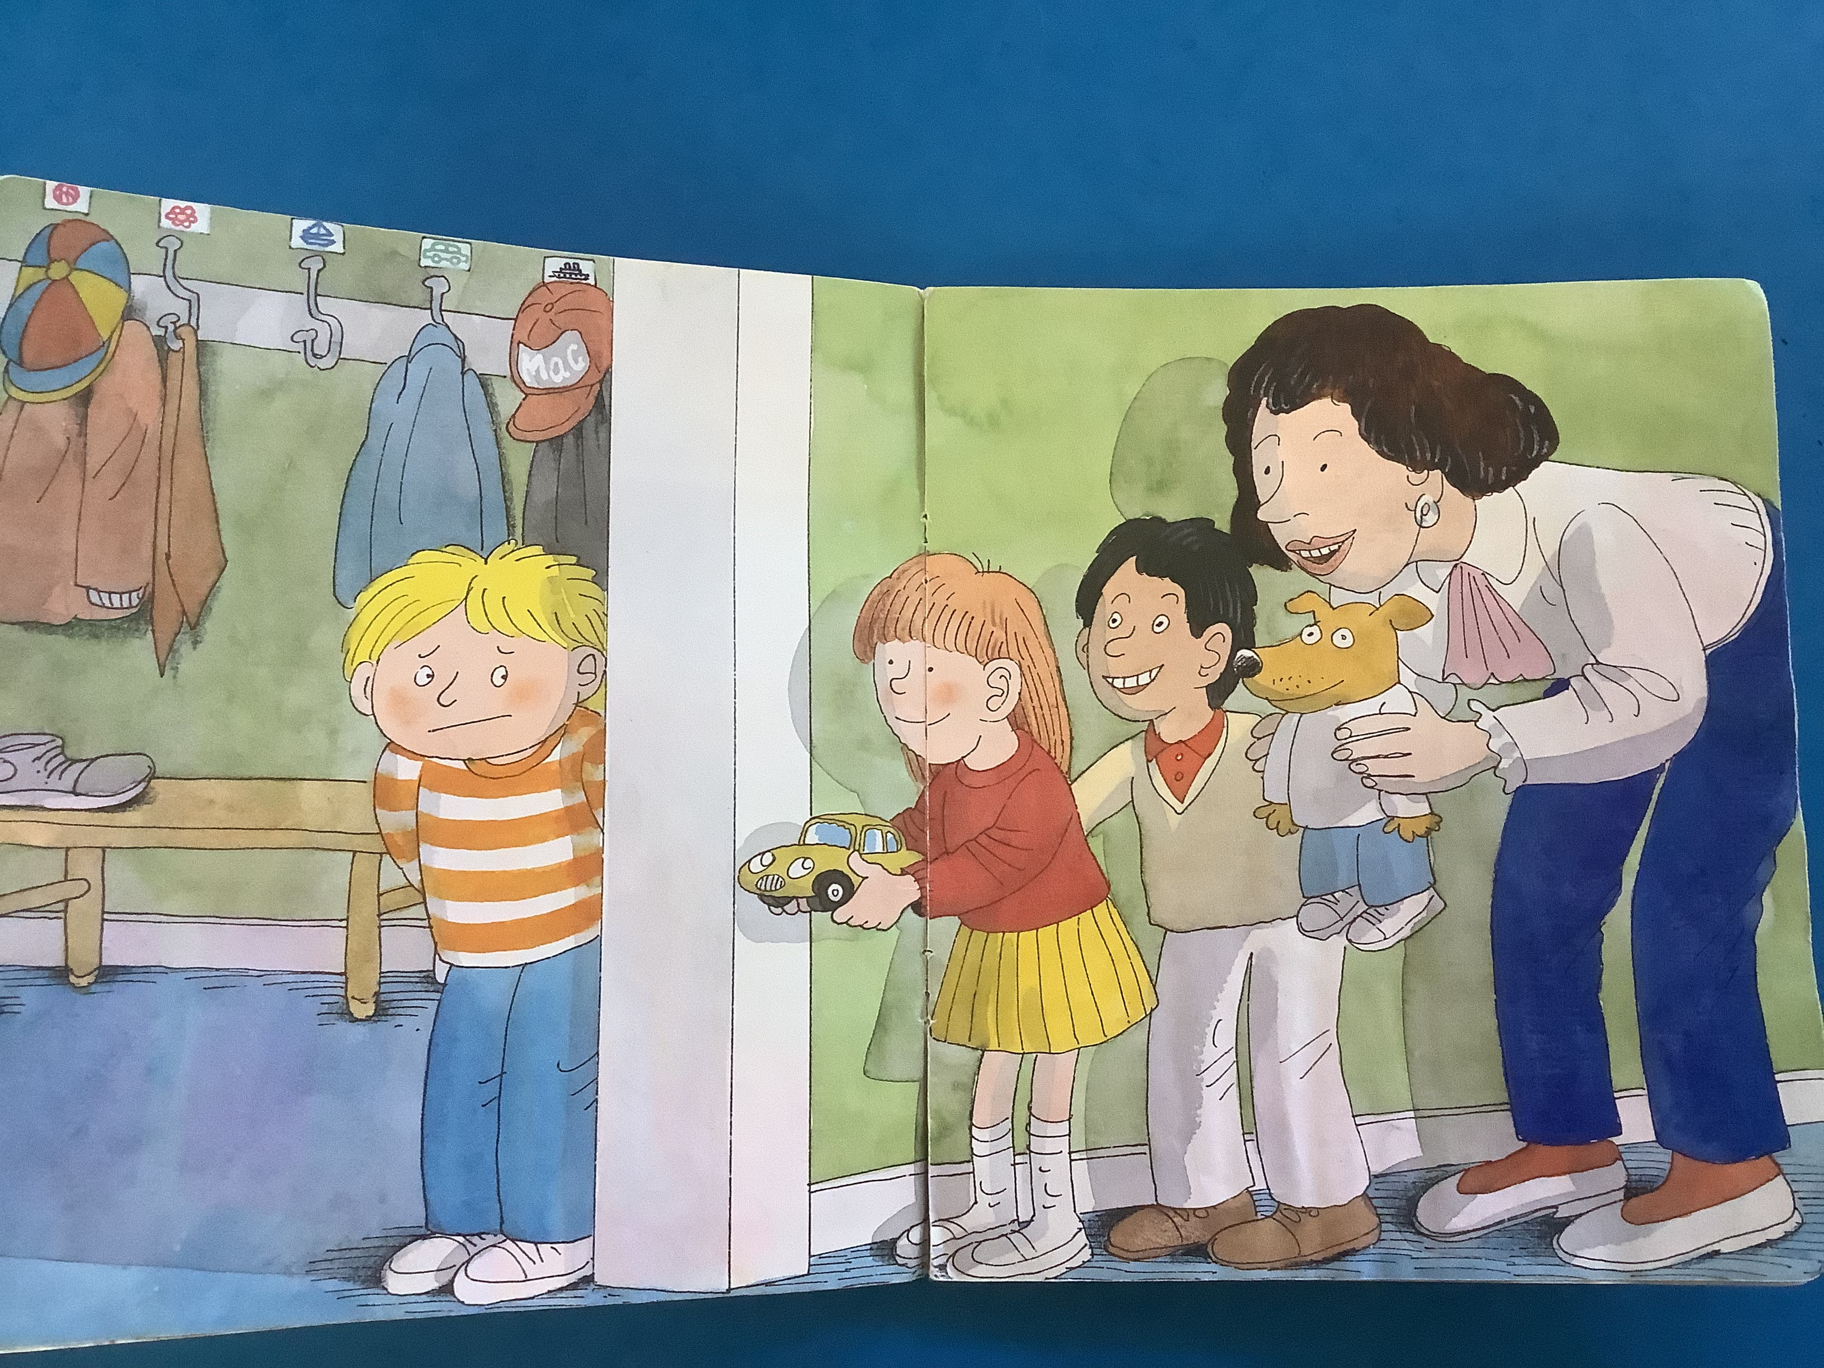
Why are books with no word important?

Slide 25
They give you the opportunity to create a routine without the pressure of ‘reading’ the book.
You can model how we look after books, holding it correctly and turning the pages carefully.
You can discuss the different parts of a book – the spine, the title, front and back cover.
They improve oracy skills- you can focus on discussing the the illustrations and the story.

Slide 26
They are a great way to expand vocabulary.
You can support developing your child’s phonological awareness eg can you see something that starts with l? Can you see something that rhymes with .. in the picture.
You could pick a picture and clap the syllables in the word.

Slide 27
Story structure
Even though there is no text, the story will still have a beginning, middle and end.
This will help to support your child’s comprehension skills.
They can make simple predictions based on what has already happened.
They can retell the story using words like first, next, finally.
Look at the facial expressions of the characters – how do you think they might be feeling? This will support their inference skills which are hugely important in reading.

Slide 28
Useful Information
Log in for phonics shed as children can access games and online books to support their phonics learning.

