Slide 1


Reception Welcome Meeting
Flixton Primary School
July 2025

Slide 2
‘Every child deserves the best possible start in life and support to fulfil their potential. Children develop quickly in the early years and a child’s experience between birth and age 5 has a major impact on their future life chances. A secure, safe and happy childhood is important in it’s own right and it provides the foundation for children to make the most of their abilities and talents as they grow up.’
(DfE Statutory framework for EYFS 2021)

Slide 3
Aims Of The Meeting
To provide you with valuable information about
Reception at Flixton Primary School.
To introduce you to how the curriculum in
Reception works.
To enable you to meet with staff to
ask any questions that you may have.

Slide 4
Staff
The staff in Early Years are:
Mrs Young and Mrs Wilson – Nursery
Mrs Harris (EYFS Lead) - Class RH
Miss Jackson - Class RJ
Learning Assistants:
Mrs Jones
Mrs Marshall
Mrs Slattery

Slide 5
Times of the day
Once the children have completed their transition in September, the times of the day will be 8.50 – 3.15pm.

Slide 6
A Typical Day
Register
Phonics
Learning through play and adult guided groups
English/ Talk for writing
Learning through play and adult guided groups
Routines
Small group reading
Dinner time
Register
Mathematics session
Learning through play and adult guided groups
Story / Singing / Circle Time/other areas of learning
Home time

Slide 7
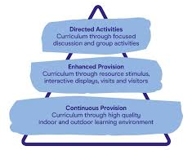
Our EYFS Curriculum at FPS is designed to achieve the balance between Continuous Provision, Enhanced Provision and Directed Teaching in order to suit the needs of our children. We endeavour for our children to become masters of their curriculum using the approach taken below.

Slide 8
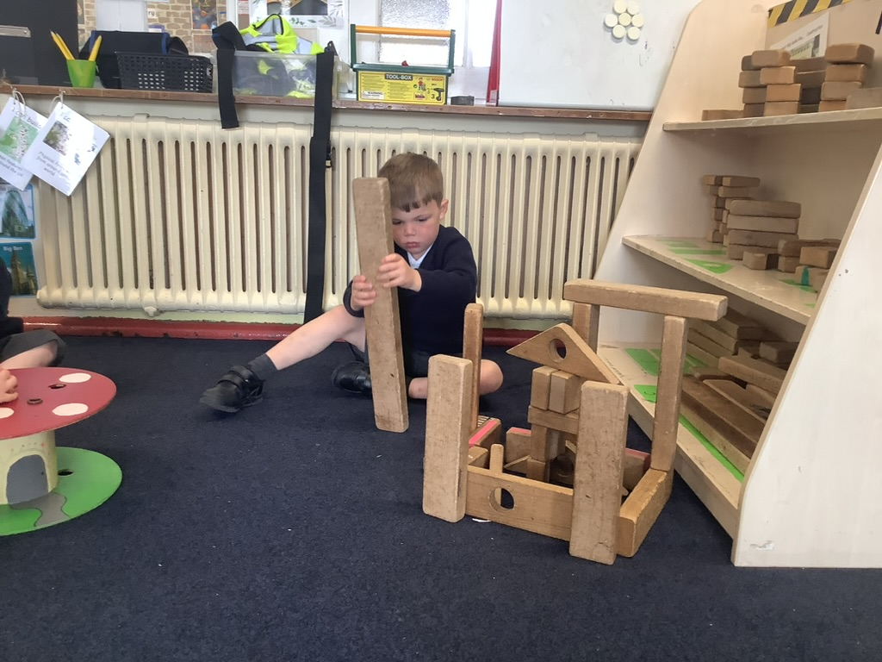
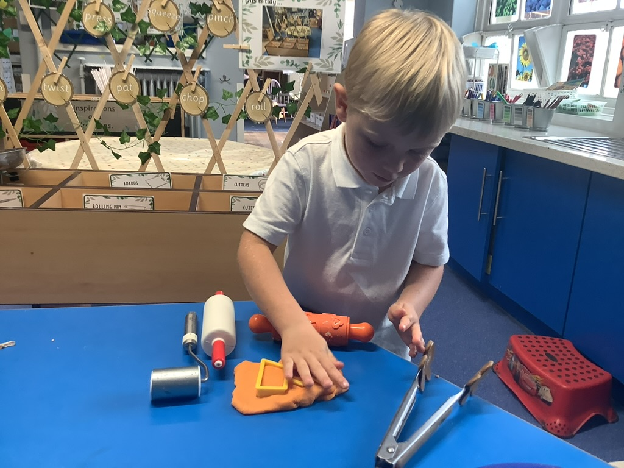
Continuous provision
Continuous Provision is the heart of our curriculum. It starts with the child, and is built from them. This means the resources we have selected, and the areas we have created will ensure our children are able to master their curriculum.
The children’s interests, needs and developmental stages inform what our environment will look like. We ensure the children are able to access opportunities to have deep, embedded experiences by carefully selecting resources.

Slide 9
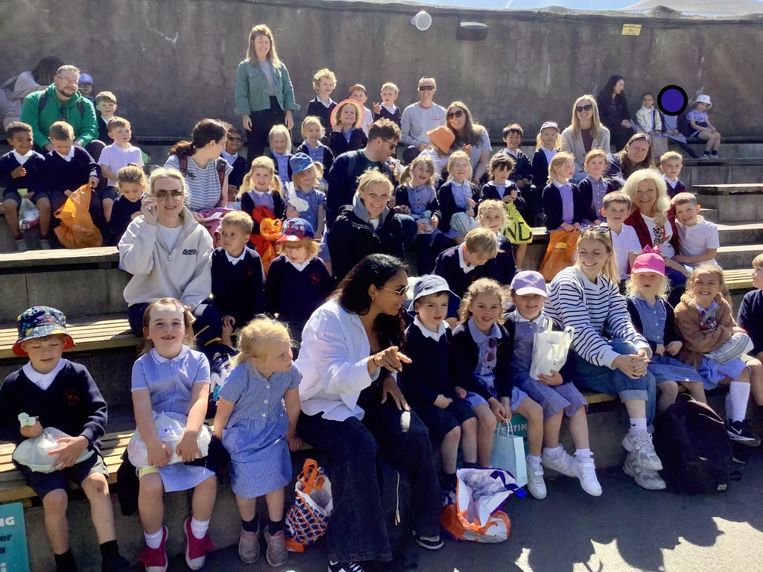
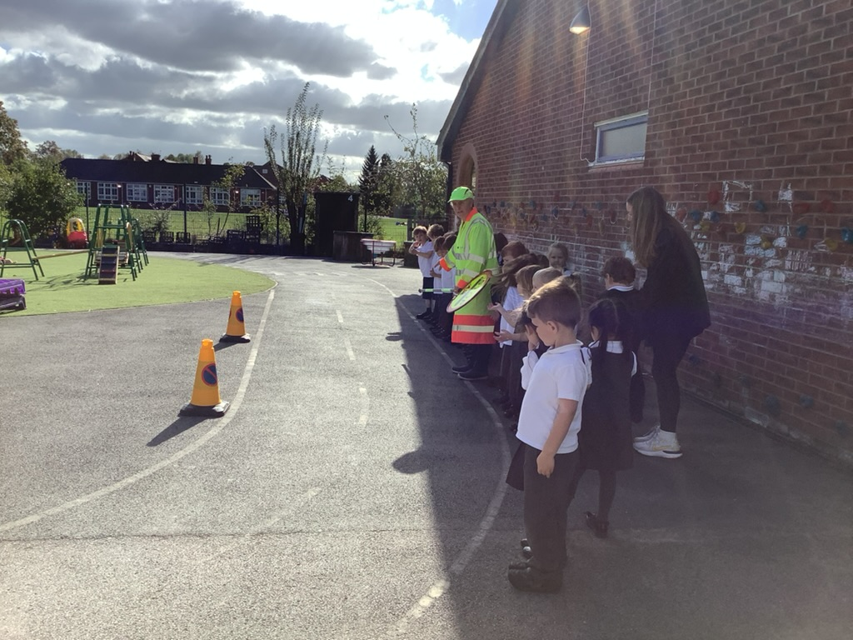
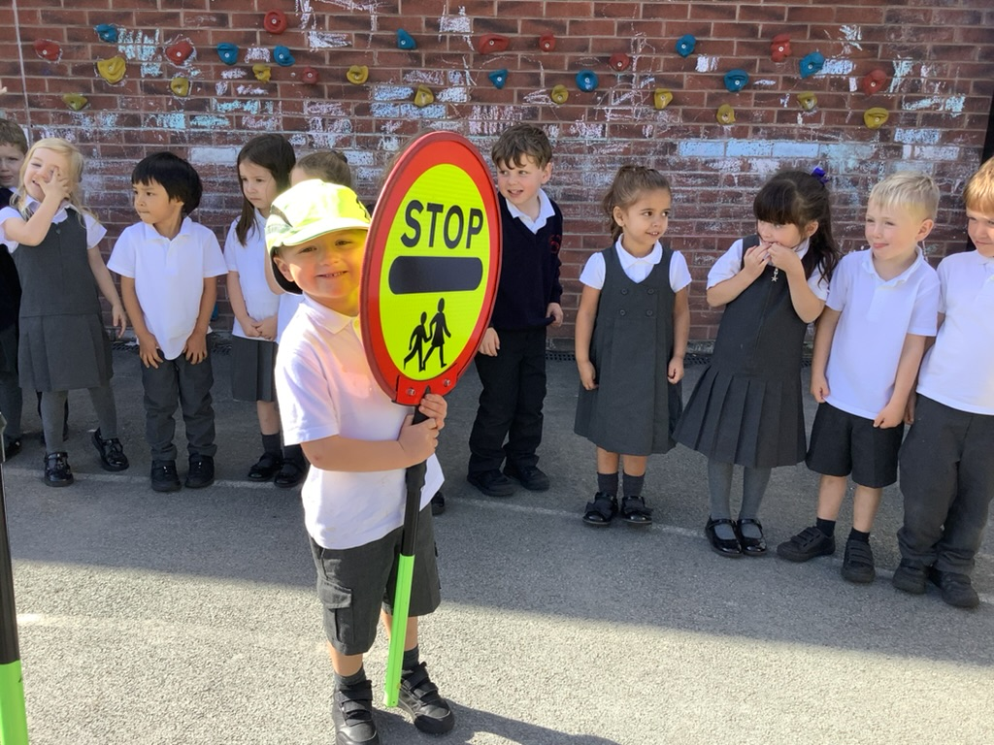
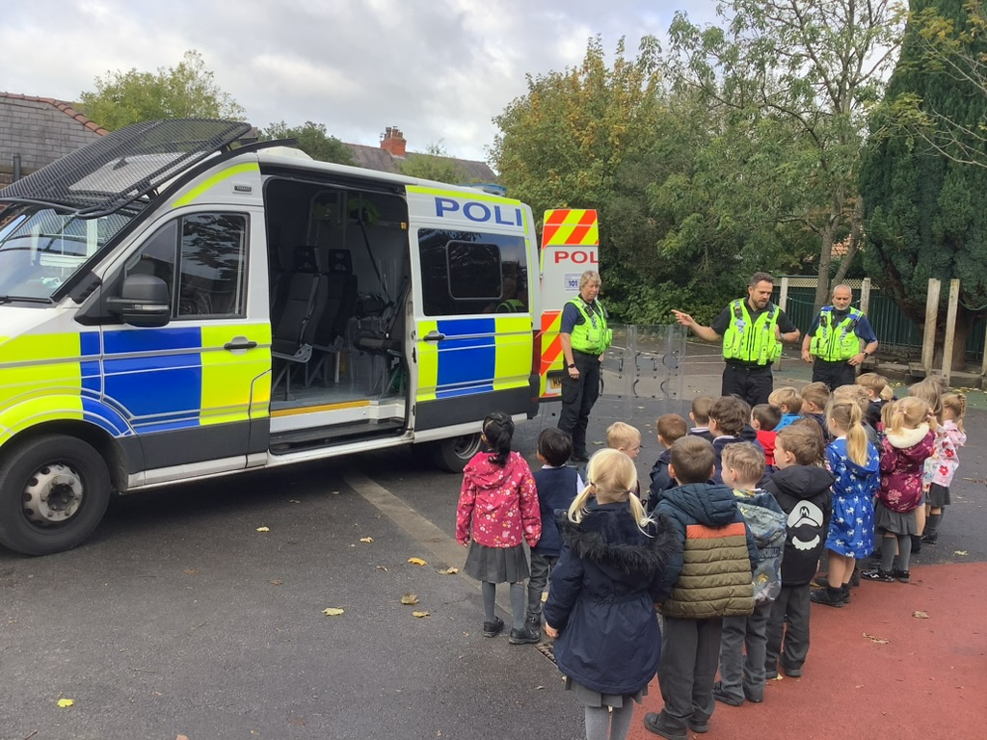
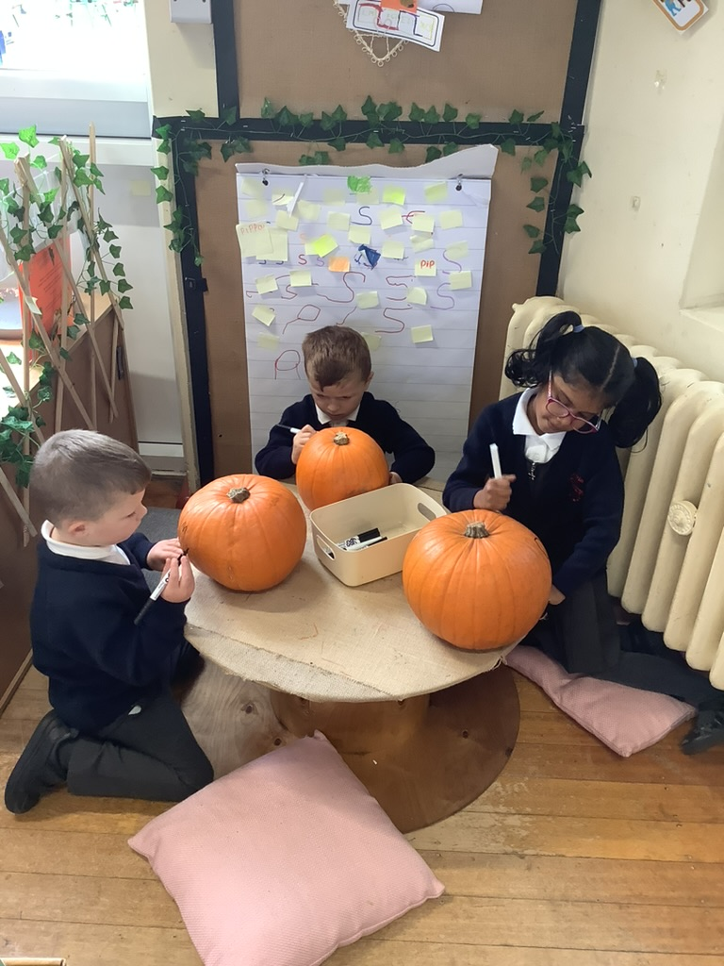
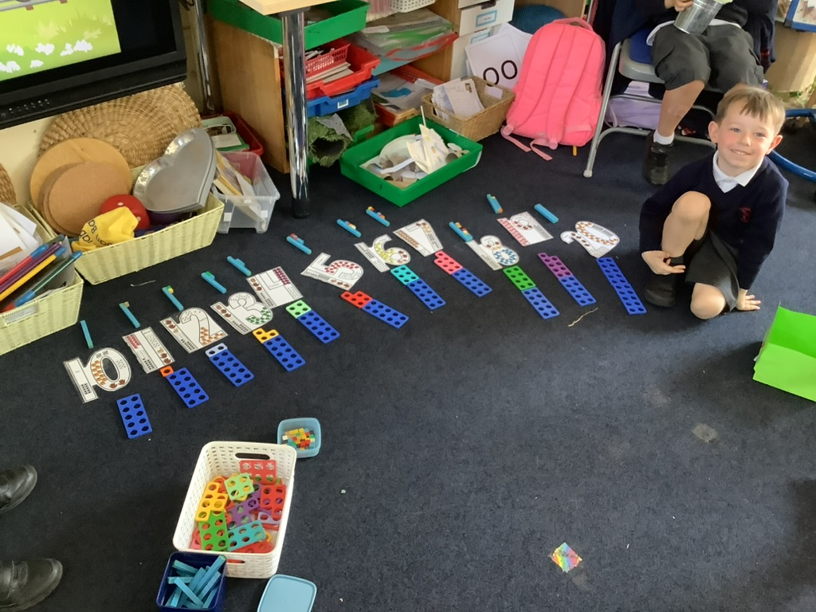
Enhanced provision
Enhanced provision are the things we add to our Curriculum to build upon our children’s learning. This includes visits, visitors and specific resources we add to our environment

Slide 10
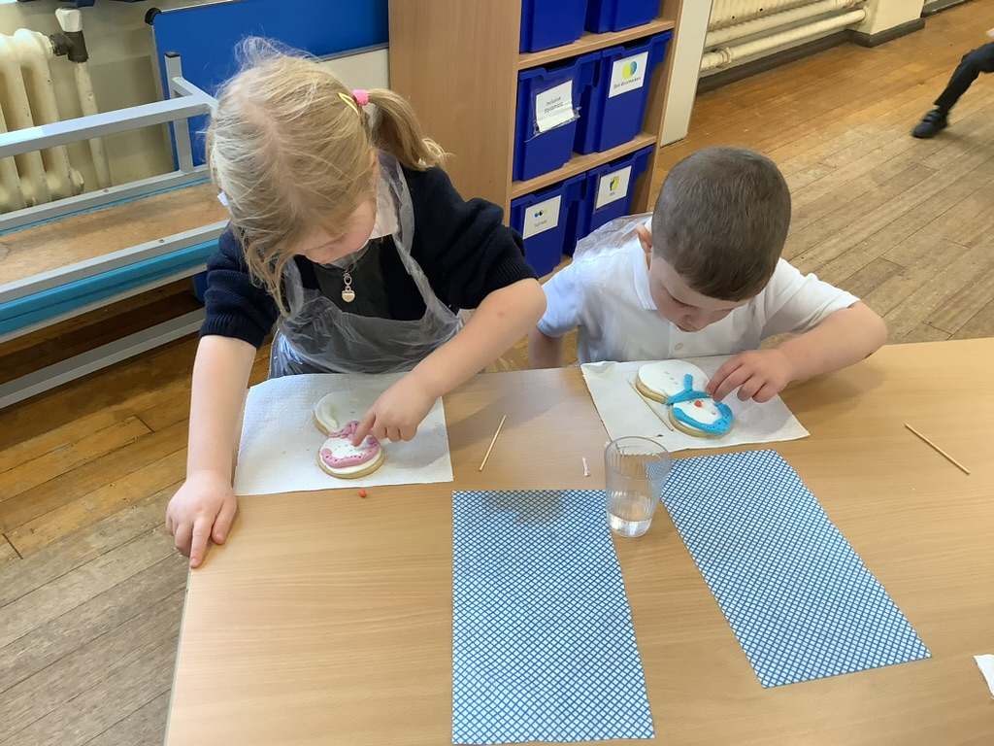
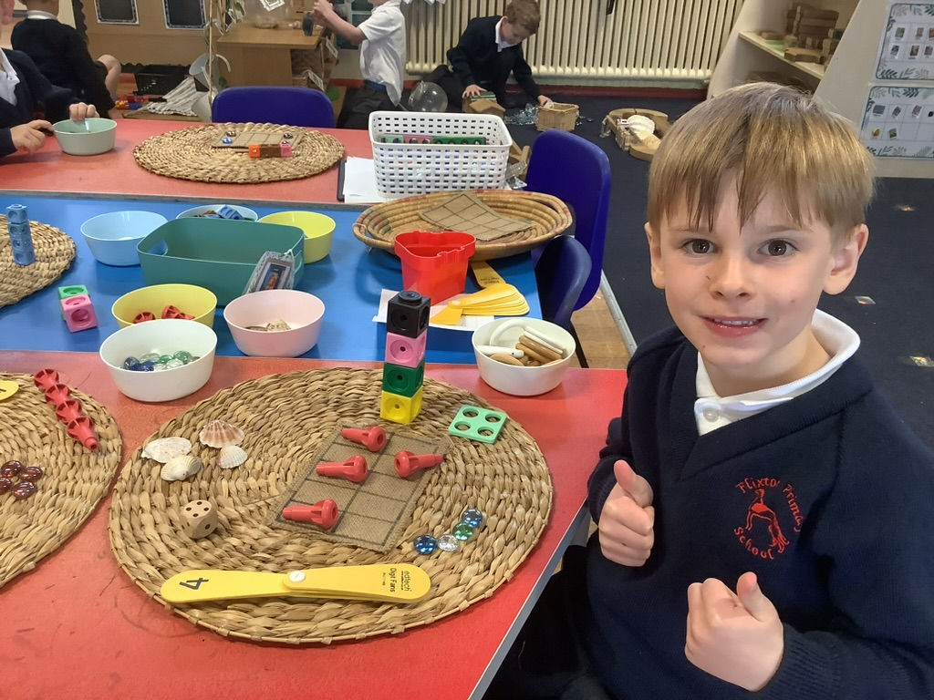
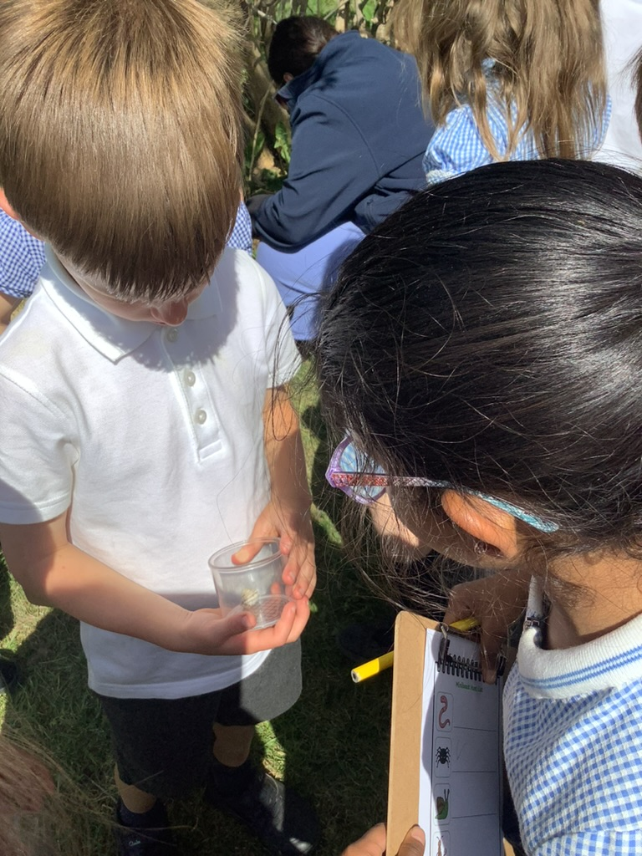
Directed teaching
Directed teaching is the parts of our curriculum that need explicit teaching. These include things such as phonics (segmenting and blending), many areas of maths and other specific skills. This may look like a whole class carpet session or a small group directed task.

Slide 11
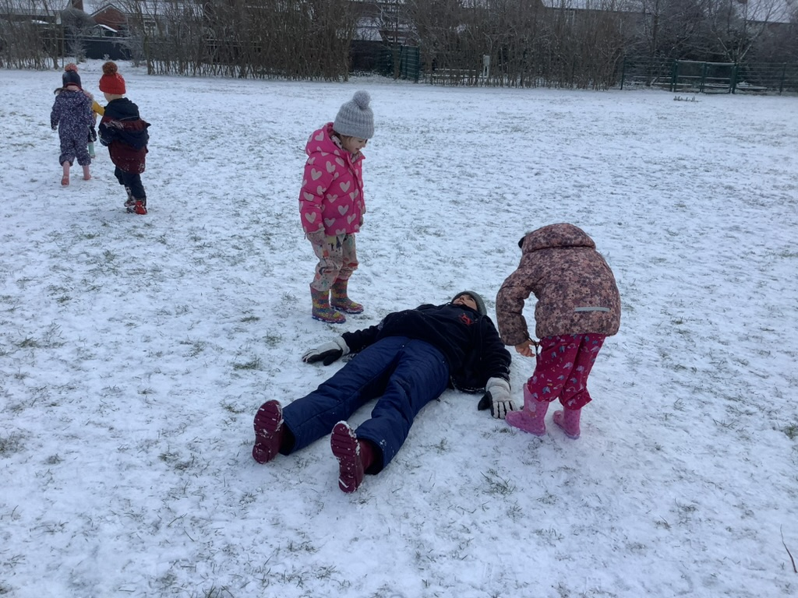
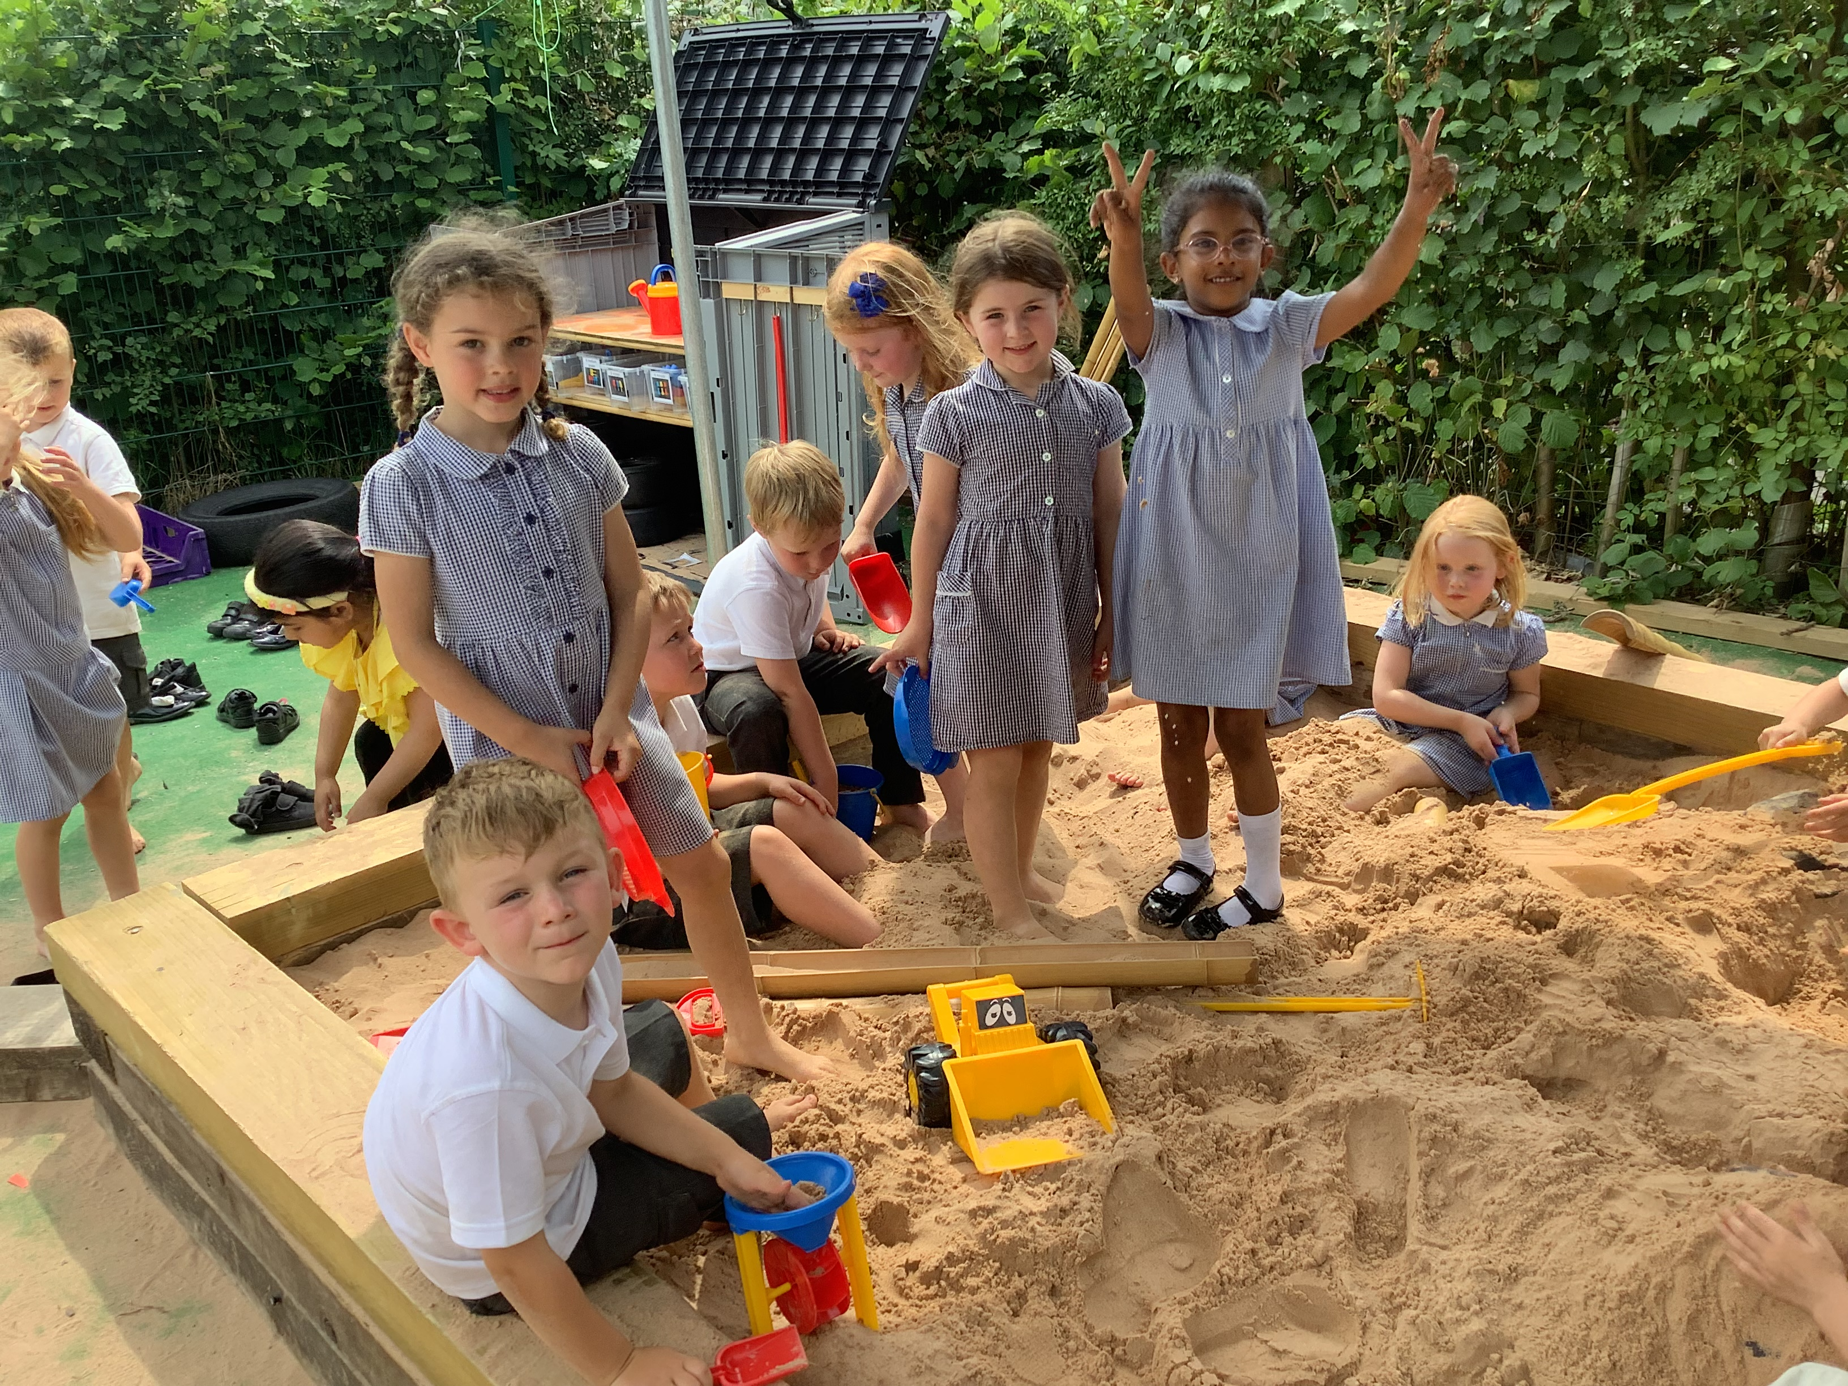
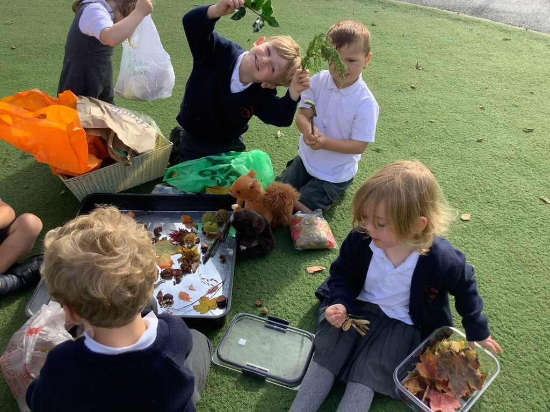
Outdoor Provision
Always send your child to school with a warm coat (preferably waterproof), even if it looks sunny. We all know that the great British weather can change so quickly! Please name all items of clothing.

Slide 12
Outdoor Provision
It is extremely useful if your child has a complete spare change of clothes that can stay in school, in a draw string bag named on the front.
Please also send a named pair of wellies and a puddle suit/ waterproof trousers that can stay in school.

Slide 13
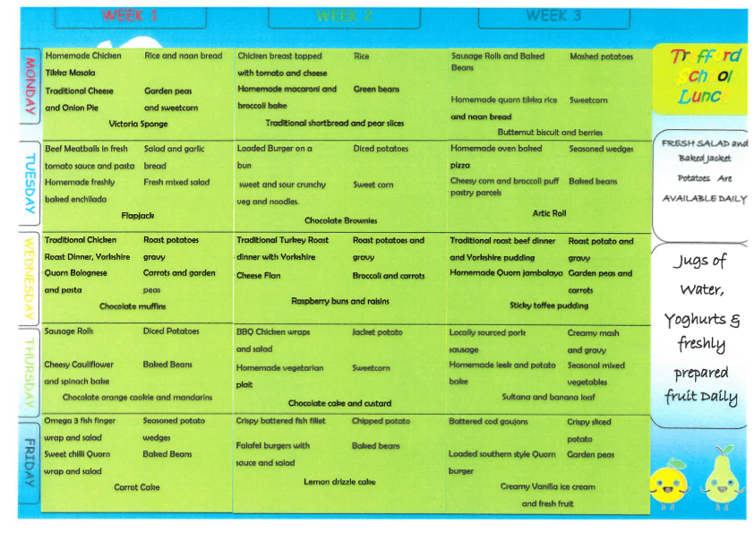
Lunchtime

Slide 14
Snacks
Children will have access to fresh fruit and milk daily.
In addition to this they may bring a named bottle with water only .
Milk is paid for once your child is 5 years old.
We are a nut free school so no nuts in lunchboxes please.

Slide 15

Our school rules- the 4bs.

Slide 16
Book Bags
These are essential. Please make sure your child
has one!
Bring their book bag to school everyday.
It allows the children to safely bring home
letters, information, books and things they have
made.
Please check their bags each night for letters.

Slide 17
Messages
Please give the staff on the door any written messages in the mornings.
Alternatively, you can send an email to
parentcontact@flixtonprimaryschool.org.uk

Slide 18
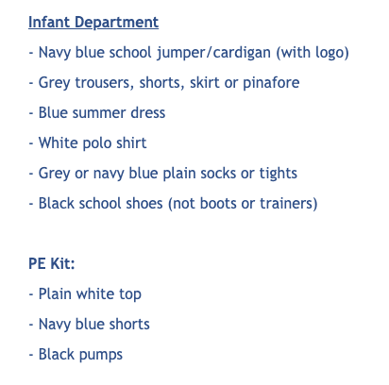
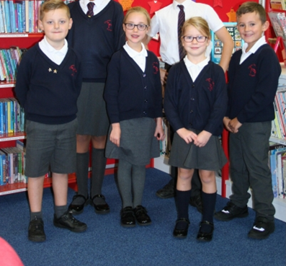
Uniform

Slide 19
Collection Arrangements
This is a very busy time for teachers and the children’s safety is our main priority. We ask that if there is anything you need to discuss, please wait until all of the children have been dismissed before approaching the teacher.
Please make sure you have filled in a collection
arrangement sheet for your child if you haven’t already completed one. This is to help us if your child is being collected by a child minder or kids club on particular days.
Please always let us know if someone other than the person we are expecting is collecting your child. If we have not had confirmation, your child will not be allowed to be collected by that person until it is confirmed by you.

Slide 20
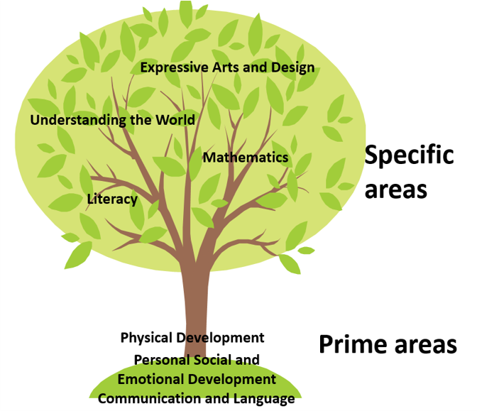
There are 7 areas of learning that shape our educational program. All areas are important and all are interconnected.
The 3 ‘Prime’ areas play a crucial role in igniting children’s curiosity and enthusiasm for learning, and building a capacity to learn.

Slide 21
Prime Areas of Learning
Communication and Language
Listening, attention and understanding
Speaking
Personal Social and Emotional Development
Self regulation
Managing self
Building relationships
Physical Development
Gross motor skills
Fine motor skills

Slide 22

Phonics
Phonics is taught daily.
It is where we learn new sounds that will help to develop both their reading and writing.
It is a 20 minute session where the children are taught in their classes with learning assistant support.
They will also learn a range of tricky words
which are words that the children can not sound out.
Information will be provided at the Phonics workshops in the Autumn Term.

Slide 23
Reading Books
Once the children have settled in and we have completed our baseline assessments, we will send a reading book home with your child.
This may be a book with no words in to begin with, and we will give you some ideas of how to share this at the phases meeting in the Autumn term.
Reading books are changed on Mondays and Fridays.

Slide 24
School Website
www.flixtonprimaryschool.org.uk
Reception class page will have updated information on it.
parentcontact@flixtonprimaryschool.org.uk

Slide 25
Family photos and individual photos.
Please send to parentcontact@flixtonprimaryschool.org.uk and put which class they are in on the email (RH or RJ)

Slide 26

Helping your child get ready for school.

Slide 27


