Slide 1
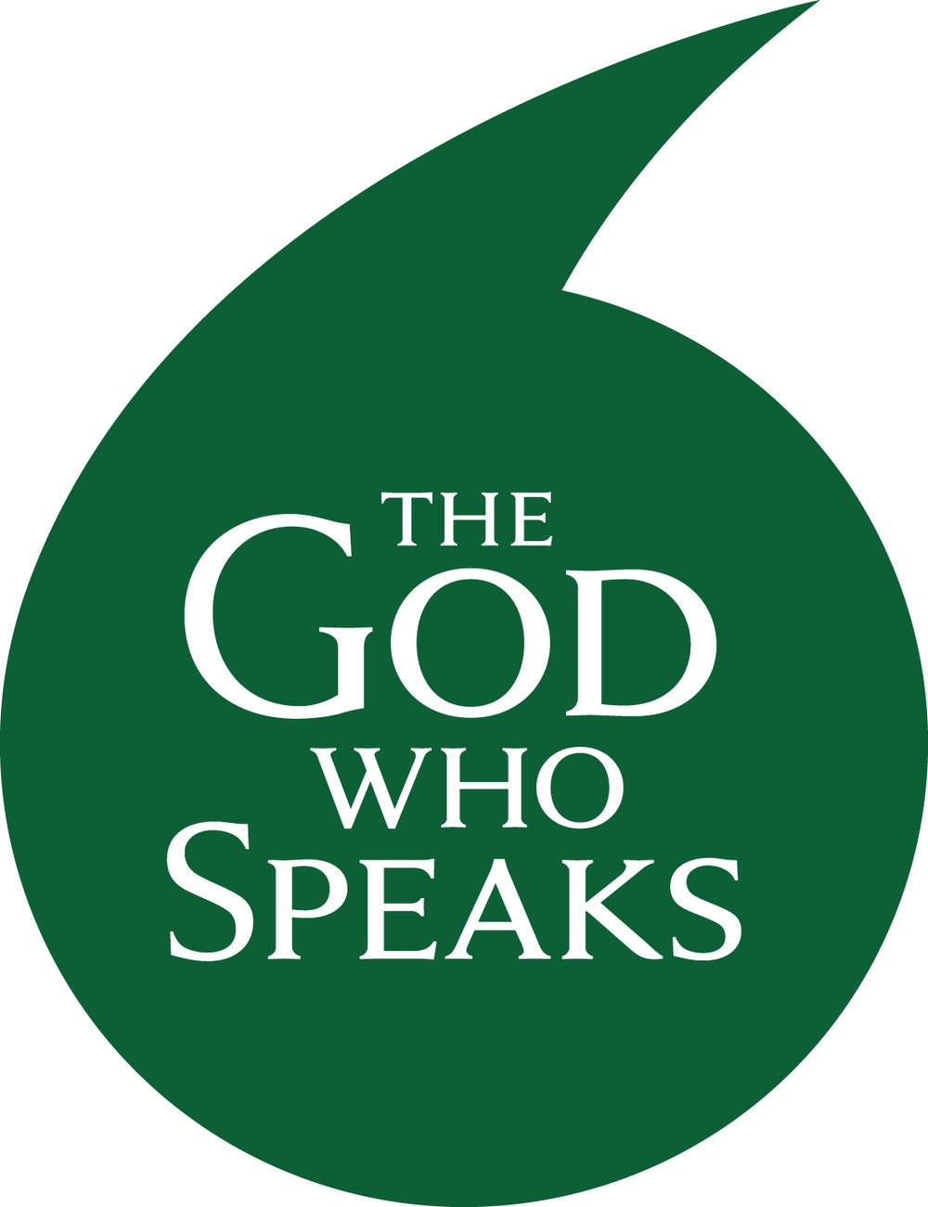

The God Who Speaks:
The Year of the Word
30th September 2019 – 31st December 2020

Slide 2
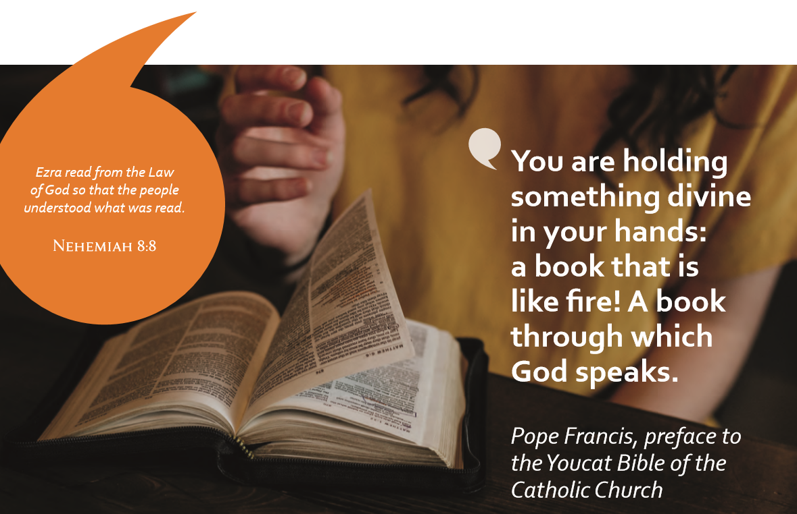

Slide 3
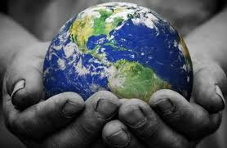
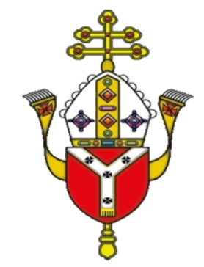
‘Scripture is at the centre of everything the Church does. The word of God shapes our prayer and worship. The Bible shows us how to understand the world, how we are called to live and relate to each other. ’

Slide 4
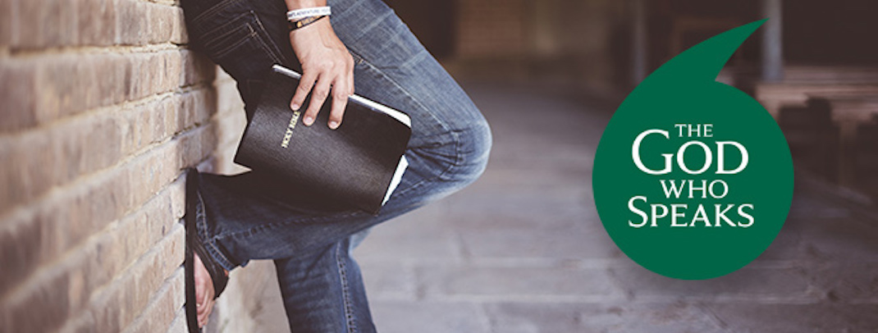
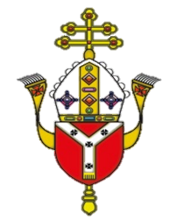
This year has been designated as 'The God Who Speaks - The Year of the Word’.
There will also be a specific focus on
St. Matthew’s Gospel.

Slide 5
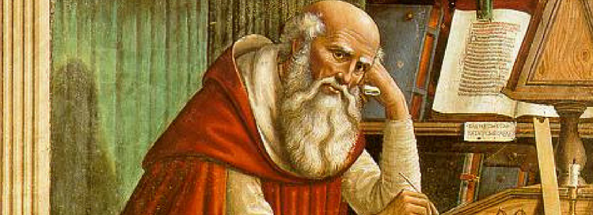
The Official Launch
The official launch of The God Who Speaks – The Year of the Word was on 30th September with Cardinal Nichols video in the National Gallery on the feast of St. Jerome.
The ‘year’ will officially start on Sunday 1st December 2019,
the first Sunday of Advent, the beginning of the Church's Liturgical Year.

Slide 6
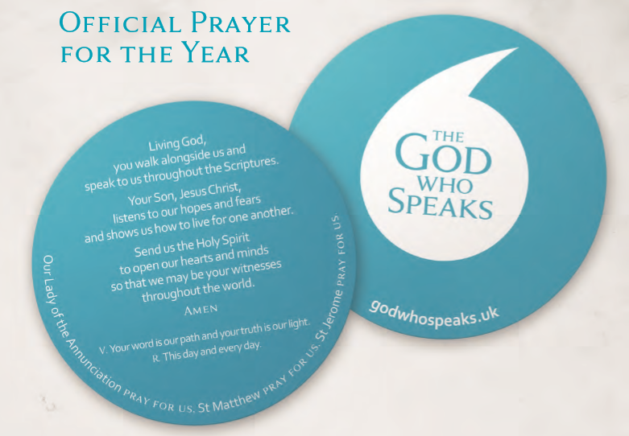

Slide 7
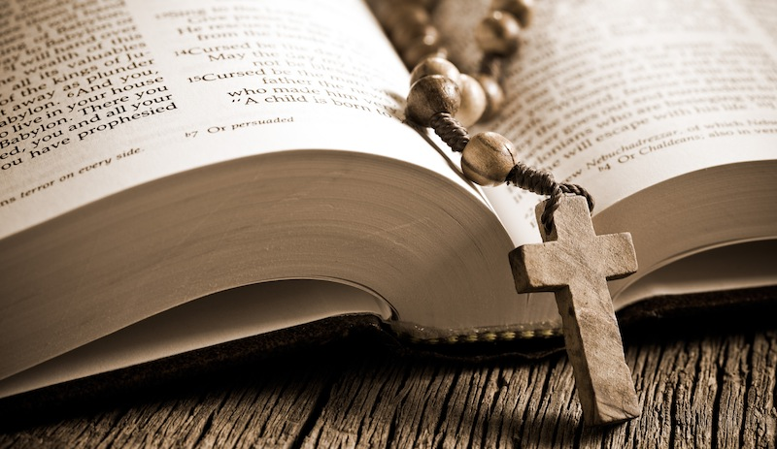
The aim of The God Who Speaks - The Year of the Word is:
‘Celebrating, Living and Sharing God’s Word.’

Slide 8
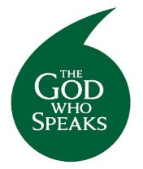

Celebrating
Living
Sharing

Slide 9
4.12.19

Slide 10
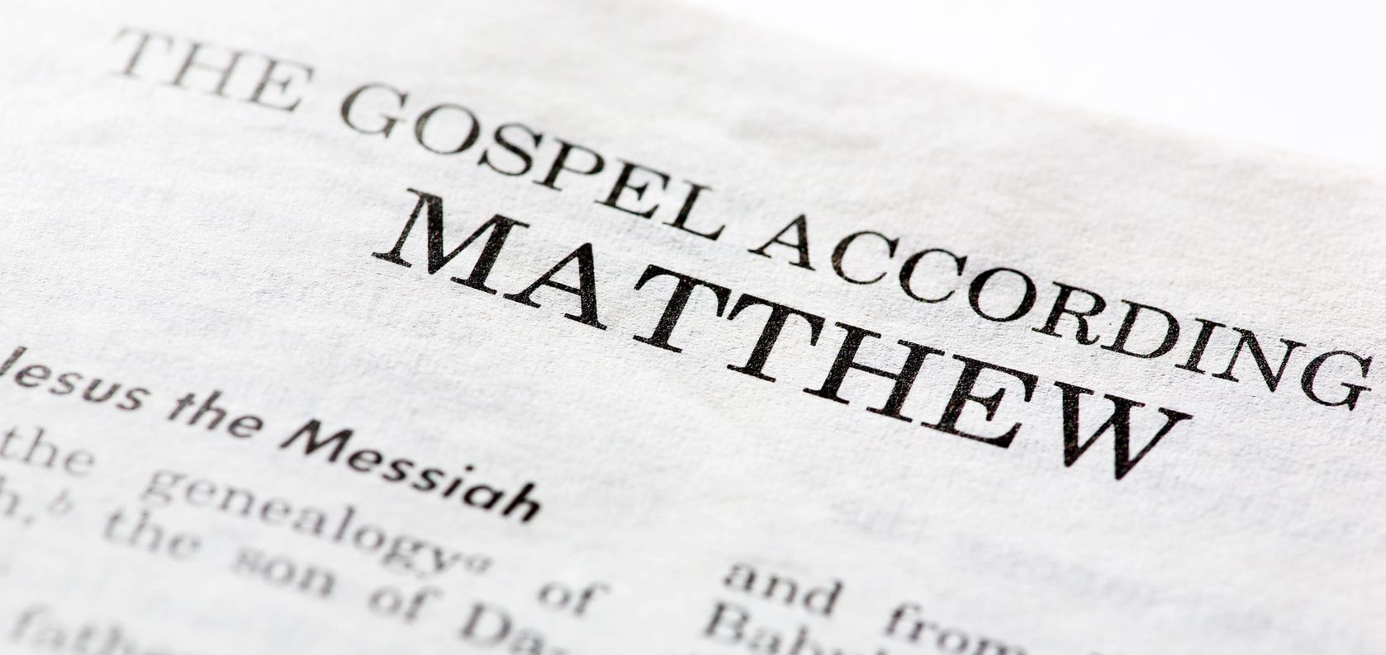
During this very special year we will have the opportunity to celebrate, live and share in the joy of scripture, and in particular the good news of Matthew’s gospel.

Slide 11
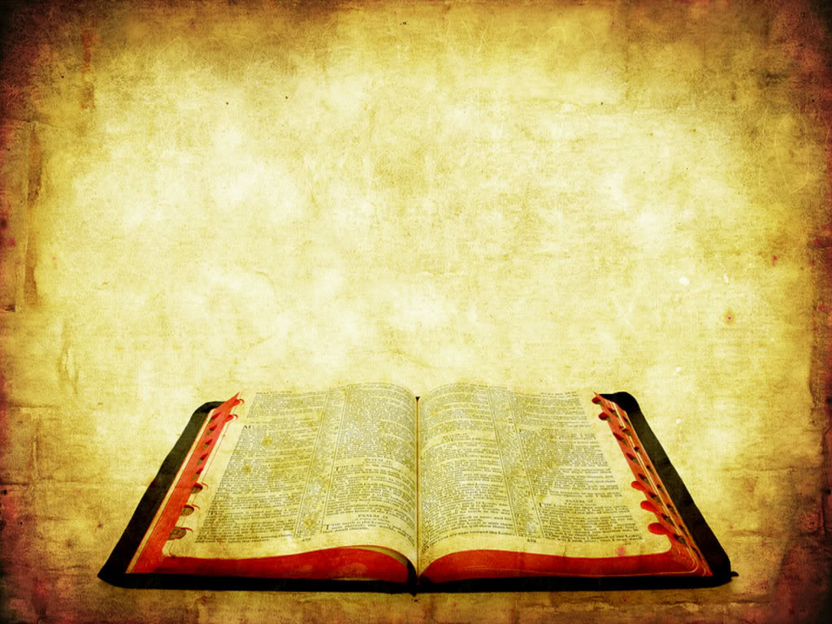
Fun Bible Facts

Slide 12
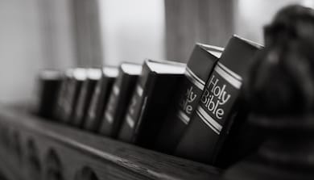
Over 100 million copies of the Bible are sold each year!

Slide 13
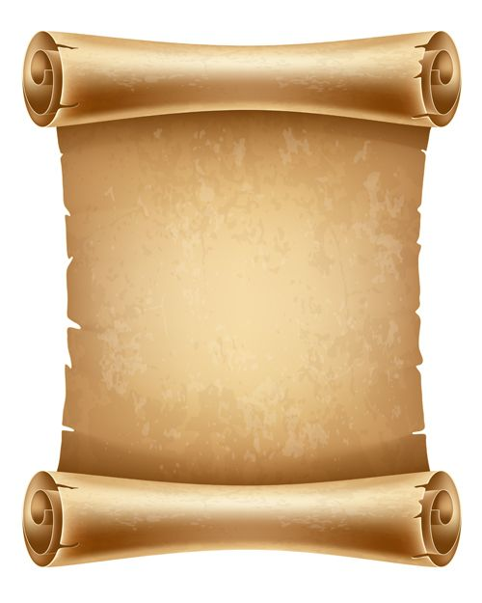
The word ‘bible’ is from the Greek ta biblia, which means ‘the scrolls’ or ‘the books’. The word is derived from the ancient city of Byblos, which was the official supplier of paper products to the ancient world.

Slide 14
The full Bible has been translated into 532 languages.
It has been partially translated into 2,883 languages.

Slide 15
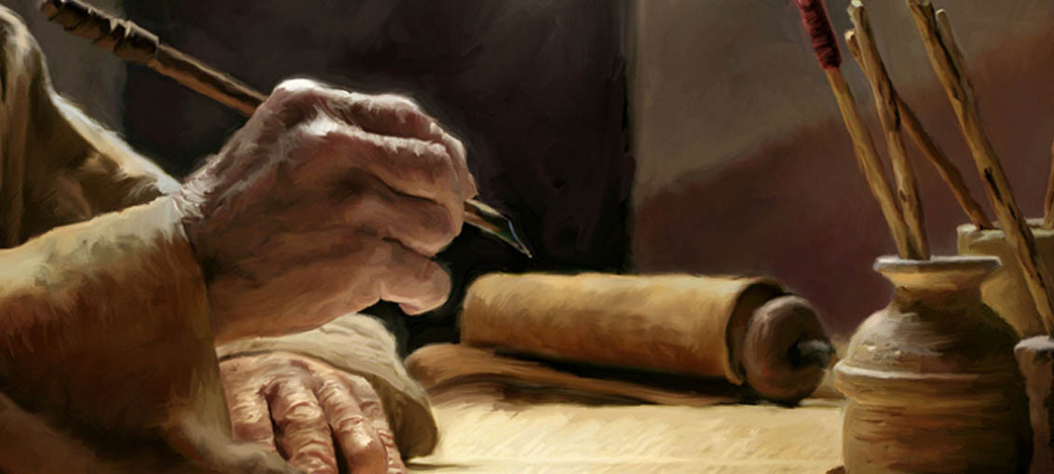
The Bible was written by people from many different occupations.
Parts of the Bible were written by kings.
Half of the Psalms, a good chunk of Proverbs, and Ecclesiastes were written by royalty.

Slide 16
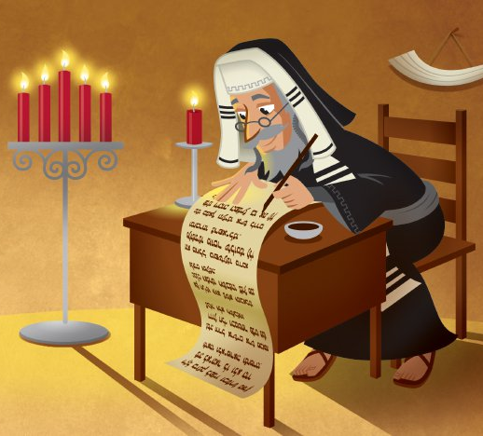
But other parts of the Bible are written by farmers, fishermen, a tentmaker, homeless prophets, a doctor, a professional scribe, musicians, pastors and many more besides!

Slide 17
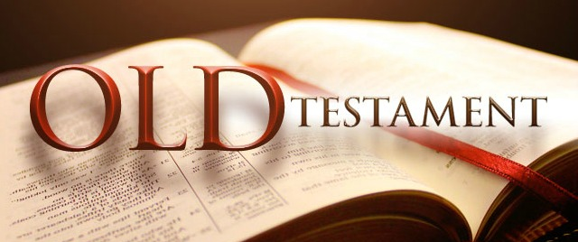
The Bible is split into two ‘sections’:
The Old Testament
The New Testament
There are 46 books in the Old Testament…

Slide 18
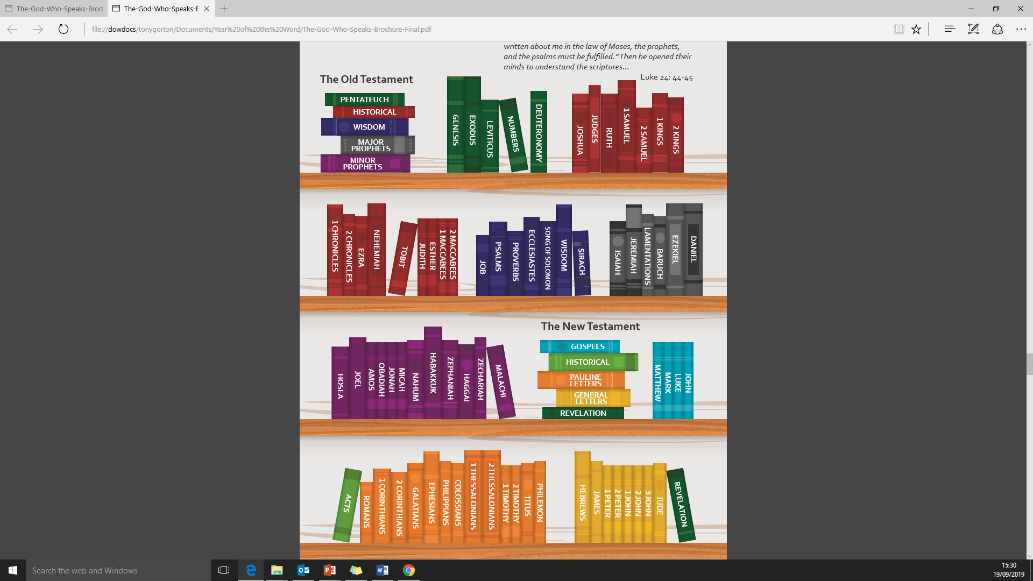

Slide 19
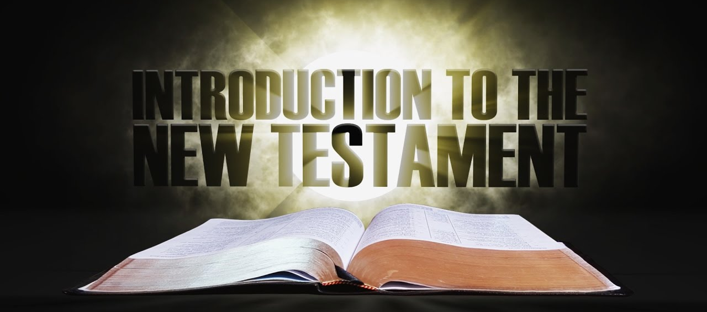
…and 27 books in the New Testament.

Slide 21
Making a total of how many books altogether in the Bible?
73!

Slide 22
The shortest verse in the Bible is John 11:35, which states, ‘Jesus wept.’

Slide 23
The shortest book of the Bible is 3 John.
You can read this book in about one minute!
The book right before it, 2 John, is the second-shortest book of the Bible.

Slide 24
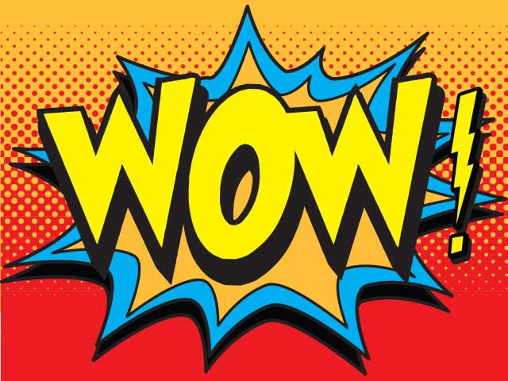
The longest word in the Bible is ‘Mahershalalhashbaz’
(Isaiah 8:3)

Slide 25
The Bible is about 611,000 words long!
When translating the Bible from its original languages to English, translators tend to use more words to get across the original author’s point.
And who wrote all of
those words?!

Slide 26
The Bible was written in three languages!
Those languages are Hebrew, Aramaic, and Greek. Most of our Old Testament was written in Hebrew, which was the language the original readers spoke. A few bits of the Old Testament were written Aramaic (looking at you, Ezra and Daniel). The New Testament was written in Greek, the commonly-spoken language of the time.

Slide 27
The Bible was written by more than 40 traditional authors!
The books of the Bible are traditionally attributed to heroes of the Jewish and Christian faiths.
Moses is given credit for the first five books of the Bible, most of the prophets are given credit for the books named after them…and there are a few ‘unknowns’!

Slide 28
Moses wrote about 20% of the Bible in terms of word count.
Paul wrote the most individual documents.
Ezra, Luke and Jeremiah make up the rest of the top 5 in the number of words written.

Slide 29
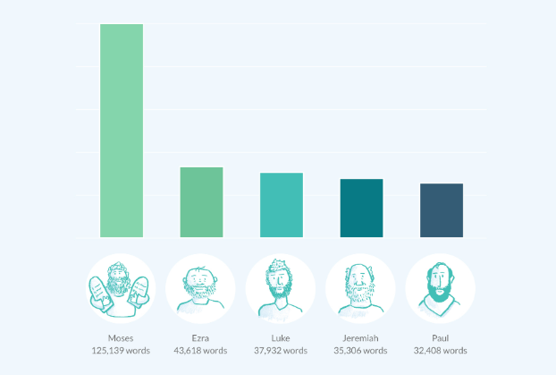

Slide 30
There are at least 185 songs in the Bible!
About 150 of these are in the book of Psalms. (we say ‘about’ because there’s some debate as to whether a few of the separate Psalms were originally meant to be sung as one.) But throughout both the Old and New Testaments, people will sing songs about God or the events around them.
And 185 is a bare minimum!

Slide 31
The Bible was written on three continents!
Most was written in what is modern-day Israel (Asia). But some passages of Jeremiah were written in Egypt (Africa) and several New Testament epistles were written from cities in Europe.

Slide 32

There are 21 dreams recorded in the Bible!
And most of them are had by two different men named Joseph!

Slide 33
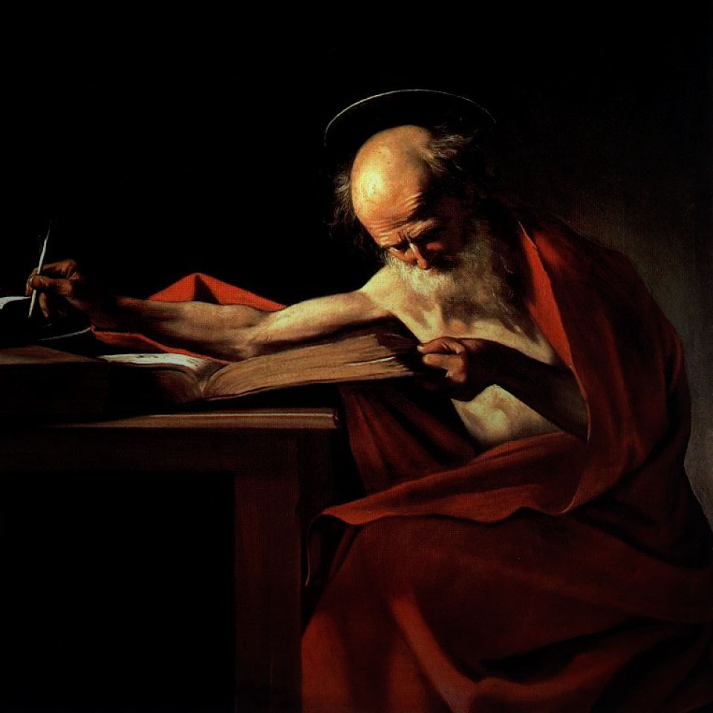
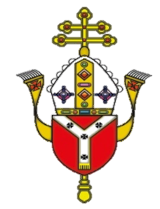
Why St. Jerome?
Patron of archaeologists, Biblical scholars, librarians, students and translators
Of all the things that made Jerome famous, nothing was so legendary as his translation of the Bible; he spent his entire life translating the scriptures from Hebrew and Old Latin.

Slide 34

The Life of St. Jerome

Slide 35
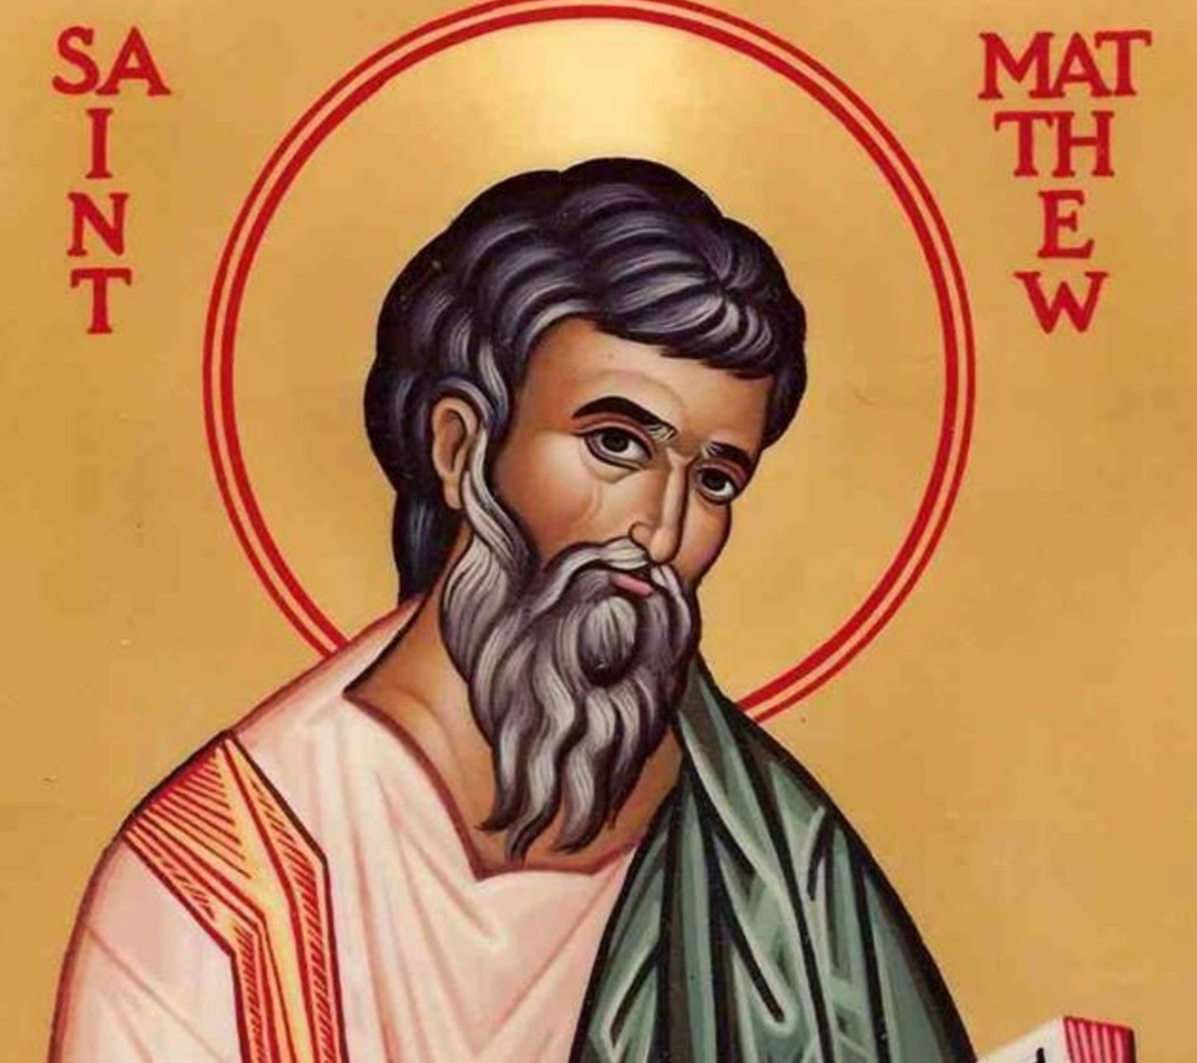
Matthew the Gospel Writer
The Year of the Word will focus on the gospel of Matthew which will start to be read at the beginning of Advent on 1st December 2019.

Slide 36
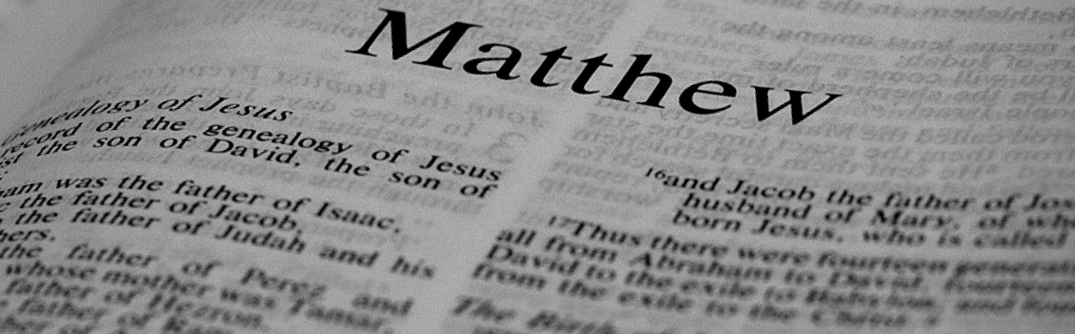
Matthew the Gospel Writer
Little is known about St. Matthew, except that he was the son of Alpheus, and he was likely born in Galilee. He worked as a tax collector, which was a hated profession during the time of Christ.

Slide 37
St Matthew – Saints For Kids

Slide 38
St. Matthew – Catholic On-line

Slide 39
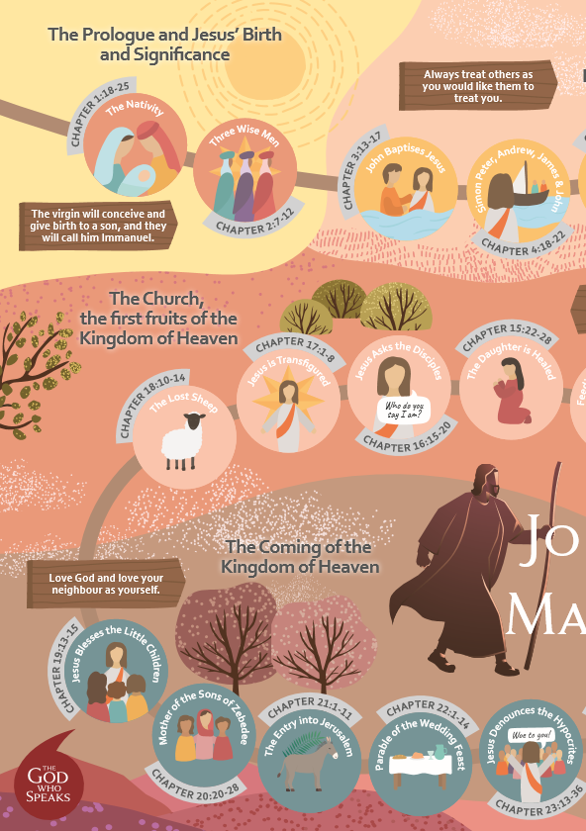
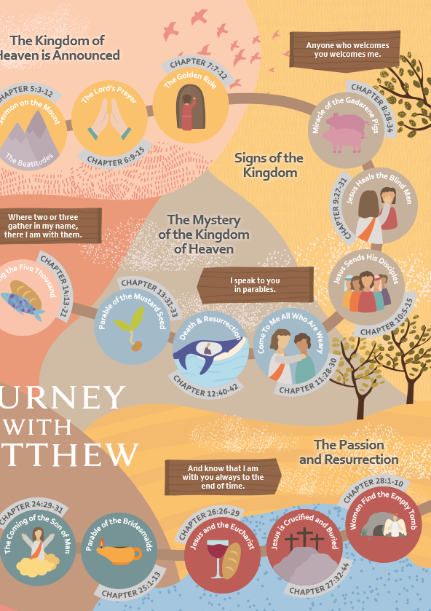

Slide 40
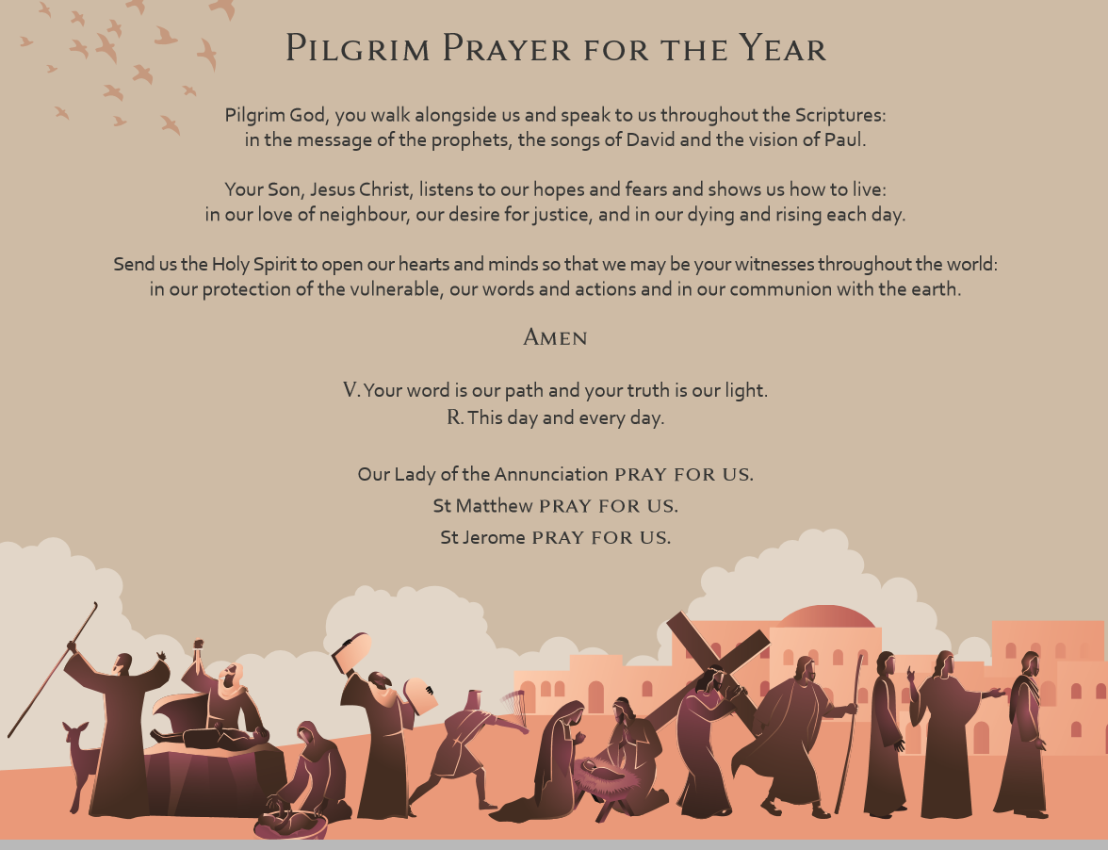

Slide 41
The God Who Speaks:
The Year of the Word
30th September 2019 – 31st December 2020

Slide 42
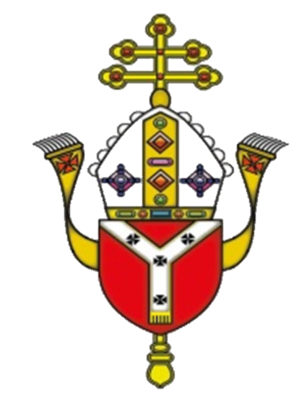
Celebrating
Living
Sharing

