Slide 1


NEVILL ROAD JUNIOR SCHOOL CURRICULUM OVERVIEW -GEOGRAPHY

Slide 2
Our Curriculum at Nevill Road Juniors
We Aim High by challenging ourselves in all aspects of school life.
We are Successful learners by using our growth mindset to achieve.
We Persevere by being resilient and trying our best in everything we do.
We use our Imagination to produce creative work that we can be proud of.
We show Respect by including everyone and making sure we all matter.
We show Enthusiasm by approaching all learning with a positive attitude.

Slide 3
Our Curriculum Intent
At Nevill Road Junior School learning is fun and all of our children are supported and challenged to enjoy learning and reach their potential. Learning in the outside environments, practical and real-life situations and special activities all help to make learning accessible and help to motivate our pupils to achieve well and become lifelong learners. We have a very positive approach to learning at our school and children are encouraged and rewarded when they do their best, work hard and make good progress.
The wellbeing of our children and their Mental Health are a priority as we believe that children learn best when they feel happy, safe and cared about. Our Restorative Approach to learning underpins our curriculum, which also celebrates equality and diversity.
Our curriculum is based on the statutory National Curriculum; it is skills based in design and intended to provide learning and teaching motivation for both children and teachers.
We aim to be as creative as possible with our approach to the curriculum, teaching and learning. All curriculum areas have been planned to deliver a well sequenced and progressive series of lessons to ensure children gain 'sticky knowledge', which they can articulate with confidence.
Every year group includes high quality book and text studies within their termly topic plans, making sure children are given a text-immersive experience.
All of our topics are supported through high quality resources, trips, visitors and experiences that provide ample opportunity for real depth of study.

Slide 4

Pedagogy of Learning
Explanation, Modelling and Scaffolding
In lessons you will see:
Clear and precise explanations given by teachers, with complex ideas broken down.
Time given to practise and consolidate children’s knowledge and understanding in new ways that stretches their thinking and allows them to consolidate key skills.
Metacognition strategies used to help scaffold learning and develop independence.
Use of sentence stems to help structure children’s talk and thinking.
Children know what is expected of them and how this can be achieved. This is done in a variety of ways including the use of a clear success criteria and examples eg a WAGOLL (What a good one looks like)
Children evaluating their own work and improving their learning.

Slide 5

Pedagogy of Learning
Questioning, Recall and Retrieval of Knowledge to make learning ‘sticky’
In lessons you will see:
A mastery approach to learning.
Every lesson starts with a ‘Can you still..?’ to recall previous knowledge
Questions asked to children that encourage them to know more and think more.
Teachers use carefully planned questions to probe children’s responses, to reshape tasks and deepen understanding.
Children are given ‘thinking time’ to allow for sufficient time for pupils to review what they are learning and to develop further.
Children are given regular opportunities within lessons to recall previous knowledge. Questions are asked to reveal their understanding and recall how well they have remembered the content.
Lollipop sticks used to select children to answer questions to encourage participation from all.
Tasks from the ‘Nevill Road Bare Necessities to Sticky learning’ used to retrieve knowledge

Slide 6
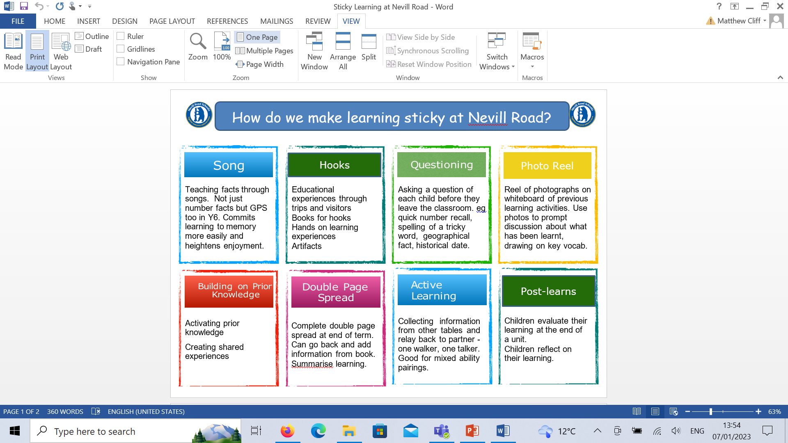
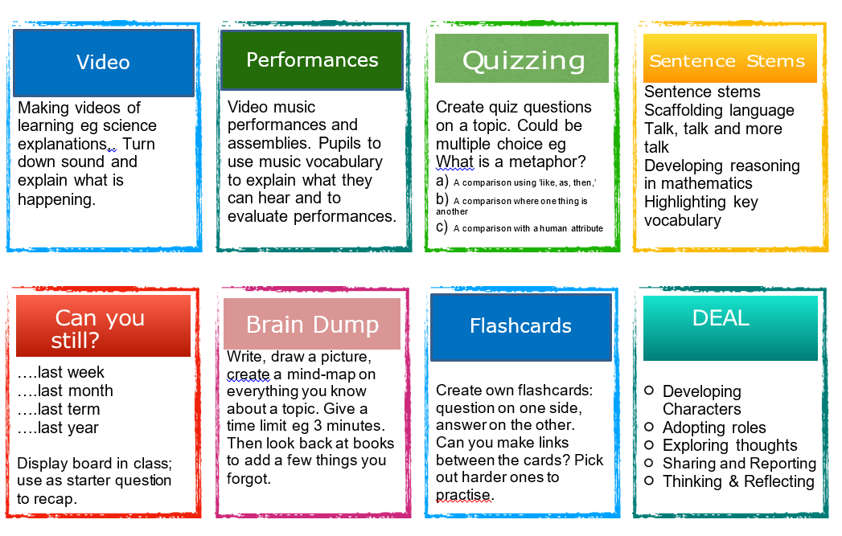
Pedagogy of Learning
In order for our children to learn more and remember more, we promote ‘sticky’ learning through….

Slide 7

Pedagogy of Learning
Check understanding throughout the lesson and provide feedback.
In lessons you will see:
We use a variety of mechanisms to assess children’s understanding throughout lessons and ensure that misconceptions are picked up quickly.
Verbal feedback given to children throughout the lesson in order to build on pupils’ strengths.
Our marking system ensures that feedback is purposeful and children’s responses enable them to practise, consolidate or stretch their learning.
Metacognition strategies are used to motivate children to improve their learning.
Children respond to feedback and this is captured through the use of purple pen in their books.
In the moment marking gives immediate feedback.
Use of mini plenaries to address any misconceptions.

Slide 8
Curriculum Leader – Alexandra Taylor (2023 – Present)
Our Geography Intent:
We seek to inspire in children a curiosity and fascination about the world and its people which will remain with them for the rest of their lives; to promote the children’s interest and understanding of diverse places, people, resources and natural and human environments.
We aim to provide children with the opportunities to investigate and build geographical expertise from their local area to the wider world. This includes locational knowledge, understanding of human and physical features and geographical and fieldwork techniques.

Slide 9
Implementation
● Geography at Nevill Road is taught in blocks throughout the year, so that children can achieve depth in their learning.
● Geography units are planned coherently across year groups to build children’s understanding progressively from their local area into the wider world.
● Chris Trevor (Geography Specialist) planned our curriculum in conjunction with staff to ensure all Geography lessons follow the 2014 KS2 National Curriculum and KS2 Skills and Knowledge list.
● An overarching enquiry question drives each unit of work with each lesson having an enquiry question to answer during the lesson.
● Lessons develop the children’s use of geographical knowledge, understanding and skills to enhance their locational and place knowledge.
● Key vocabulary is outlined for each year group, building on what has been taught before.

Slide 10
Implementation
● Opportunities are provided for children to develop their skills and fieldwork using maps and atlases (both physical, digital and Digimaps).
● Fieldwork allows children to apply their geographical skills in a real-life setting, exploring the school grounds and their local area and the features within it.
● Year 5 go on an overnight fieldwork residential to develop map work skills.
● Where possible, Geography lessons make links to other subjects such as History.
● At the end of the unit children complete a post learn task to capture learning.
● We have the same high expectations for all learners, including those with SEND in Geography. The attached provision map shows what Geography looks like for all learners at Nevill Road Junior School.
● All learners are included, providing relevant support for those with additional needs (educational, medical or otherwise).

Slide 11
Impact
What will it look like by the time children leave school and at the end of each academic year?
As pupils progress, their growing knowledge about the world should help them to deepen their understanding of the interaction between physical and human processes, and of the formation and use of landscapes and environments.
Outcomes in Geography books evidence a broad and balanced Geography curriculum and demonstrate children’s acquisition of identified key knowledge and vocabulary. Children record what they have learned at the end of every topic through their post learn.

Slide 12
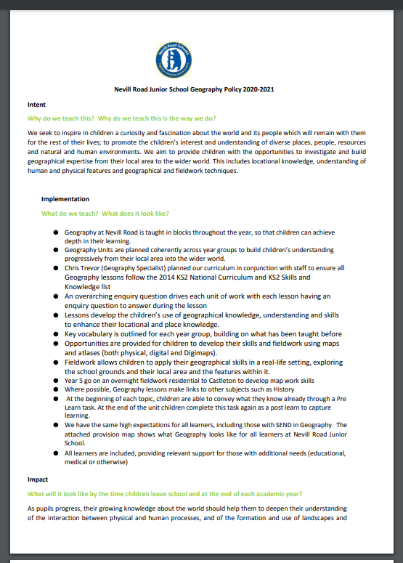
Policy
To find out more about our
Geography policy click the link below:
http://www.nevillroad-jun.stockport.sch.uk/serve_file/3001545

Slide 13
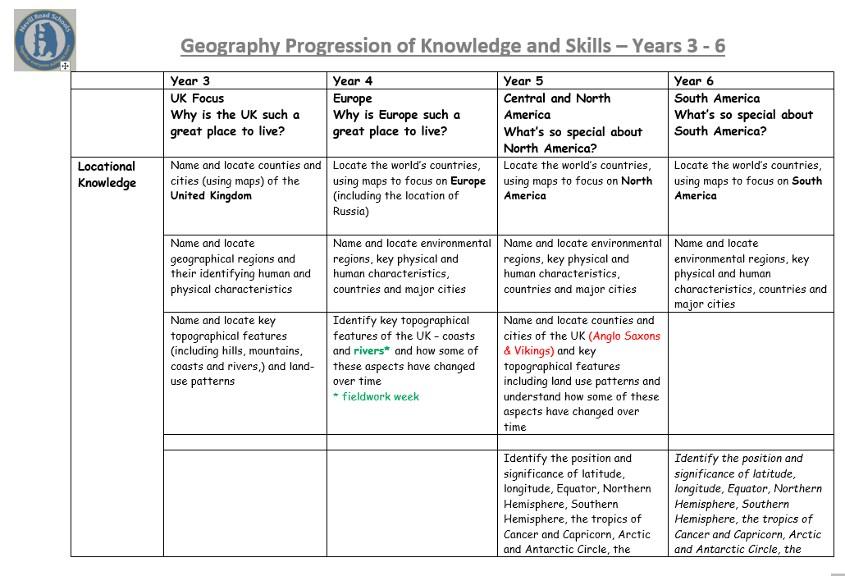
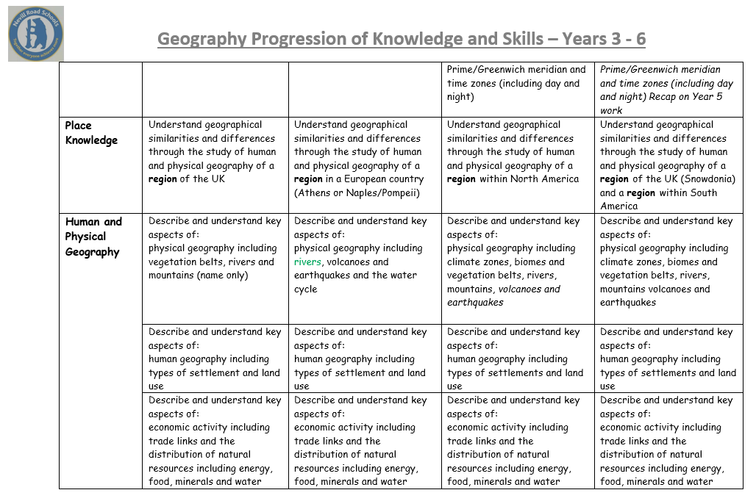
Progression of Skills in Geography
To see how the knowledge, skills, concepts and vocabulary are progressed throughout the school, follow the link below:
http://www.nevillroad-jun.stockport.sch.uk/serve_file/564793

Slide 14
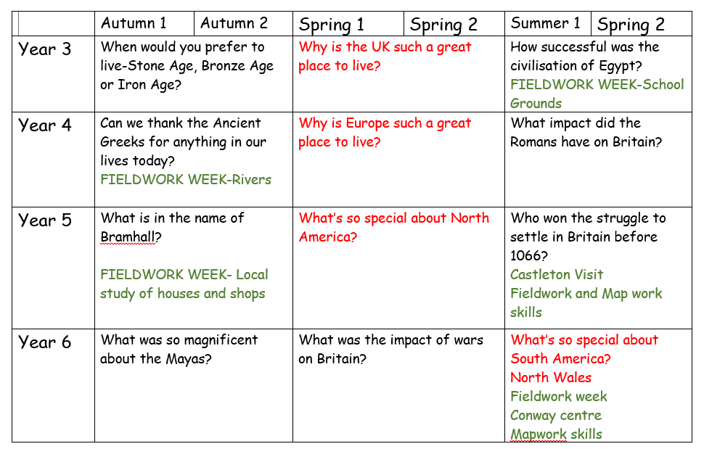
Sequence of Learning Whole School Plan
At Nevill Road Geography is taught in blocks over the year in order to immerse children in the subject. Year 3, Year 4 and 5 Spring and Year 6 Summer. High quality lessons are planned and delivered from a new year group planning structure which is enquiry question led and skills/knowledge based. Evidence in books shows high quality teaching linked clearly to LO for skills and knowledge.
.

Slide 15
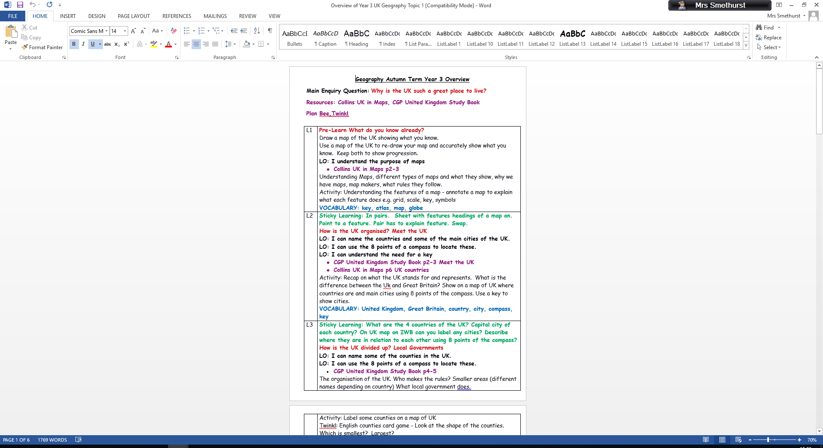
Each lesson is thought out purposefully with clear steps in order to achieve the learning objective. Here we have made links to our ‘sticky’ learning, vocabulary and required resources.

Slide 16
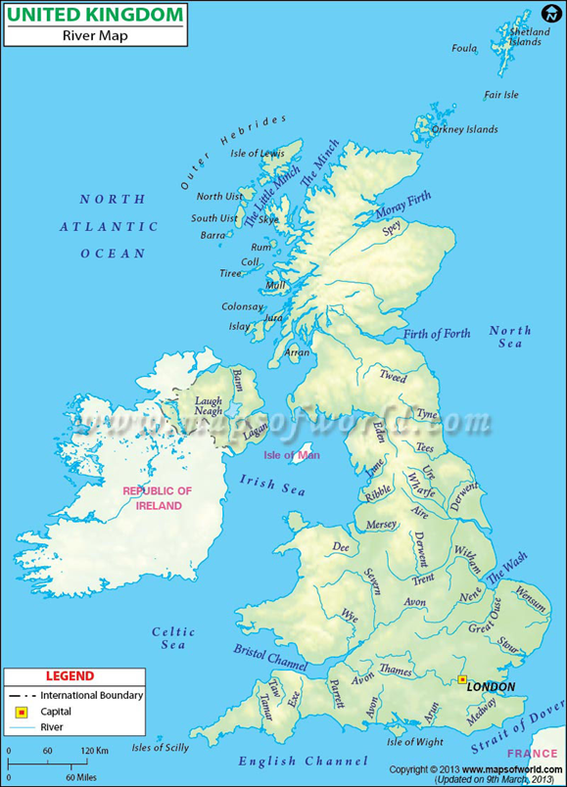
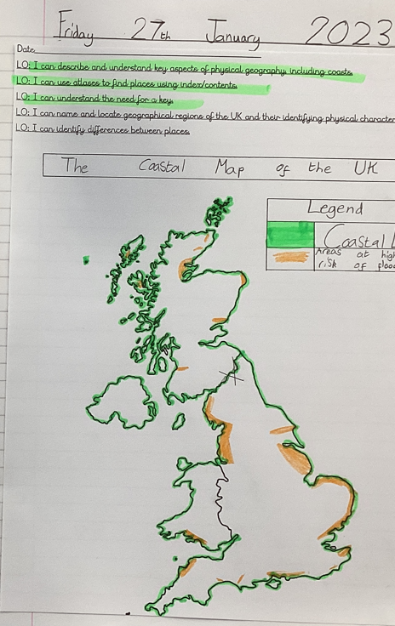
Ava – Year 3
Pupil Voice
“I loved the first lesson, when we had to draw the UK because we got to learn where everything was. I used to think Geography was hard but now I love it. Geography is 10 out of 10”

Slide 17
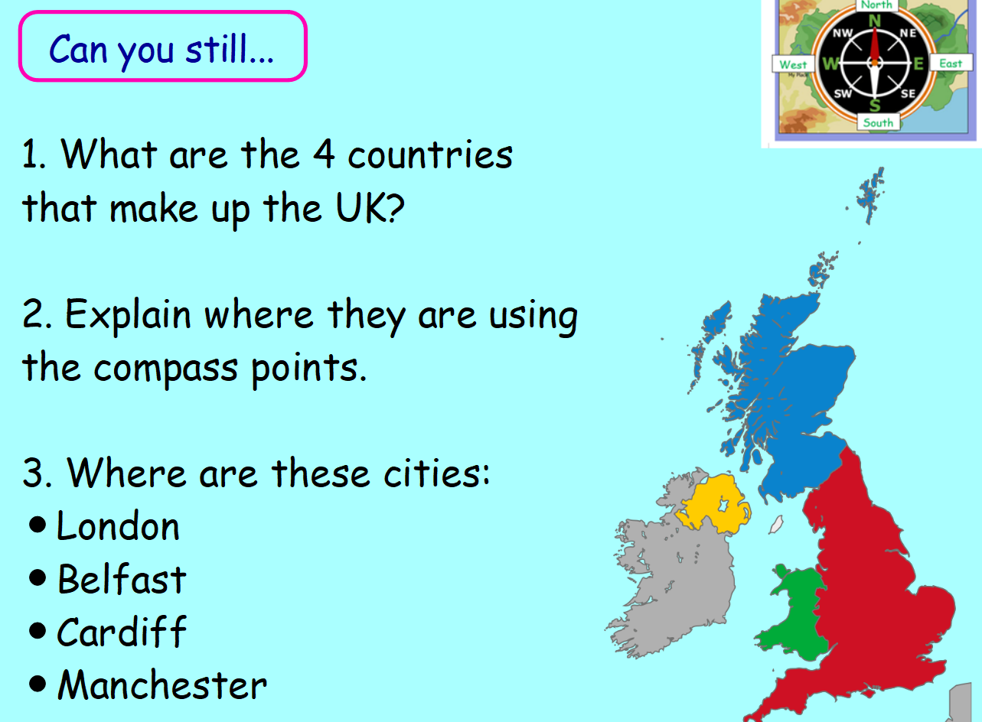
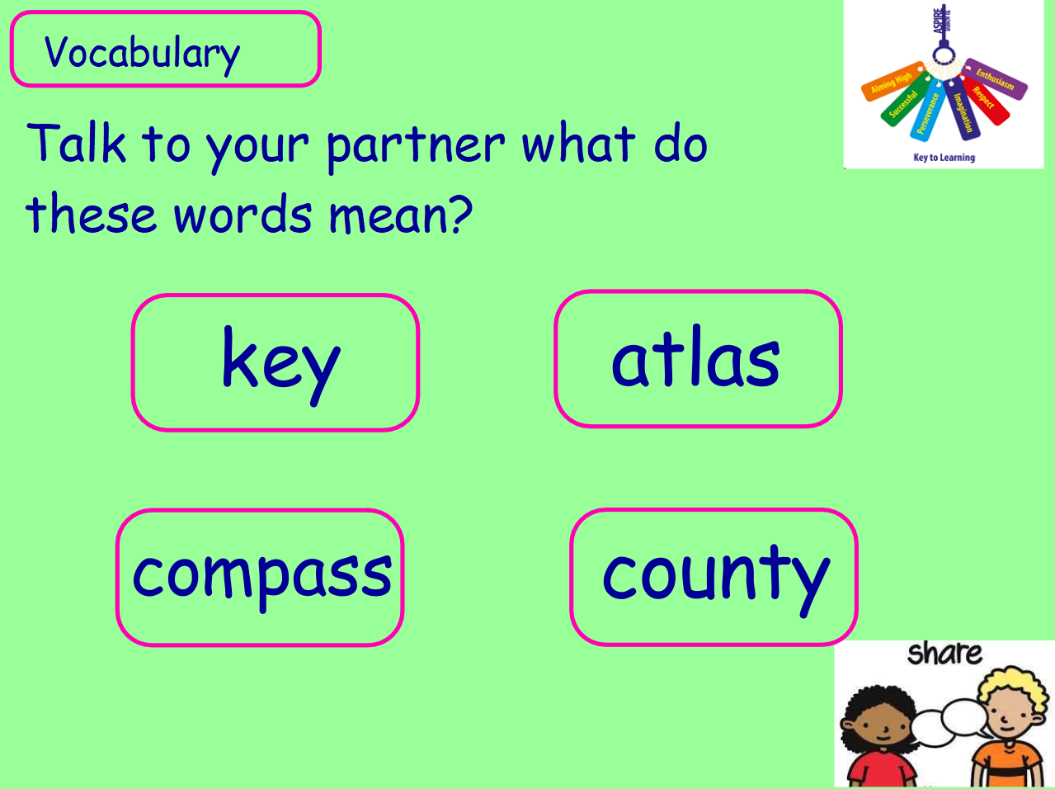
Geography lessons at Nevill Road.
In lessons you will see:
Teacher talk is kept to a minimum ensuring children work hard and focus upon their learning.
A clear outcome for the children and what devices they will be using to complete the unit.
Lessons begin with a recap of previous learning and with ‘Can you still…’ questions.
Vocabulary is explored throughout lessons.
What is coming up next.

Slide 18
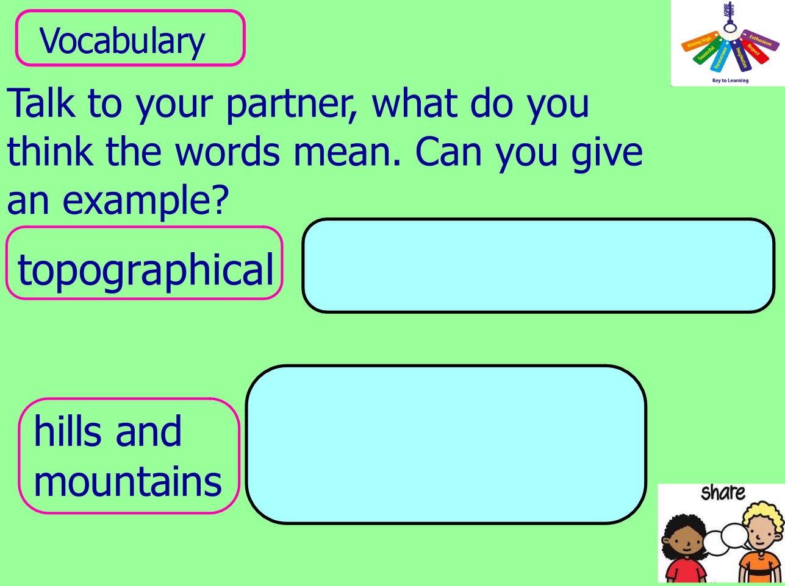
Vocabulary
At Nevill Road Junior School we develop pupils’ vocabulary by:
Each lesson will have a focus on the key technical (tier 3) words for the unit. These will be displayed on the PowerPoints during the teaching part of the lesson and referred to throughout the lesson.
Pupils are encouraged to share vocabulary throughout the lesson and ask questions.

Slide 19
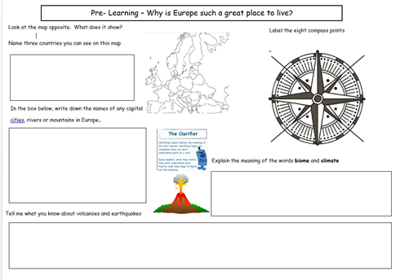
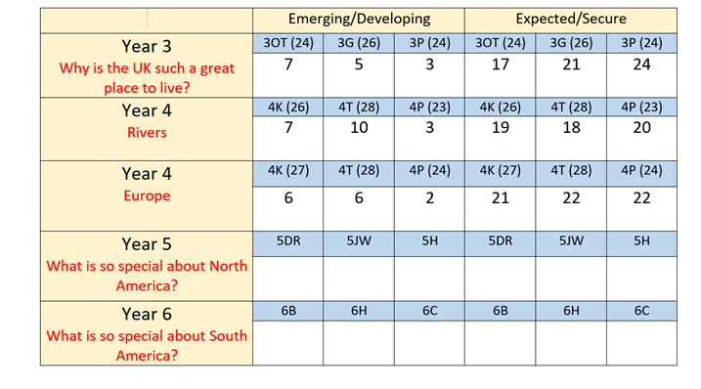
Assessment
At the end of the unit the children are given a post learn task. This assessment uses the enquiry questions which are the main body of the unit and focuses on key knowledge and chronological understanding.
Teachers then complete an assessment grid at the end of the unit indicating children that are working towards the expectations and those that have met the expectations. (This is related to key knowledge from the post assessment and skills observed in lessons)

Slide 20
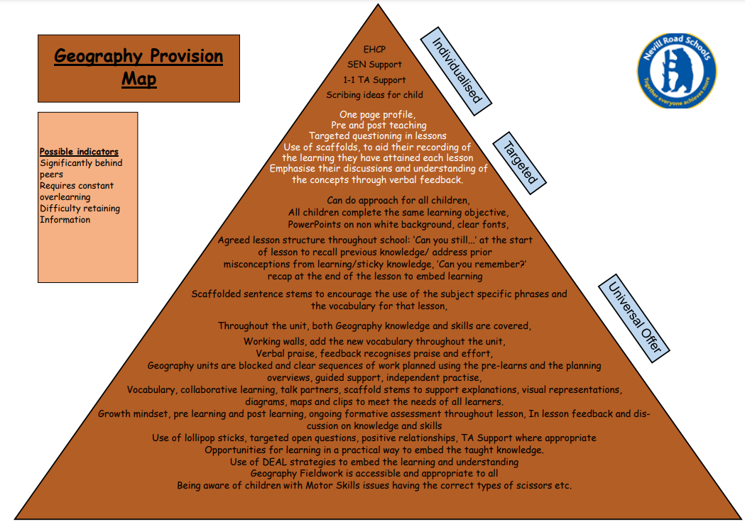
Inclusion
In all our subject areas we have created a provision map of need that shows how all children are supported in order to enable them to access the full curriculum.
The needs of all children are considered with a lens on provision for our SEND children and teaching is adopted necessary. We believe that if we are getting it right for our children with additional needs, then we are getting it right for everyone.
Learning is not capped by differentiation but stretched by enabling all pupils to deepen their learning through a range of texts and reading skills.
Some tasks are open ended and allow children to present their findings in a variety of creative and individual ways.
Staff check in regularly to check understanding.
Metacognition strategies are used to encourage independent learning such as frames and sentence stems to ensure pupils do not suffer with cognitive overload.
Teaching assistants are used effectively to help scaffold learning and support children to become more independent learners.
The growing diversity of our school community means that teachers are adapting lessons to support children who have English as a second language. In reading, EAL pupils will use word mats, picture cues, Google translate, and reading texts are chunked into smaller parts to not overwhelm pupils. Advice is sought from EDS.

Slide 21
British Values
Mutual respect – Online Safety / social media responsibilities and behaviours / respect to each other online
Tolerance – Using computing to access cultural diversity, through research projects, E-safety and
Individual liberty – Navigate and use computers independently, researching projects across the whole curriculum
Democracy – School council using computing resources to produce posters and documents to teach how to successfully navigate voting system within the school.
Rule of Law – Children demonstrate how to be safe online, using search engines safely and demonstrating how to follow school rules regarding E-safety.
http://www.nevillroad-jun.stockport.sch.uk/page/our-school-values/42774

Slide 22
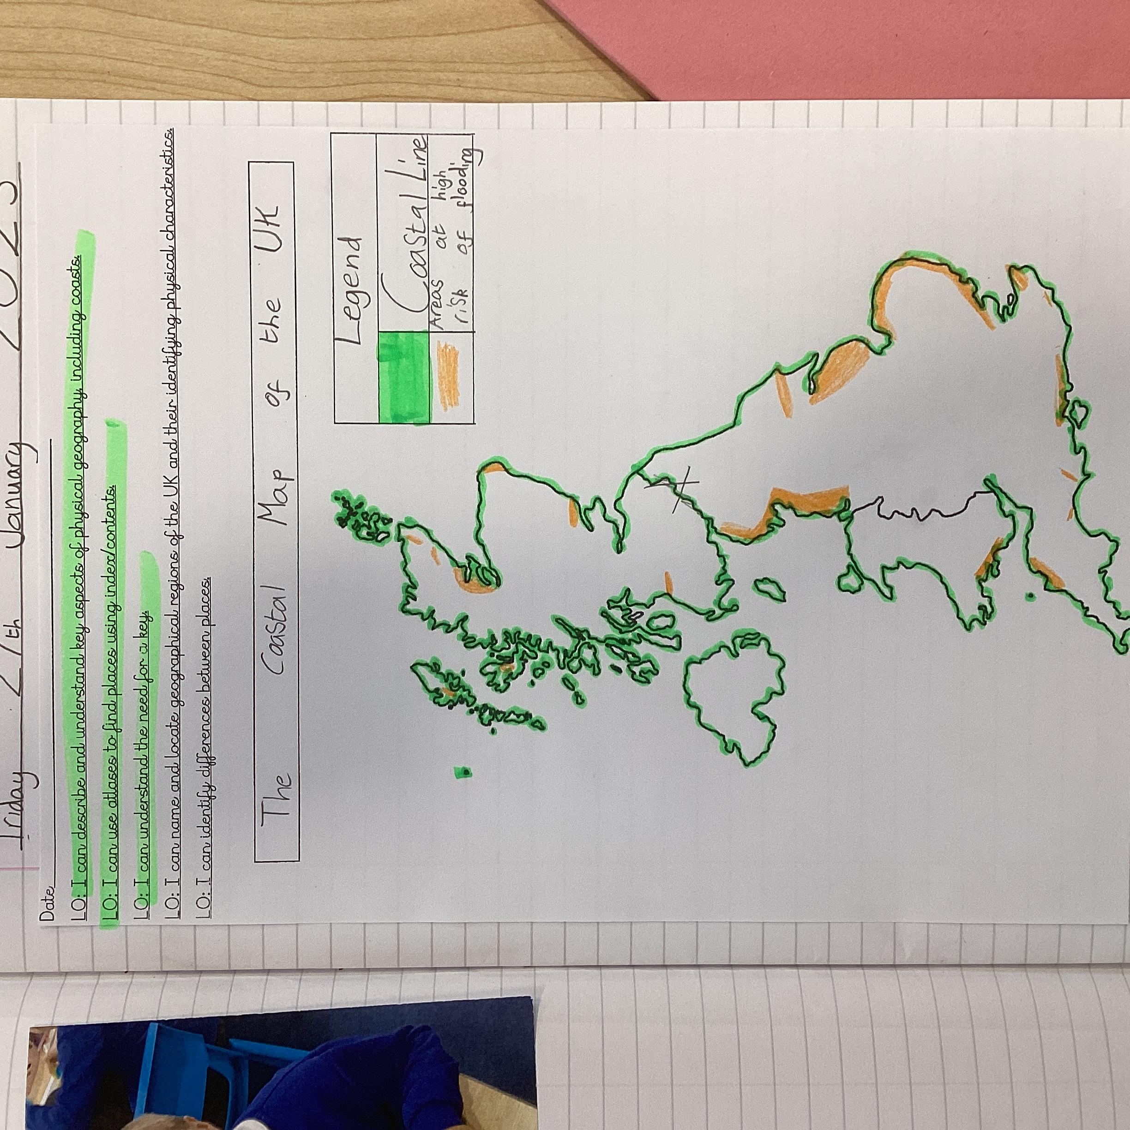
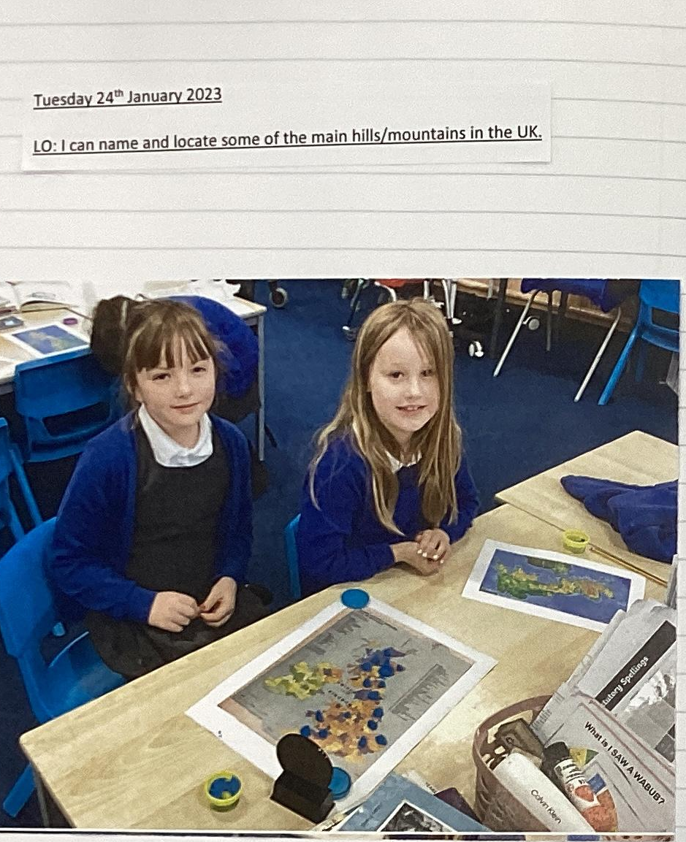
Monitoring and Evaluation
Subject leaders are allocated time to have a ‘Deep dive review’. This can involve reviewing planning, lesson looks, book scrutiny and pupil voice.

Slide 23
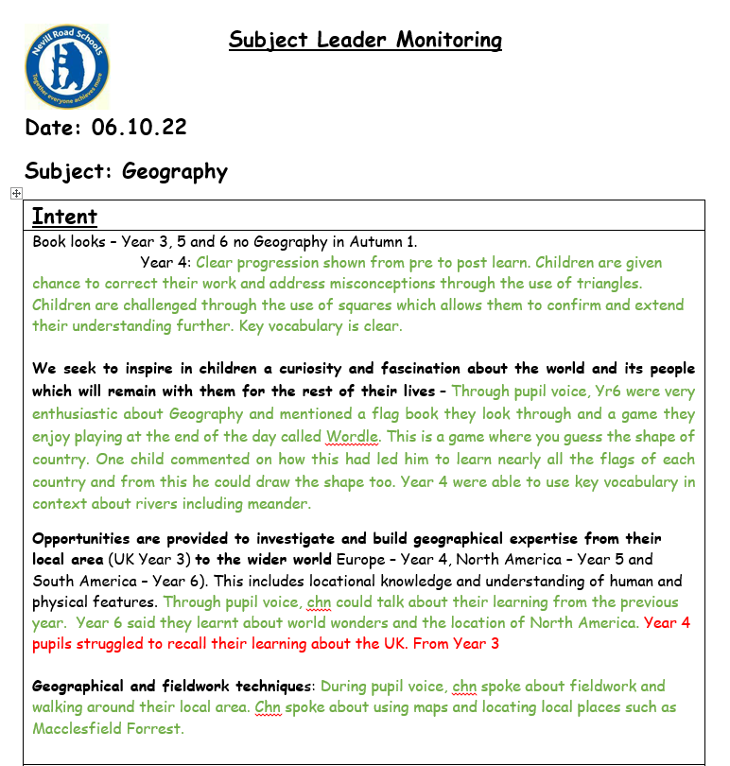
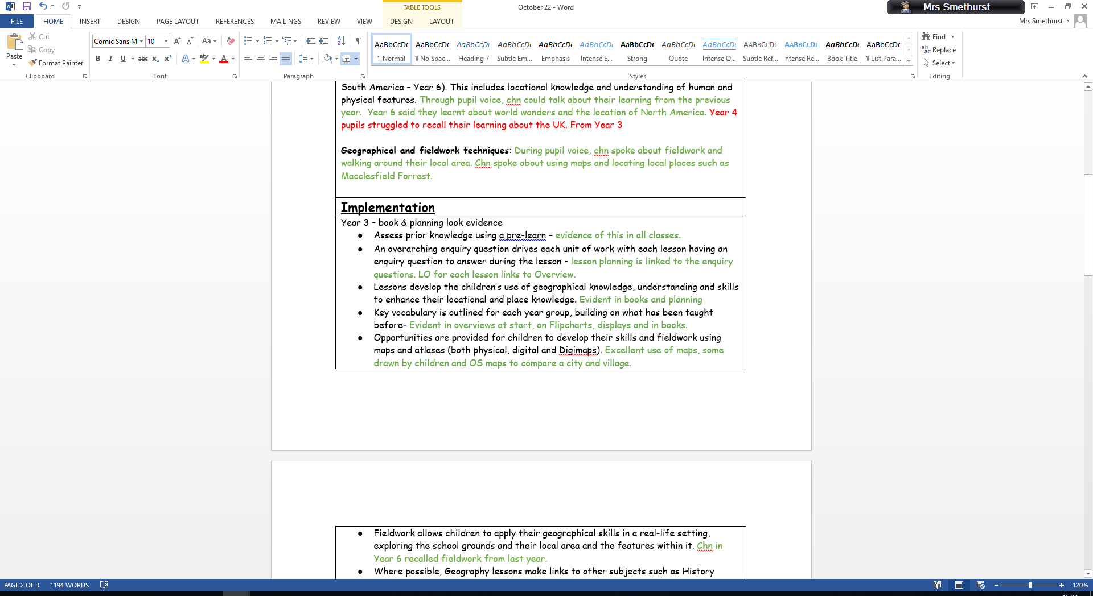
Monitoring Geography At Nevill Road.

Slide 24
Next Steps
To continue to monitor Geography across school
Ensure an open-door approach continues where staff feel supported
To attend network meetings and CPD opportunities and making sure those opportunities are available to staff when required.

