Slide 1


NEVILL ROAD JUNIOR SCHOOL Curriculum overview - Music

Slide 2
Our curriculum at Nevill Road Juniors
We Aim High by challenging ourselves in all aspects of school life.
We are Successful learners by using our growth mind set to achieve.
We Persevere by being resilient and trying our best in everything we do.
We use our Imagination to produce creative work that we can be proud of.
We show Respect by including everyone and making sure we all matter.
We show Enthusiasm by approaching all learning with a positive attitude.

Slide 3
Our curriculum intent
At Nevill Road Junior School learning is fun and all of our children are supported and challenged to enjoy learning and reach their potential. Learning in the outside environments, practical and real-life situations and special activities all help to make learning accessible and help to motivate our pupils to achieve well and become lifelong learners. We have a very positive approach to learning at our school and children are encouraged and rewarded when they do their best, work hard and make good progress.
The wellbeing of our children and their Mental Health are a priority as we believe that children learn best when they feel happy, safe and cared about. Our Restorative Approach to learning underpins our curriculum, which also celebrates equality and diversity.
Our curriculum is based on the statutory National Curriculum; it is skills based in design and intended to provide learning and teaching motivation for both children and teachers.
We aim to be as creative as possible with our approach to the curriculum, teaching and learning. All curriculum areas have been planned to deliver a well sequenced and progressive series of lessons to ensure children gain 'sticky knowledge', which they can articulate with confidence.
Every year group includes high quality book and text studies within their termly topic plans, making sure children are given a text-immersive experience.
All of our topics are supported through high quality resources, trips, visitors and experiences that provide ample opportunity for real depth of study.

Slide 4
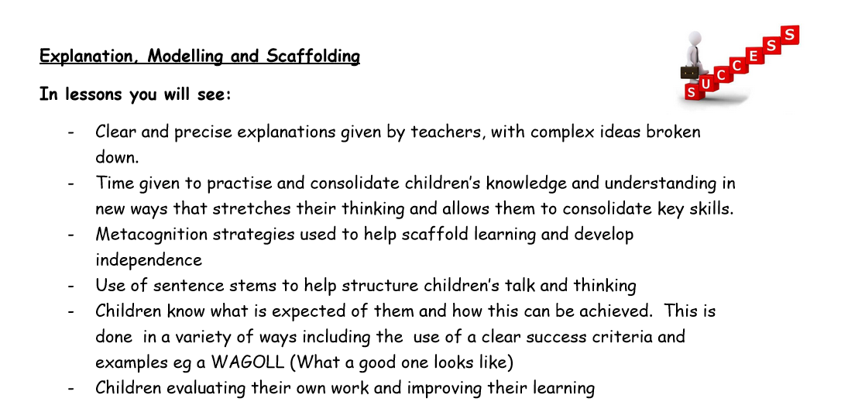
Pedagogy OF LEARNING
AT NEVILL ROAD

Slide 5
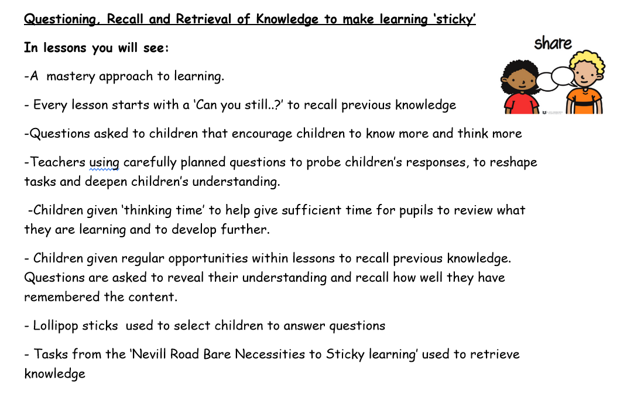

Slide 6
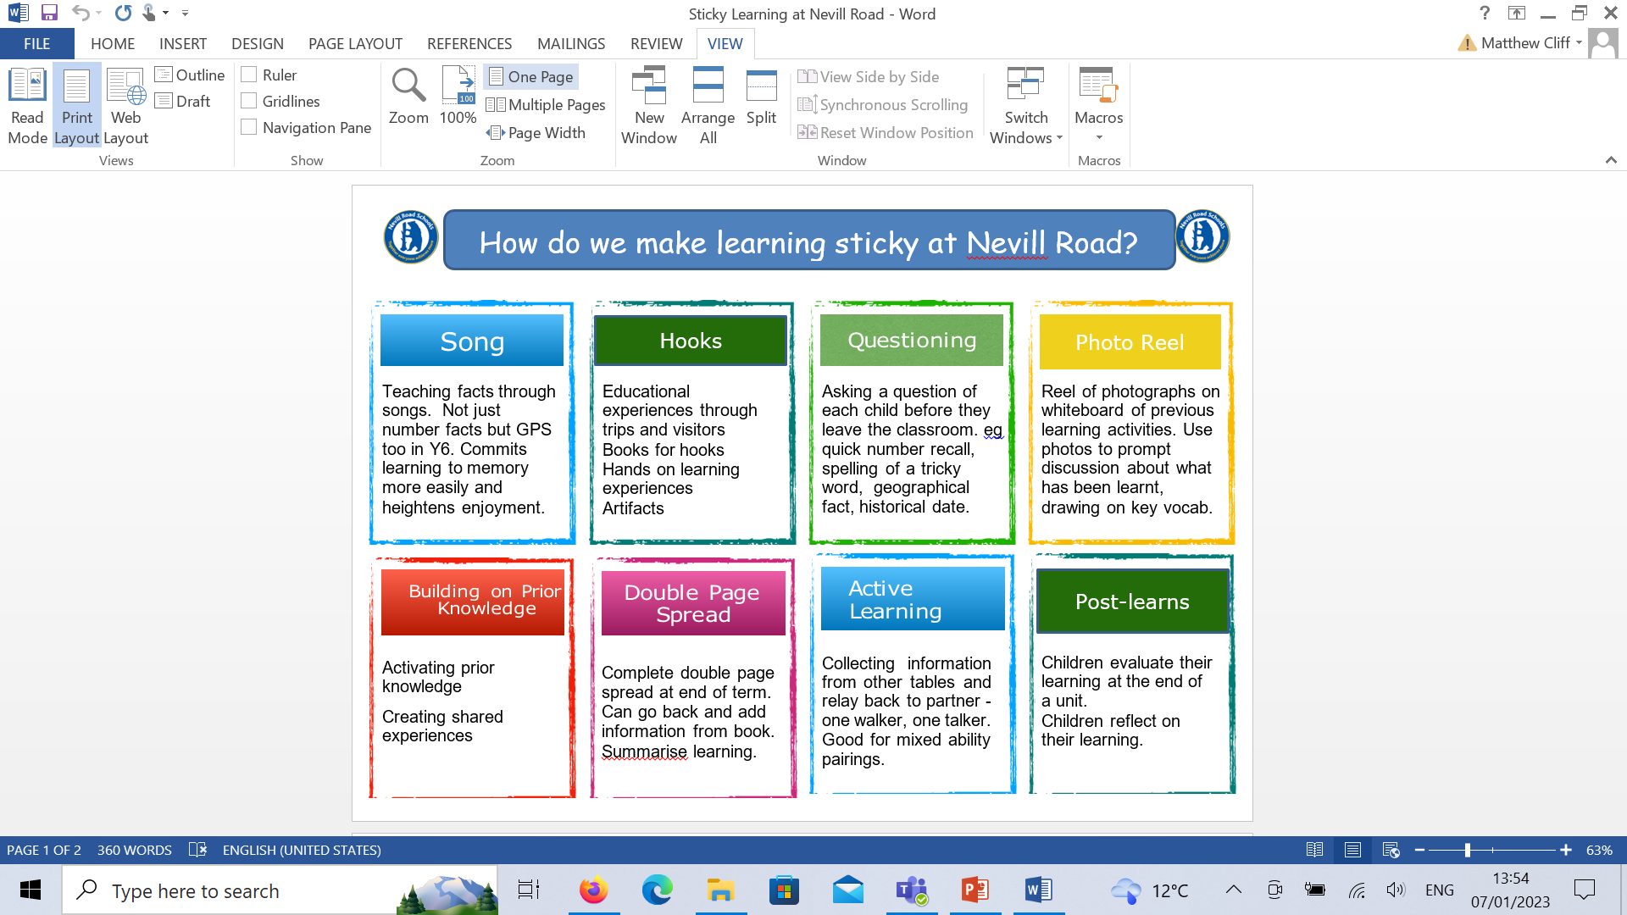
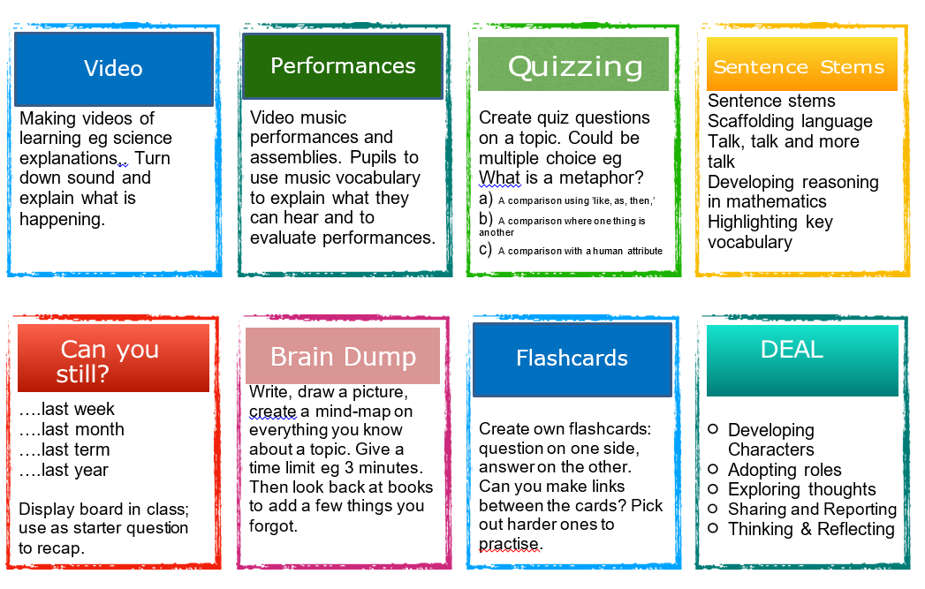
In order for our children to learn more and remember more, we promote ‘sticky’ learning through….

Slide 7
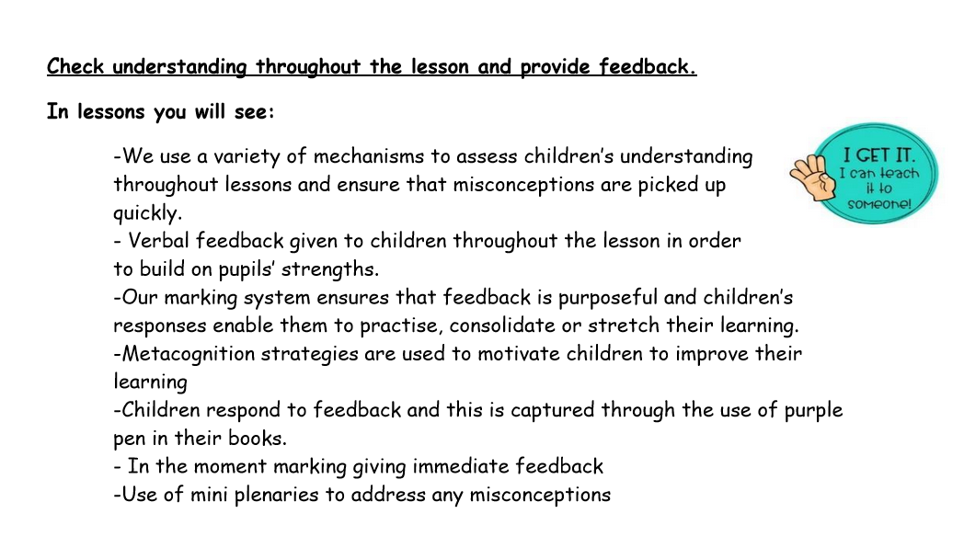

Slide 8
Curriculum leader – EMMA HUMPHREYS
(leader from 2018 – current)
Intent
Why do we teach this? Why do we teach this in the way we do?
At Nevill Road Junior School, we value music because it is a must powerful and unique form of communication that can change and impact the way children feel, think and act. We believe that teaching music helps the body and the mind work together. Exposing children to music during early development helps them to learn the sounds and meanings of words. We believe that every child should have the opportunity to develop their musical potential and we aim to nurture and encourage musical development across the school.

Slide 9
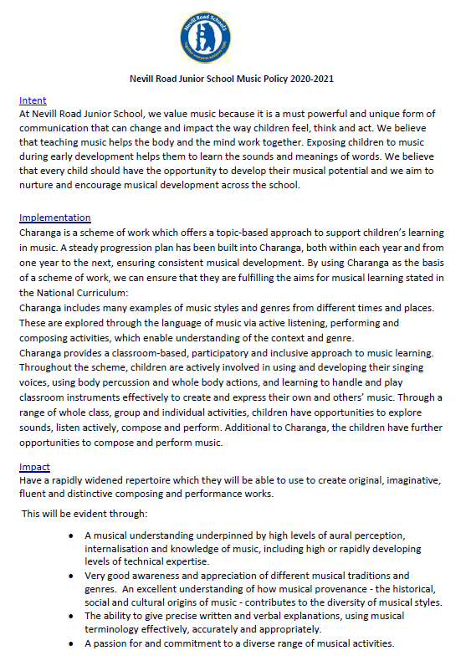
policy
To find out more about our
Music policy click the link below:
Policy and progression\Music Policy 2022-23.pdf

Slide 10
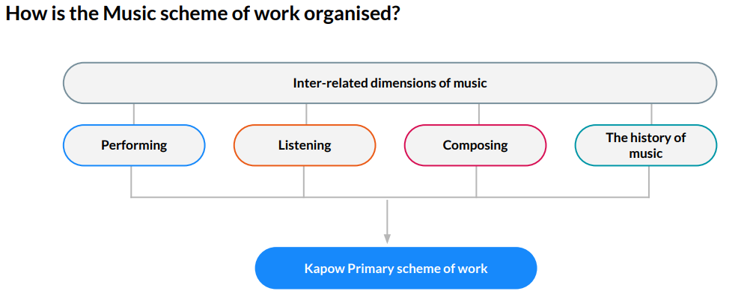
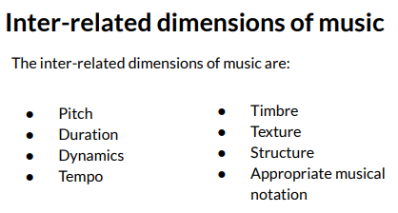
SEQUENCE OF LEARNING-
unit and lesson plans
Whole School Planning Overview
During the school year 2023-2024, we have adopted the Kapow scheme of work. We felt this all the aspects of music teaching required in a fun and varied way. It also ensures that all the objectives of the national curriculum for Music.
As this is an online resources, we benefit from the content that is updated regularly and provides a range videos for teachers to help with subject knowledge and skills.
Sometimes known as the elements of music, these are the building blocks of music and therefore run throughout the scheme of work as an overarching strand.

Slide 11
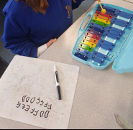
SEQUENCE OF LEARNING –Curriculum PROGRESSION plans
As Kapow is a new scheme to us, to ensure complete coverage and the progression of skills and knowledge required, in the first year (2023-2024) Y3 and Y4 are completing the Y3 teaching and Y5 and Y6, the Y4 teaching.
The children will then progress through the units.
The progression of skills and knowledge are grouped into the 4 strands: listening, composing, performing, the history of music and the inter-related dimensions of music.
To see more about how we sequence the units of Music and how the
knowledge, skills and vocabulary are progressed throughout the
school, follow the link: M_Standard-Music-Progression-of-KSAV-A4_KP22-20.10.23.pdf

Slide 12
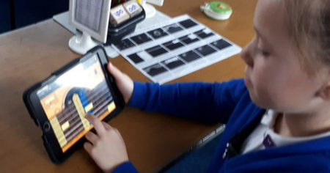
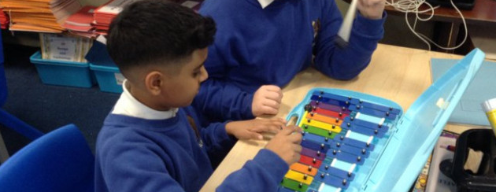
MUSIC LESSONS AT NEVILL ROAD
The children have a music lesson once a week and there is a timetable so that resources, such as musical instruments, are available for that year group that afternoon.
Tuesday - Year 6
Wednesday - Year 3
Thursday - Year 4
Friday - Year 5
Music lessons are divided into six units per year group with five lessons per unit.
Lessons have a structure which consists of
Can you still?
Vocabulary
Attention grabber
Main event
Wrapping up

Slide 13
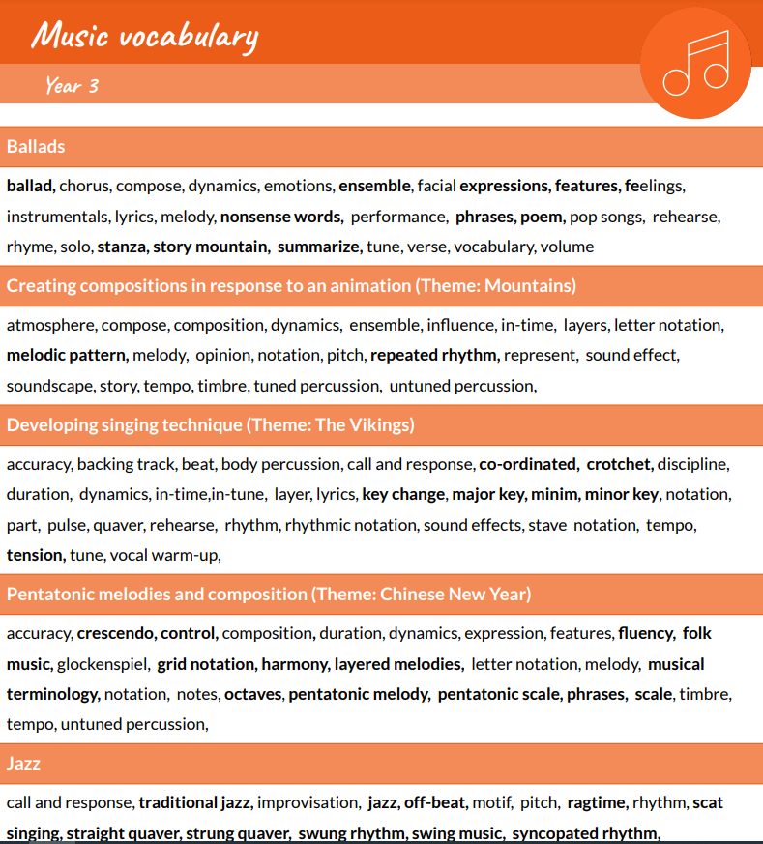
VOCABULARY
At Nevill Road Junior School we develop key vocabulary with the children by:
Highlighting key vocabulary within lessons verbally.
Vocabulary is developed and built upon throughout a sequence of work. Much key vocabulary is revisited throughout the Junior school, especially the vocabulary of the inter-related dimensions of Music.
Reflecting on key vocabulary used within the lesson.
M_Music-vocabulary-Last-updated-20-10-2023.pdf

Slide 14
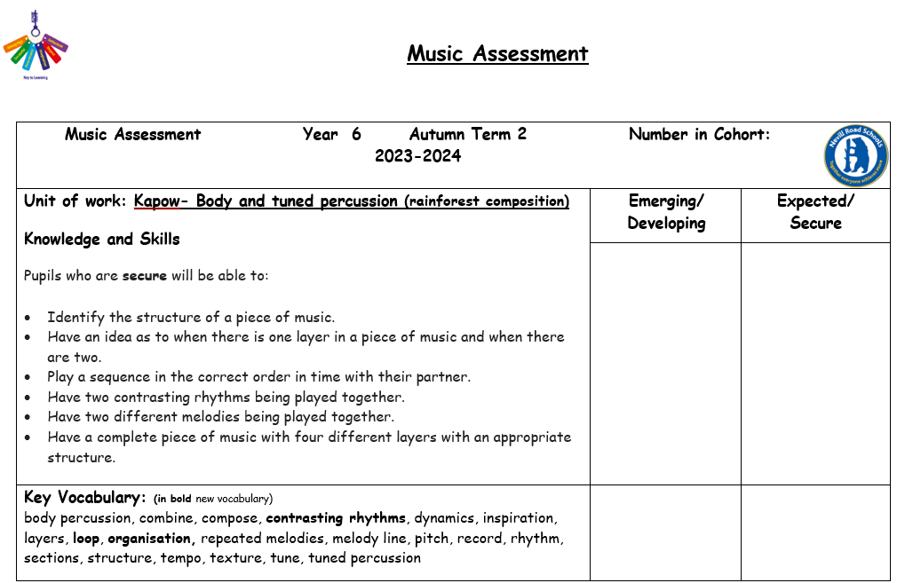
assessment
Teachers then complete an assessment grid at the end of the unit indicating children that are working towards the expectations and those that have met the expectations.
Within the Kapow each unit there is a multiple choice assessment quiz which will help the teachers assess the children’s understanding.

Slide 15
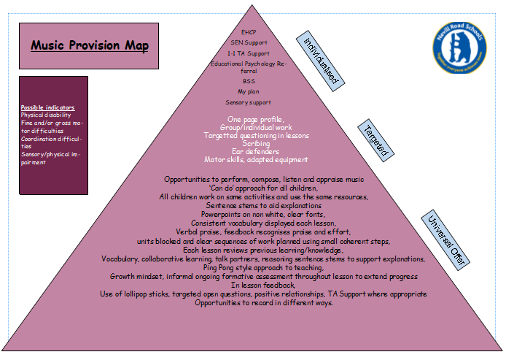
inclusion
In all our subject areas we have created a provision map of need that shows how all children are supported in order to enable them to access the full curriculum.
The needs of all children are considered with a lens on provision for our SEND children and teaching is adopted necessary. We believe that if we are getting it right for our children with additional needs, then we are getting it right for everyone.
Learning is not capped by differentiation but stretched by enabling all pupils to deepen their learning through investigations and enquiry questions.
Some tasks are open ended and allow children to present their findings in a variety of creative and individuals ways.
Staff check in regularly to check understanding.
Metacognition strategies are used to encourage independent learning.
Teaching assistants are used effectively to help scaffold learning an support children to become more independent learners.
The growing diversity of our school community means that teachers are adapting lessons to support children who have English as a second language.
W:\Staff Shared Area\SEND 22 - 23\Curriculum Pyramids\Provision map Music.pub

Slide 16
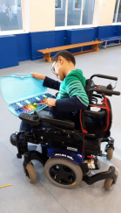
EQUAL OPPORTUNITIES
To find out more about our Equality Objectives, follow the link below:
http://www.nevillroad-jun.stockport.sch.uk/serve_file/8211907
Here are examples of how the protected characteristics are promoted through the Music Curriculum:
We ensure that we provide opportunities for all with in Music lessons.
Lessons are adapted to help suit the needs of all users.

Slide 17
BRITISH VALUES
To find out more about how we promote British Values through our curriculum, follow the link below:
http://www.nevillroad-jun.stockport.sch.uk/serve_file/6477805
Key British Values are at the heart of key values that we teach and promote through Music lessons, such as respect and tolerance through collaboration and teamwork.

Slide 18
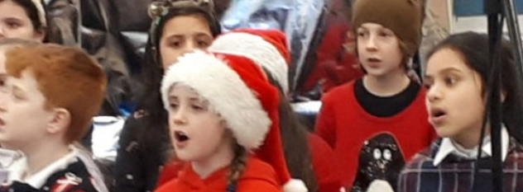
SMSC
To find out more about how we promote Spiritual, Moral, Social and Cultural (SMSC) through our curriculum, follow the link below:
http://www.nevillroad-jun.stockport.sch.uk/page/smsc/63936
Spiritual- we encourage this aspect of the curriculum through the experience and the emotion of listening and responding to music, composition and performance. We encourage our pupils to express their feelings verbally when responding to a piece of music. Where pupils are sensitive about expressing their feelings, we support them appropriately so that they have the confidence to do so.
Moral - where children have presented their own work, we ensure fair and objective assessment and evaluation of their composition. Improving on their performances requires self-discipline, resilience and commitment which we foster here in school.
Social- children engage in group tasks to encourage a sense of unity and collaboration, enabling them to be aware of their own individual abilities and strengths. We also encourage the skills of independence and resilience.
Cultural- students are given the opportunity to listen and play a wide style of music from different genres, traditions and cultures.

Slide 19
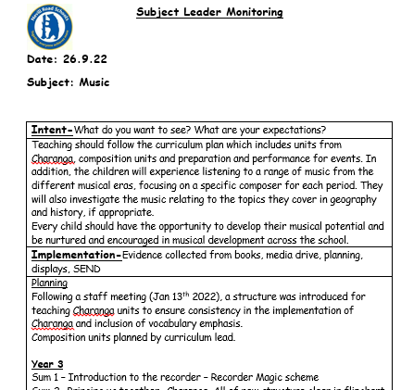
Monitoring and evaluation
Subject leaders are allocated time to have a ‘Deep dive review’ This can involve reviewing planning, lesson looks and pupil voice.
The evidence of how the time has been used is then recorded on a monitoring sheet, which reviews the intent, implementation and impact document. This is then fed back to staff or referred to in future staff meetings/emails or INSETS.
Subject Leader Monitoring - Music 26.9.22.docx

Slide 20
Staff CPD
Increasing staff confidence and subject knowledge has been a key part of the CPD.
This has involved demonstration lessons from the School Liaison and CPD Coordinator, Stockport Music Service. Also Curriculum lead staff meeting input, planning support, demonstration lessons and team teaching.

Slide 21
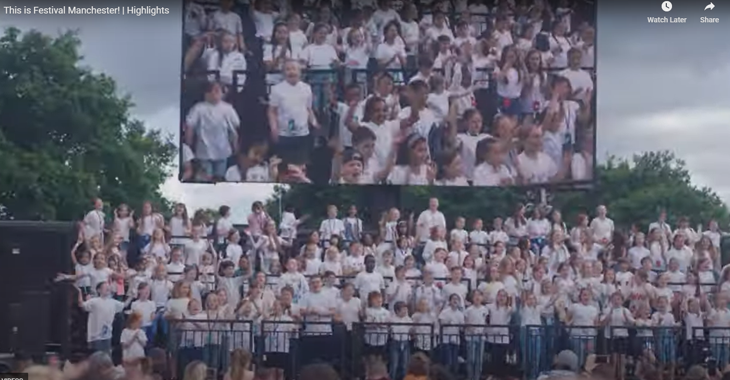
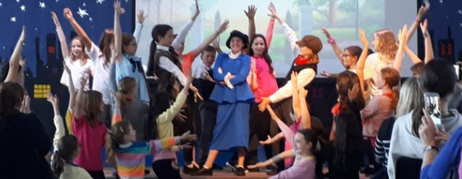
ENRICHING THE CURRICULUM
At Nevill Road we want to enhance the learning of Music through extra-curricular clubs.
Performance club
Glee club
Choir
Band
All children have the opportunity for instrument lessons through Stockport Music Service and Front Row Music. Currently, 55 children have instrument lessons.

Slide 22
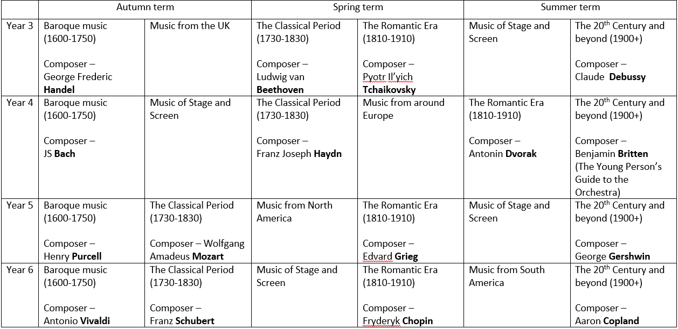
ENRICHING THE CURRICULUM
Listening Diary
To expand the children’s music listening repertoire and cover the history of music, we have subscribed to Naxos MusicBox. www.naxosmusicbox.com
Music Listening Diary.docx

Slide 23
Strengths of Music at Nevill Road Junior School
Units of work are progressive across the school and allow for skills to be developed year to year as well as within a unit of work.
Each unit is planned in a uniformed way, outlining key skill and vocabulary.
Assessment is in place for Music.
Children enjoy Music which has been displayed in pupil voice.
The opportunities for extra-curricular music is available.

Slide 24
NEXT STEPS
To develop the use of key vocabulary within Music lessons.
To plan and develop units for each year group that teach and progress the children’s understanding of notation. Investigate the scheme Kapow as a possible solution.
Monitoring of Music lessons with a focus of key skills and vocabulary.

