Slide 1


NEVILL ROAD JUNIOR SCHOOL CURRICULUM OVERVIEW -FRENCH

Slide 2
Our Curriculum at Nevill Road Juniors
We Aim High by challenging ourselves in all aspects of school life.
We are Successful learners by using our growth mind set to achieve.
We Persevere by being resilient and trying our best in everything we do.
We use our Imagination to produce creative work that we can be proud of.
We show Respect by including everyone and making sure we all matter.
We show Enthusiasm by approaching all learning with a positive attitude.

Slide 3
Our Curriculum Intent
At Nevill Road Junior School learning is fun and all of our children are supported and challenged to enjoy learning and reach their potential. Learning in the outside environments, practical and real-life situations and special activities all help to make learning accessible and help to motivate our pupils to achieve well and become lifelong learners. We have a very positive approach to learning at our school and children are encouraged and rewarded when they do their best, work hard and make good progress.
The wellbeing of our children and their Mental Health are a priority as we believe that children learn best when they feel happy, safe and cared about. Our Restorative Approach to learning underpins our curriculum, which also celebrates equality and diversity.
Our curriculum is based on the statutory National Curriculum; it is skills based in design and intended to provide learning and teaching motivation for both children and teachers.
We aim to be as creative as possible with our approach to the curriculum, teaching and learning. All curriculum areas have been planned to deliver a well sequenced and progressive series of lessons to ensure children gain 'sticky knowledge', which they can articulate with confidence.
Every year group includes high quality book and text studies within their termly topic plans, making sure children are given a text-immersive experience.
All of our topics are supported through high quality resources, trips, visitors and experiences that provide ample opportunity for real depth of study.

Slide 4

Pedagogy of Learning
Explanation, Modelling and Scaffolding
In lessons you will see:
Clear and precise explanations given by teachers, with complex ideas broken down.
Time given to practise and consolidate children’s knowledge and understanding in new ways that stretches their thinking and allows them to consolidate key skills.
Metacognition strategies used to help scaffold learning and develop independence.
Use of sentence stems to help structure children’s talk and thinking.
Children know what is expected of them and how this can be achieved. This is done in a variety of ways including the use of a clear success criteria and examples eg a WAGOLL (What a good one looks like)
Children evaluating their own work and improving their learning.

Slide 5

Pedagogy of Learning
Questioning, Recall and Retrieval of Knowledge to make learning ‘sticky’
In lessons you will see:
A mastery approach to learning.
Every lesson starts with a ‘Can you still..?’ to recall previous knowledge
Questions asked to children that encourage them to know more and think more.
Teachers use carefully planned questions to probe children’s responses, to reshape tasks and deepen understanding.
Children are given ‘thinking time’ to allow for sufficient time for pupils to review what they are learning and to develop further.
Children are given regular opportunities within lessons to recall previous knowledge. Questions are asked to reveal their understanding and recall how well they have remembered the content.
Lollipop sticks used to select children to answer questions to encourage participation from all.
Tasks from the ‘Nevill Road Bare Necessities to Sticky learning’ used to retrieve knowledge

Slide 6
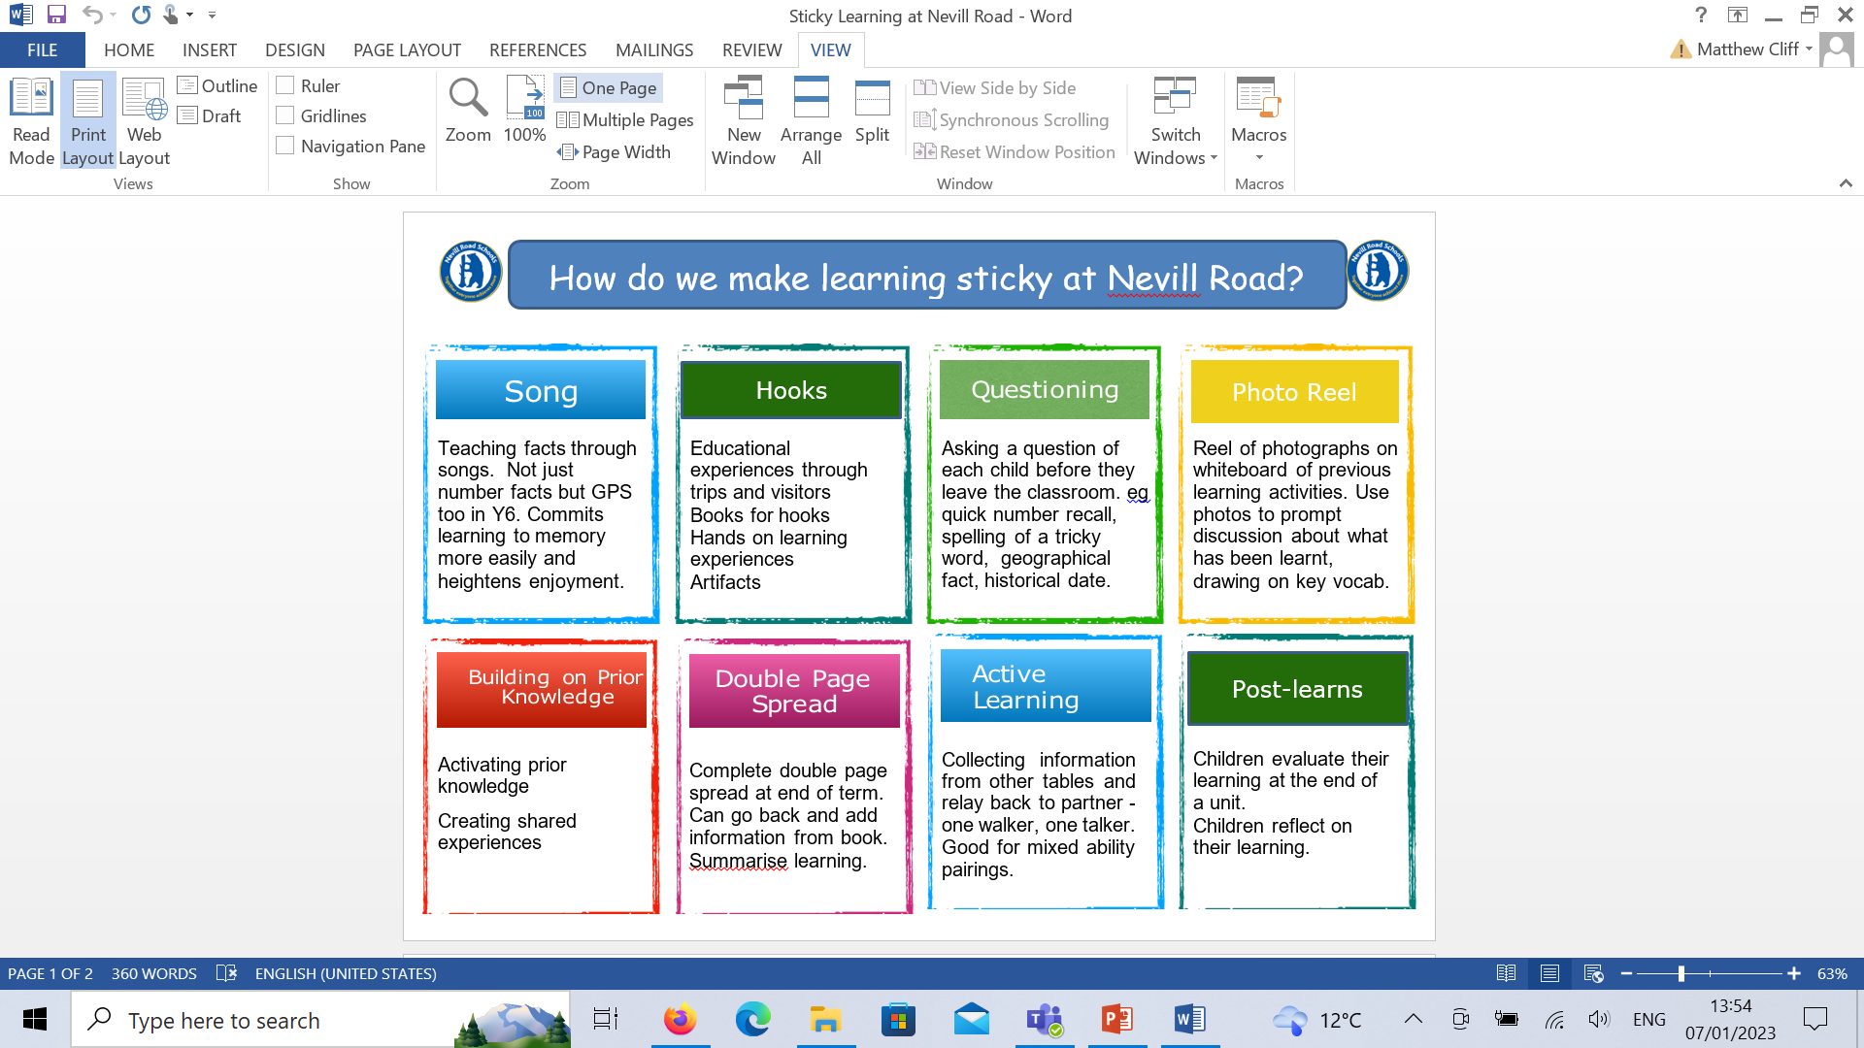
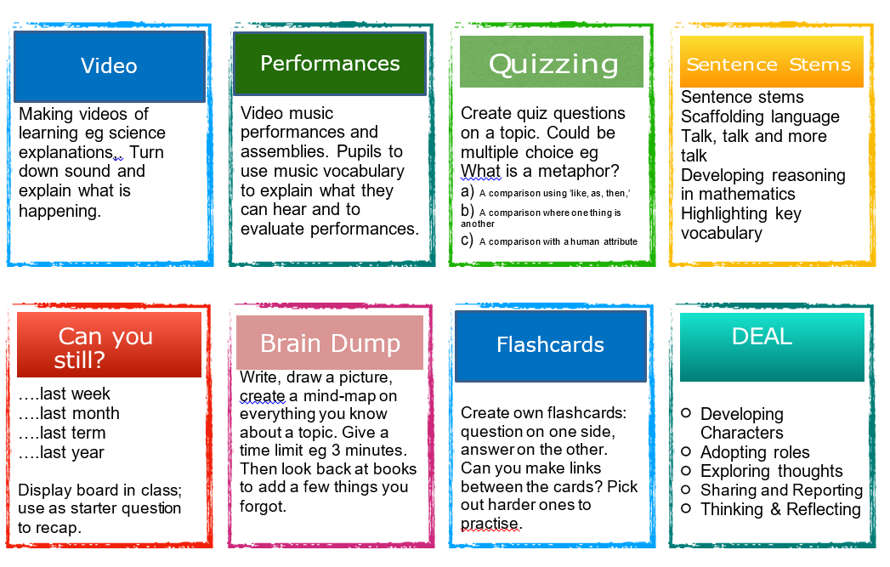
Pedagogy of Learning
In order for our children to learn more and remember more, we promote ‘sticky’ learning through….

Slide 7

Pedagogy of Learning
Check understanding throughout the lesson and provide feedback.
In lessons you will see:
We use a variety of mechanisms to assess children’s understanding throughout lessons and ensure that misconceptions are picked up quickly.
Verbal feedback given to children throughout the lesson in order to build on pupils’ strengths.
Our marking system ensures that feedback is purposeful and children’s responses enable them to practise, consolidate or stretch their learning.
Metacognition strategies are used to motivate children to improve their learning.
Children respond to feedback and this is captured through the use of purple pen in their books.
In the moment marking gives immediate feedback.
Use of mini plenaries to address any misconceptions.

Slide 8
Curriculum Leader – Laura Campbell (2019 – Present)
Nevill Road Junior School Modern Foreign Languages Policy 2022-2023
Intent
The intention of the French curriculum at Nevill Road Junior School is that children are taught to develop an interest in learning other languages in a way that is enjoyable and stimulating. We encourage children’s enthusiasm for languages, as we strive to inspire and encourage children’s curiosity and imagination for learning about language and culture. In planning, we actively plan links to develop their awareness and respect of cultural differences in other countries, through our French lessons and other curriculum opportunities. Children are encouraged to aim high, in sessions and they are successful for learning by embedding the skills of listening, speaking, reading and writing. This is necessary to enable children to use and apply their French learning in a variety of contexts and lay the foundations for future language learning. Our MFL curriculum is designed to progressively develop children's skills in languages. Children progressively acquire, use and apply a growing bank of vocabulary organised around topics. We follow the ‘Language Angels’ Scheme of work, to ensure coverage and progression across school. All our children in KS2 will have weekly language lessons.
The national curriculum for languages aims to ensure that all pupils:
understand and respond to spoken and written language from a variety of authentic sources
speak with increasing confidence, fluency and spontaneity, finding ways of communicating what they want to say, including through discussion and asking questions, and continually improving the accuracy of their pronunciation and intonation
can write at varying length, for different purposes and audiences, using the variety of grammatical structures that they have learnt
discover and develop an appreciation of a range of writing in the language studied.

Slide 9
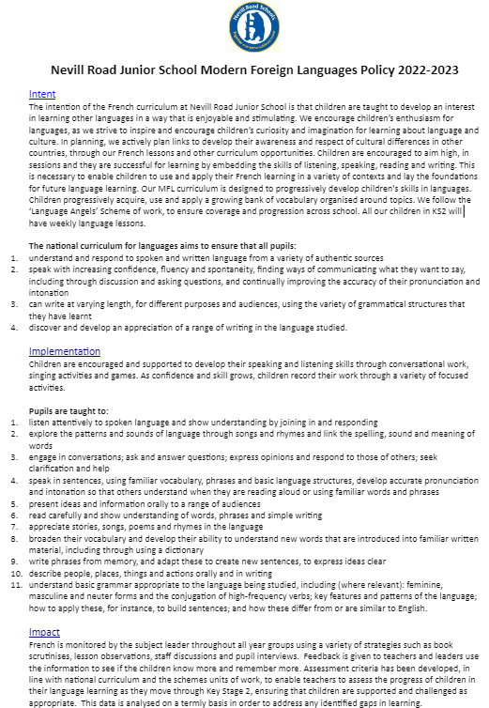
Policy
To find out more about our
French policy click the link below:

Slide 10
French Ambassadors
Pupil Voice
At Nevill Road we promote the voice, perspective and opinions of our children. Through pupil voice we are able to gain an insight into the quality of teaching and learning within French lessons, which enables us to fully understand the experiences of our children. The feedback we receive is then used as a tool to analyse our successes in the area and to outline our next steps for improvement within the subject.

Slide 11

Sequence of Learning Whole School Plan
At Nevill Road we follow the Language Angels scheme which This has enabled a clear progression of skills and knowledge as well as developing the confidence of teachers in the subject.
Each unit consists of 6 lessons and is taught weekly each half term. This ensures a progression in learning French through of regular varied skill practise. Children work their way through the unit by initially by revisiting and learning vocabulary and then building on vocabulary through sentence practise to become more fluent in all areas of speaking, listening, reading and writing.

Slide 12
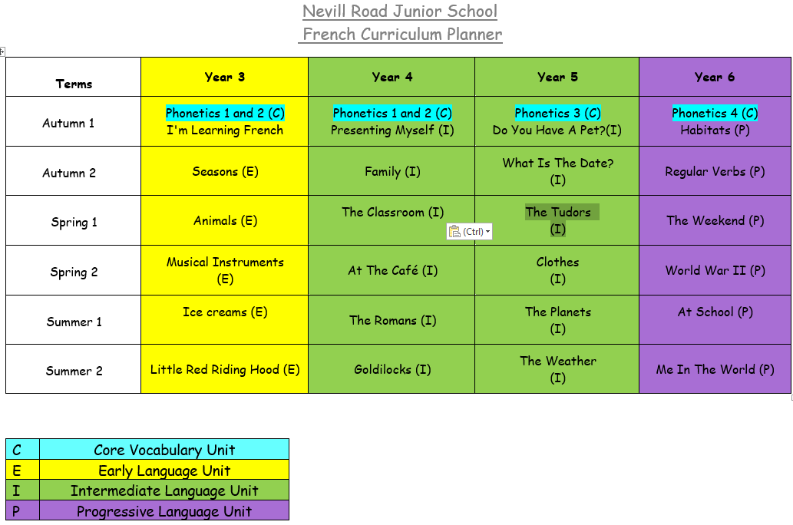

Slide 13
Sequence of Learning - Curriculum Progression plan
The Language Angels Progression Map shows how pupils study foreign language learning across each of the key skills of SPEAKING, LISTENING, READING, WRITING and GRAMMAR progresses within each Language Angels Teaching Type.
It also shows how the level of learning and progression of each pupil is increased; as pupils move across each subsequently more challenging Language Angels Teaching Type from Early Language to Intermediate and on to Progressive.
It is a visual demonstration of the progression that takes place in each of the key language learning skills in TWO ways: 1. WITHIN a Teaching Type and 2. ACROSS each Teaching Type.
Progression WITHIN a Teaching Type is demonstrated by the downward pointing arrows in the Progression Map. These show how each skill develops and increases in level of challenge WITHIN a Teaching Type. This effectively shows how each skill is developed within each primary school year.
Progression ACROSS a Teaching Type is demonstrated by the arrows pointing to the right in the Progression Map. These show how each skill develops and increases in level of challenge ACROSS a Teaching Type. This effectively shows how each skill is developed as pupils move through the various primary school years.

Slide 14
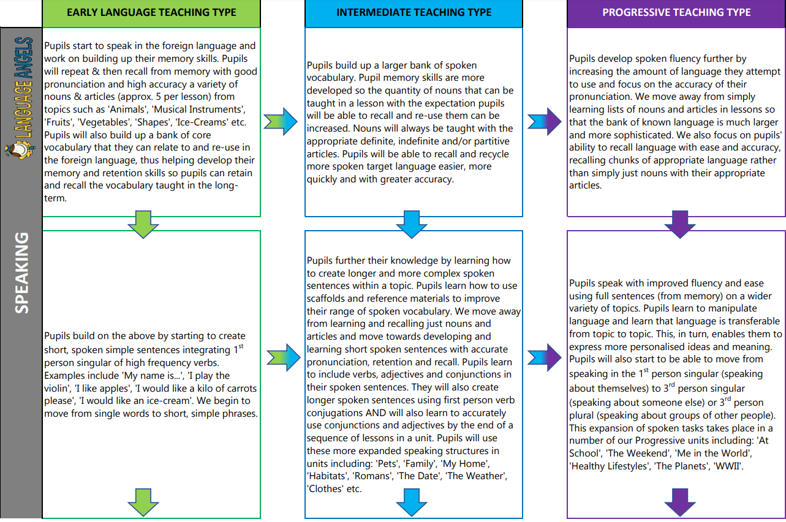

Slide 15
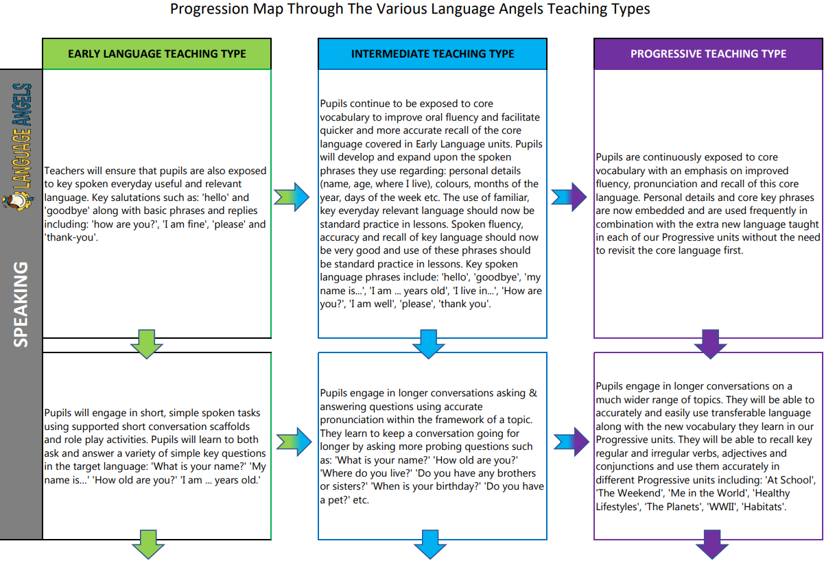

Slide 16
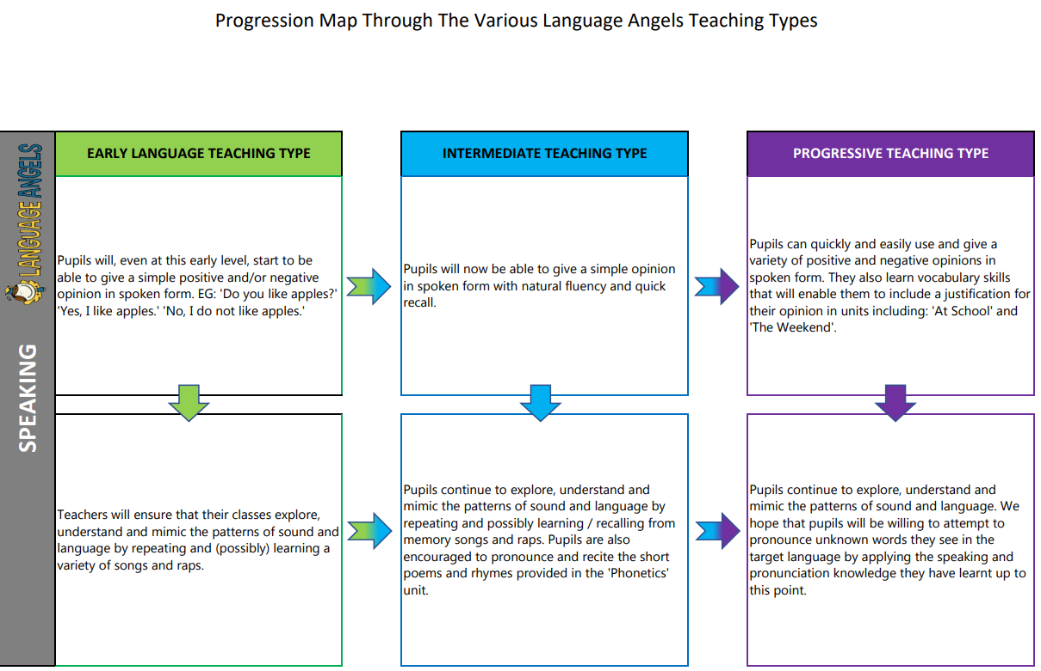

Slide 17
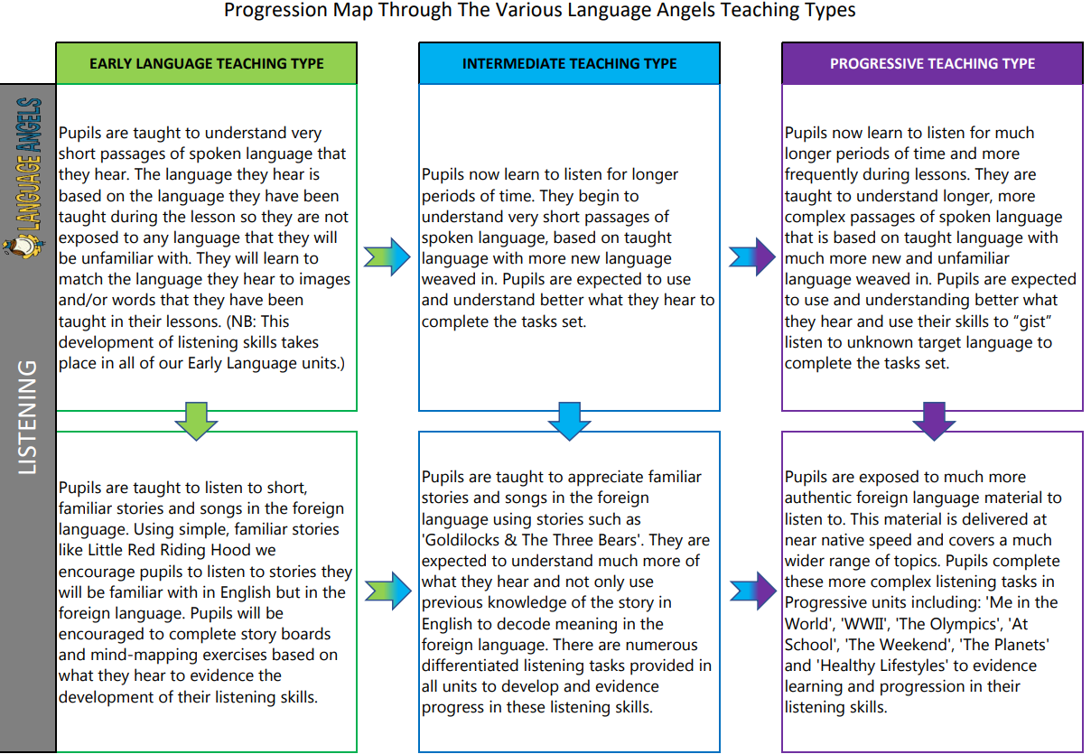

Slide 18
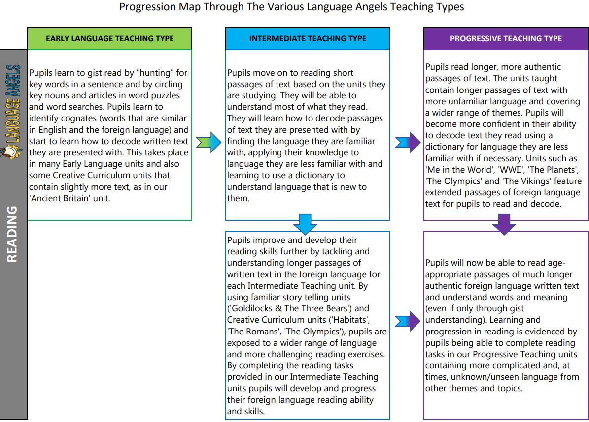

Slide 19
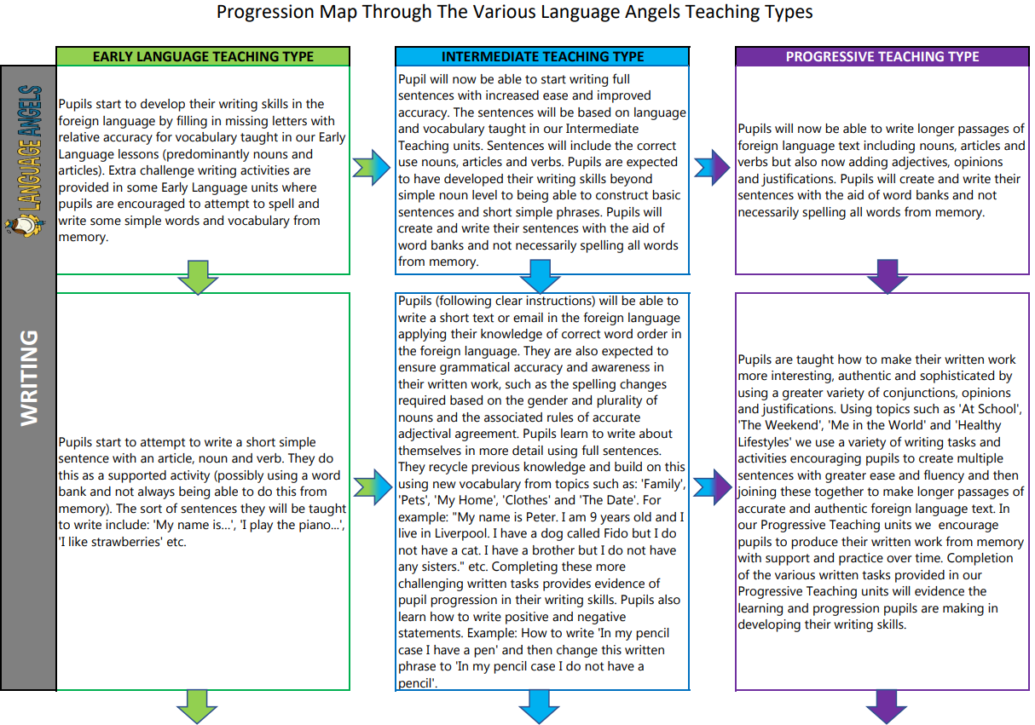

Slide 20
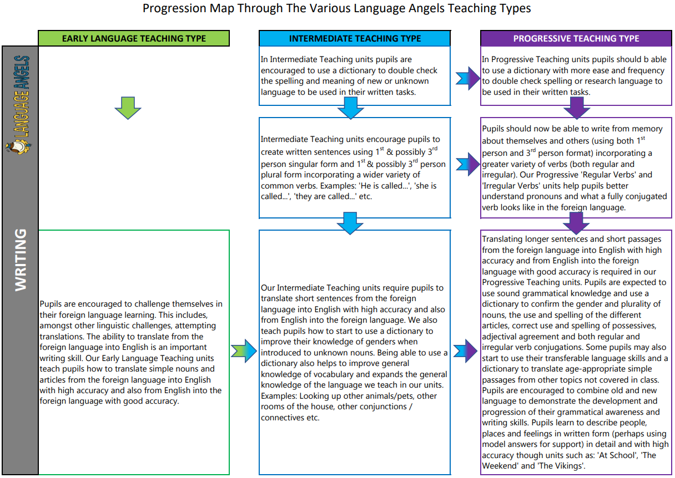

Slide 21
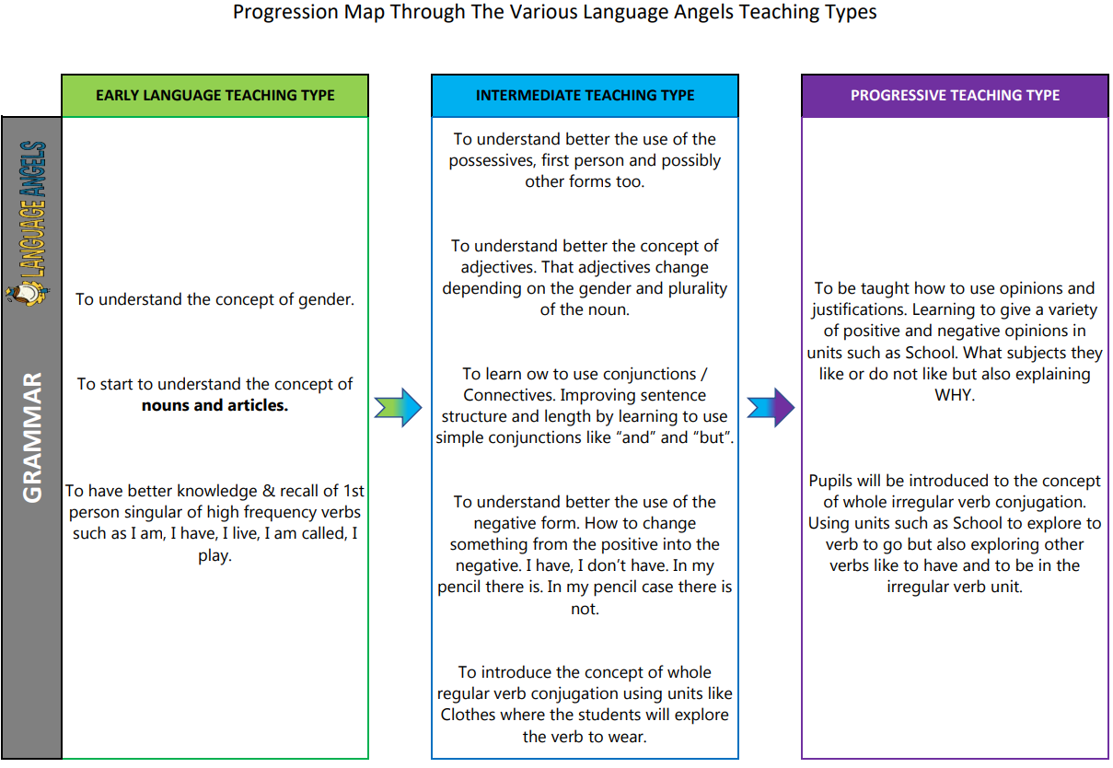

Slide 22
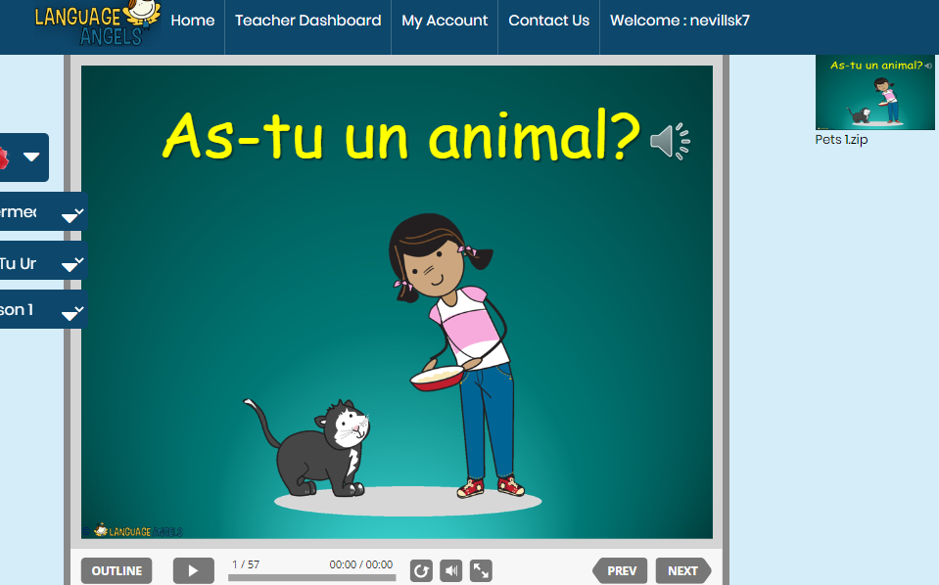
In lessons you will see:
A clear outcome for the children and what the unit is about.
Lessons begin with a recap of previous learning of that unit. ‘Can you still’ style recapping of skills and vocabulary
Vocabulary is explored and expanded on throughout lessons and repeated by the teacher and practised by the children.
Opportunities for children to practise the appropriate targeted skills (speaking,listening,reading and writing)
All pupils are engaged in their learning and a variety of pedagogy strategies such as stories, songs, games and conversational practise.
Lesson outcomes are recorded in line with the appropriate skill being practised e.g speaking recorded on the Ipad and uploaded to the media drive.
French lessons at Nevill Road.

Slide 23
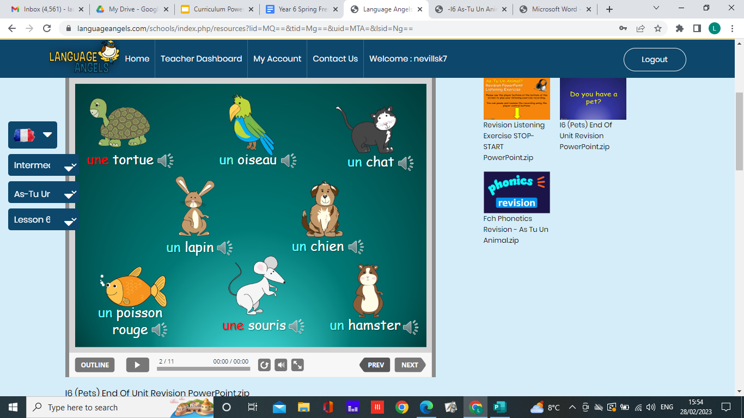
Vocabulary
At Nevill Road Junior School we develop pupils’ vocabulary by:
Vocabulary is an essential part of the French curriculum. Each lesson will have a focus on the key technical words for the lesson. These will be displayed repeated during the teaching part of the lesson and referred to throughout the lesson.
Pupils are encouraged to use and share vocabulary through conversational partner work, through games and songs, throughout the lesson and when asking questions.
This vocabulary is then recapped at the start of each lesson and built on as the unit progresses. The vocabulary is then used in forming sentences and applied in all four key skill areas.

Slide 24
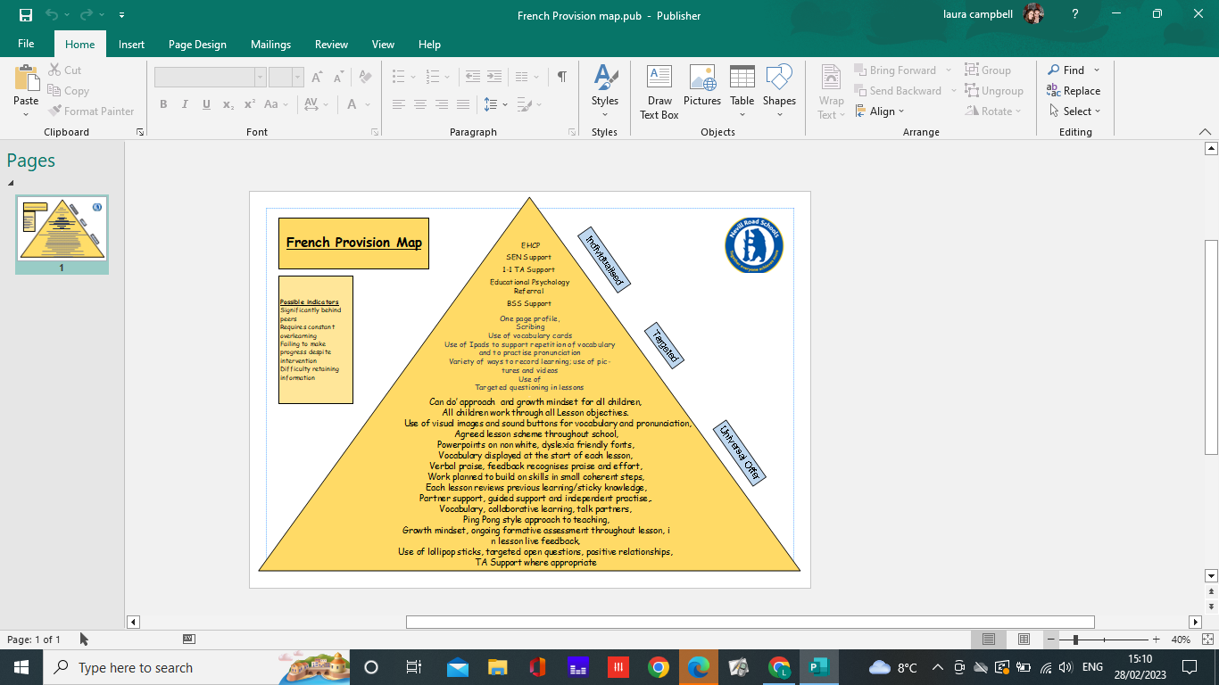
In all our subject areas we have created a provision map of need that shows how all children are supported in order to enable them to access the full curriculum.
The needs of all children are considered with a lens on provision for our SEND children and teaching is adopted necessary. We believe that if we are getting it right for our children with additional needs, then we are getting it right for everyone.
Learning is not capped by differentiation but stretched by enabling all pupils to deepen their learning through a range of texts and reading skills.
Some tasks are open ended and allow children to present their findings in a variety of creative and individuals ways.
Staff check in regularly to check understanding.
Metacognition strategies are used to encourage independent learning such as frames and sentence stems to ensure pupils do not suffer with cognitive overload.
Teaching assistants are used effectively to help scaffold learning and support children to become more independent learners.
The growing diversity of our school community means that teachers are adapting lessons to support children who have English as a second language. In reading, EAL pupils will use word mats, picture cues, Google translate, reading texts are chunked into smaller parts to not overwhelm pupils. Advice is sought from EDS.
Inclusion

Slide 25
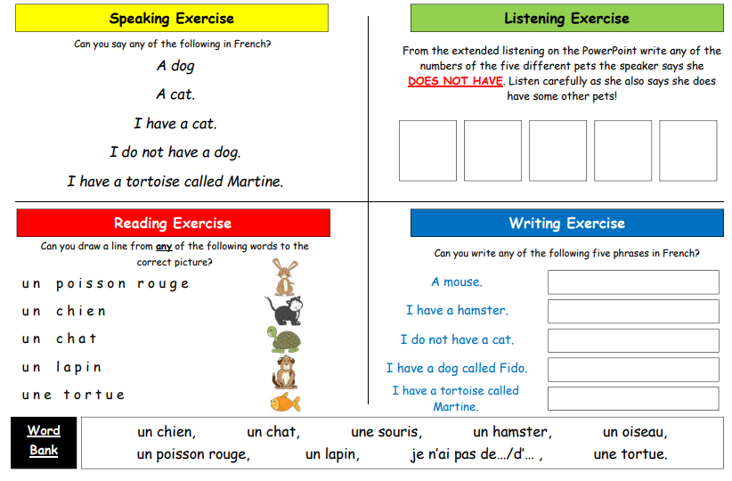
Assessment and Data
It's important for teachers and our school as a whole to be able to accurately monitor pupil progress. At the end of each of our teaching units we provide two forms of assessment.
End Of Unit Assessments
At the end of each unit children are expected to complete a skills-based assessments using the bespoke Language Angels skills assessment worksheet. This form of assessment enables us to determine the learning and progression of our pupils in the 4 key language learning skills(speaking,listening,reading and writing)as well as monitoring their progress against the 12 attainment targets stipulated in the DfE Languages Programme of Study for Key Stage 2.

Slide 26
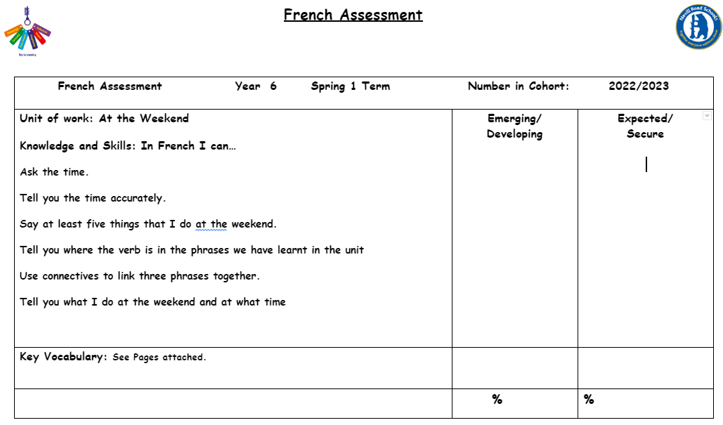
Assessment and Data
The outcome of these assessments is then input into an assessment sheet to identify whether the child is either emerging or secure within that unit of works’ vocabulary, knowledge and skills. Following which, we can assess the overall progress of the individual class and year group cohort.

Slide 27
http://www.nevillroad-jun.stockport.sch.uk/page/our-school-values/42774
British Values
The Rule of Law
Our school’s behaviour policy, is reinforced in every lesson, which helps them in turn understands how important the respect of rules of all countries.
Democracy
.At Nevill Road we encourage democracy through our various school councils and groups. Languages can be useful in understanding others’ opinions and reasoning as well as how language can be used to change perception, opinion and can cause reaction.
Individual Liberty
Freedom of Speech: pupils are encouraged to give their opinion about aspects of French culture compared to British culture, for example about eating habits and school life whilst ensuring pupils are respectful to others. At all times, children are reminded of an expectation of respect for all others and that person's right to express their opinion.

Slide 28
Tolerance of Other Faiths & Beliefs
In French, we actively promote pupils' understanding of their own culture through comparison with the culture of various French speaking countries as well as of all European countries.At Nevill Road we are preparing children to be apart of a multicultural society. Learning a foreign language is about feeling comfortable in another culture and be willing to understand and accept different sets of values, religious and otherwise.
Mutual Respect
As the various topics that we study, mostly centre around pupils' lifestyle, personality, identity, school and family, we have to establish from the beginning in the classroom, an atmosphere of trust and respect for each other. Pupils must be able to share information about their background, their beliefs or simply their way of life, safe in the knowledge that their peers will respect and accept them for who they are. Pupils are encouraged to recognise an individual’s strength and support their development, they are also encouraged to embrace diversity and treat all others with respect both in and out of the classroom.

Slide 29
Monitoring and Evaluation
Subject leaders are allocated time to have a ‘Deep dive review’ This can involve reviewing planning, lesson looks, book scrutiny and pupil voice.
Staff are then given feedback and opportunities to ask questions around the scheme and resources that are being used.

Slide 30
Impact as a leader.
What I found out | What I did | Impact
Scheme did not meet all the areas of French and did not have clear progression. | Set up new Scheme of work and end of unit assessments. | Clear progression through all key stages, ensuring all areas of French Curriculum is being met.
Children lacked experiences of French culture. | Held an ASPIRE day to promote the wider cultural values and experiences of French across the school. Introduced children to different regions of France. Promoted the use af books to support with that year groups unit of work. Invited in parents from the school community to talk about their experiences of France and learn about the culture. | Children enjoyed and learnt more about French culture as well as had opportunities to practise key skills.
Following deep dive it became apparent that children required further progression with oracy skills and current scheme was providing this enough. | Researched into a new scheme through discussions at Languages Teacher Network and Purchased new scheme Language Angels. Put in place new assessment and planning overview for teachers to follow. | Following a unit of work, children have opportunities to rehearse and practise their oracy skills through constant repetition of vocabulary and sentences on a weekly basis. Children enjoy lessons more through the use of songs and games that the scheme provides. Teachers have support in delivering the lessons.
Limited confidence within the teaching staff. | Gave feedback following deep dives on the subject. Staff Meetings Supported planning and delivering of lessons. Guided and supported staff in how to use both schemes of work. | Teachers confidence in teaching French has grown and continues to develop good practise.

Slide 31
Strengths of French At Nevill Road.
Children learn the language through a clear scheme of work that teaches them the skills of speaking, reading and writing.
Skills are developed and recapped weekly to allow children opportunities to practise the appropriate skill in vocabulary, sentences and phrases.
Staff have an easy accessible platform, that enables them to teach the language and engage the pupils during lessons.
Assessment of the children's learning across the three key areas is done at the end of each unit.
All SEND children have appropriate resources needed to access the content of the itching and help them achieve their best.
Lessons are fun and engaging and children and children have opportunities to work independently in pairs or as part of a team.
Pupils progression is recorded in either books or recorded via the IPad.

Slide 32
Next Steps
Present scheme of work has been in place for around six months.
Further monitoring and evaluation is required to see how the staff and children are accessing the content.

