Slide 1
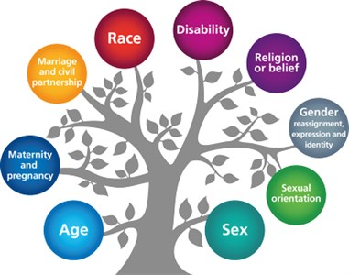
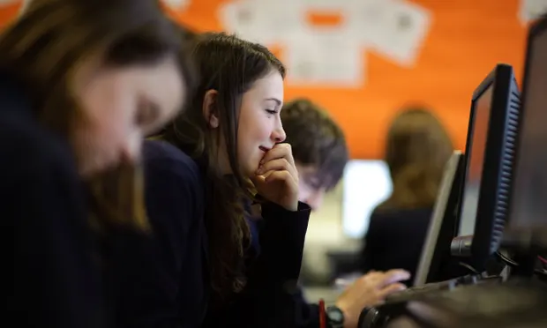
Protected Characteristics
Gender
Sadly, many young women do not see computing-related subjects as an option for their future career. Research suggests that a variety of factors are likely to be responsible, including feeling like they don’t belong in the subject or its community, a lack of sustained encouragement, and a lack of computing role models when they are learning about the subject.
But the subject is still more popular with boys than with girls – only 2,031 females took the computing A-level in the summer of 2021, compared with 11,798 boys.
Our aim is to increase the number of young women who choose to study Computer Science at GCSE and A level. From a pupil voice, and applicants for the Web Warrior role, girls are very much engaged within the subject and enjoy Computing at Nevill Road.

