Slide 1
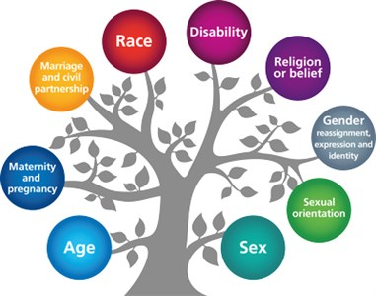
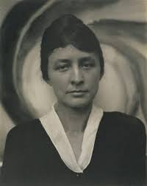
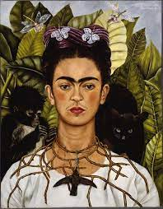
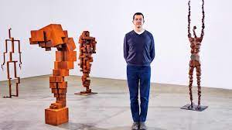
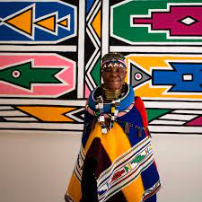
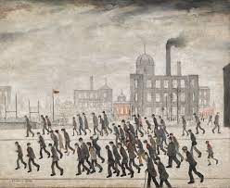
Protected Characteristics
For many years, when looking at the teaching of Art, it has been dominated by the teaching of male artists from European countries. While their art and it’s impact on the World cannot be overlooked, we believe that it is of great importance to expose our children to artwork from artists all around the world and of any gender.
Our aim when designing our curriculum overview was to ensure that this was reflected in the artists and art movements that we chose. This is a careful balance and one that is regularly reviewed and updated, specifically in regard to contemporary artists. We hope that this will ensure our children’s aspirations are limitless and they can see that anyone can achieve in becoming an artist.

