Slide 1

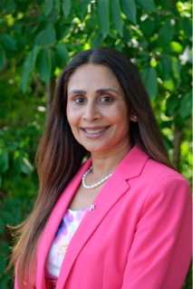
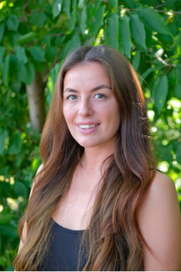
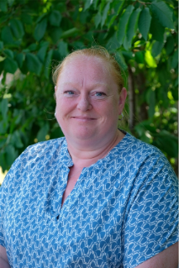
If you are worried, speak to a trusted adult.
Speak to: Teachers, TAs, Office Staff or any adult in school.
We are here to help.
Designated Safeguarding Lead |  | Deputy Designated Safeguarding Lead |  | Deputy Designated Safeguarding Lead
Safeguarding Champion - Head Girl - |  | Safeguarding Champion - Head Boy -

