Slide 1
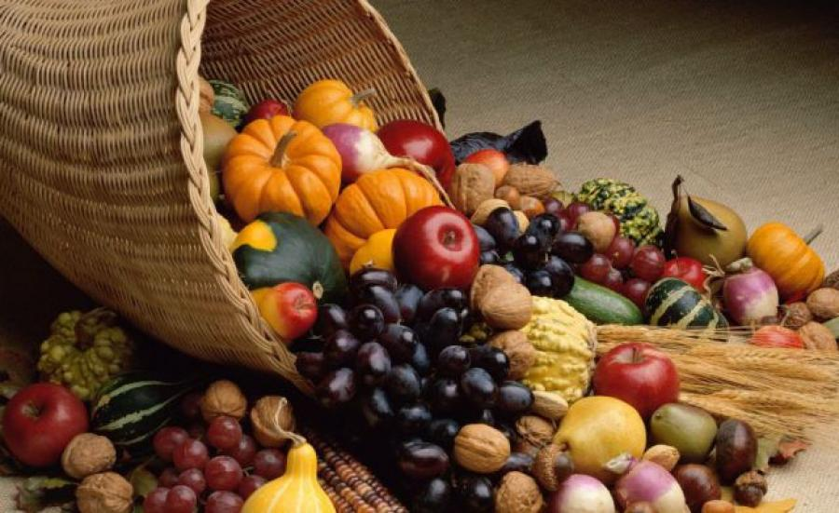

Harvest Prayers 2020

Slide 2
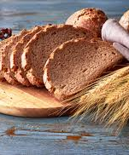
Horse Chestnut Class

Slide 3
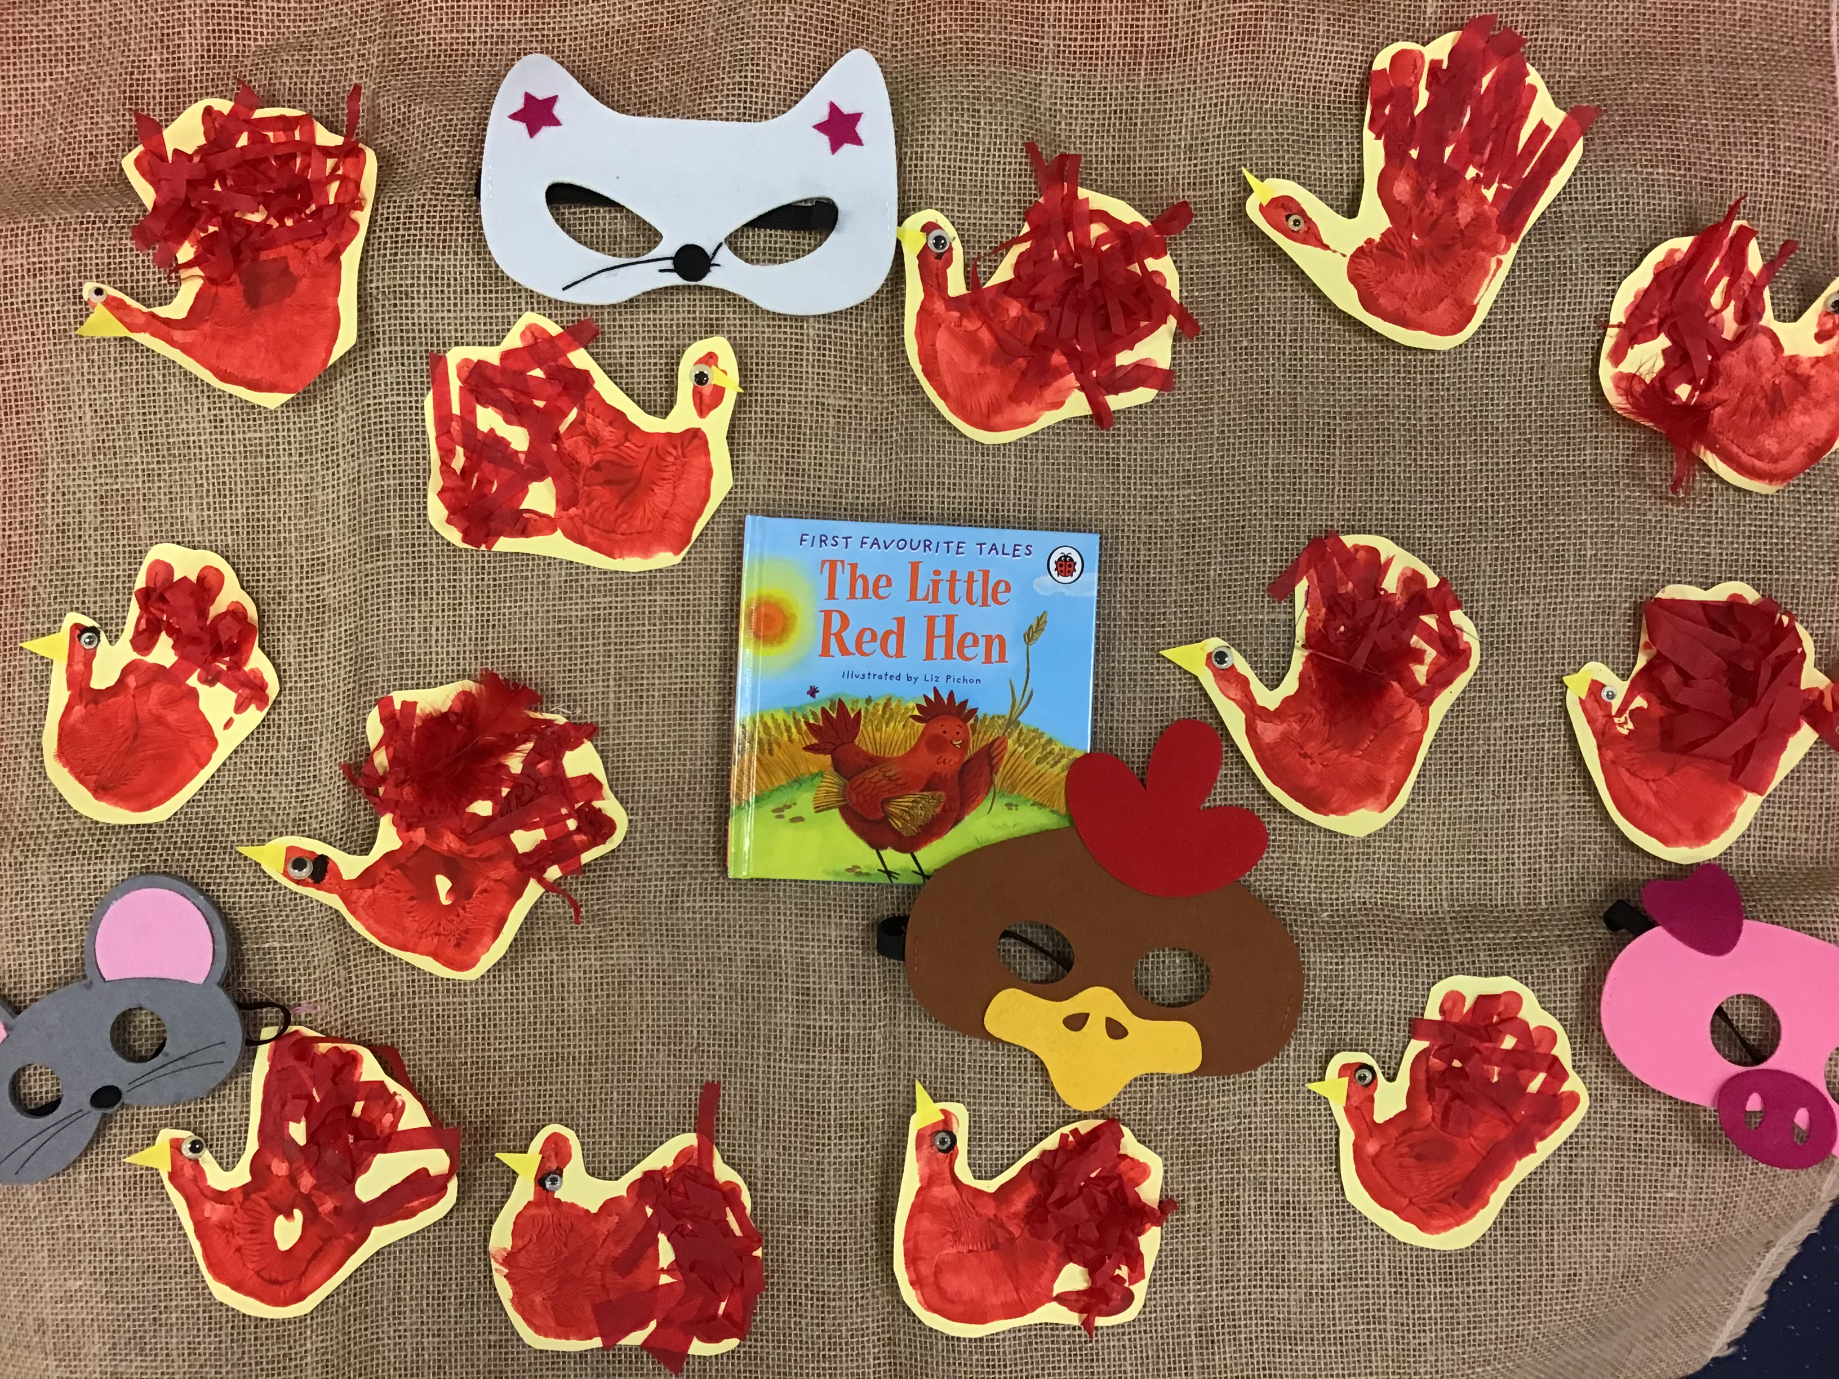
The Little Red Hen has helped us to think about how we should help each other and how we can share what we have.

Slide 4
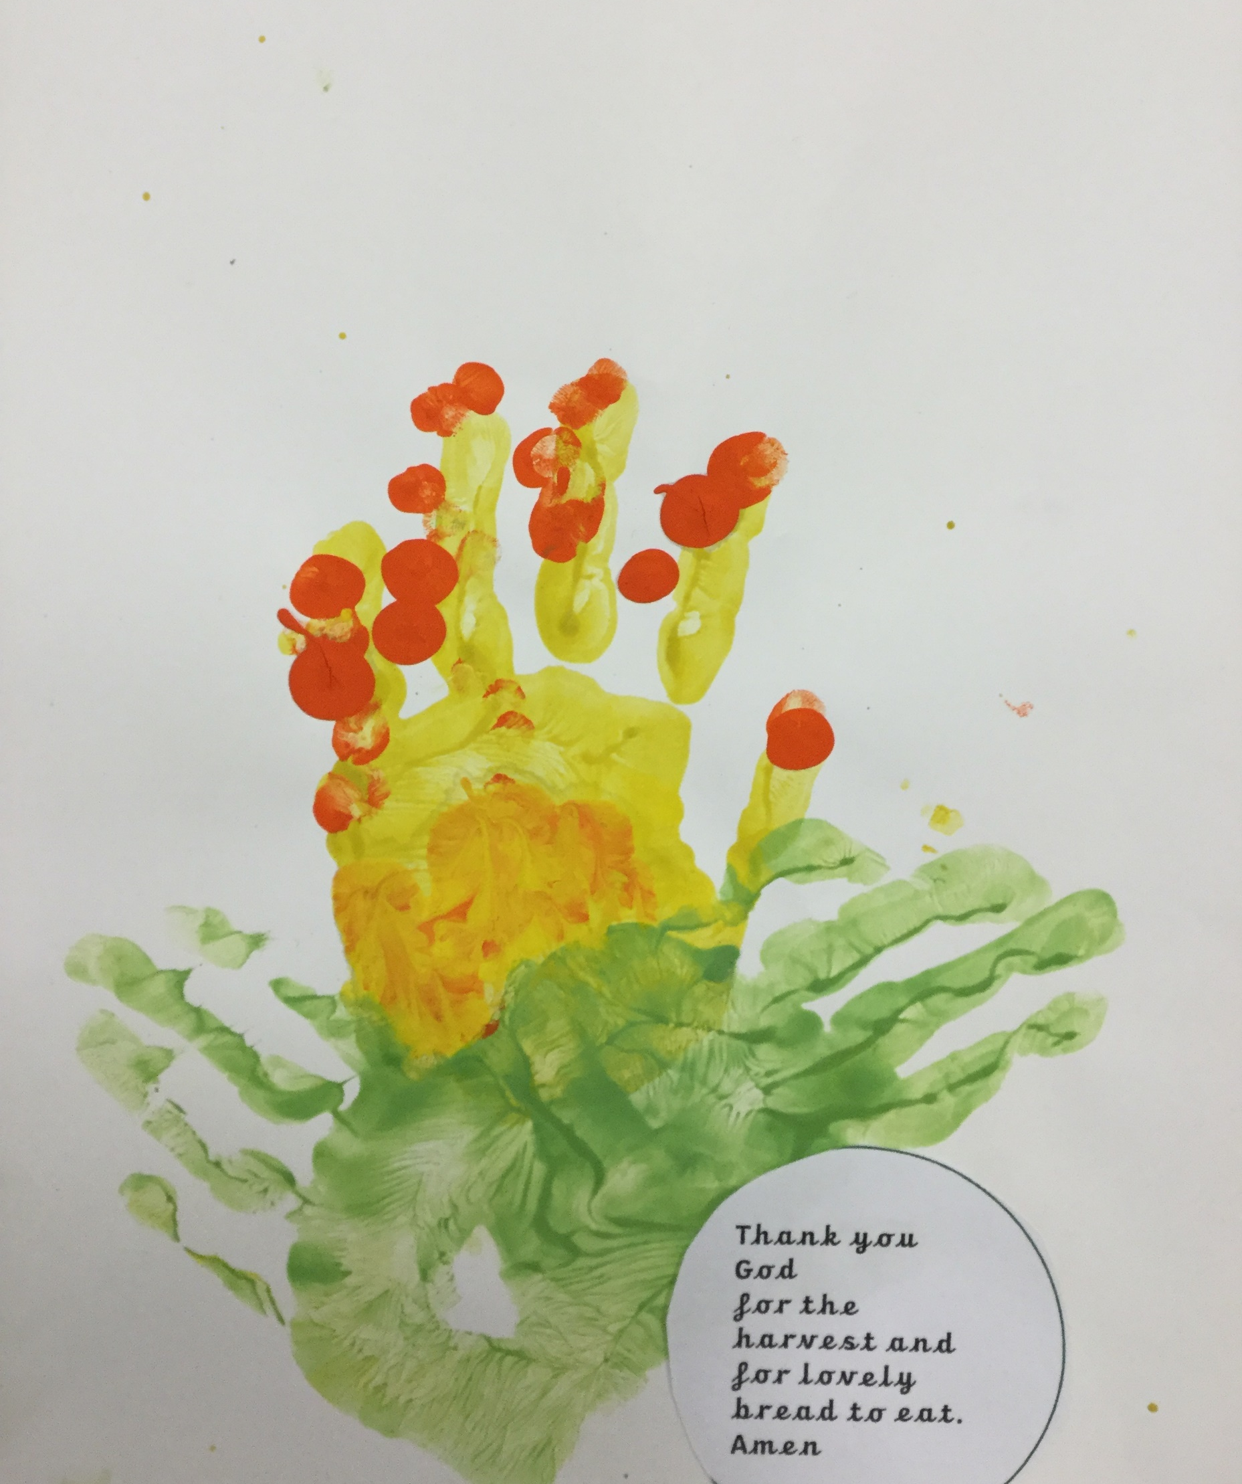
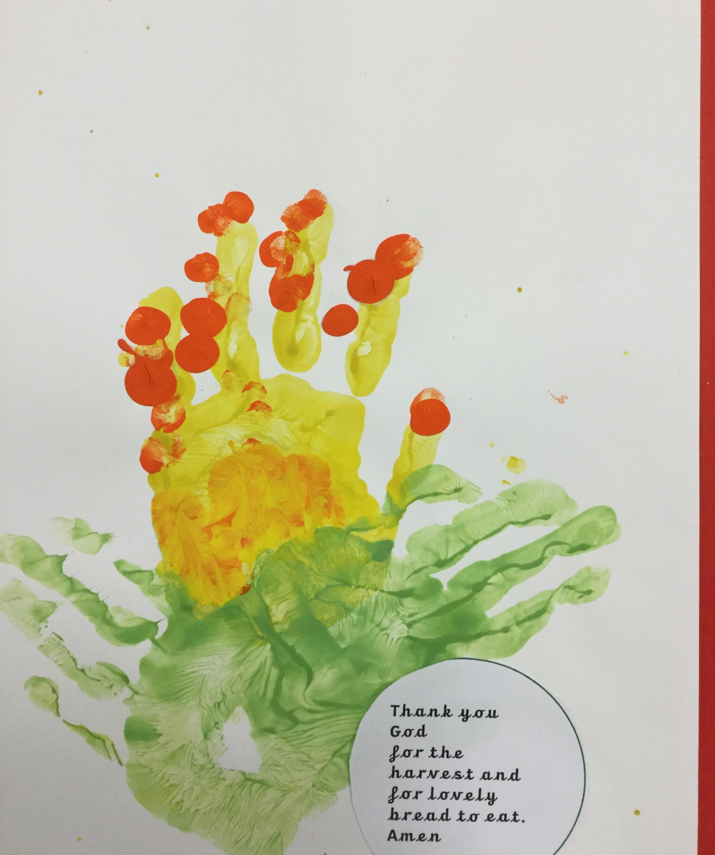
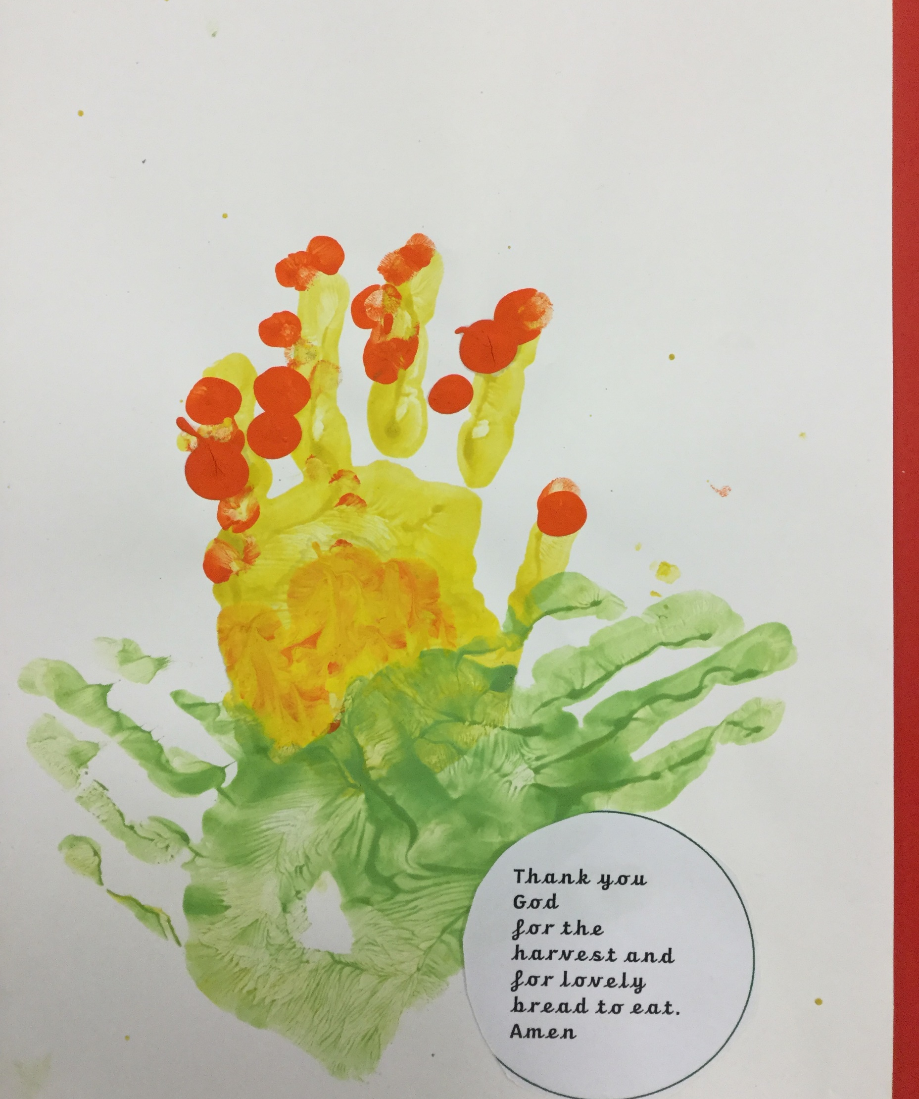
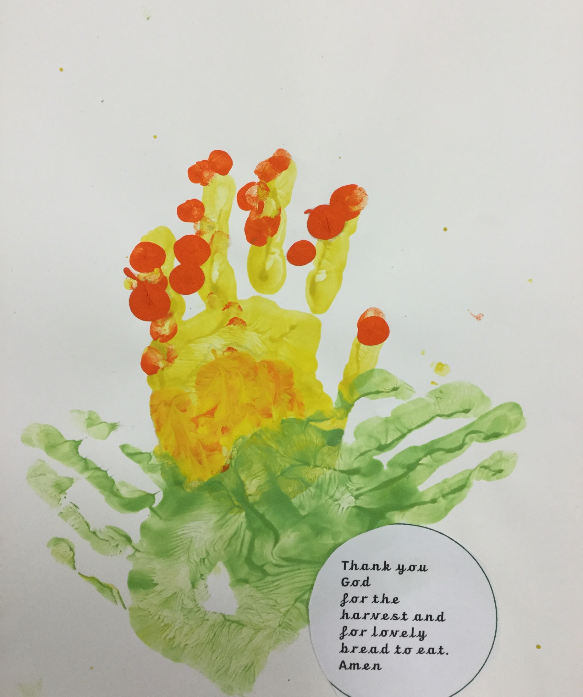
Thank you, God, for the harvest and for lovely bread to eat. Thank you for the hands that have made it and for all those who share it. Amen

Slide 5
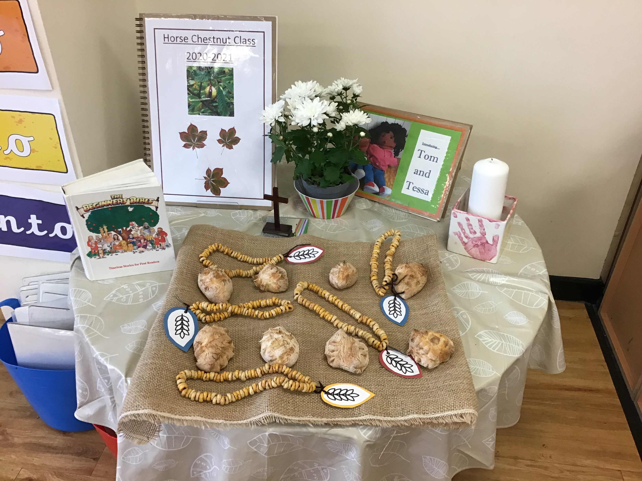
Thank you for our daily bread.

Slide 6
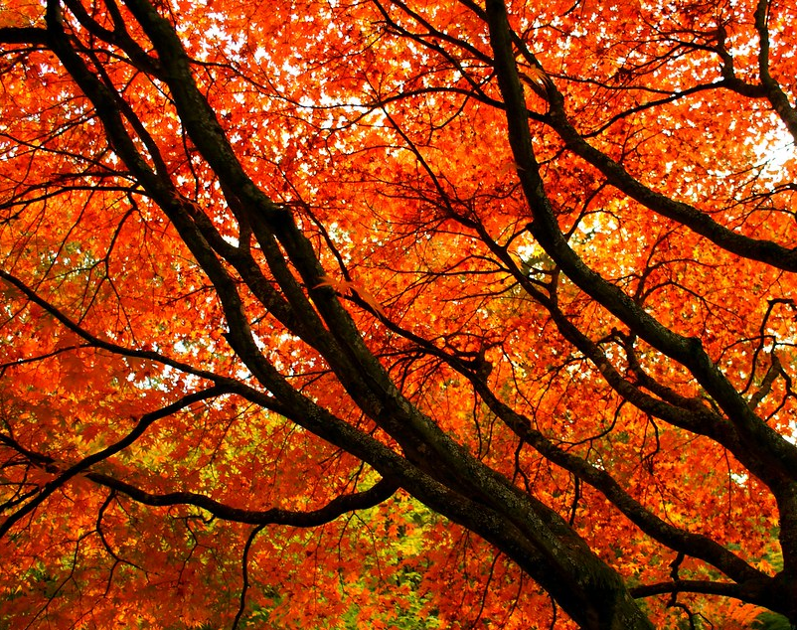
Harvest by
Sycamore Class
Year One
This Photo by Unknown Author is licensed under CC BY-ND

Slide 7
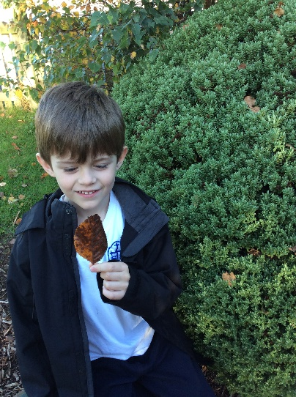
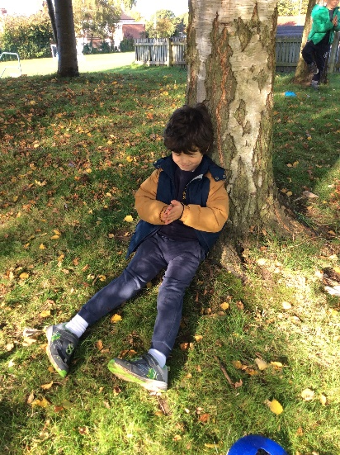
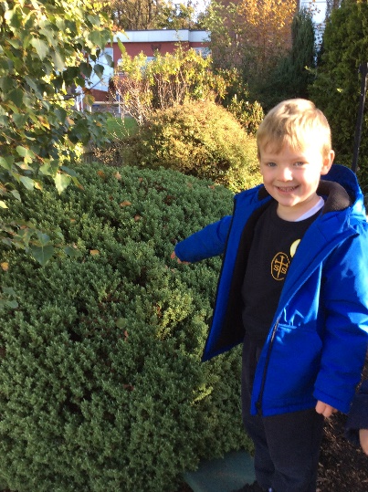
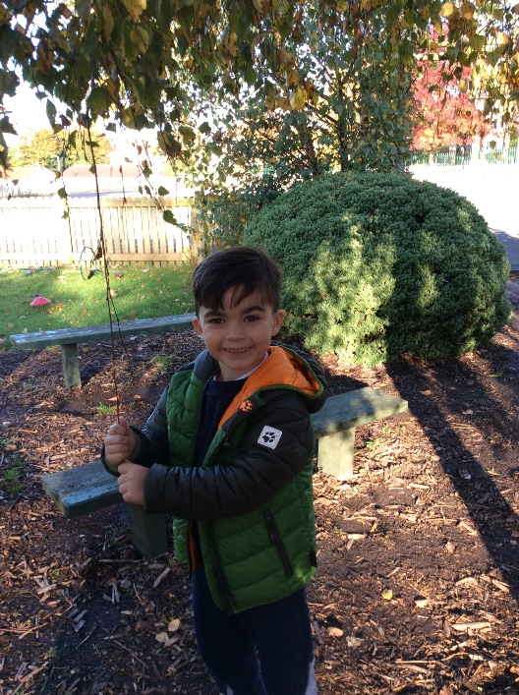
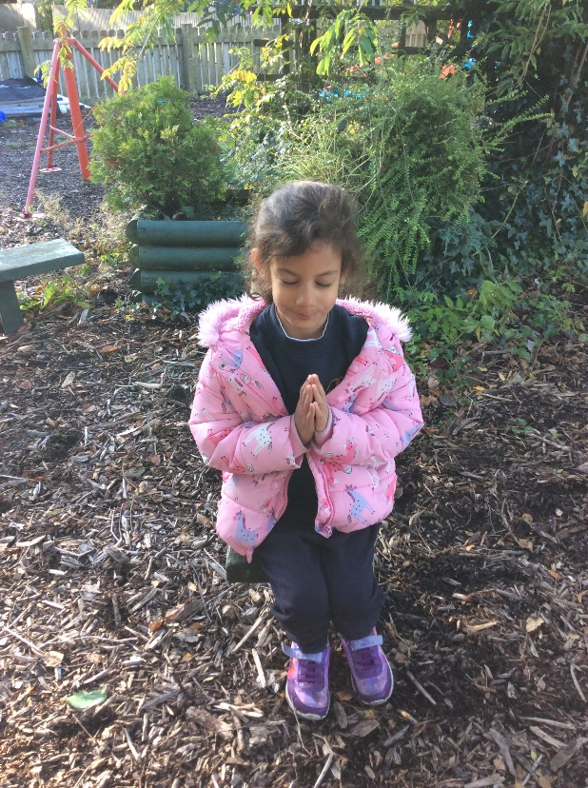
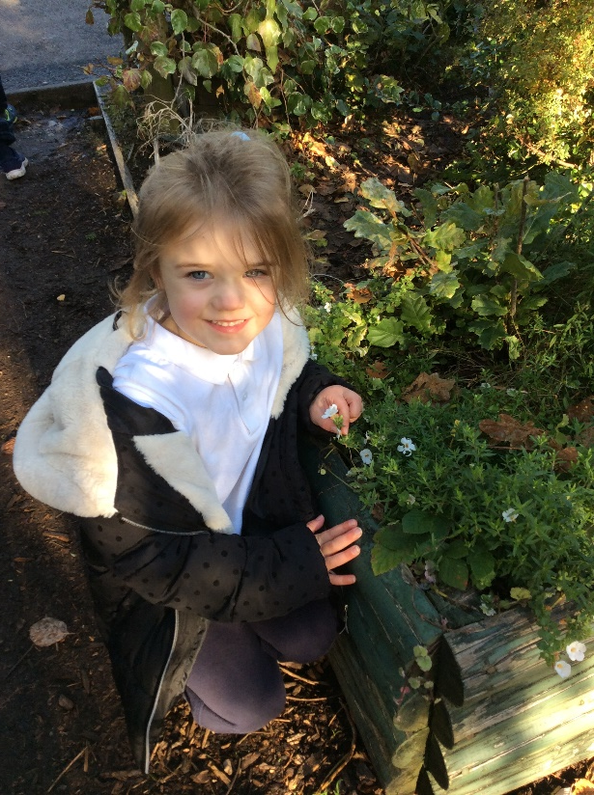
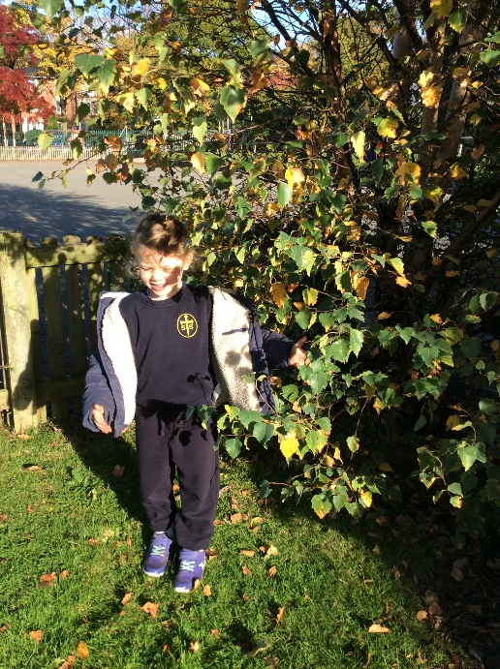
Dear Lord,
Thank you for the trees,
Thank you for the leaves,
Thank you for the flowers,
Thank you for the Harvest.
Thank you for all the seasons and our wonderful world.
Help us to take good care of it.
Amen
by Sycamore Class

Slide 8
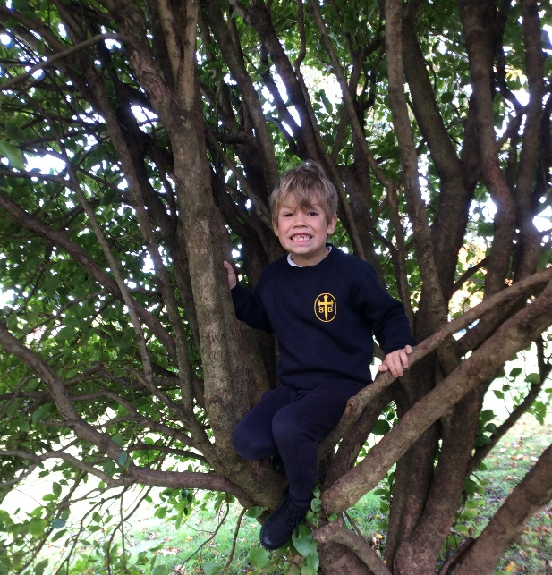
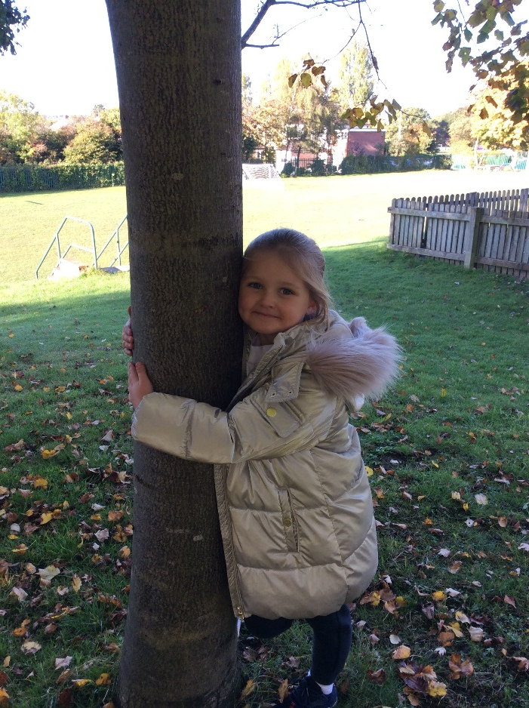
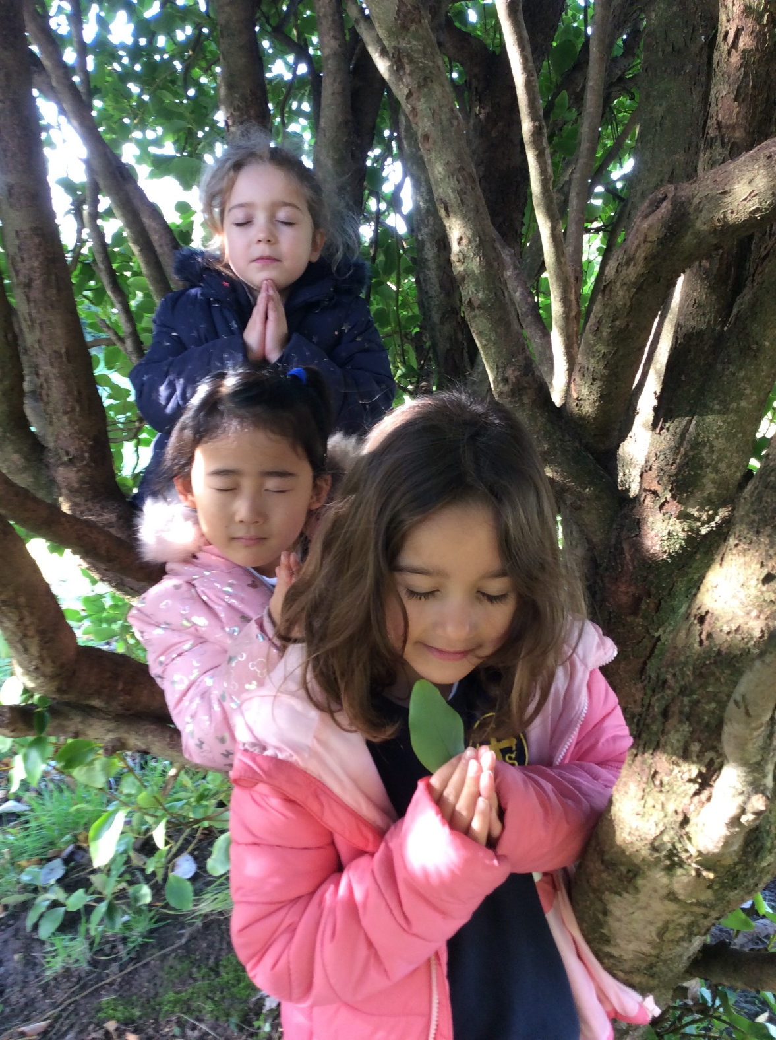
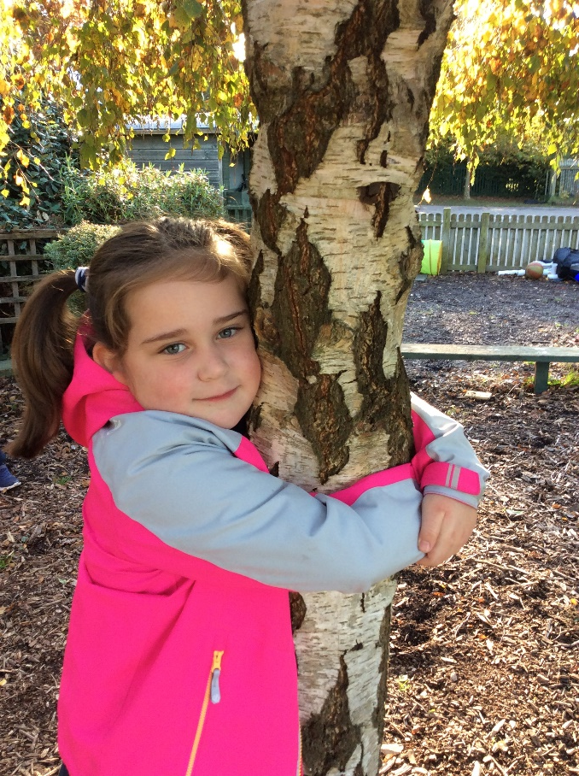
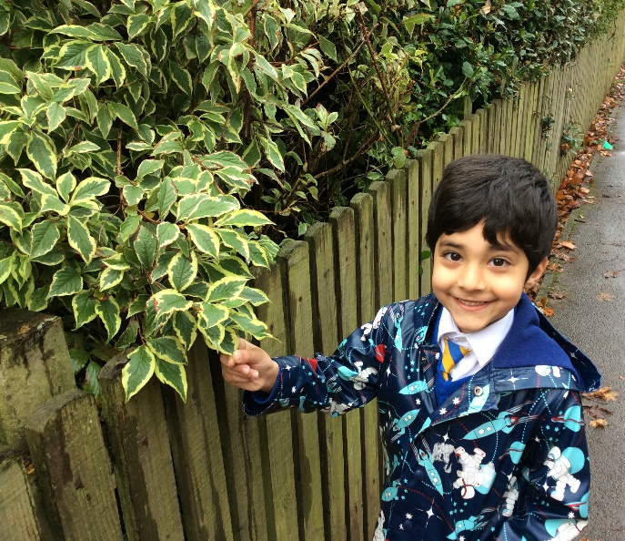

Slide 9
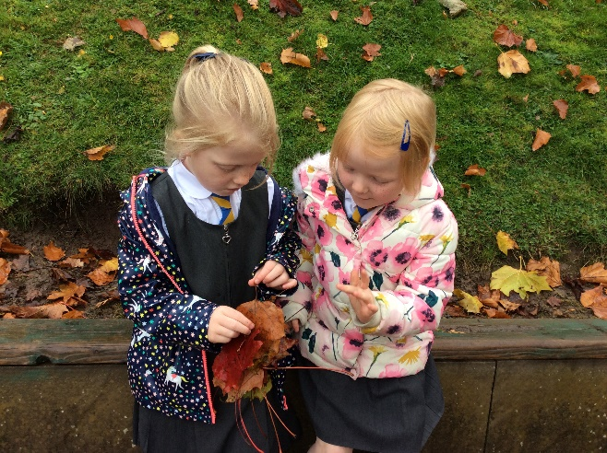
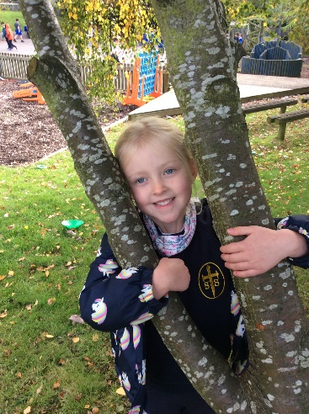
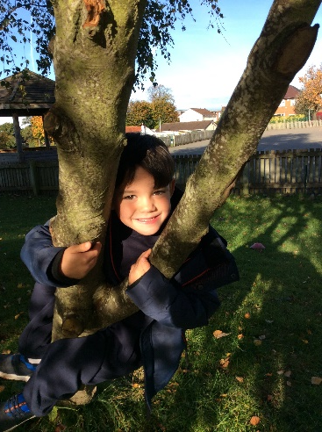
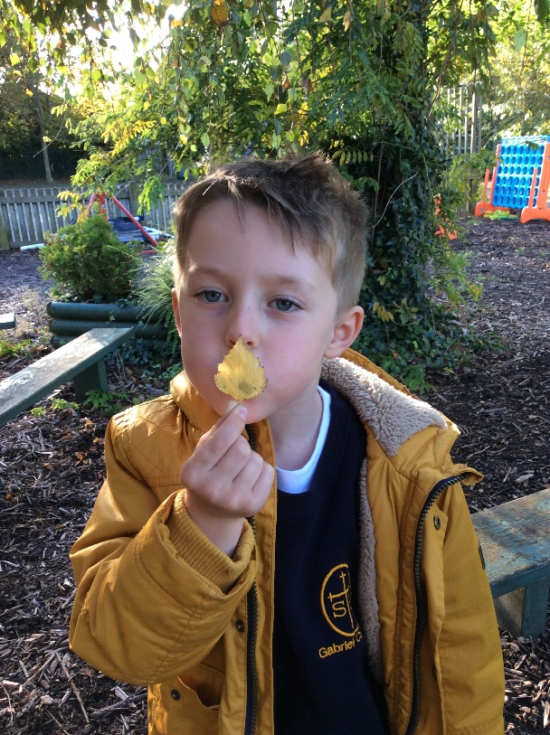
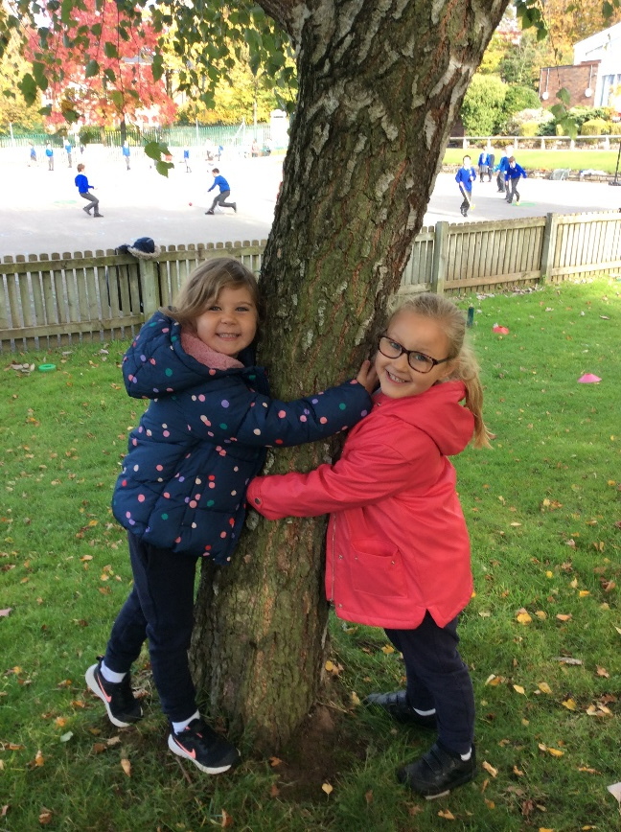
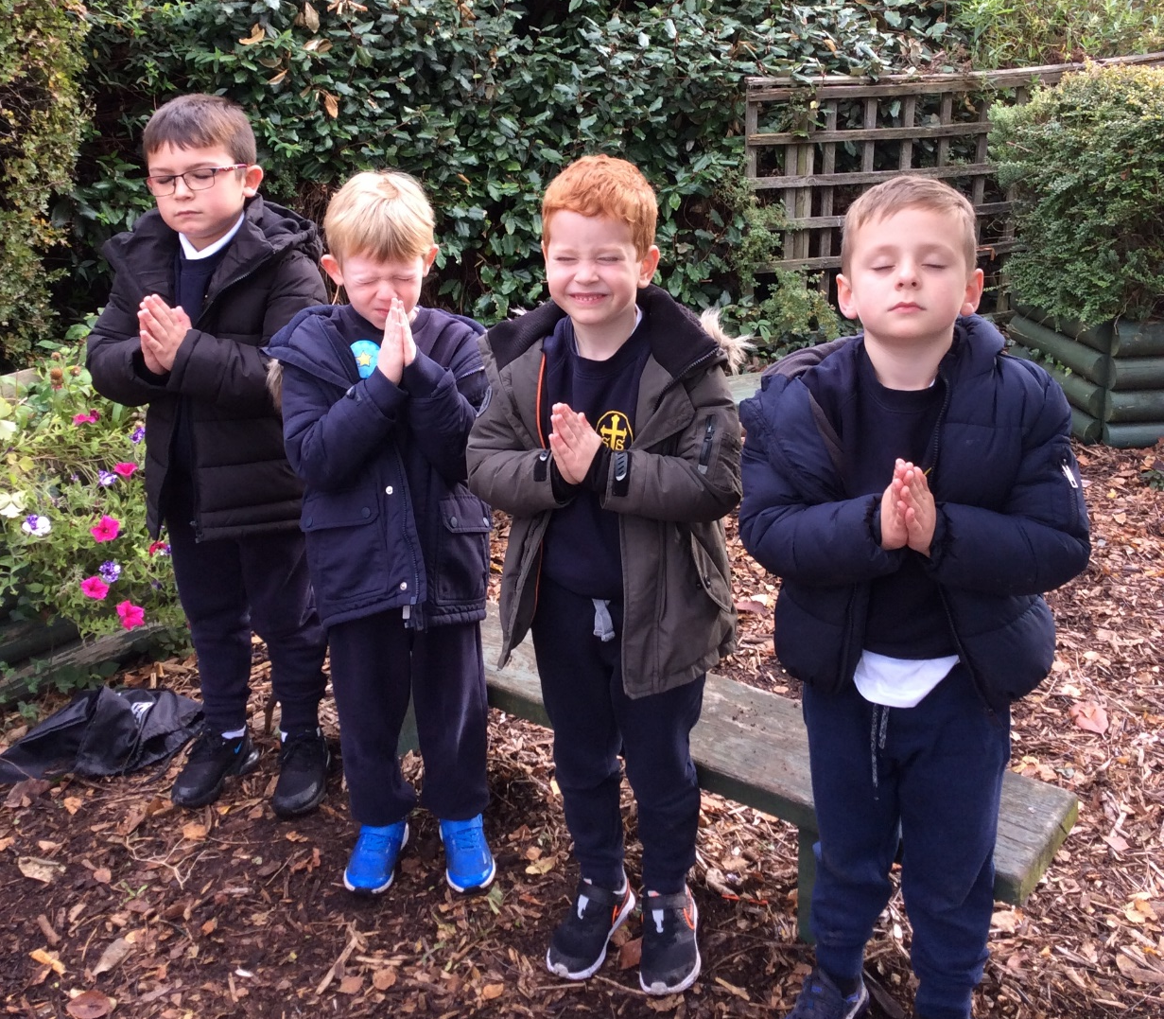
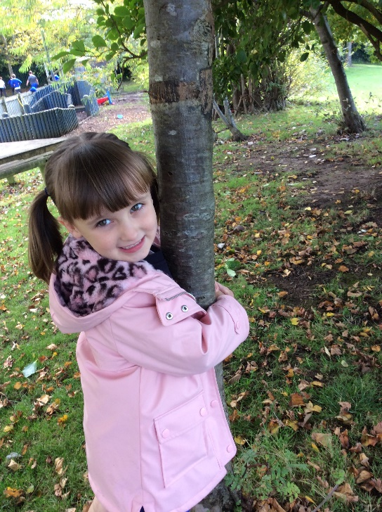
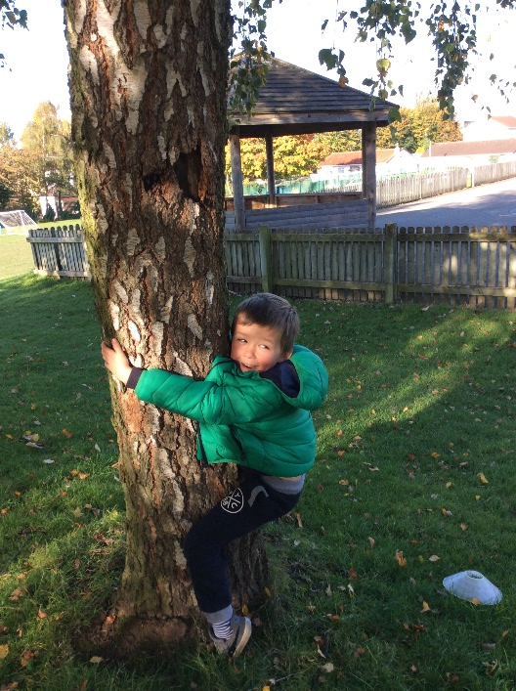

Slide 10
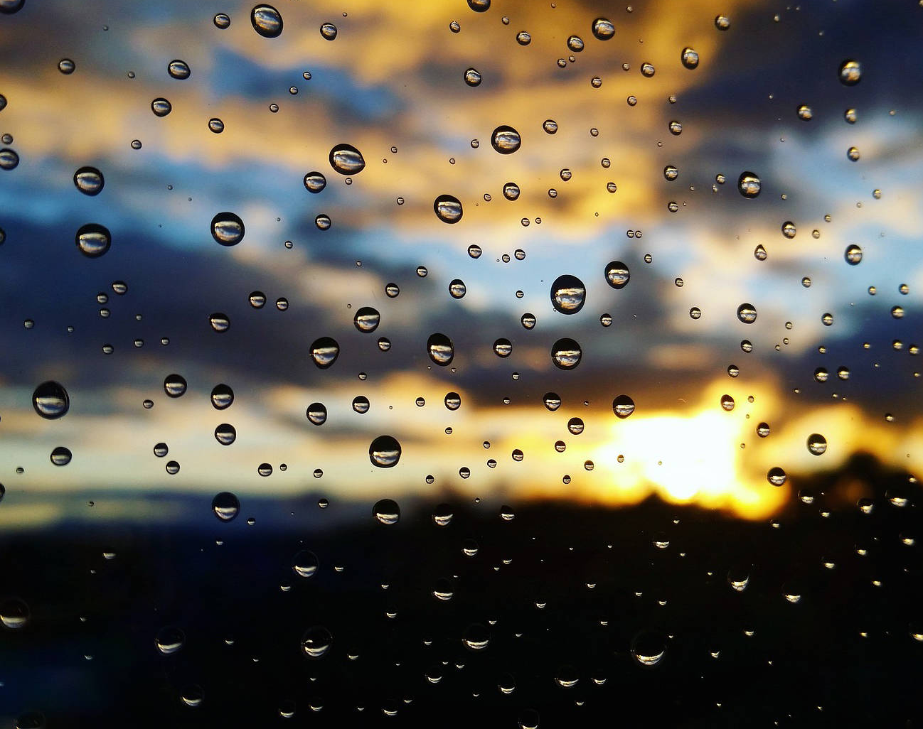
Poplar Class
Year Two

Slide 11
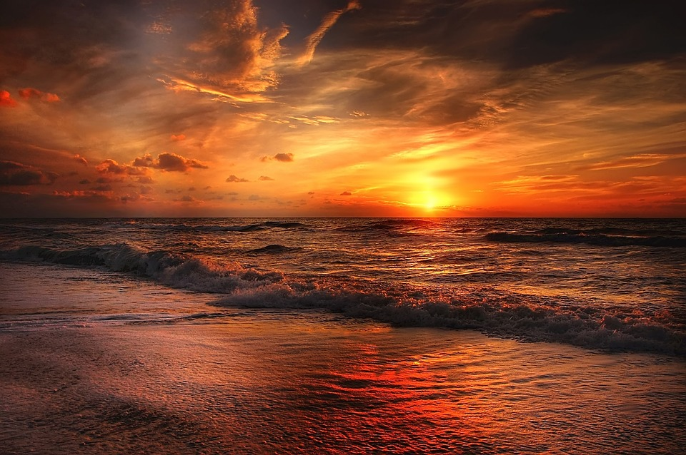
Year 2
Harvest of the rain and sun

Slide 12
Dear God
Thank you for the bright, beautiful sun. It keeps us warm and gives us daylight. It shines down on the flowers and helps them to grow.
The sun means we can go and play outside in the park with our friends and family. We are so lucky to have it.
Thank you for the rain, it is special because it gives us something to play in by splashing in the puddles and catching it on our tongue.
Sometimes on a rainy day it is good to stay inside all snug and warm, watching the rain run down the window.
We need rain to help the plants to grow and keep the animals and sea creatures healthy.
Without sun and rain we wouldn’t have the beautiful rainbows with all their special colours.
Amen

Slide 13
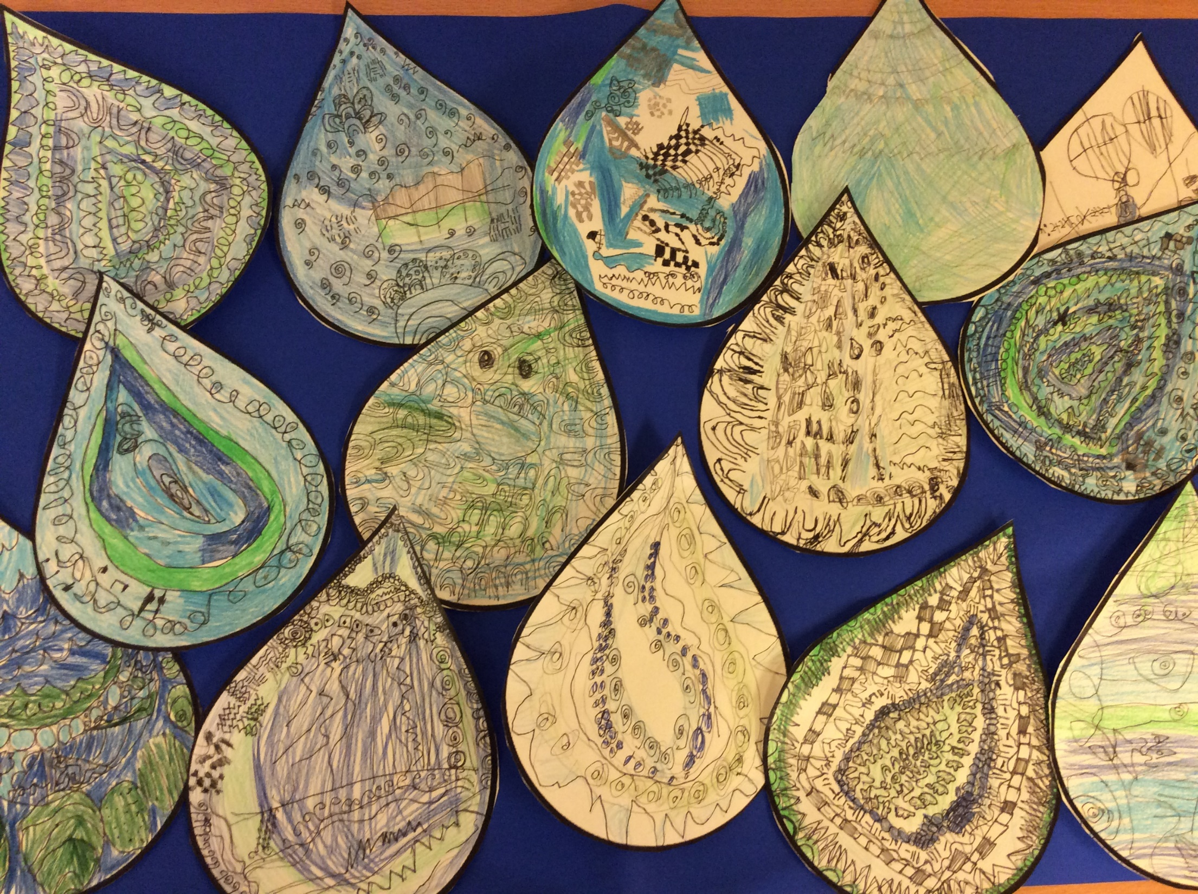

Slide 14
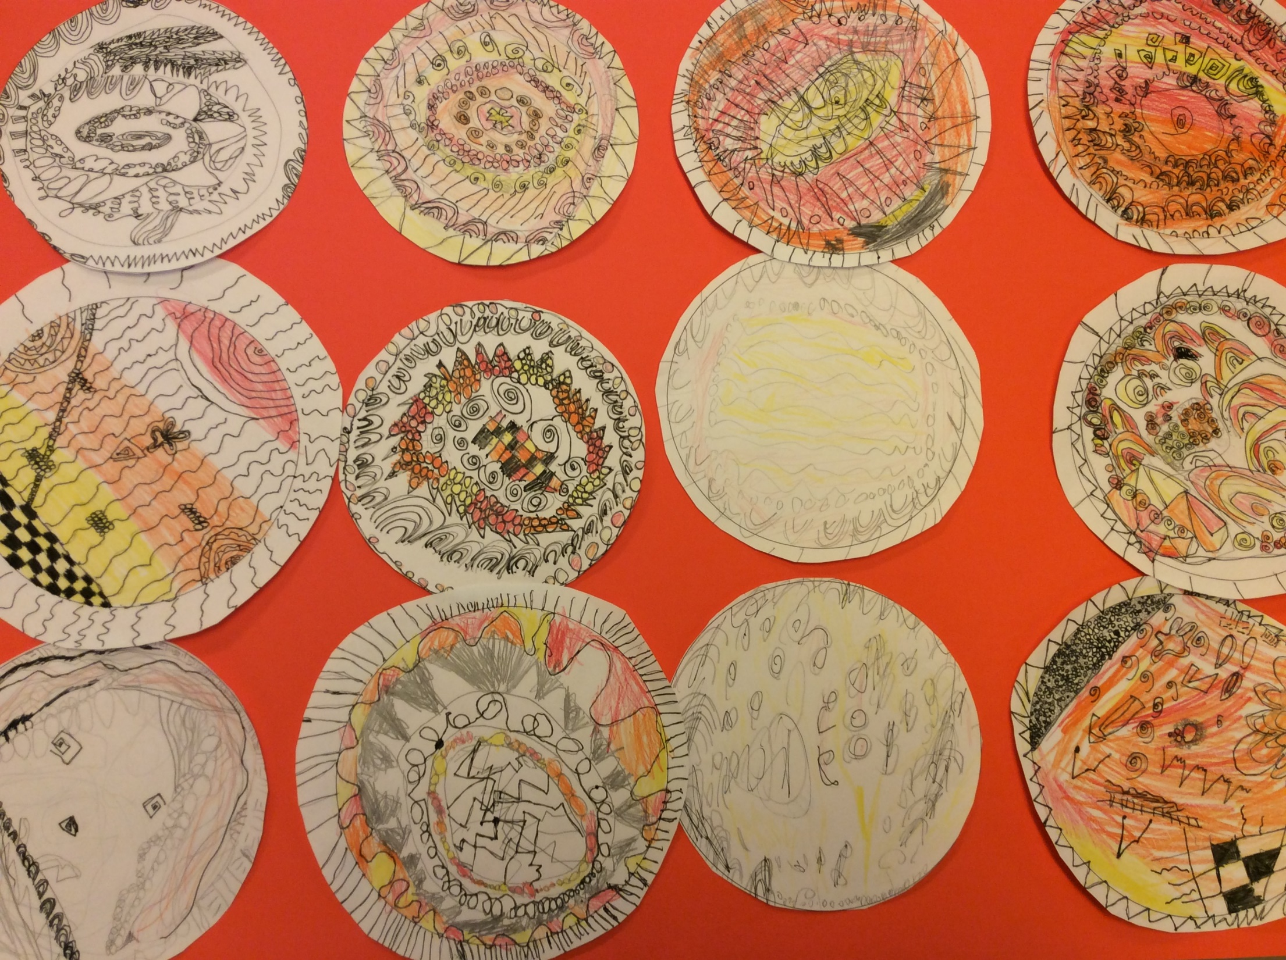

Slide 15
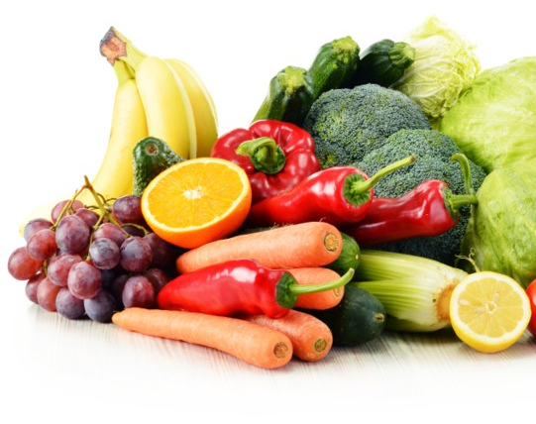
Willow Class
Year Three

Slide 16
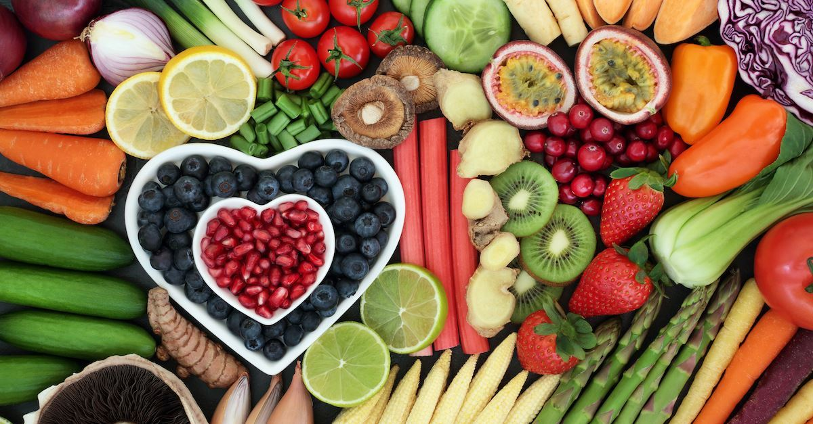


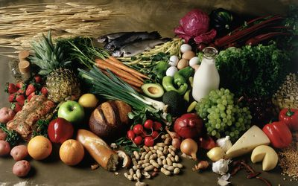
Year 3
Fruit and Vegetables
Now he who supplies seed to the sower and bread for food will also supply and increase your store of seed and will enlarge the harvest of your righteousness.
2 Corinthians 9:10

Slide 17
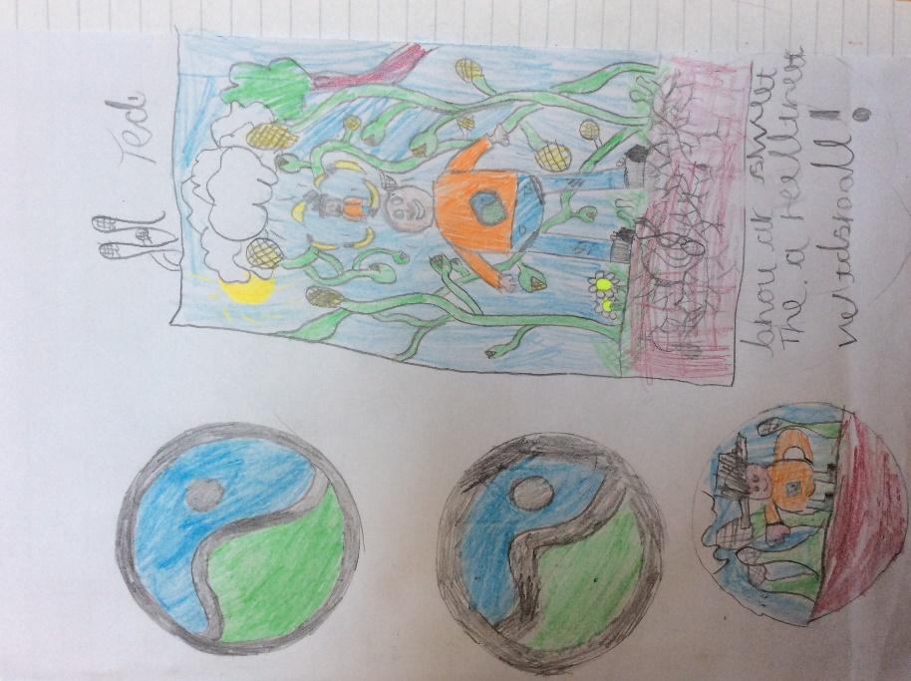
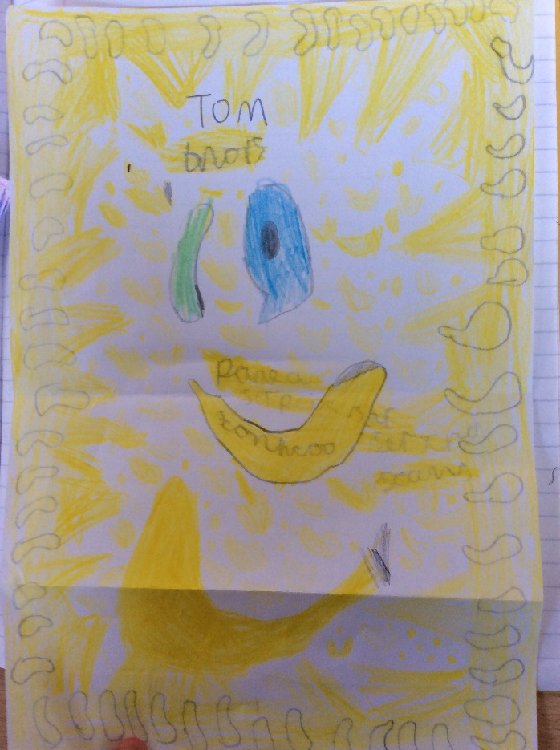
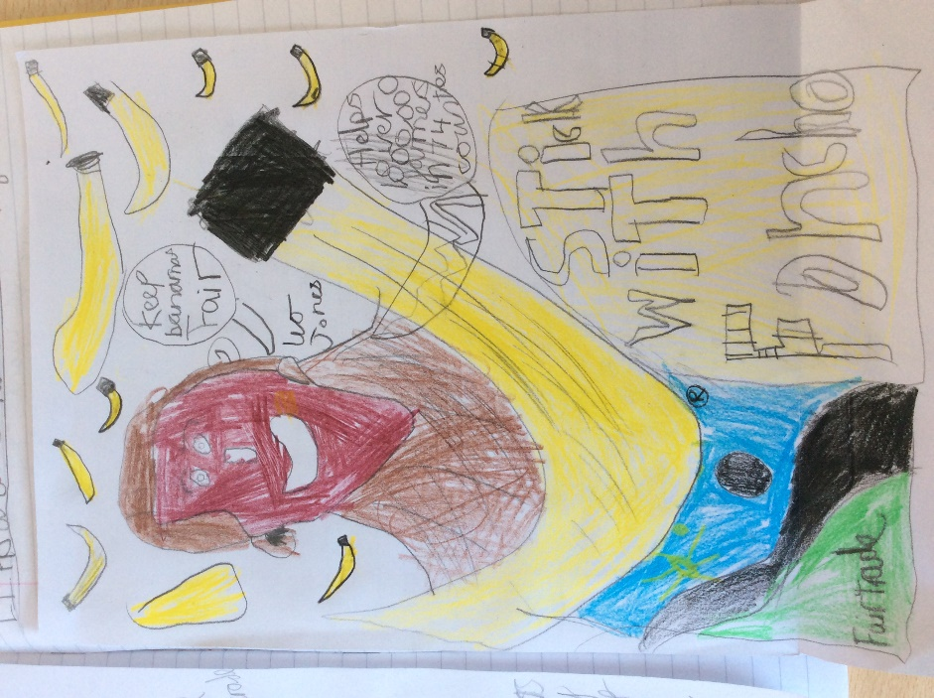
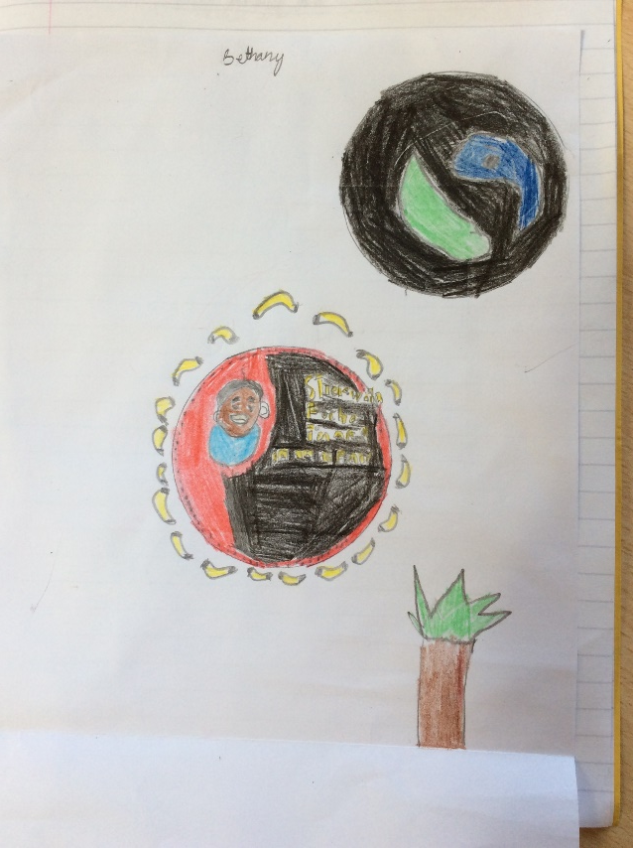
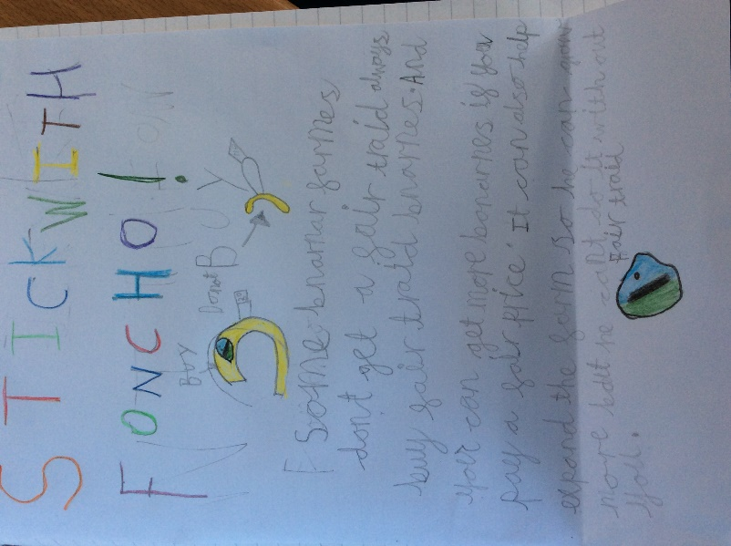
Year 3 have been learning about the important work fair trade does and how we can help to improve lives by supporting this important organisation.

Slide 18
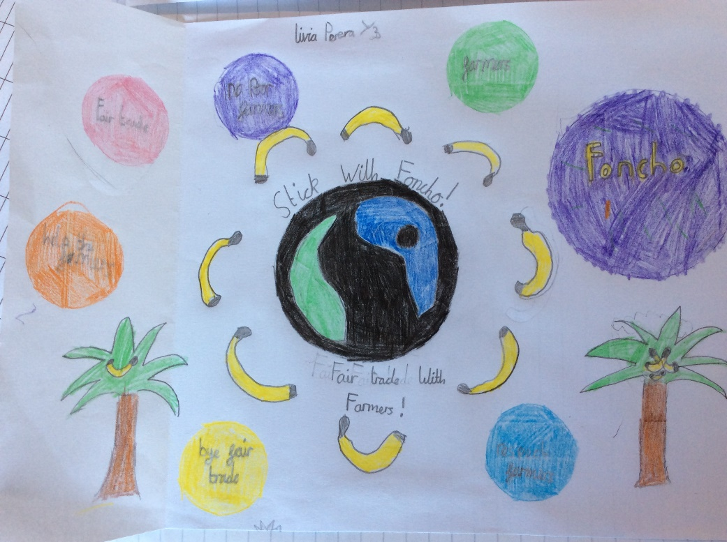
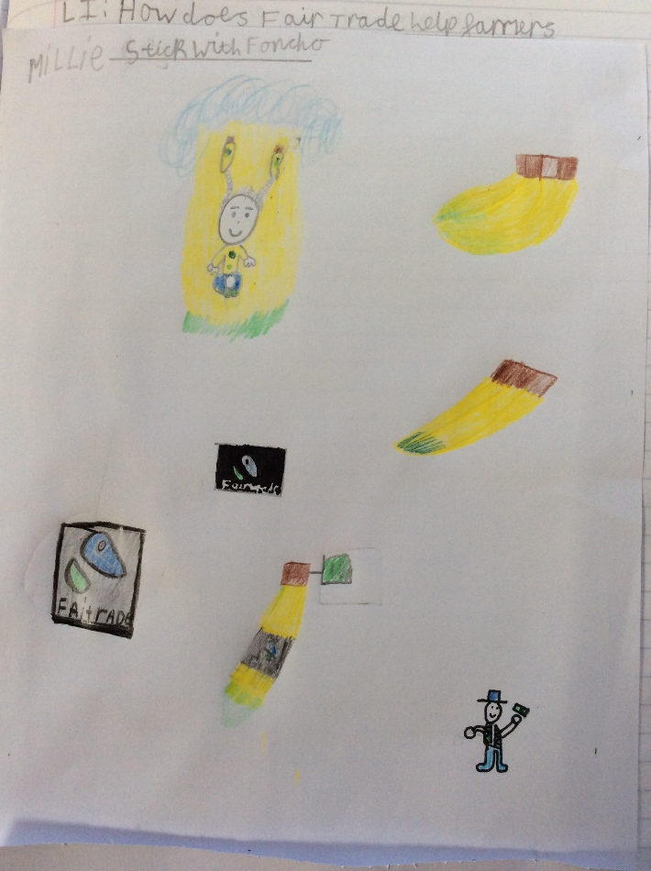
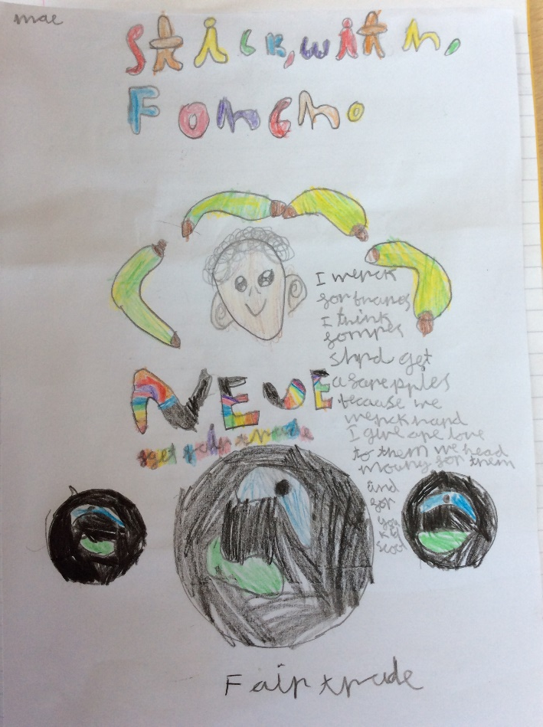
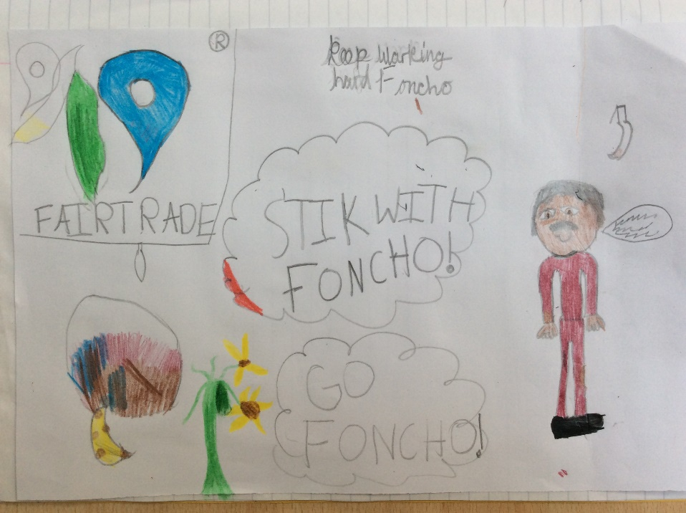
We thanked God for our hardworking farmers and also those in poor countries who supply us with such beautiful fruit.

Slide 19
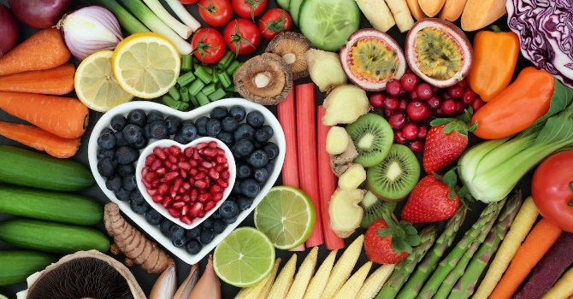
Dear God
Thank you for the delicious fruit and vegetables we eat, thank you for the sour and thank you for the sweet.
We should remember the farmers who work so hard in our country to grow the fruit and vegetables which keep us healthy. We are thankful for everything.
Fair trade looks after the poor farmers who struggle to live their lives comfortably. They get fair prices for their fruit and vegetables, making enough money to improve their business and also share with their community.
Please help us and large companies to make wiser choices by buying or supporting Fair Trade, so that others may have a better life.
Amen

Slide 20
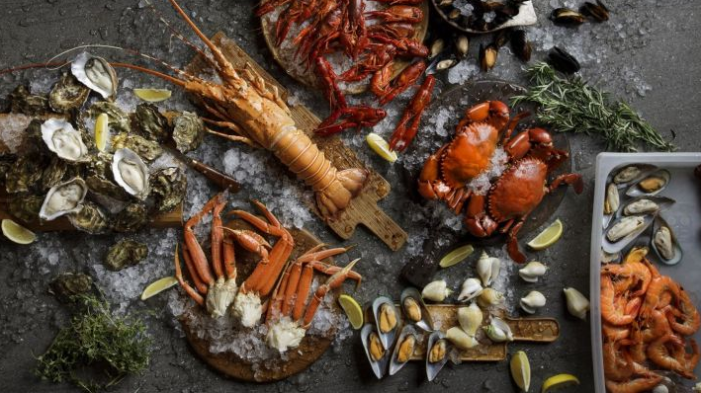
Cherry Blossom
Year Four

Slide 21
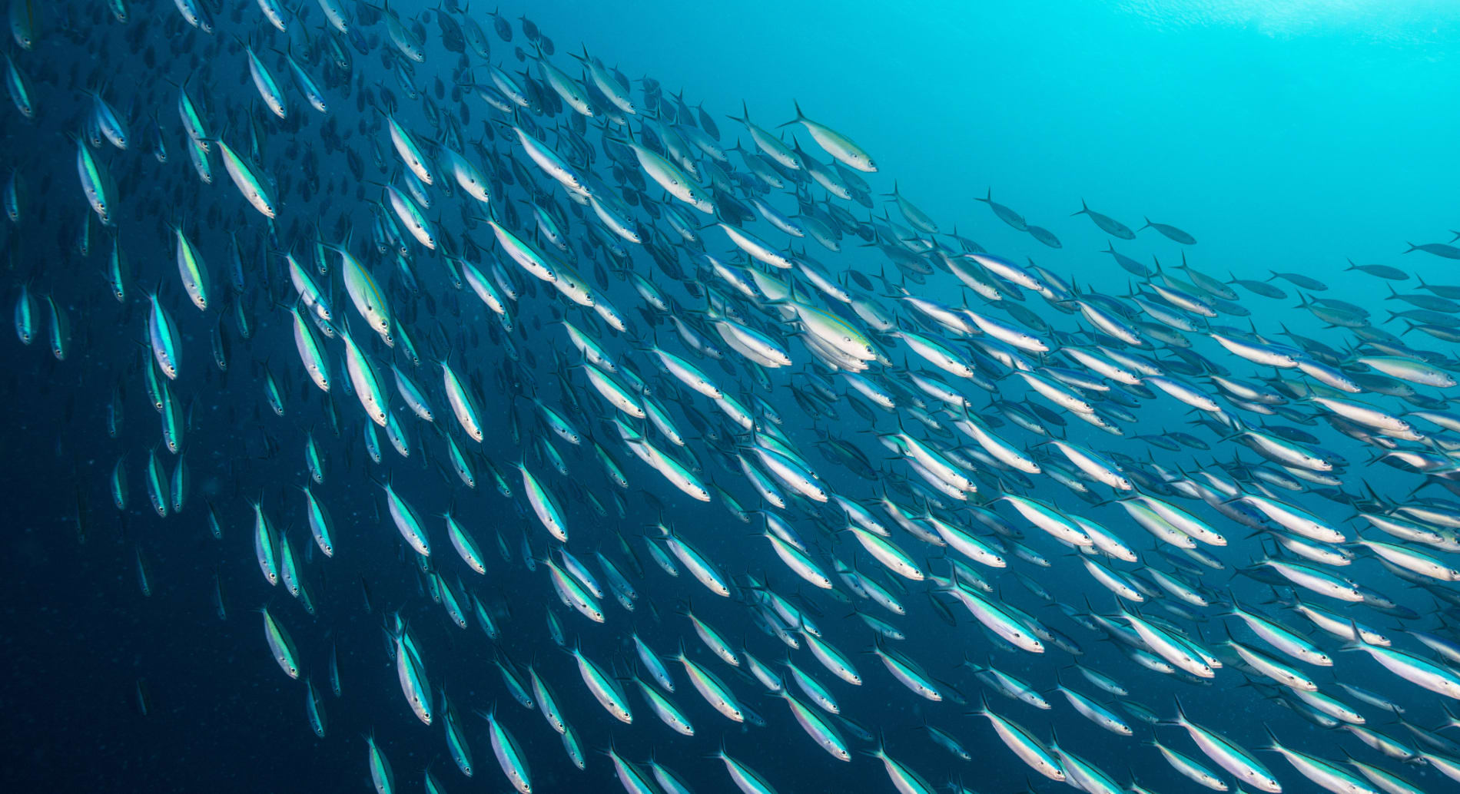
Harvest of the Sea
Year 4

Slide 22
Heavenly Father
Thank you for our seamen who cross oceans far away,
Bringing home the harvests we eat every day.
Thank you for the fishermen who sail out to sea,
To catch a multitude of fish for my family and me.
Thank you for the lifeboat crews, in mighty seas are brave,
Rescuing in times of trouble- many lives they do save.
Thank you for the scientists who research our oceans deep,
Seeing all God’s beauty for our planet to keep.
Amen

Slide 23
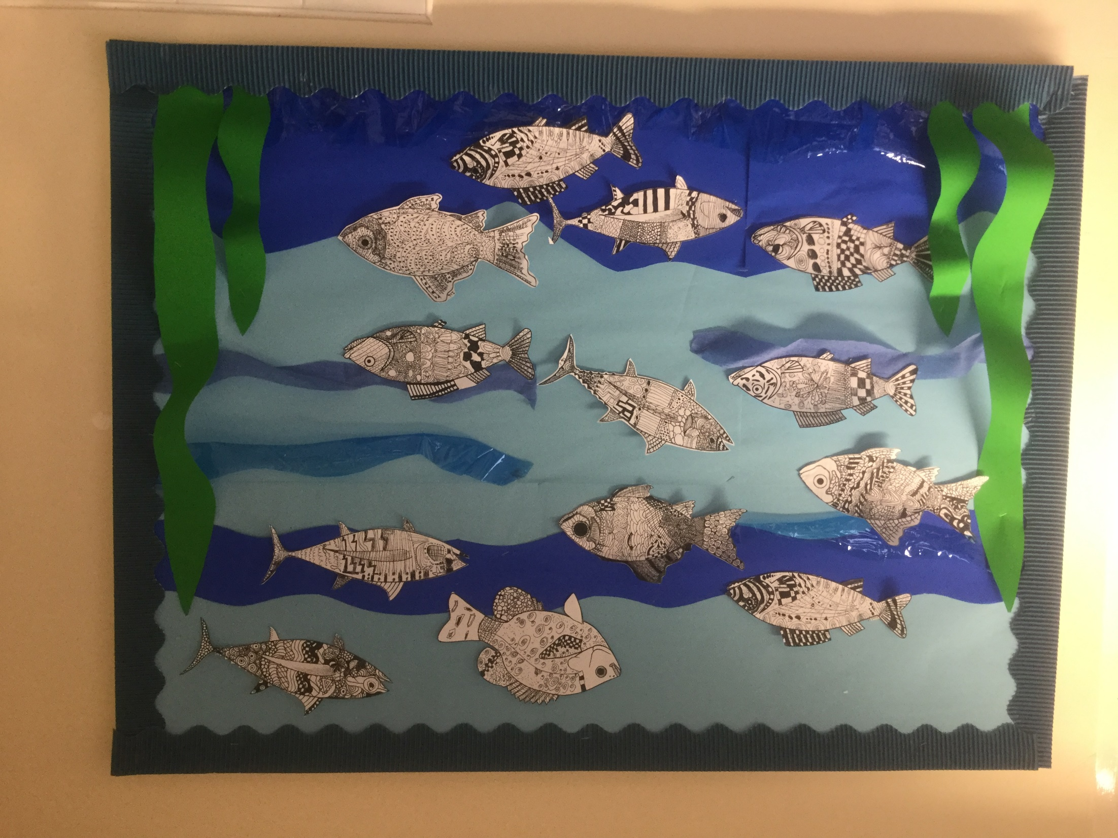

Slide 24
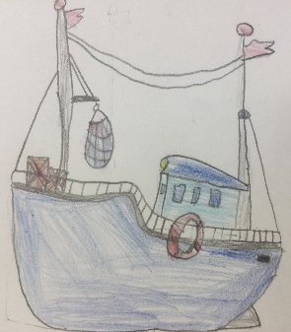















Many different boats bring food and goods to the port of Liverpool.
Thank you to the Liverpool Seafarer’s Centre who help seamen from around the world when they come into port after a long journey.

Slide 25

Maple Class
Year Five

Slide 26

Y5 - Harvest of Day and Night

Slide 27

Year 5 have read the book ‘Here We are’ and reflected on the amazing world that we live in and the wonders that we see as the day turns into night and night turns into day.
They agreed our Earth is:
a place we live,
full of wonderful creatures, depths and heights
and full of amazing humans who can act, look and sound different and have amazing talents.

Slide 28

Heavenly Father,
Thank you for the glorious sunshine that starts our day,
it brings us hope and happiness as we walk to school.
Thank you for the midday sun which is high in the sky as we play happily with our friends.
Thank you for the velvet night sky with it’s twinkling stars it brings us comfort whilst we rest our tired heads.
Thank you God for protecting us
Amen .

Slide 29

Rowan Class
Year Six

Slide 30


All good gifts around us are sent from
Heav'n above; then thank the Lord, O thank the Lord for all his love.

Slide 31



Slide 32



Slide 33





