Slide 1

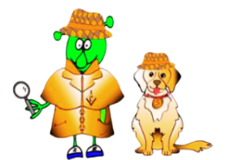

Spanish Stage 4 Summer 1 Café culture
Language Detectives’ Memory Bank of Café Culture
Café food and drinks bank
tortilla de patata – Spanish omelette
gambas – prawns
patatas bravas – fried potatoes with spicy sauce
chorizo – spiced pork sausage
calamares – squid
pulpo – octopus
queso – cheese
croquetas – croquettes
agua – water
zumo – juice
fanta – fanta
coca-cola – coke
mosto – grape juice
un/una turista – a tourist
un camarero – a waiter / una camarera – a waitress
Sound spelling
“vas”
“zo”
“que”
“zu”
Café role play phrases bank
¿Qué querías? - What would you like?
Quiero … - I would like
¡Claro! – of course!
Gracias - thank you
Por favor - please

