Slide 1

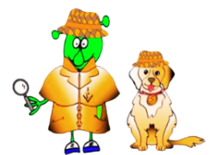

Spanish Stage 3 Spring 1: At the market
Language Detectives’ Memory Bank of “At the market”.
At the market Noun Bank
una manzana – an apple
una cebolla – an onion
un mango – a mango
un pimiento – a pepper
unas uvas – a bunch of grapes
una sandía – a watermelon
un plátano – a banana
una lechuga – a lettuce
una zanahoria – a carrot
una patata– a potato
¿Te gusta…? – Do you like…?
Me gusta. – I like.
No me gusta. - I don’t like
¿Cuál es tu fruta/verdura favorita? – what is your favourite fruit/vegetable ?
Mi fruta/verdura favorita es… - My favourite fruit/vegetable is …
Question and Answer Bank
¿Tienes…? – do you have…?
Sí tengo. – I have
No tengo. - I haven’t
¿Cuánto cuesta/n? - how much is it?
Cuesta/n… céntimos – it is….cents
Dos euros – two euros
Por favor - please
Gracias - thank you
Sound spelling
“mien”
“vas”
“horia”
Grammar
In Spanish, when you want to ask for the price of1 item, you ask “¿cuánto cuesta?” and if you want to ask for 2 or more, you ask “¿cuánto cuestan?”

