Slide 1

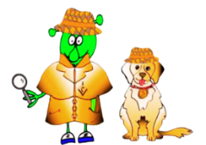

Spanish Stage 3 Autumn 1: Talking about us.
Language Detectives’ Memory Bank: Talking about us.
Sound spelling
“liz”
“cio”
“ham”
Adjective Bank with “I am ….”
Remember there are two different spellings for some of these adjectives, when you use them with “Estoy” (I am).
Estoy – I am
feliz – happy
triste - sad
confundido / confundida - confused
cansado / cansada – tired
gracioso / graciosa – (feeling) silly
fenomenal – (feeling) great
Grammar Bank
The personal pronouns (singular) in Spanish are:
Yo – I
Tú - You
Él – he
Ella – she
Tú te llamas / tú tienes … años / tú vives en
You are called /you are…years old / you live in
Él se llama / él tiene…años / él vive en
He is called / he is… years old / he lives in
Ella se llama / ella tiene…años / ella vive en
She is called / she is… years old / she lives in
Can you see how the verb changes depending on the pronoun? That´s why in Spanish, you don´t need to use the pronouns.
Adjective Bank with “tengo”
Remember that in Spanish we do not always use “I am” (estoy) to explain how we are feeling, we also use “tengo”. Take a look here.
Tengo hambre. - I am hungry.
Tengo sed. – I am thirsty.
Tengo calor. - I feel hot.
Tengo frío. - I feel cold.
Grammar Bank
To describe feelings in Spanish, we need to make sure that the adjective used matches the person. The spelling can change for a male or a female person. Watch out!

