Slide 1

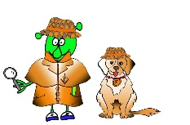

Spanish Y5 Stage 4 Summer 2 Seaside
Language Detectives’ Memory Bank of Seaside
Sound spelling
“aña”
”illos”
“jug”
“va”
Grammar
Say or write “puedes” before a verb written as an infinitive and you can make a simple persuasive sentence.
Beach Nouns bank
La playa- the beach
Los helados- the ice creams
Los castillos de arena – the sandcastles
Las frutas- the fruits
El sol- the sun(shine)
La mochila – the rucksack
Las gafas de sol - the sunglasses
Las chanclas- the flip flops
El sombrero – the hat
La crema de sol- the sun cream
El bañador - the swim suit
Verb bank
Puedes / podemos – you can/we can
Ven a …. – come along to..
Va a ser genial – it’s going to be ..
tomar el sol – to sunbathe
hacer- to make
comer- to eat
jugar (al fútbol/ al voleibol)- to play(football/volleyball)
nadar-to swim

