Slide 1
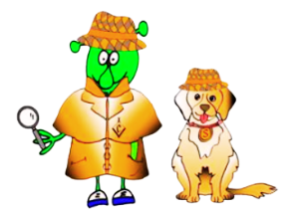


Spanish Stage 2 Autumn 1: Classroom objects and asking for an item
Language Detectives’ Memory Bank: Welcome to school.
Noun Bank
el patio – the playground
el comedor – the dinner hall
la sala de profesores – the staffroom
el aula de informática – the ICT room
los baños – the toilets
el despacho del director – the headteacher’s office (man)
el despacho de la directora – the headteacher’s office (woman)
la clase - the classroom
una mochila – a rucksack
un lápiz - a pencil
un boli - a pen
un libro - a book
un sacapuntas – a sharpener
una goma - a rubber
una mesa - a table
una silla - a chair
una regla - a ruler
unas tijeras - some scissors
unas pinturas - some coloured pencils
un pegamento – a gluestick
Grammar Bank
To say “I have” in Spanish we use “tengo” (I have).
To say the negative ( I have not..) we use “no tengo”.
Sound spelling
“au”
“ño”
“lla”
“je”

