Slide 1

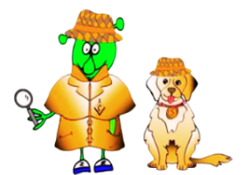

Spanish Stage 2 Spring 1: Parts of the face
Language Detectives’ Memory Bank of “parts of the face”.
Noun Bank
la nariz – the nose
la boca - the mouth
la cabeza - the head
el pelo - the hair
los ojos – the eyes
las orejas - the ears
Tengo… – I have …
Soy… - I am…
Grammar
There are two words for “the” in Spanish with singular nouns (el and la).
There are also two words for “the” with Spanish plural nouns: “los” and “las”.
Sound spelling
“riz”
“za”
“jos”
“jas”
Question and Answer Bank
¿De qué color es…? – What colour is …?
¿De qué color son…? - What colour are….?
La boca es… - The mouth is…
Las orejas son… - The ears are…

