Slide 1

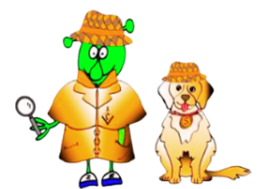

Spanish Stage 2 Autumn 2: Town and shops.
Language Detectives’ Memory Bank of “Town and Shops”
Noun Bank
el cine - the cinema
el restaurante – the restaurant
el supermercado - the supermarket
el estadio – the stadium
la carnicería - the butchers
la panadería - the bakers
la cafetería - the café
la pastelería - the cake shop
la farmacia - the chemist
la escuela – the school
Sound spelling
“ci”
“ería”
“cia”
Facts
Lots of shop names in Spanish end with the suffix –ería.
Grammar
We use “la” (the) for most of the nouns ending in –a.
Question and Answer Bank
¿Dónde está…? Where is …?
Aquí está… - Here is …

