Slide 1

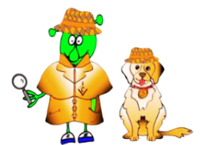

Spanish Stage 2 Autumn 2: Classroom Commands.
Language Detectives’ Memory Bank of “Classroom Commands”
Verb Bank
mira - look
escucha - listen
repite - repeat
levántate - stand up
siéntate - sit down
cuenta conmigo - count with me
canta conmigo– sing with me
encuentra - find
enséñame - show me
Sound spelling
“van”
“sien”
“cuen”
Grammar
All the words in the verb bank are commands.

