Slide 1

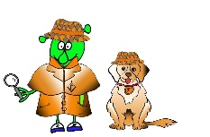

Spanish Y4 Stage 2 Summer 1 I don’t feel well
Language Detectives’ Memory Bank of “I don’t feel well”
Sound spelling
“qué”
“sien”
“za”
“illa”
“I don’t feel well” -Questions and Answers bank
¿Qué te pasa?- What’s wrong?
No me siento bien- I don’t feel well
Me duele la muela- My tooth hurts
Me duele la cabeza- I have a headache
Me he cortado la rodilla- I have cut my knee
Me duele el oído- I have earache
Me duele la tripa- I have tummy ache

