Slide 1

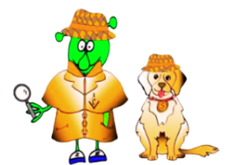

Spanish Stage 1 Autumn 2: days of the week.
Language Detectives’ Memory Bank of “Days”
Noun Bank
lunes - Monday
martes - Tuesday
miércoles - Wednesday
jueves - Thursday
viernes - Friday
sábado - Saturday
domingo - Sunday
Sound spelling
“mier”
“jue”
“ves”
“vier”
Grammar
When you ask a question in Spanish you can turn a sentence into a question by raising the pitch of your voice at the end of the question. Practice reading these phrases!
Hoy es lunes. – Today is Monday.
¿Hoy es lunes? – Is it Monday today?
Question and Answer Bank
¿Qué día es hoy? - What day is it today?
Fact Bank
Some of the Spanish days of the week are named after the planets!
e.g. martes → Mars

Slide 2
Spanish Stage 1 Autumn 2: months of the year
Language Detectives’ Memory Bank of “Months”
Noun Bank
enero - January
febrero - February
marzo March
abril - April
mayo - May
junio - June
julio - July
agosto - August
septiembre – September
octubre – October
noviembre – November
diciembre - December
Sound spelling
“ayo”
“ju”
“tiem”
“viem”
“ciem”
“bre”
Grammar
When words are the same in two languages we call them cognates and when they look very similar we call them semi-cognates.
Fact Bank
Lots of the months in Spanish look very similar to English spelling if the months.
Fact Bank
Months of the year and days of the week in Spanish do not have a capital letter.
Question and Answer Bank
¿Cuándo es tu cumpleaños? - When is your birthday?

