Slide 1

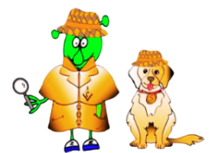

Spanish Stage 1 Spring 1: Animals I like and don’t like
Language Detectives’ Memory Bank of Animals
Noun Bank
un gato – a cat
un perro - a dog
un pez – a fish
un caballo - a horse
un conejo - a rabbit
una oveja – a sheep
una serpiente - a snake
un pájaro – a bird
una vaca - a cow
un ratón - a mouse
Grammar
There are two words for “a”
in Spanish.
These words are “un” and “una”.
Sound spelling
“llo” “ja”
“jo” “va”
Grammar
In Spanish when we use “the” with a plural noun, we use the word “los” or “las”.
Fact Bank
In different languages animals make different noises. In Spanish the noise a dog makes is “guau”.
Question and Answer Bank
Me gusta… – I like…
Mi animal favorito es… - My favourite animal is….
¿Cuál es tu animal favorito? – What is your favourite animal?

