Slide 1

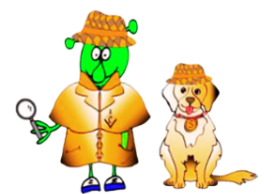

Spanish Stage 1 Spring 2: using numbers up to 15
Language Detectives’ Memory Bank of using numbers up to 15
Numbers Bank
once- 11
doce- 12
trece- 13
catorce- 14
quince- 15
Up to 20:
dieciséis - 16
diecisiete -17
dieciocho - 18
diecinueve - 19
veinte - 20
Sound spelling
“ce”
“quin”
“vein”
Fact Bank
In Hopscotch in Spanish the bottom of the hopscotch grid is called “la tierra”(the Earth) and the top of the grid is called “el cielo” (the sky).
Grammar
In English we ask people “how old are you?” and in Spanish we ask what age “have you?”.
Question and Answer Bank
¿Cuántos años tienes? - How old are you?
Tengo … años – I am …. years old

