Slide 1

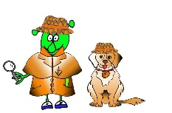

Spanish Y3 Stage 1 Summer 1 Hungry Giant
Language Detectives’ Memory Bank of “Hungry Giant” fruits and vegetables
Fruits and Vegetables Bank
Una manzana – an apple
Un plátano- a banana
Un melocotón- a peach
Un tomate- a tomato
Una zanahoria- a carrot
Una naranja - an orange
Una pera- a pear
Un melón- a melon
Un pepino- a cucumber
Una sandía- water melon
Uvas- grapes
Grammar
We often add “s” at the end of the word in Spanish to make the noun a plural word e.g. una manzana/ dos manzanas
Sound spelling
“z”
“ja”
“uv”
Fact Bank
Grapes are grown in Spain. As you drive along the roads you can see rows and rows of vines with grapes growing on them.
“Asking politely phrases” bank
quisiera- I would like…
por favor - please

