Slide 1

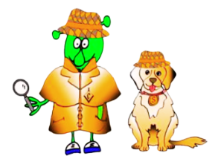

Spanish Stage 1 Autumn 1: Colours .
Language Detectives’ Memory Bank: Colours.
Colours Bank
azul - blue
blanco - white
rojo - red
negro - black
amarillo - yellow
verde – green
naranja – orange
rosa - pink
Sound spelling
“zul”
“jo”
“llo”
“ver”
Grammar Bank
Colours are words that describe objects.
We call them “adjectives”. Watch out in Spanish every time we meet the colours as the spelling might change to match the object the colour describes.
Question Bank
¿Qué color es? - What colour is it?

