Slide 1

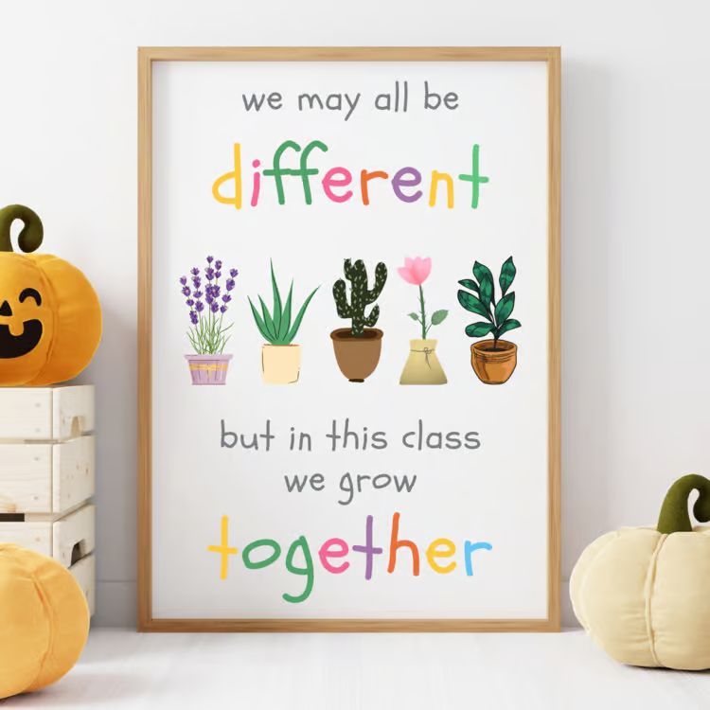
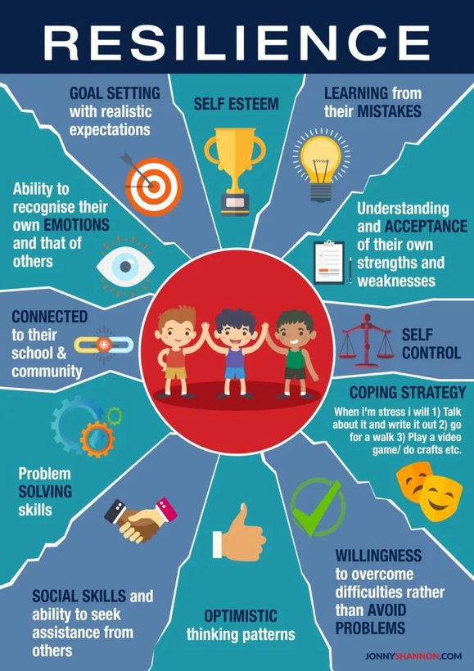
Year 6
Rowan Class
2026 - 2027
Mrs Hughes

Slide 2
Classroom Expectations
Be Respectful
Be Ready and Safe
Be Productive
Use class time wisely and work hard. Follow class routines and model school behaviour.
Respect staff, peers and yourselves, as well as our class environment.
Arrive on time with the necessary materials. Act responsibly.

Slide 3
Housekeeping
  Please provide your child with a reusable water bottle
  Please send your child with the correct school uniform & PE kit
  Please label belongings
  Any snack must be fruit or vegetables – no nuts
  No jewellery other than studded earrings and watches (no smart watches) and no nail varnish
  Long hair needs to be tied back to avoid lice
  Phones can only been brought into school if the child is walking home
  Send medical updates and check we have in-date inhaler in school

Slide 4


Routines
  Doors open at 8.45am and children are to be collected at 3.15pm
  Children are to wear their PE kit to school on Mondays and Thursdays
Homework
Each week on a Friday, children will come home with a list of spellings to memorise.
Children should have their reading record signed by a grown-up at least once a week to confirm they are reading at home.
Additional optional projects will be set throughout some half terms to celebrate our topics (e.g. WW2, the circulatory system, local history).

Slide 5







Behaviour rewards and sanctions
House Dojos
Reflection time
Certificates
Individual Dojos
End of term prizes
Phone call home

Slide 6

Why should they read at home?
Reading for pleasure is a cornerstone of a child's development.
Reading sparks the imagination, helps children to understand empathy, and increases knowledge across various subjects. Encouraging children to read for pleasure can provide a valuable escape, a source of joy, and a lifelong habit that benefits their overall wellbeing.
Studies have shown that children who read regularly tend to have a higher reading comprehension ability, a wider vocabulary and stronger communication skills. It is incredibly beneficial in preparing them for life.
https://corp.oup.com/feature/more-than-words-the-real-life-impact-of-reading/
READ ALONG WITH AN AUDIOBOOK
CREATE ILLUSTRATIONS FOR YOUR BOOK
READ IN DIFFERENT VOICES

Slide 7
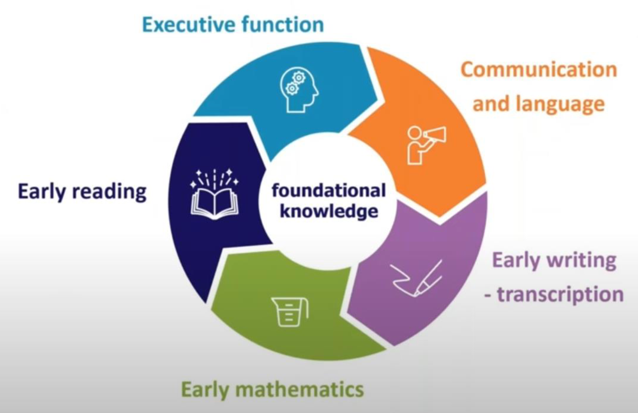

Slide 8
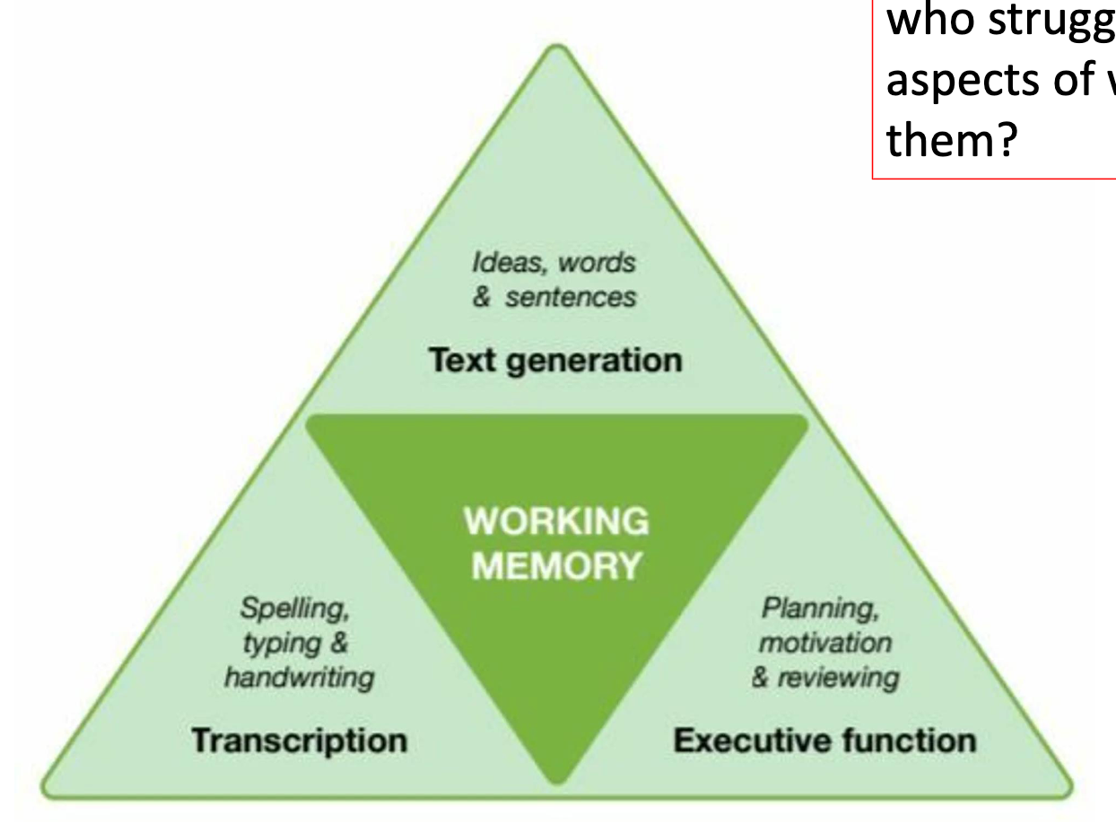
Why is writing so challenging?

Slide 9
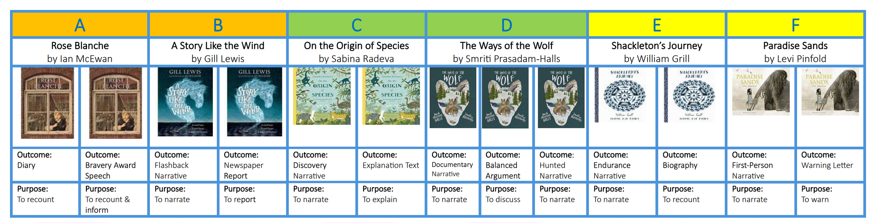

Slide 10


SATS ARE STANDARDISED ASSESSMENT TESTS ADMINISTERED BY PRIMARY SCHOOLS. THEY ARE A WAY OF MEASURING THE ATTAINMENT AND PROGRESS CHILDREN MAKE IN KEY STAGE TWO.
SATS 2027
MONDAY 10TH MAY SPAG
TUESDAY 11TH MAY ENGLISH READING
WEDNESDAY 12TH MAY MATHS PAPER 1 AND PAPER 2
THURSDAY 13TH MATHS PAPER 3

Slide 11

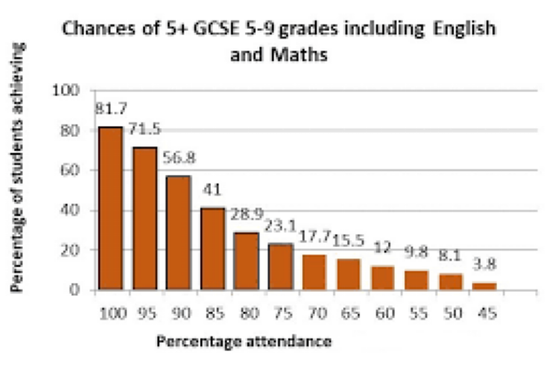
How can I help my child?
  Help children not to feel worried or pressured about SATS. All that is asked is that they try their best, but please reassure children that the SATS should not be causing anxiety. Do give lots of praise and encouragement!
  Support them to be confident readers, writers
and mathematicians (times tables)
  Support them to achieve high attendance

Slide 12
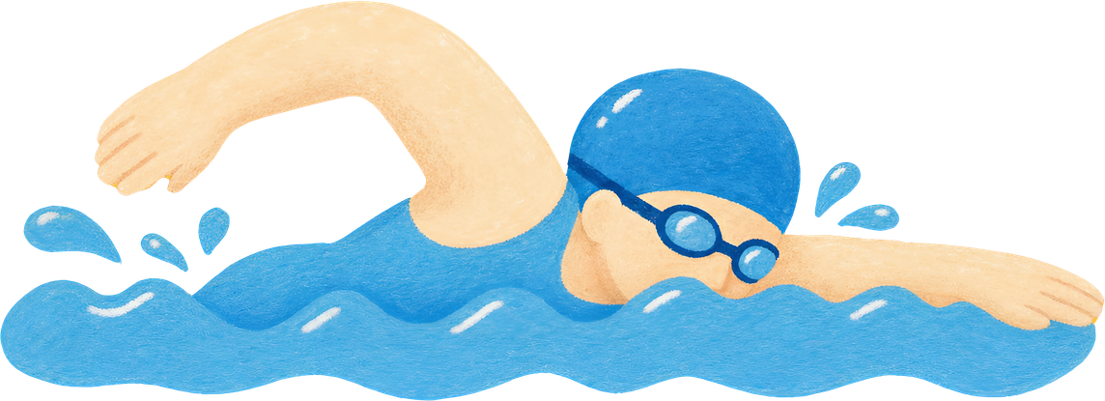
Swimming
  Europa pool
  12.15 until end of day
  Everyday on the week of 30/11/26

Slide 13


PRESENTATION
26/27 dates
31 October
1 March
15 March
17 - 19 March
10 - 13 May
The national deadline for Year 6 pupils to apply for a secondary school
Receive secondary school place offer
Deadline for appeals or requested changes
Y6 Residential
SATs week

Slide 14

We are very excited for the year ahead and we are confident the children will continue to work hard and enjoy their last year at Oxton St Saviour’s.
We are always here to help in any way that we can. If you have any concerns, the best way to contact us is on the playground or via the office email.

