Slide 1
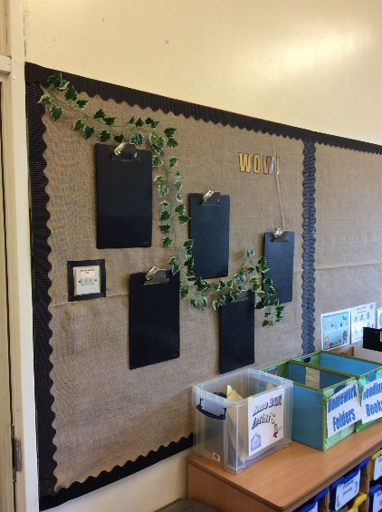
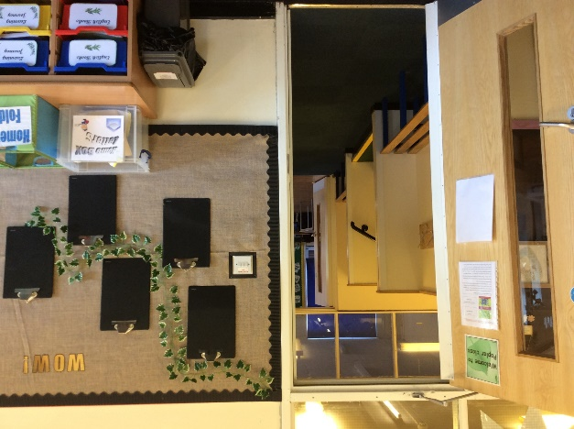
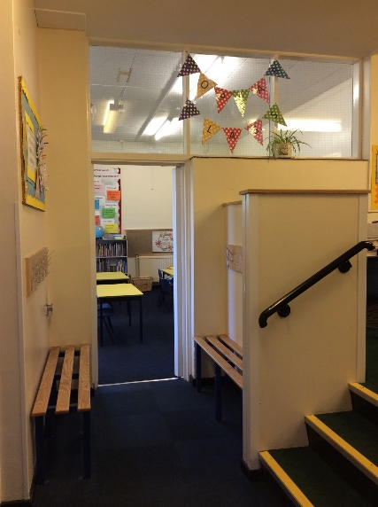
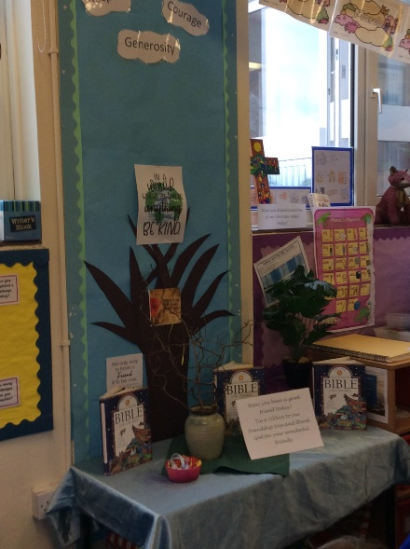
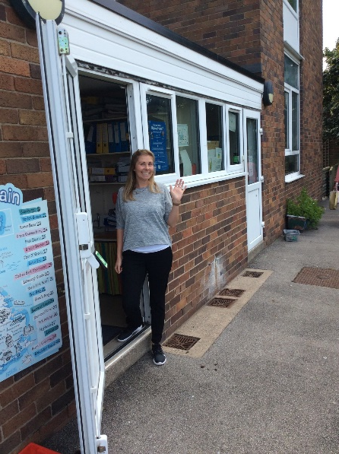
Welcome to Year Two
We are Poplar Class
Staff
Miss Down
Miss Miller
Miss Cowling

Slide 2

Year Two
Year Two is all about continuing to develop independence so the children are encouraged to look after their own possessions.
Each morning coats, lunch boxes, water bottles, fruit snacks and books are all put in the correct places by the children.
Children are rewarded with Dojos throughout the day for good behaviour and hard work.

Slide 3

Routines
Doors open at 8.45am. The earlier the children are in, the quicker learning can start. The children have 4 maths problems and independent reading to complete before phonics and reading groups begin at 9am.
PE is Wednesday and Thursdays.
Reading books and spellings will be sent home each Friday.
Homework ideas for each term will be posted on the class page of the website.

Slide 4

Curriculum
Please view the school’s website for a detailed, termly summary of all curriculum areas
English – RWI and Literacy Counts
Maths – White Rose activities supplemented with a range of reasoning and problem solving
History/geography and art/DT taught during alternative half terms

Slide 5

Key Stage 1 SAT tests
These are now non statutory for KS1 but will still be used to inform assessment at the end of Year 2.
There are 2 maths papers and 2 reading papers along with an optional spelling, grammar and punctuation test
Writing is teacher assessed
Examples of past SAT papers are on the table for you to have a look at if you’d like.
No extra preparation at home is needed. The children will cover what they need to know in class over the year

Slide 6
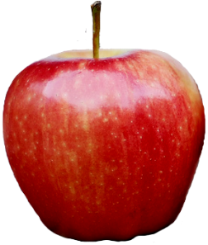

Other information
Please provide a named water bottle for your child.
Vegetable or fruit snacks only please.
School fruit is available each day.
Please provide a coat every day as we often learn outside.
Please name all clothes, coats and possessions.
Reading books need to be back in school by Wednesday in order for them to be changed over and given out again by Friday.

Slide 7

How can you support at home?
Reading
Daily reading of books from school.
Use the Year 2 guided reading questions during reading sessions to help develop comprehension skills.
Share a wide range of books together – note these in reading logs if you’d like.
Writing
Revisit and practise Y1 & 2 spellings regularly. Refer to them during homework activities and encourage children to copy them down correctly.
Maths
Mental strategies – gradually moving away from relying on the hundred square.
Times tables and division facts
Telling the time
Money

Slide 8
Useful websites/resources
Hit the button – https://www.topmarks.co.uk/maths-games/hit-the-button
Times Tables Rockstars (for Year 2 from the spring term)
Spelling games and activities to support the Year 2 programme of study - https://spellingframe.co.uk/
A range of English and maths interactive games can be found here - https://www.ictgames.com/
BBC Bitesize Keystage 1 – Lots of English and Maths games here
https://www.booksfortopics.com/year-2 - A brilliant site for age appropriate book recommendations.

