Slide 1
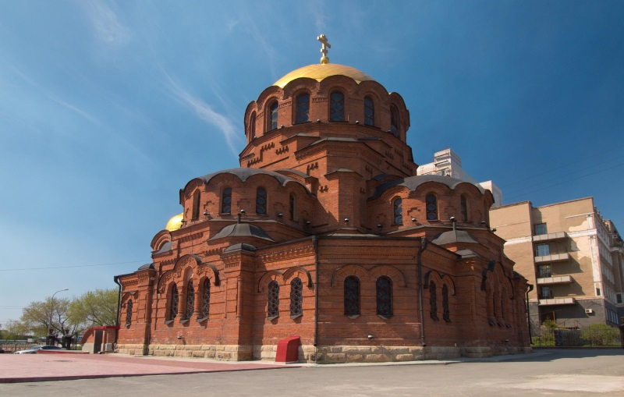
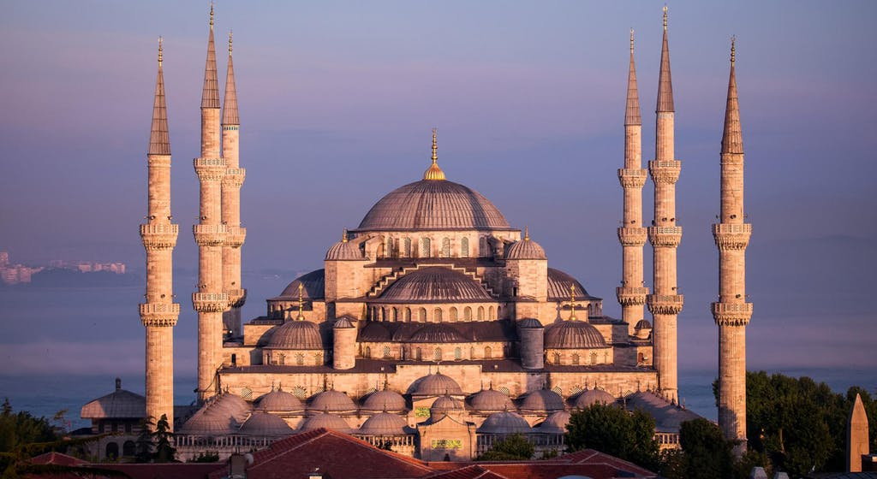
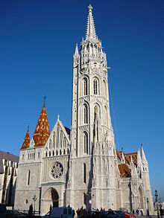
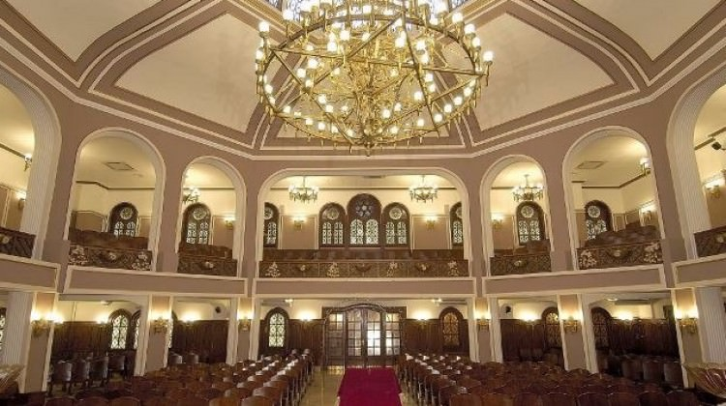
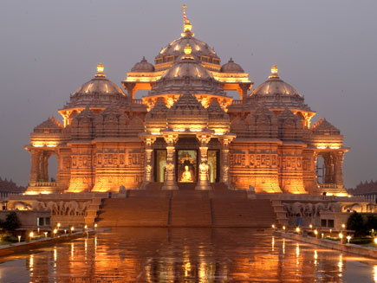
Places Of Worship

Slide 2
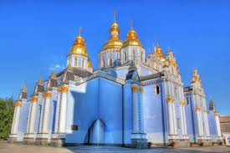
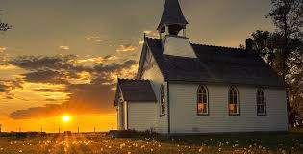
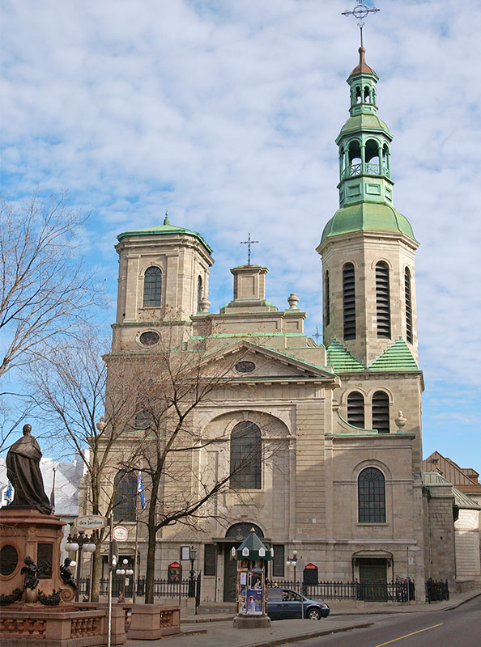
St Sophia
Churches are special places for Christians. They go to church every Sunday and pray.
CHRISTIANS

Slide 3
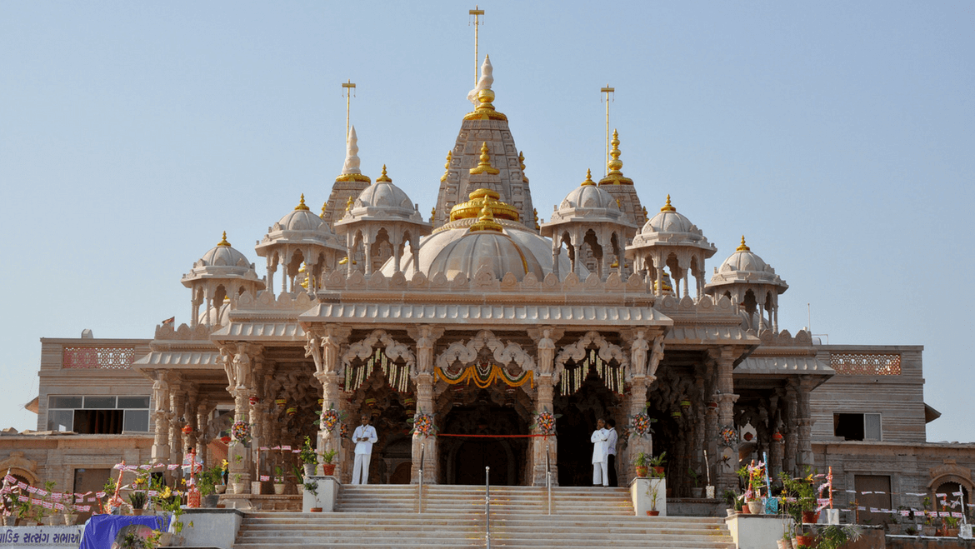
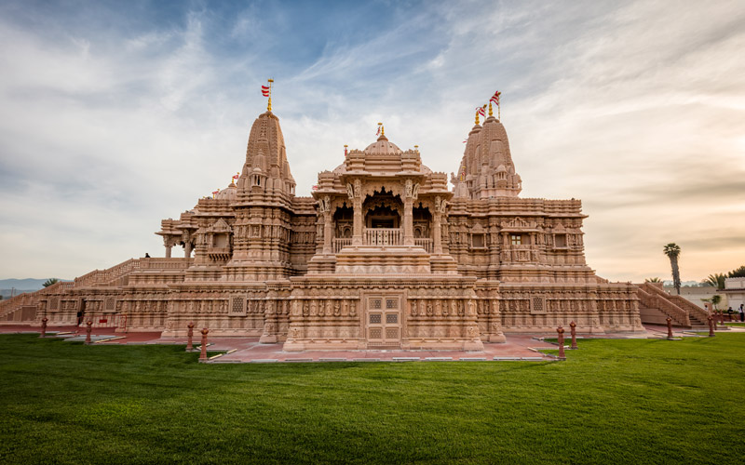
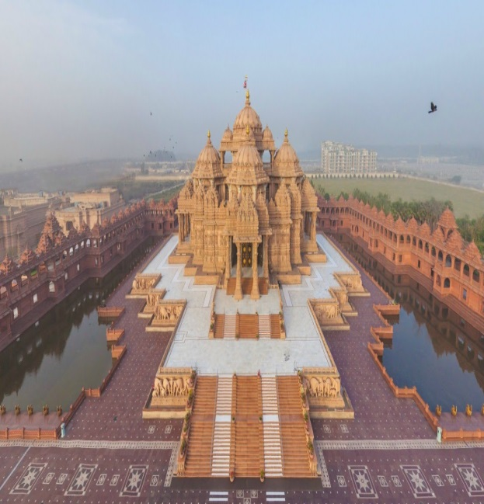
LA
India
Hindus believe in many Gods.
Hindu

Slide 4
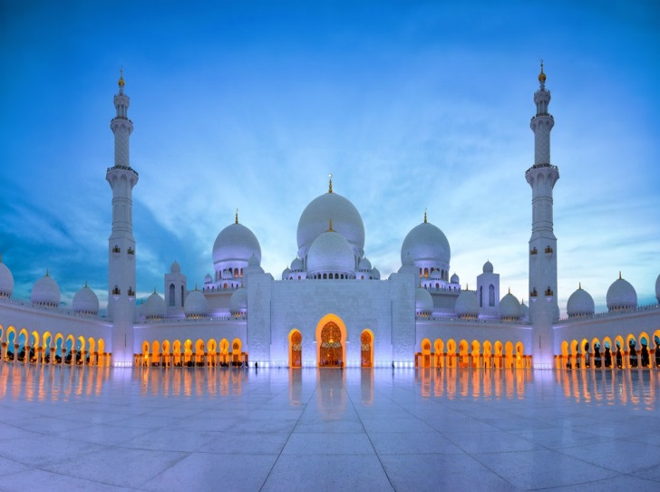
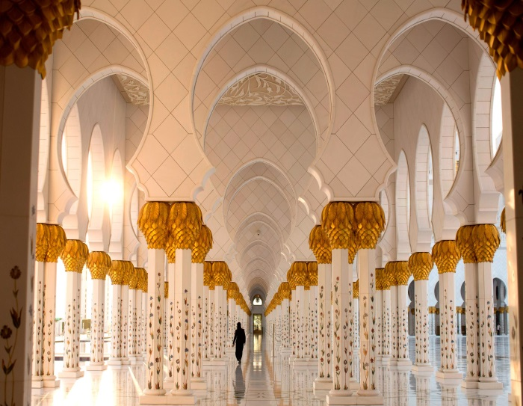
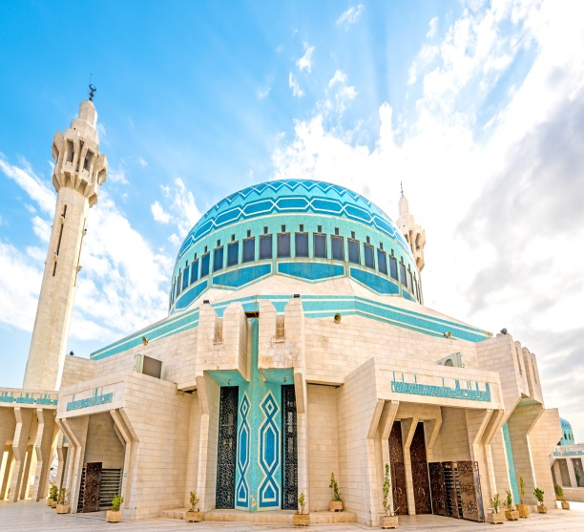
Abu Dhabi plus 2
Jordan
Mosques are place were Muslims worship. Mus lims believe in only 1 god Allah. They also need to pray 5 times a day sunrise afternoon late afternoon sunset and night. Muslims also in there life they have to go to Mecca once to worship Allah they also need to wear white clothes.

