Slide 1
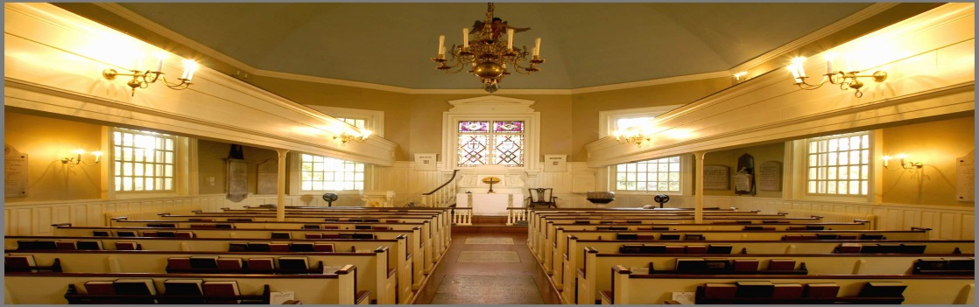
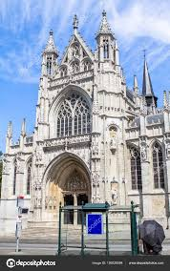
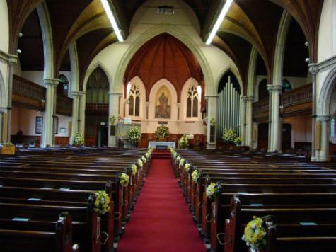
Churches of all faith

Slide 2
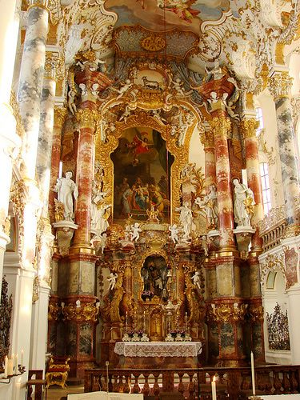
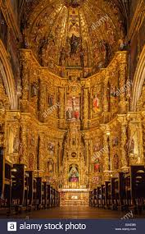
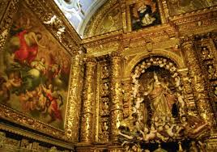
these churches are one of the most grandest churches and very good to worship the lord .

Slide 3
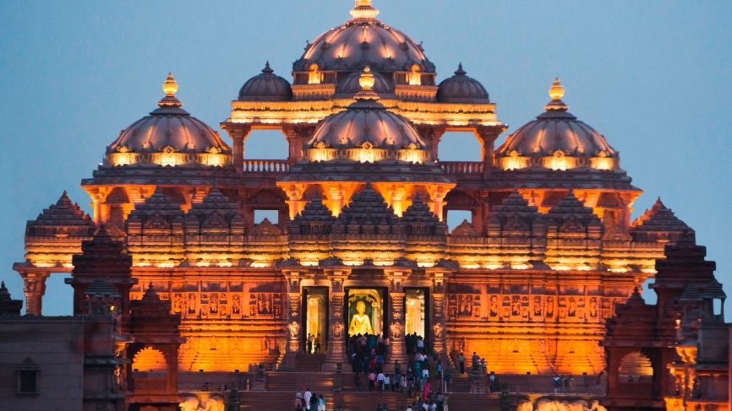
We should worship god because we need to thank him for everything in the world
and the best place to do it is in a church . Because churches are like the house of god because he is there most .
Other faiths are important to because people are different and worship other gods and faiths like hindus worship in a temple

Slide 4
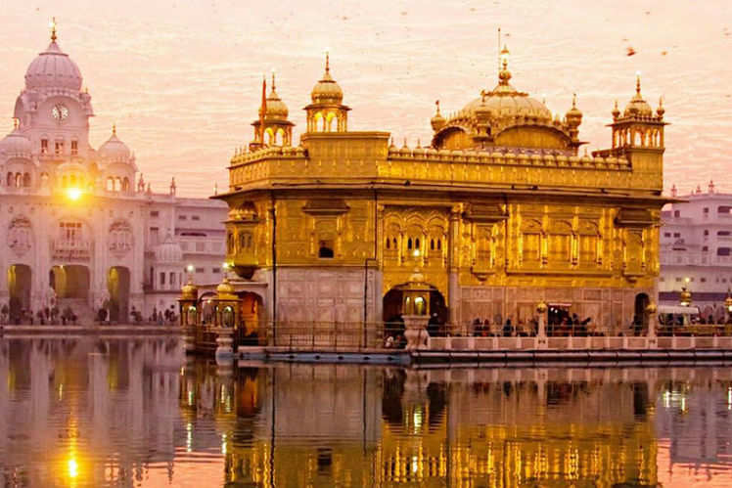
This is called gold temple world for hindus to pray to there god for what he has done for the world

