Slide 1
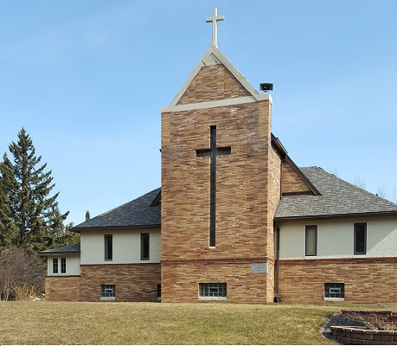
Different Churches

Slide 2
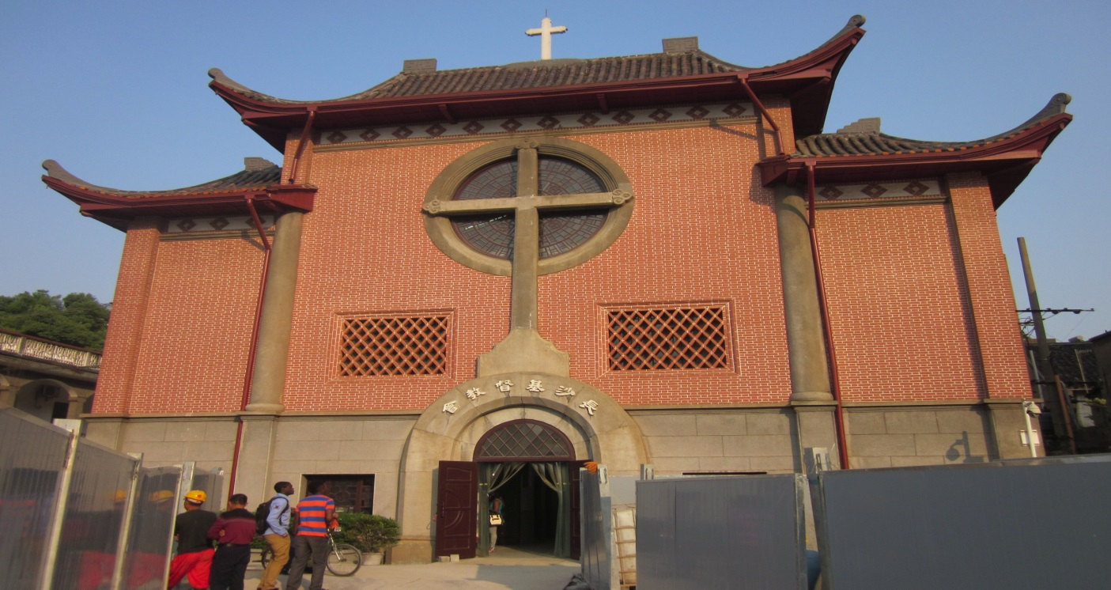
Located in Hunan
Chinese church

Slide 3
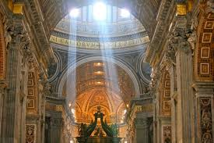
Irish Church
Located in Ireland

Slide 4
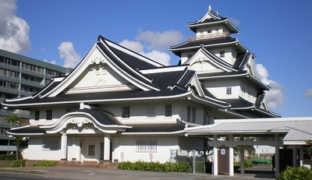
Japanese Churches
Located in Makki

