Slide 1
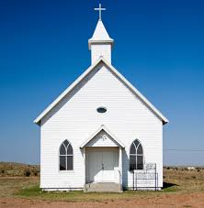
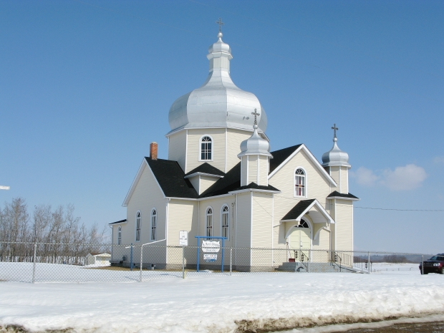
CHURCHES AROUND THE WORLD

Slide 2
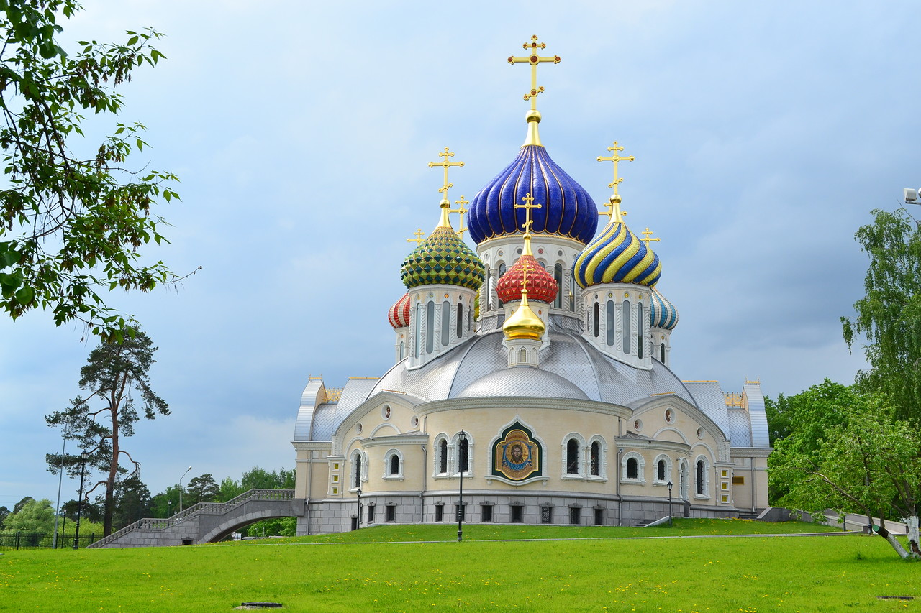
A church building or church house, often simply called a church is a building used for Christian religious activities, particularly for worship services.
The earliest identified Christian church building was a house church found between 233 and 256.

Slide 3
