Slide 1
ANTI BULLYING 2018
RESPECT

Slide 2

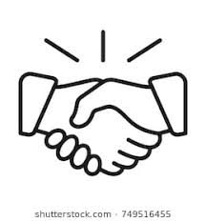
What does respect mean?
RESPECT MEANS CARE AND LOVE
ISLAM-HINDU

Slide 3

EVERYONE IS EQUAL

Slide 4
RESPECT IS IMPORTANT BECAUSE IT SHOWS LOVE AND CARE FOR EACH OTHER.

