Slide 1

Anti-bullYing week 2018
Respect

Slide 2
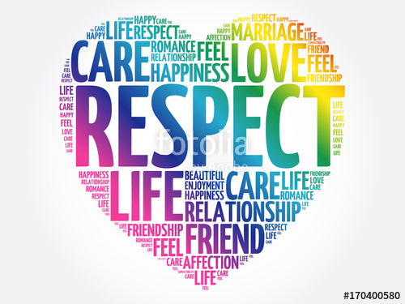


Why do we show respect?

Slide 3
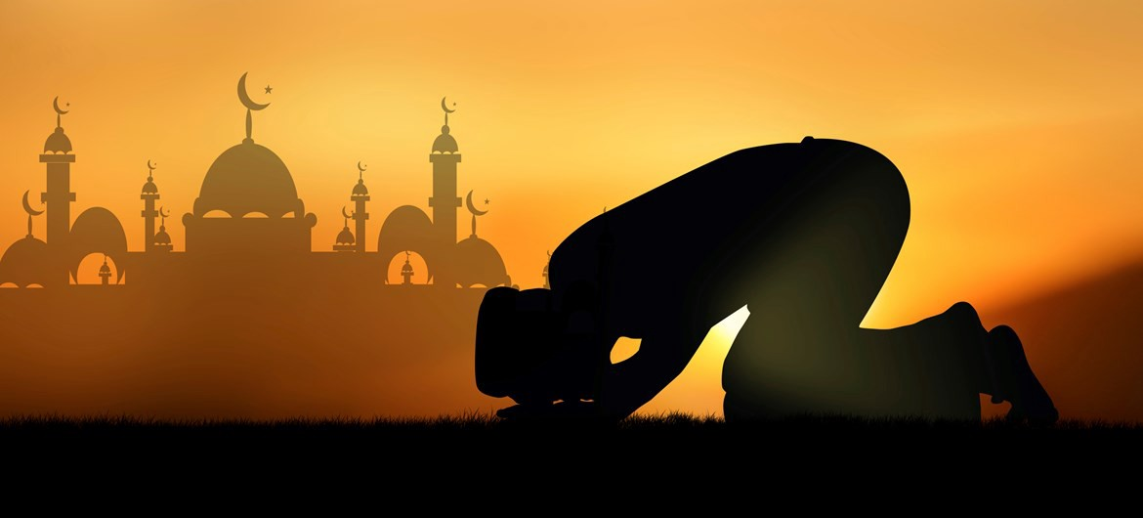
Muslim faith
When you are born you have to have honey or date rubbed on your gums to show that the baby will have a sweet life. When you get married you have got to keep a promise . They have to pray 5 times a day morning, noon, night, evening and late afternoon.

Slide 4
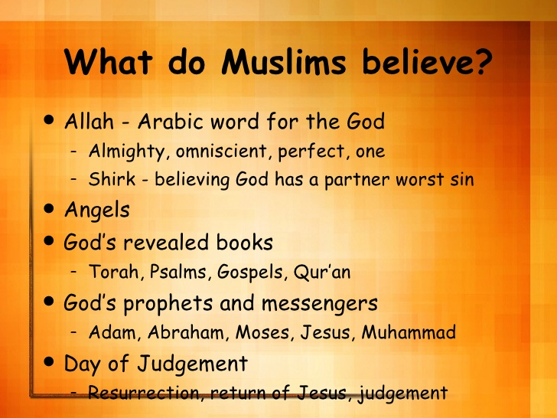

Muslim Gods
Muslims believe that there is only one god Allah.

Slide 5
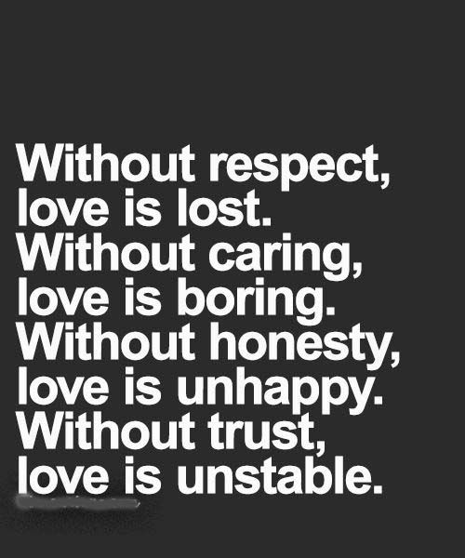
RESPECT
We should respect because everyone is different . You should never judge people by there skin colour. We all have different faith and people need to respect that.

