Slide 1
anti-bulling week 2018
Respect other faiths

Slide 2





Some respect pictures

Slide 3
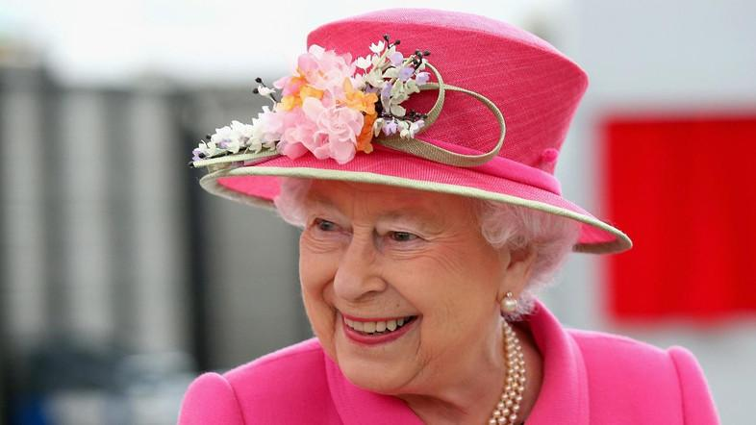
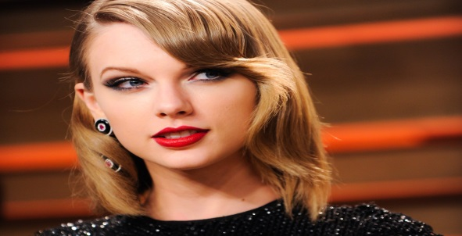
How do famous Christians show respect?
Taylor Swift is a famous Christian. She shows respect by taking up all of her time by singing and making albums for people to enjoy.
Queen Elizabeth shows respect by
looking after all of the UK
Why is respect so important?
Respect is so important because people need to be treated equally and if someone wants to play with their friends, they shouldn’t be left out so then no one feels upset.

Slide 4


Thank you for looking at our power point
By Lily Boyd and Mollie Coles year 4LS

