Slide 1
Anti Bullying week 2018
RESPECT

Slide 2


RESPECT it means to regard for the feeling,wishes or rights of others and ourselves.

Slide 3

ISLAM
Muslims need to pray 5 times a day to the Muslim god Allah. Allah has a messenger prophet Mohammed. Muslims are not allowed to eat haram food such as pork bacon and gelatine.

Slide 4
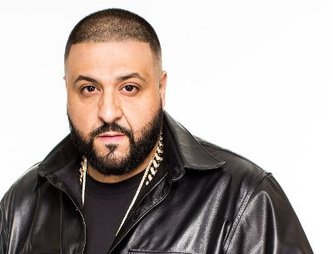
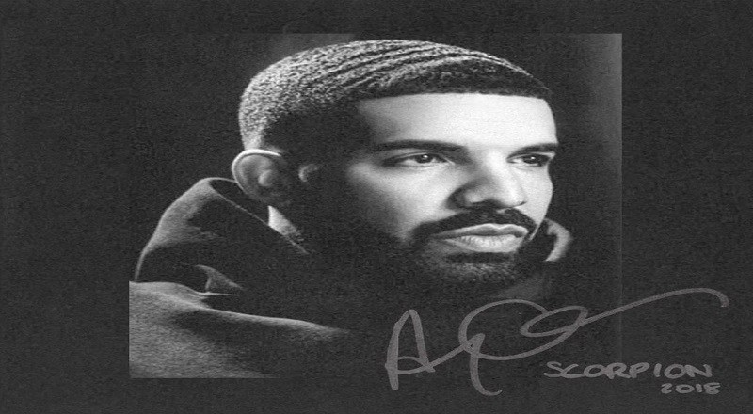
DJ Khaled
Drake
Famous Muslims

Slide 5

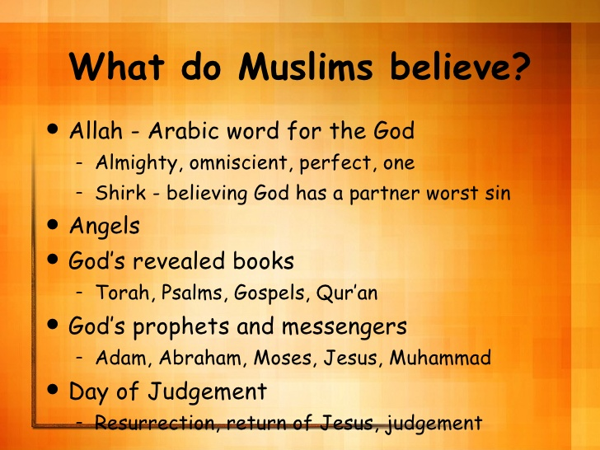
What do Muslims believe?
And many many more,

Slide 6
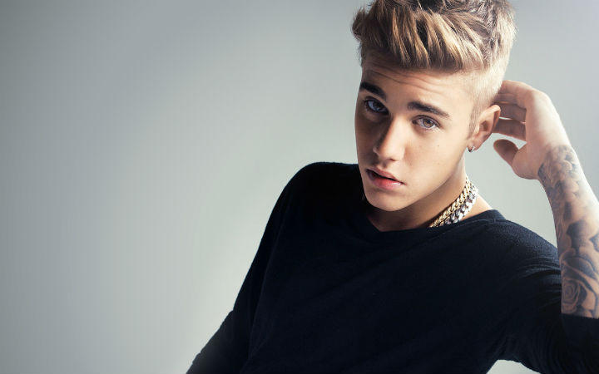
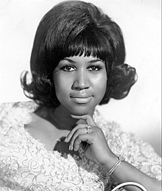
RESPECT EVERYBODY
You can respect different faiths by not judging them on there skin colour.

