Slide 1

Year 1 Phonics Screening Check
2022
Miss Adamson and Miss Bardsley
Notes:
1

Slide 2
Year 1 Phonics Screening Check Week
Statutory assessment = attendance vital
Notes:
Year 1 screening check statutory and all children across the country have to take the check.
If for any reason a child is going to be absent school MUST know.
EMPHASISE not to pressurise children and talk about the test during the week
2

Slide 3
Designed to be a light touch end of year assessment of phonic ability to see if pupils are reaching the age expected standard.
Notes:
3

Slide 4
The ‘Check’
Consists of 40 words:
20 real words and 20 alien/nonsense words
There is a standard set as a ‘pass’ rate.
If children do not reach it, they will re-take the test at the same time the following year (end of Year 2)
Notes:
CB are calling it a CHECK not a test – it is for our use and we want to CHECK not TEST the children
The check assesses only decoding using phonics because this is the crucial skill which enables children to become effective readers.
At CB we do not underestimate the importance of teaching wider reading skills. All children should be taught to read for meaning and pleasure as well as to decode throughout school. If you are reading at home, when children come across an unfamiliar word its important that you at home encourage the children to decode it (sound it out) using phonics.
Numerous reading strategies in place – not like when you were in school – phonics, guided reading and individual readers.
Introducing a check of phonic decoding in Year 1 does not mean that we will delay teaching children wider literacy and comprehension skills.
Our children are used to being assessed each half term – it’s not a formal process but we regularly check where the children are up to and what their next steps for learning are.
Nonsense-words are an established assessment method in our school and they are included in ‘Letters and Sounds’ – the scheme that is suggested and we follow. We play lots of games with nonsense words in so they won’t be phased by this
4

Slide 5
The ‘Check’
Approx 5-10 minutes but no time limit
1:1 with class teacher
Self correction allowed
Don’t have to do 40 all words at one time – can have a rest and come back later
No time limit for each response
Assessment can be split over the week
Notes:
In the check, where a child immediately self-corrects their answer they will receive credit for reading the word. This is something we are teaching the children from very early on and we hope that you can do this too at home. So when reading try to get the children to think for themselves – is this a real word? Does this sound similar to a word I know?
Pupils can’t be prompted to ‘have another go’ or ‘try again’.
The results of the check will not be published on a school by school basis in Performance Tables. The information is for us as a school – something which we’ve always done anyway really – reflective practice.
Teachers can’t indicate whether a pupil has decoded a word correctly or incorrectly during the administration of the screening check but may offer encouragement or support to ensure children remain focused on the task.
5

Slide 6
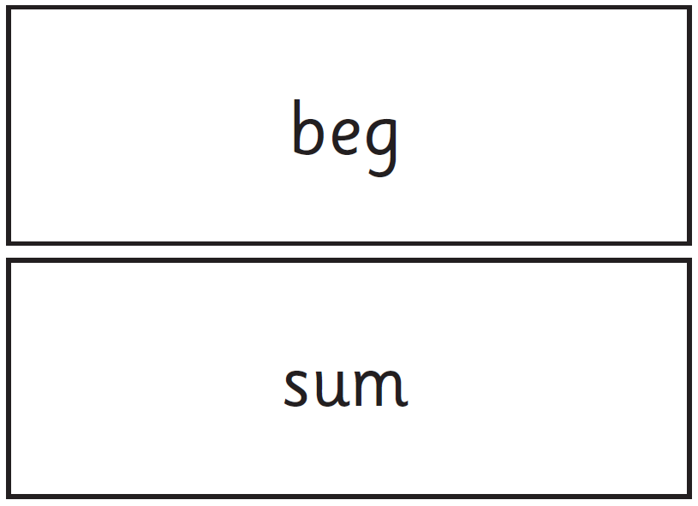
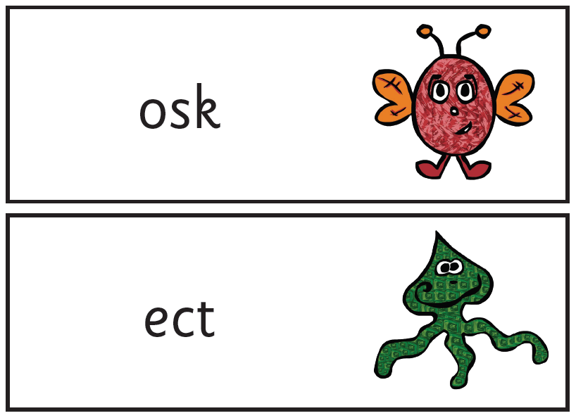
Real and Alien/Nonsense words
Notes:
They are used to assess grapheme recognition and blending
In the test these words will have a symbol next to them so that the children know they are alien/nonsense words – this way they will know that once they have sounded it out, it won’t be a word they know, and they won’t try to self correct if it doesn’t sound familiar.
Children become really familiar with the process and during phonics they are expected to segment and blend each word to avoid sight recognition which can sometimes lead children to say something incorrect when nonsense words are very similar to real words. Eg osk, some could read as ask.
6

Slide 7
How do we help as a school?
By ensuring we follow a clear phonics progression from Reception into Year 1 and that children’s progress in phonics is specifically assessed and tracked through to Year 1 and during Year 1 and 2
By providing good quality and appropriate resources for the teaching of the higher levels of phonics in Year 1
By ensuring a rich reading environment in the school so that children can apply their skills in real contexts
Reception and Year 1 – 20 minutes per day and embedded in other activities and areas of the curriculum.
Notes:
7

Slide 8

Story time Phonics

Slide 9
Phonics Phases
Organised into 6 phases, progressing from early listening of sounds to decoding and spelling complex words and phrases.
also provides some resources for activities and assessment criteria.
Phase | When is this taught? | Number of new graphemes | Additional information
3 | Reception 12 weeks | 27 | One grapheme learned for each sound. Most graphemes are 2 letters representing one sound (digraphs, e.g. ch) but some are 3 letters (trigraphs, e.g. air).
4 | Reception/Year 1 Up to 6 weeks | 0 | This is a consolidation unit. There are no new graphemes to learn. Reading and spelling of tricky words continues.
5 | Throughout Year 1 Ongoing | 22 + alternative pronunciations and spellings of learnt sounds | This is a huge phase and precedes the learning of spelling rules. Children learn alternative sounds for graphemes and choose best bet when reading words. They learn alternative spellings of phonemes and choose best bet when spelling words.
Notes:
9

Slide 10

Each phase provides a range of activities, including:
    Letter recognition – sounds and letter names
    Oral blending for reading
    Oral segmenting for spelling
    Reading and spelling high frequency and tricky words
    Identifying sounds in words and the graphemes that represent them using sound buttons, e.g.
    Caption and picture match – children are given captions containing high frequency and tricky words and have to match them to the correct pictures
    Yes/no questions with thumbs up or down for the answer. e.g. Can a bird hop?
    Lots of whiteboard work – teacher says a word, children sound talk, count the phonemes and spell it
    Tricky words – identifying the tricky parts of words

Slide 11
The check results
The check outcome will be communicated in the end of year reports
Notes:
11

Slide 12
Top tips for reading at home
-Read as often as possible, both your child’s reading book and for pleasure!
Read to your child if they are struggling with reading, and then read with your child as soon as they can.
Talk about the book by asking questions (who, what, where, when, why are the most useful) and relating it to own experiences.
Read the book more than once to build fluency and confidence.
Sing songs and play rhyming games such as I spy linked to the story
Read the book to your child first before they do.
If a child is struggling to read a word, read it for them.
Notes:
12

Slide 13
Book bands; we do assess reading every half term (comprehension or fluency) but we are following school policy to assess before moving up book bands.

Slide 14
How can you help at home?
Useful web sites (these are all on the Year 1 page on the school website)
https://www.mrthornenetwork.com/
http://www.coxhoe.durham.sch.uk/curriculum-links/literacy
https://www.bbc.co.uk/cbeebies/shows/alphablocks
http://www.bbc.co.uk/schools/wordsandpictures/phonics/
https://www.bbc.co.uk/education/topics/zcqqtfr
https://www.phonicsplay.co.uk/freeIndex.htm
http://www.sparklebox.co.uk/literacy/letters-and-sounds/#.WeyNzGhSzIU
www.ictgames.com/literacy.html
http://www.getreadingright.com.au/phoneme-pronunciation/
http://www.primaryresources.co.uk/english/english.htm#A
Notes:
14

Slide 15
Thank you for listening…
There are some sound mats at the exit.
Please feel free to take one to help support your child at home.
Notes:
AH
15

