Slide 1

Year 2 Autumn 1 PSHE Information Leaflet
Respecting Ourselves and Others; Families and Friendships
In Year 2 during Autumn 1, we will be learning about the importance of rules. We will learn about the importance of respecting ourselves and others including learning about our similarities and differences with others, how to play and work cooperatively with others and how to share opinions respectfully. We will also be learning about how to make and maintain friends and how to get help with friendships.
Pupils will create rules for the classroom.
To know the importance of being polite to others
To know how to be polite to others
The know the difference between rewards and consequences.
Pupils will learn about the ways in which they are the same as, and different to, others and that there is a great deal they share in common.
To identify special things about them that make them who they are
To describe similarities and differences between themselves and others and the things they have in common
To recognise how they are all equal despite their differences
Pupils will learn to cooperate with others to achieve a task.
To explain what cooperation is and the skills needed to cooperate well with others.
To reflect upon how well my group was able to cooperate.
To think of one skill I am good at and one I would like to get better at.
Pupils will describe what makes someone a good friend.
To think about why it is important to have good friends.
To explain what we can do to be a good friend to others.
To reflect on qualities I have which make me a good friend and those I would like to get even better at
Pupils will describe ways to help resolve arguments and disagreements without being unkind.
To discuss different scenarios where people have fallen out.
To identify bullying and teasing and know what to do if it happens.
Pupil will begin to understand that being friendly to others makes them feel welcome and included.
To understand the difference between a friend and friendly behaviour
To explain what friendly behaviour is
To explain how being unfriendly can affect other people
To know different ways that people meet and make friends
To know strategies for positive play with friends
Key vocabulary: Rules, manners, polite, rewards, consequences, respect, share, take turns, same, different, ourselves, others, individual, together, similar, likes, dislikes, cooperate, cooperation, team, group, skills, help,
support, share, listen, achieve, friend, good, kind, caring, support, help, listen, share, thoughtful, happy, respect, trust, honest, helpful, manners, conflict, sort, solve, positive, choices, consequences, disagreement, making up, friendship, trust, help, talk, listen, friend, friendly, feeling, welcome, included, positive, jealous
Further information for parents:
https://www.nspcc.org.uk/keeping-children-safe/sex-relationships/healthy-relationships/
https://www.twinkl.co.uk/blog/helping-your-child-to-develop-positive-friendships

Slide 2
Statutory Guidance Links:
Topic: Caring Friendships
how important friendships are in making us feel happy and secure, and how people choose and make friends.
the characteristics of friendships, including mutual respect, truthfulness, trustworthiness, loyalty, kindness, generosity, trust, sharing interests and experiences and support with problems and difficulties.
that healthy friendships are positive and welcoming towards others, and do not make others feel lonely or excluded.
that most friendships have ups and downs, and that these can often be worked through so that the friendship is repaired or even strengthened, and that resorting to violence is never right. • how to recognise who to trust and who not to trust, how to judge when a friendship is making them feel unhappy or uncomfortable, managing conflict, how to manage these situations and how to seek help or advice from others, if needed.
Topic: Respectful Relationships
the importance of respecting others, even when they are very different from them (for example, physically, in character, personality or backgrounds), or make different choices or have different preferences or beliefs.
practical steps they can take in a range of different contexts to improve or support respectful relationships.
the conventions of courtesy and manners
that in school and in wider society they can expect to be treated with respect by others, and that in turn they should show due respect to others, including those in positions of authority.
Topic: Being safe
how to ask for advice or help for themselves or others, and to keep trying until they are heard.
what sorts of boundaries are appropriate in friendships with peers and others

Slide 3
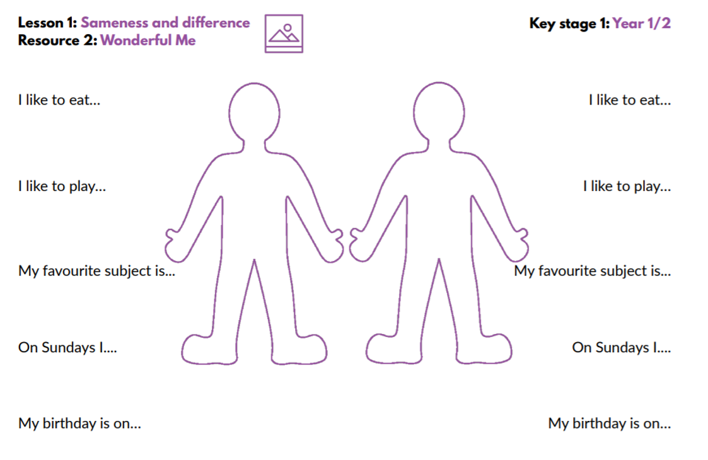
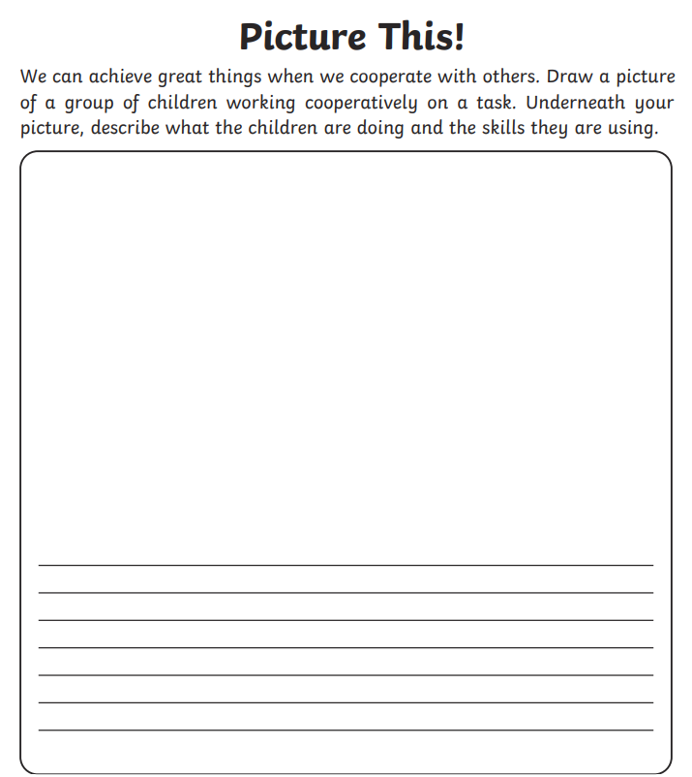
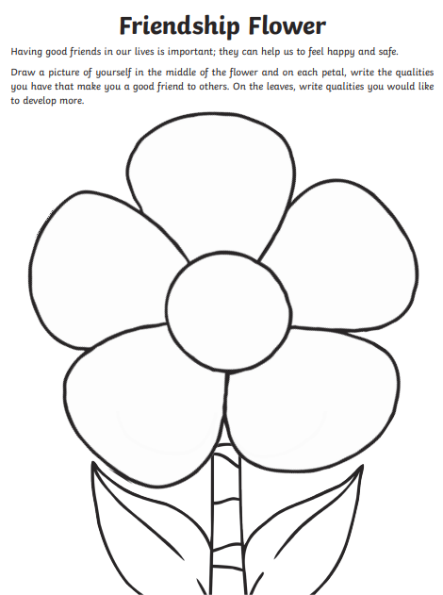
Year 2 Autumn 1 PSHE Information Leaflet
Respecting Ourselves and Others; Families and Friendships
Below are some examples of resources that will be used within the lessons:

