Slide 1


5 past&present presidents of USA
BY JOSHUA PERKINS

Slide 2
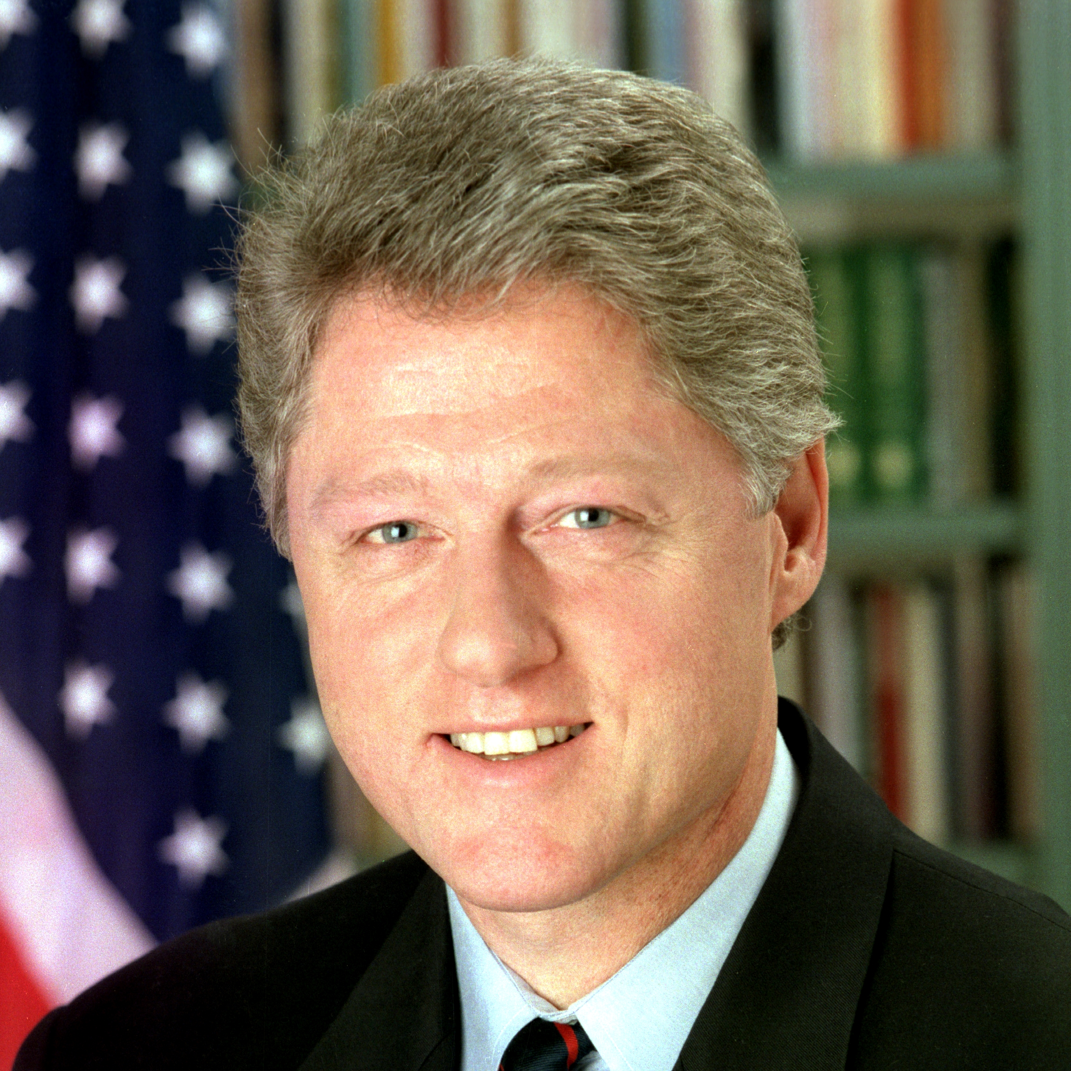

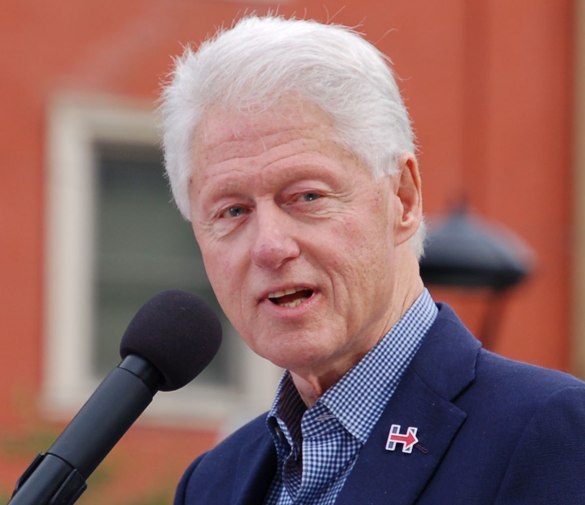
Bill Clinton
Bill Clinton’s father was a travelling salesman who died 3 months before Bill was born.Reared in part by his grandmother,Bill Clinton developed political aspirations.Bill’s administration got off to a rocky start,the victim of what some critics called ineptitude and bad judgement. This,however,changed into a healthy career.

Slide 3
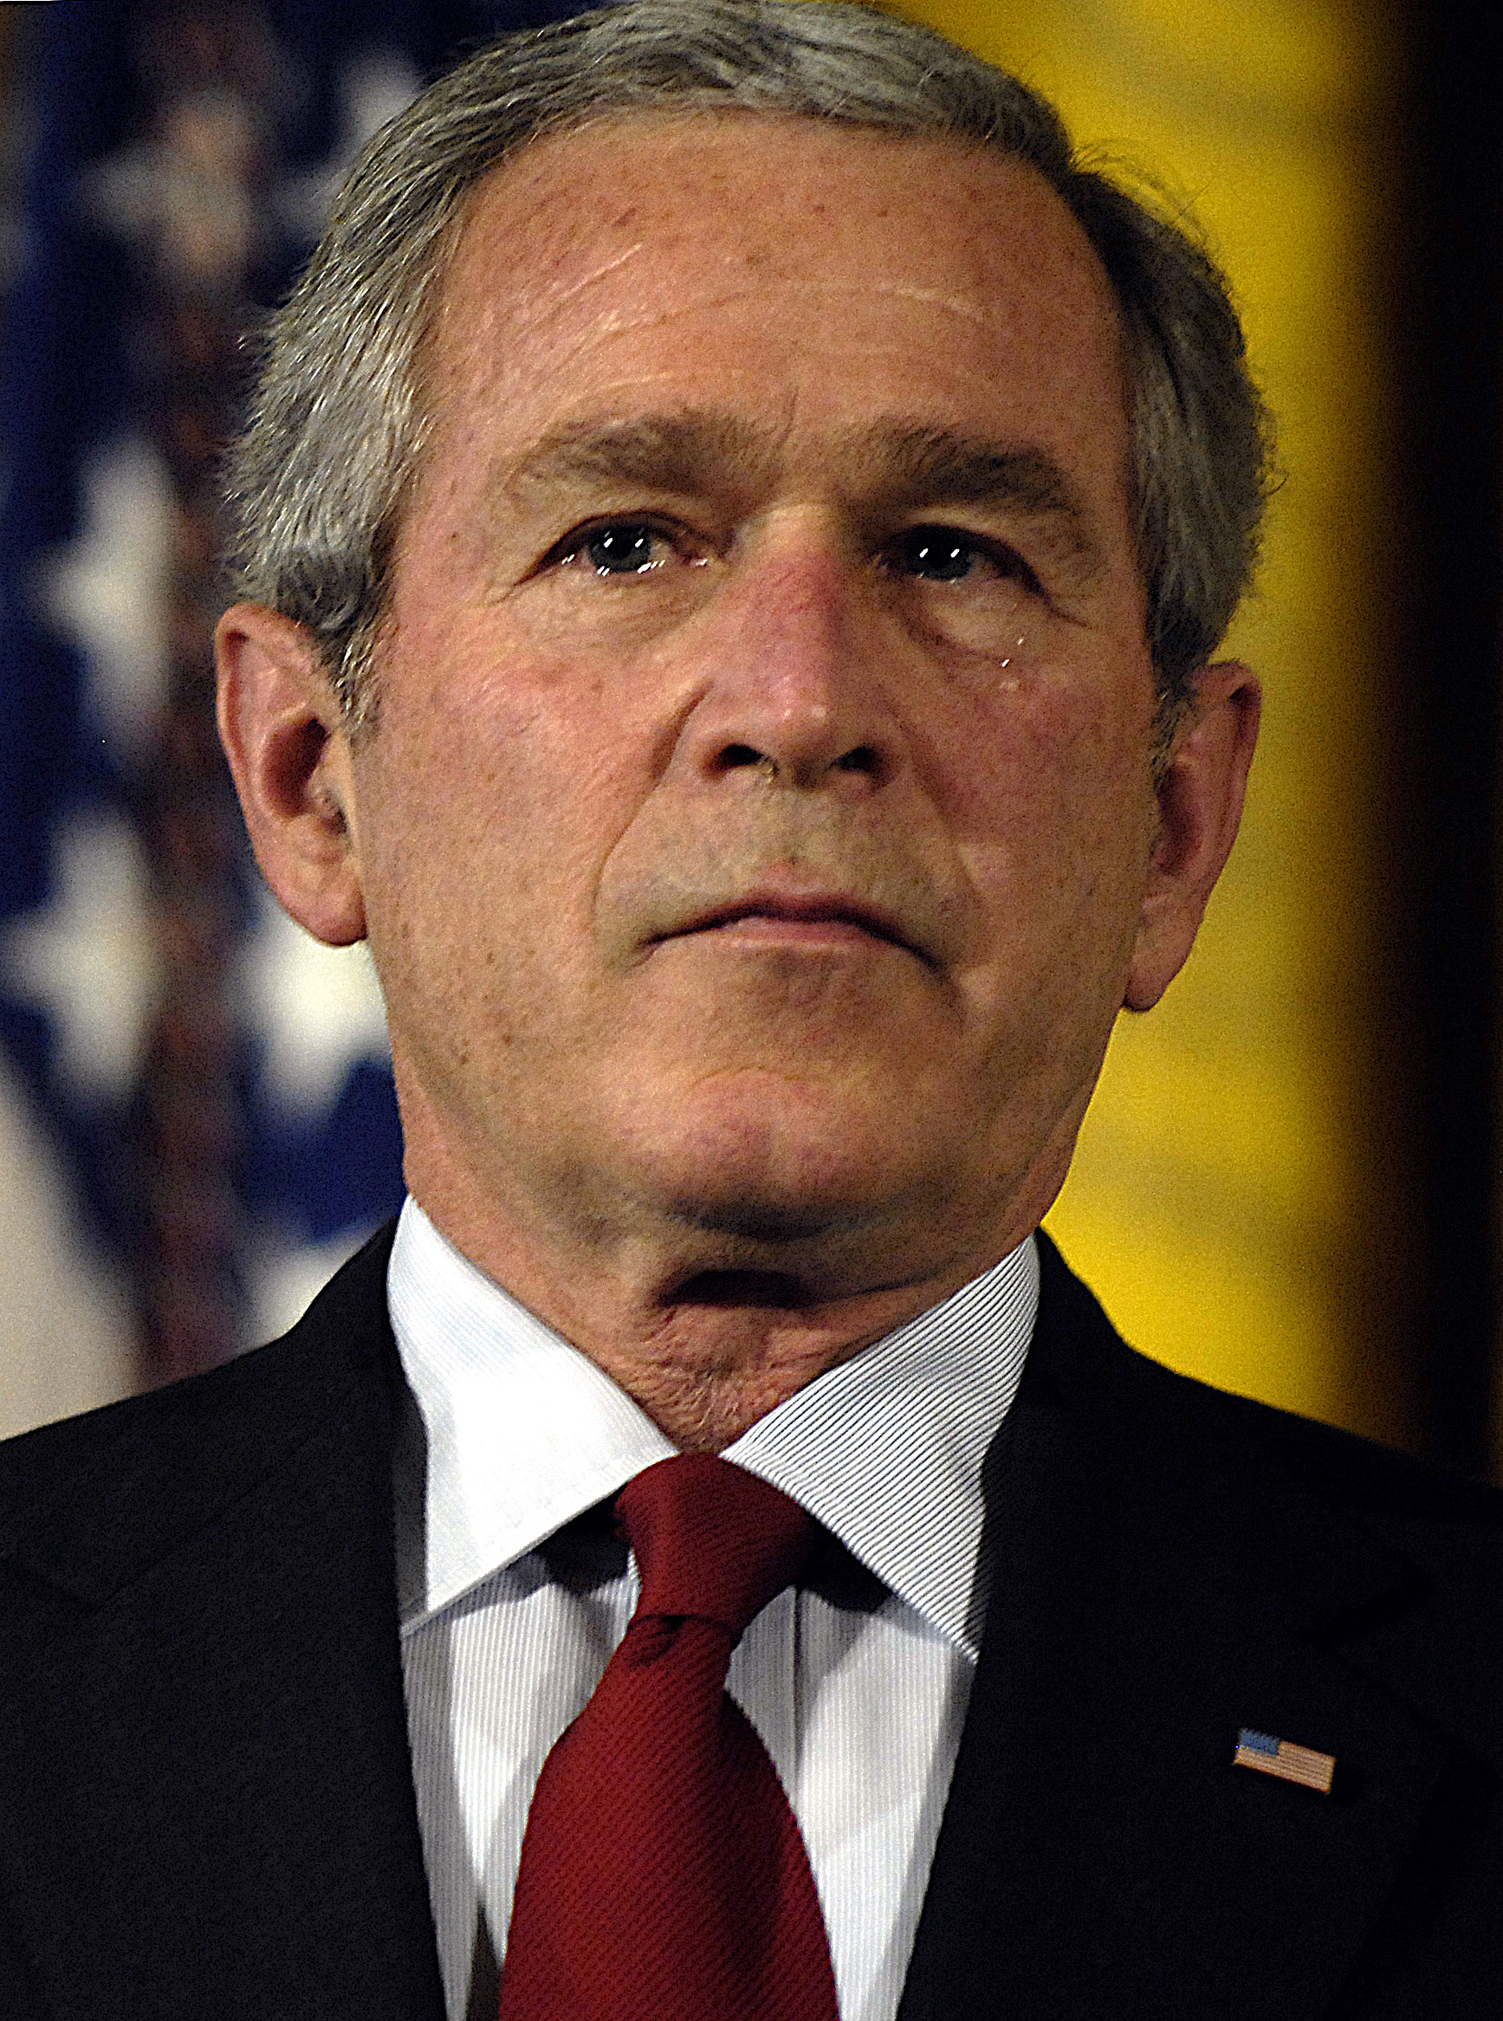
George W. Bush
George Walker Bush was an American president from 2001 to 2009.He was the 43rd president of USA.He had previously served as the 46th governor of Texas.

Slide 4
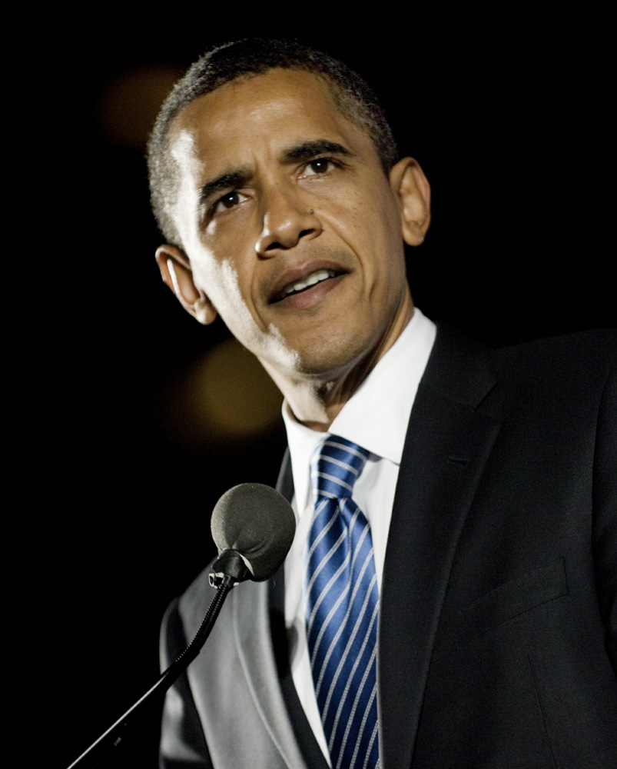
Barack Obama
Barack Hussein Obama was an American president from 2009 to 2017. He was the 44th president of the USA.
DID YOU KNOW ?
USA citizens wanted Barack’s wife to run for president.
He was the first black president of the USA.
This Photo by Unknown Author is licensed under CC BY-SA

Slide 5
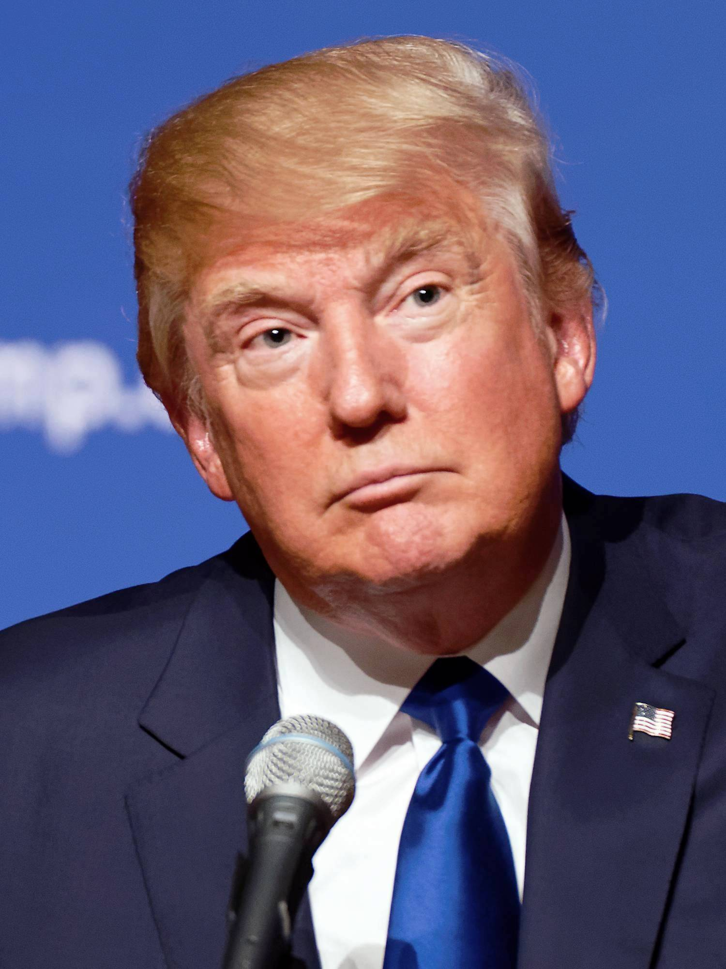
Donald Trump
PICTURE
FACTS
Donald John Trump was an American president from 2017 to 2021. He was the first USA president without prior military or governor service. Donald made many false and misleading statements.

Slide 6
JOE BIDEN
Joe Biden is the current USA president. He is the 46th. Joe Biden was Barack Obama’s vise president. Joe Robinette Biden Jr. was raised in Scranton.

Slide 7
THANK YOU FOR WATCHING.THIS TOOK ME A LONG TIME SO I HOPE YOU ENJOYED. BYE.

