Slide 1



5 Facts about the last 5 Presidents of the United States of America!

Slide 2

Bill Clinton
1993 - 2001
He studied at Yale Law school
He can play the saxophone
He was born in 1946
He was impeached but still finished his term as President
His wife Hilary Clinton is still in Politics now and even ran for President against Donald Trump

Slide 3
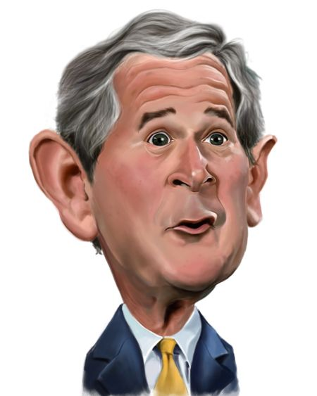
George .W. Bush
2001 - 2009
He was born in 1946
He was President when September 11th happened
His father George H. W. Bush was the 41st President
He went to Yale College & Harvard Business School
He served in the Texas Air National Guard

Slide 4

Barack Obama
2009 - 2017
He was the first black President
He was born in 1961
He studied Law at Occidental College, Columbia University (BA) & Harvard University (JD)
He grew up in Hawaii
In 2008 & 2012, he was named Time magazine’s “Person of the Year.”

Slide 5

Donald Trump
2017 - 2021
He was born in 1946 in New York
He was the star of the American version of ‘The Apprentice’
He majored in economics at the University of Pennsylvania's Wharton School
He was the third president in U.S. history to be impeached
Before he was President he owned & managed hotels, casinos, golf courses, resorts, and residential properties all around the world.

Slide 6
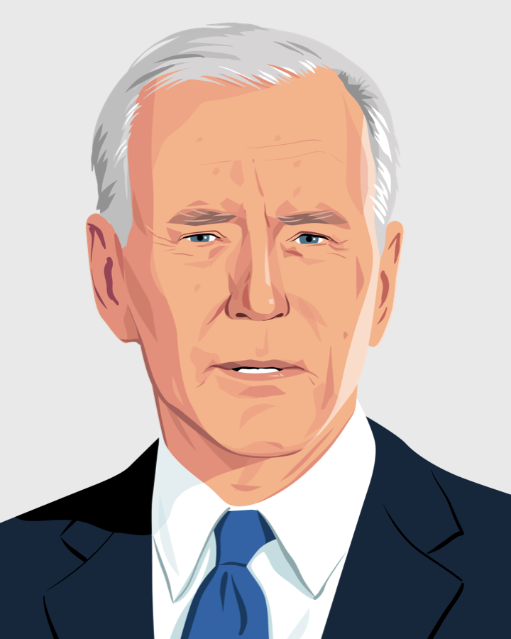
Joe Biden
2021 - Present
When he was a boy he has a stutter
He studied law at Syracuse University
He failed in his medical to fight in the Vietnam war due to his Asthma
He loves ice cream
He was born 1942, which makes him the oldest ever President at 77 years old!

