Slide 1
5 AMERICAN PRESIDENTS
Enjoy.

Slide 2
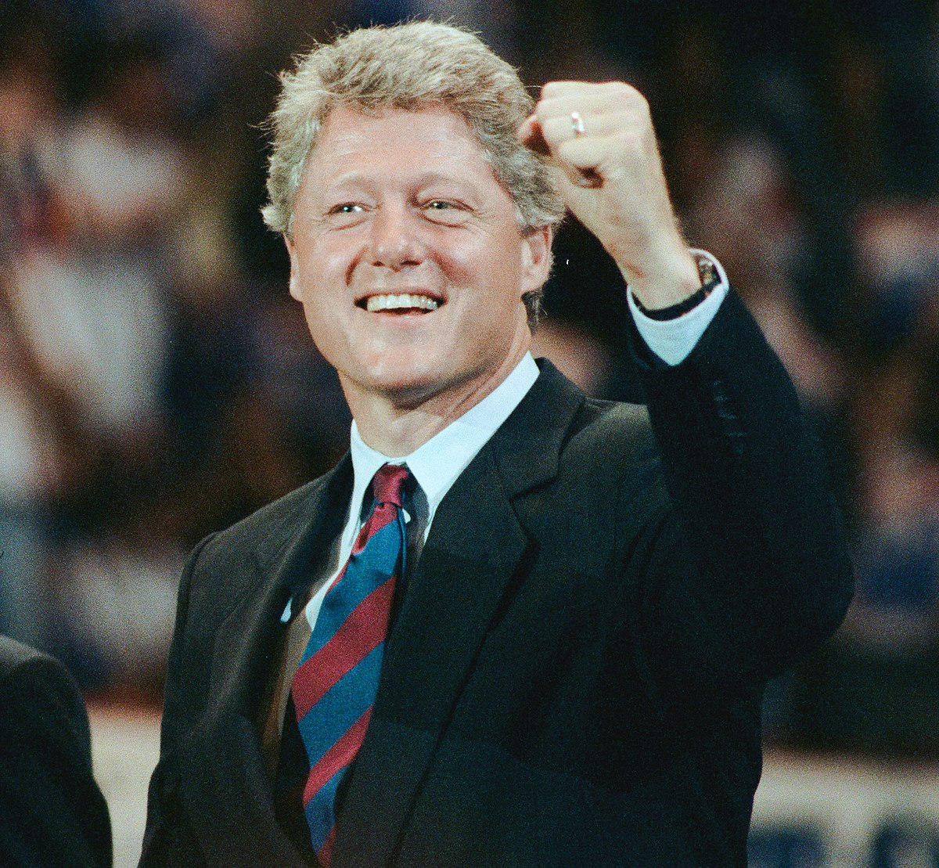
Bill clinton
William Jefferson Clinton (born August 19, 1946) was an American lawyer and politician who served as the 42nd president of the United States from 1993 to 2001.
He was born and raised in Arkansas and attended Georgetown University, University College, Oxford and Yale Law School.
He met Hillary Rodham at Yale and they were married in 1975.
After graduating from law school, Clinton returned to Arkansas and won election as state attorney general, followed by two non-consecutive terms as Arkansas governor.
Clinton was elected in 1992, defeating incumbent Republican President George H. W. Bush.

Slide 3
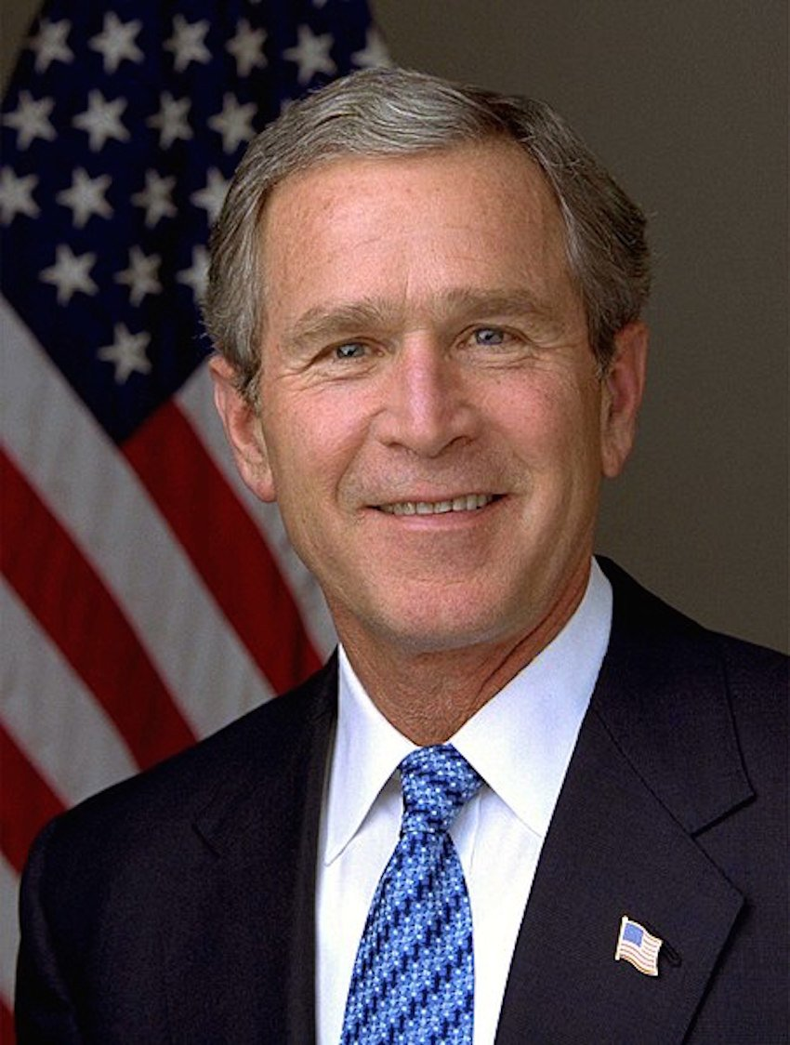
GEORGE W. BUSH
George Walker Bush (born July 6, 1946) was an American politician and businessman who served as the 43rd president of the United States from 2001 to 2009.
Bush was the eldest son of Barbara and George H. W. Bush.
As such he is the second son of a former United States president to himself become the American president, with the first being John Quincy Adams, the son of John Adams.
Bush was re- elected to a second term in the 2004 presidential election, defeating Democratic Senator John Kerry in a close race.

Slide 4
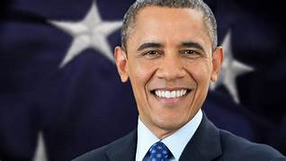
BARACK OBAMA
Barack Hussein Obama (born August 4, 1961) was an American politician, academic, author and attorney who served as the 44th president of the United States from 2009 to 2017.
Obama was born in Honolulu, Hawaii.
After graduating from Columbia University in 1983, he worked as a community organizer in Chicago.
In 1988, he enrolled in Harvard Law School, where he was the first black person to be president of Harvard Law Review.

Slide 5

Donald Trump
Donald John Trump (born June 14, 1946) is an American politician who was the 45th president of the United States from 2017 to 2021.
Before entering politics he was a businessman and television personality.
Born and raised in Queens, New York City, Trump attended Fordham University for two years and received a bachelor’s degree in economics from the Wharton School of the University of Pennsylvania.

Slide 6
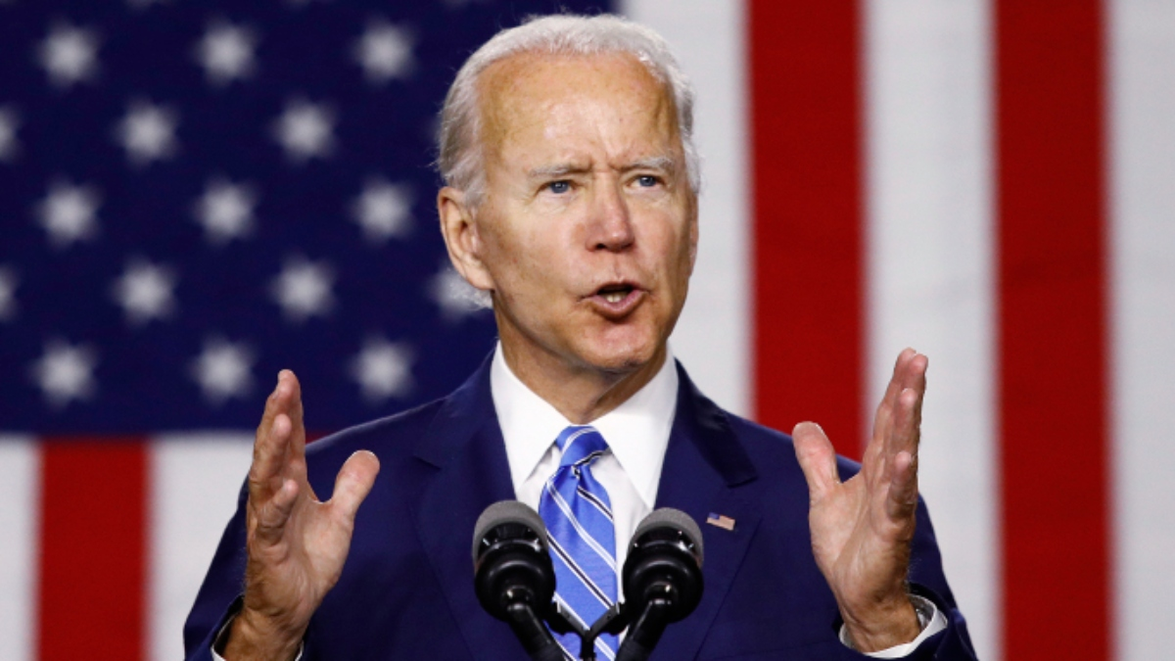
Joe Biden
Joseph Robinette Bidon Jr. (born November 20, 1942)is an American politician serving as the 46th and current president of the United States.
Raised in Scranton, Pennsylvania, and New Castle County, Delaware, Biden studied at the University of Delaware before earning his law degree from Syracuse University in 1968.
He was elected to the New Castle Country Council in 1970 and became the sixth-youngest senator in American history when he was elected to the U.S. Senate from Delaware in 1972, at the age of 29.

Slide 7

Thanks for watching

