Slide 1

A new way to teach
Telling the Time
Mrs Wendy Edwards
Alvanley and Manley Village School 2026

Slide 2
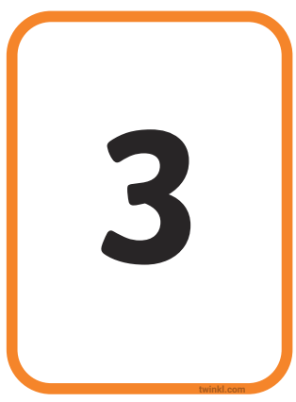
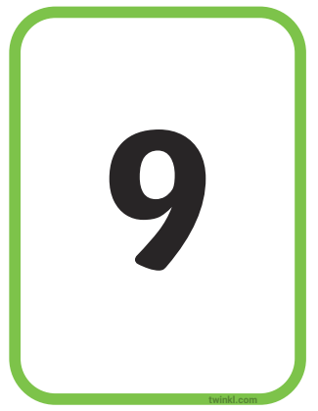
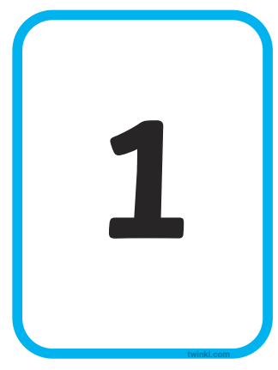
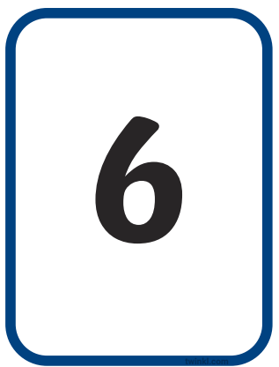
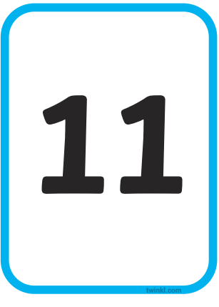
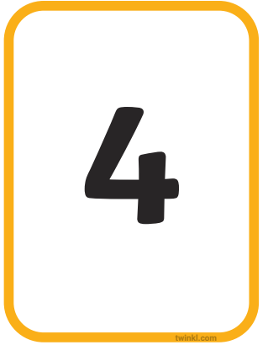
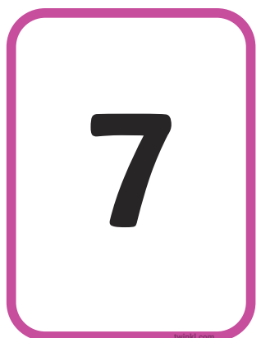

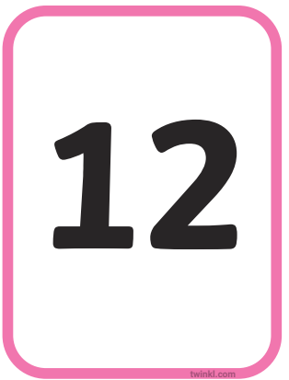
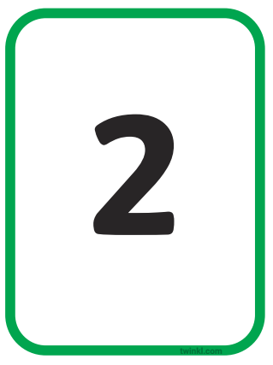
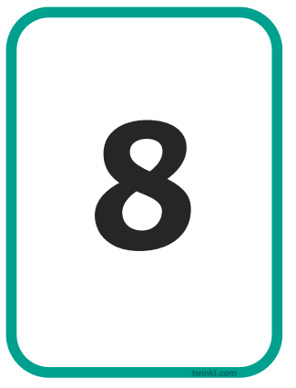
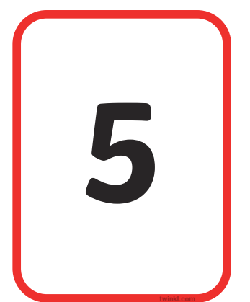
Year 1 o’clock

Slide 3
Year 1 o’clock
Step 1
Put the number cards 1 – 12 in order.
Start with numbers in a straight line.

Slide 4
Year 1 o’clock
1 o’clock
Step 2
Introduce the ‘hour’ hand.
Practice telling o’clock times.

Slide 5
Year 1 o’clock
2 o’clock
Step 2
Introduce the ‘hour’ hand.
Practice telling o’clock times.

Slide 6
Year 1 o’clock
3 o’clock
Step 2
Introduce the ‘hour’ hand.
Practice telling o’clock times.

Slide 7
Year 1 o’clock
11 o’clock
Step 2
Introduce the ‘hour’ hand.
Practice telling o’clock times.

Slide 8
Year 1 o’clock
Step 3
Explore ‘What happens after 12 o’clock?’
Show that we go back to 1 o’clock.

Slide 9
Year 1 o’clock
1 o’clock
Step 4
We are ready to put the numbers in the familiar ‘clock ‘circle.

Slide 10
Year 1 o’clock
1 o’clock
Step 4
We are ready to put the numbers in the familiar ‘clock ‘circle.

Slide 11
Year 1 o’clock
2 o’clock
Step 4
Practice telling o’clock times.

Slide 12
Year 1 o’clock
3 o’clock
Step 4
Practice telling o’clock times.

Slide 13
Year 1 o’clock
12 o’clock
Step 7
Explore ‘What happens after 12 o’clock?’
Show that we go back to 1 o’clock.

Slide 14
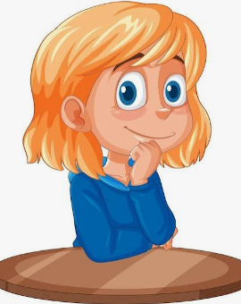
Resist the temptation to rush on to half past until your child has mastered o’clock.

Slide 15
Year 1 half past
half past 1
Step 8
Spread the cards out in a line again. Leave a bit more of a gap now.
Explain that, because the hour hand is half way between 1 and 2, we say it is ‘half past 1’.

Slide 16
Year 1 half past
half past 2
Step 5
Practice making other half past times.

Slide 17
Year 1 half past
half past 3
Step 8
Practice making other half past times.

Slide 18
Year 1 half past
Step 8
Explore ‘What happens after half past 12.
Show that we go back to 1 o’clock.

Slide 19
Year 1 half past
half past 12
Step 9
Back to the circular clock face.
Leave a bigger gap between the numbers and practice finding half past.

Slide 20
Once this is secure, there is lots of Maths you can do using your circular number line to work out what time it will be:
Half an hour later
Half an hour earlier
We will not refer to or use the minute hand at all in Y1.

Slide 21
Year 2 quarter past
Step 10
Explore what time this could be.
It is not 1 o’clock or 2 o’clock. It cannot be half past 1 as the hour hand is not half way between 1 and 2.

Slide 22
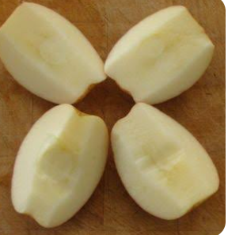
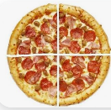
Year 2 quarter past
quarter of an apple
quarter of a pizza
Step 10
Split the 2 numbers apart. Show where half past would be.
The hour hand is half way between o’clock and half past.
Knowledge of quarters will support children to understand that the hour hand is pointing to quarter past 1.

Slide 23
Year 2 quarter past
Step 10
Practice telling quarter past times on your number line now.
Remember to keep the numbers far apart.

Slide 24
Year 2 quarter past
Step 11
Practice telling quarter past times on your circle number line now.
Remember to keep the numbers far apart.

Slide 25
Repeat the whole process for quarter to.
At this stage we will still not refer to or use the minute hand.

Slide 26
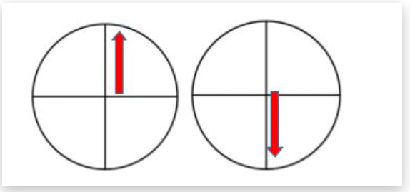
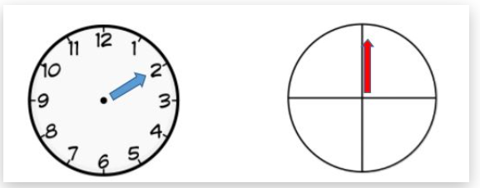
Introducing the minute hand – end of Y2.
Step 12
When we think the children are ready, we will introduce a minute hand.
This might show o’clock.
It might show half past.
By now, children will have two little clocks.
Each clock will have only 1 hand.
They will use the minute hand clock to provide more information and detail.

Slide 27
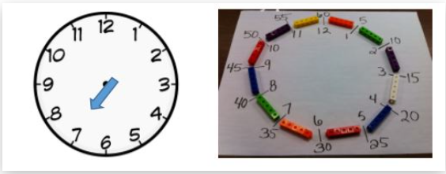
In Y3 and Y4 …
In Y3 and Y4, we will support children to understand that there are 60 minutes in one hour. They will find this out by building a clock model.
If children can already count in 5s to 60, it will be really helpful.

Slide 28
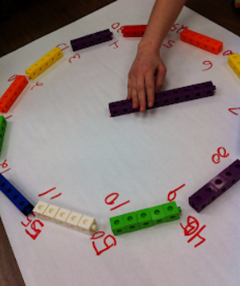
In Y3 and Y4 …
Children will practice moving the minute hand around the clock and counting in 5s.
5 past, 10 past, quarter past, 20 past, 25 past, half past.
They will learn that AFTER half past, we say ‘to’ the next hour.
25 to, 20 to, quarter to, 10 to, 5 to.

Slide 29
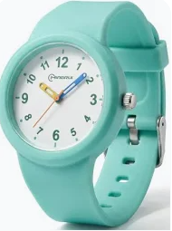
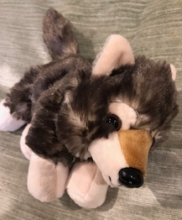
What can families do to support?
Practice putting number cards 1 – 12 in order as a straight line and then as a clockface circle.
Notice clocks in the house and also when you are out of the house.
If you are buying your child a watch, consider buying an analogue watch. Reading a clockface is an important life skill.
Look at the time books with your child when ‘Tell the Time Wolf’ comes home. (Class 2 and 3)
Practice counting up in 5s.

