Slide 2

at

Slide 3

pim

Slide 4
tap

Slide 5
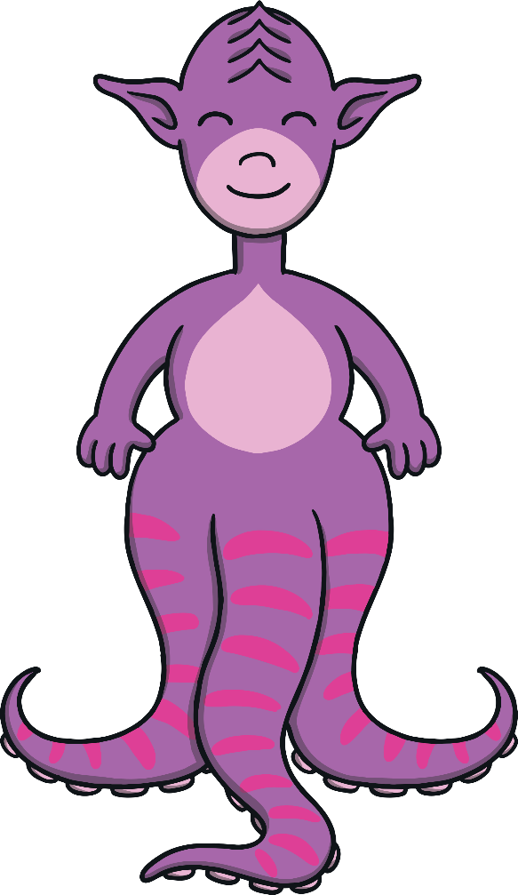
gan

Slide 6
sit

Slide 7

nid

Slide 8
nip

Slide 9

kag

Slide 10
man

Slide 11
pit

Slide 12
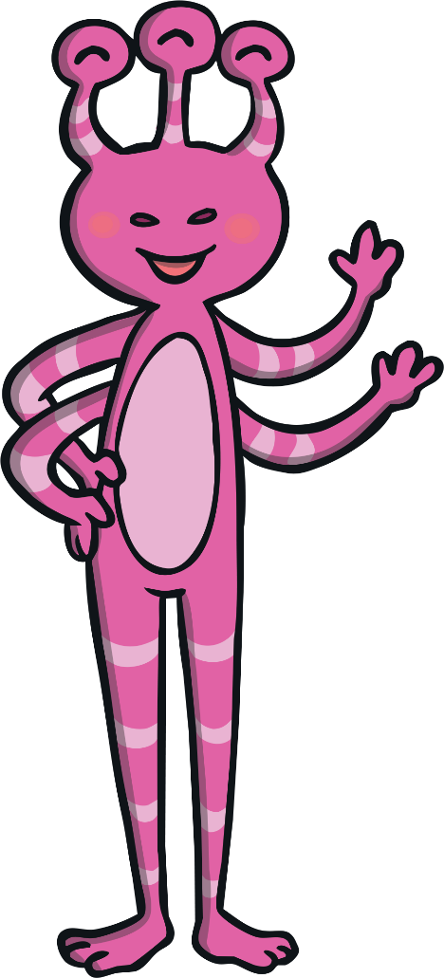
seck

Slide 13
pin

Slide 14

fip

Slide 15
map

Slide 16
teg

Slide 17
din

Slide 18

tull

Slide 19
gas

Slide 20
cak

Slide 21
cop

Slide 22
nad

Slide 23
dit

Slide 24
pop

Slide 25
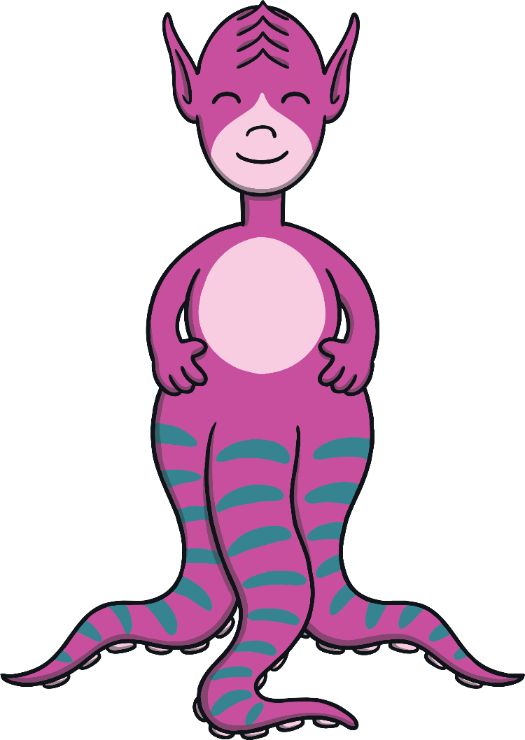
gis

Slide 26

keb

Slide 27
sag

Slide 28
kid

Slide 29
fot

Slide 30
cat

Slide 31
sa

Slide 32
deck

Slide 33

gak

Slide 34
panic

Slide 35
dack

Slide 36
sunset

Slide 37

cag

Slide 38
cup

Slide 39
nin

Slide 40
rap

Slide 41
rug

Slide 42

gop

Slide 43
huff

Slide 44
nen

Slide 45
bell

Slide 46
fit

Slide 47
pib

Slide 48
lot

Slide 49
mep

Slide 50
mess

Slide 51
doll

Slide 52

gock

Slide 53
off

Slide 54
tas

Slide 55
kick

Slide 56
dat

Slide 57
sat

Slide 58
mip

Slide 59
mim

Slide 60

kig

Slide 61
dim

Slide 62
rin

Slide 63
pem

Slide 64
dog

Slide 65
reb

Slide 66
hab

Slide 67
pat

Slide 68
back

Slide 69
beff

