Slide 2





sing

Slide 3
aim

Slide 4
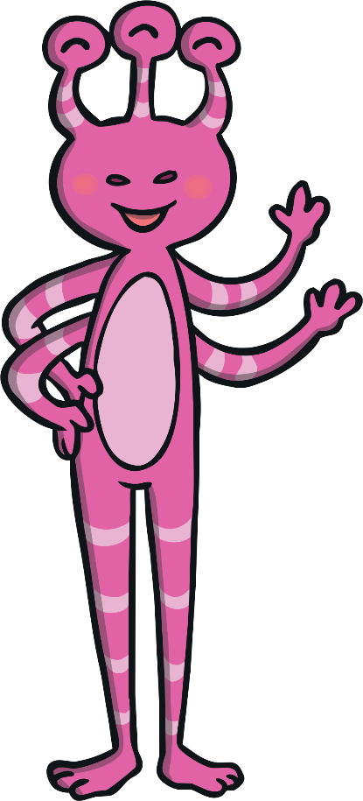
ain

Slide 5

jix

Slide 6
boat

Slide 7
queet

Slide 8
born

Slide 9
buzz

Slide 10
charming

Slide 11

charp

Slide 12
chart

Slide 13
gair

Slide 14
check

Slide 15
cheek

Slide 16

vair

Slide 17
chip

Slide 18
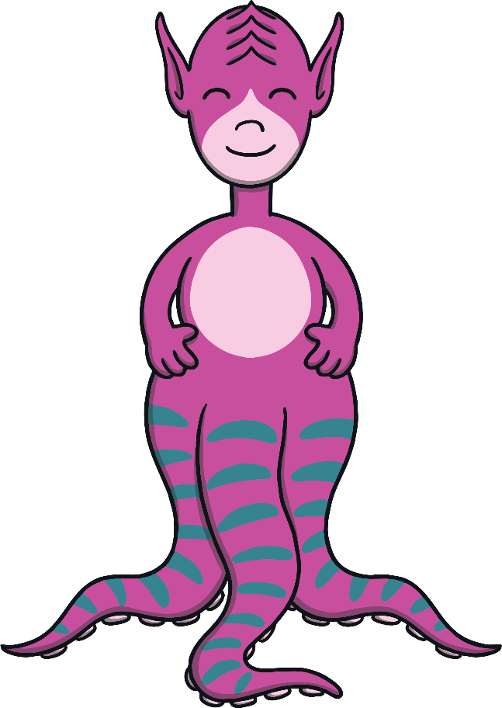
cheem

Slide 19
chop

Slide 20
chum

Slide 21
cobweb

Slide 22
coin

Slide 23
dinner

Slide 24
garm

Slide 25
doom

Slide 26
exit

Slide 27

darp

Slide 28
fair

Slide 29
feel

Slide 30

pown

Slide 31
farm

Slide 32
fix

Slide 33
fur

Slide 34
jang

Slide 35
quiz

Slide 36
dax

Slide 37
goal

Slide 38
goat

Slide 39
poit

Slide 40
hang

Slide 41
high

Slide 42

ving

Slide 43
hood

Slide 44

doin

Slide 45
horn

Slide 46
how

Slide 47
fazz

Slide 48
jam

Slide 49

yair

Slide 50
jazz

Slide 51
jet

Slide 52
gorn

Slide 53
lair

Slide 54
zem

Slide 55
lightning

Slide 56
vark

Slide 57
liquid

Slide 58
thard

Slide 59
rog

Slide 60
look

Slide 61
ched

Slide 62
main

Slide 63

jorb

Slide 64
manure

Slide 65
theen

Slide 66
zoal

Slide 67
march

Slide 68
midnight

Slide 69
lail

Slide 70
mix

Slide 71
shog

Slide 72
thait

Slide 73
modern

Slide 74
quock

Slide 75
moth

Slide 76
lart

Slide 77
nigh

Slide 78

chorm

Slide 79
giving

Slide 80
person

Slide 81
shick

Slide 82
queen

Slide 83
zear

Slide 84
quick

Slide 85
hing

Slide 86
quit

Slide 87
beard

Slide 88
yell

Slide 89
river

Slide 90
vol

Slide 91
road

Slide 92
bish

Slide 93
roof

Slide 94
chob

Slide 95
rush

Slide 96
sail

Slide 97
vook

Slide 98
see

Slide 99
shed

Slide 100
veen

Slide 101
shock

Slide 102
vock

Slide 103
shop

Slide 104
short

Slide 105
soil

Slide 106
garch

Slide 107
such

Slide 108
them

Slide 109
yort

Slide 110
then

Slide 111
thick

Slide 112
yis

Slide 113
thorn

Slide 114
tight

Slide 115
wath

Slide 116
toil

Slide 117
boof

Slide 118
took

Slide 119
torn

Slide 120
town

Slide 121
boach

Slide 122
turn

Slide 123
turnip

Slide 124
van

Slide 125
voom

Slide 126
visit

Slide 127
nurt

Slide 128
waiting

Slide 129
foth

Slide 130
wax

Slide 131
wishing

Slide 132
coaf

Slide 133
worn

Slide 134
yap

Slide 135
year

Slide 136
wid

Slide 137
yes

Slide 138
zigzag

Slide 139
quorg

Slide 140
zoom

Slide 141
beel

Slide 142
chush

Slide 143
doil

Slide 144
week

Slide 145
durn

Slide 146
foid

Slide 147
farmer

Slide 148
gix

Slide 149
long

Slide 150
gur

Slide 151
guzz

Slide 152
jair

Slide 153
jat

Slide 154
cash

Slide 155
jerp

Slide 156
joad

Slide 157
cheep

Slide 158
jorn

Slide 159
loat

Slide 160
peef

Slide 161
quam

Slide 162
bait

Slide 163
powder

Slide 164
quig

Slide 165
dart

Slide 166
quigh

Slide 167
that

Slide 168
yigh

Slide 169
quack

Slide 170
shan

Slide 171
rang

Slide 172
jog

Slide 173
thep

Slide 174
reef

Slide 175
thizz

Slide 176
chin

Slide 177
varn

Slide 178
rocker

Slide 179
vash

Slide 180
fighters

Slide 181
vus

Slide 182
wob

Slide 183
yazz

Slide 184
zigh

Slide 185
wig

Slide 186
zight

Slide 187
thin

Slide 188
zim

Slide 189
longer

Slide 190
zong

Slide 191
zow

Slide 192
zuch

