Slide 2

Disclaimer: Our resource creation team do their best to provide phonically regular ‘nonsense’ words that are not in use as colloquial or slang language. We recommend that any student research into real and ‘nonsense’ words is done with a reliable dictionary. Twinkl cannot be held responsible for slang definitions discovered when searching the internet and any liability associated with this.

Slide 3




school

Slide 4
chef

Slide 5
chord

Slide 6
delay

Slide 7
spray

Slide 8

blay

Slide 9
crayon

Slide 10
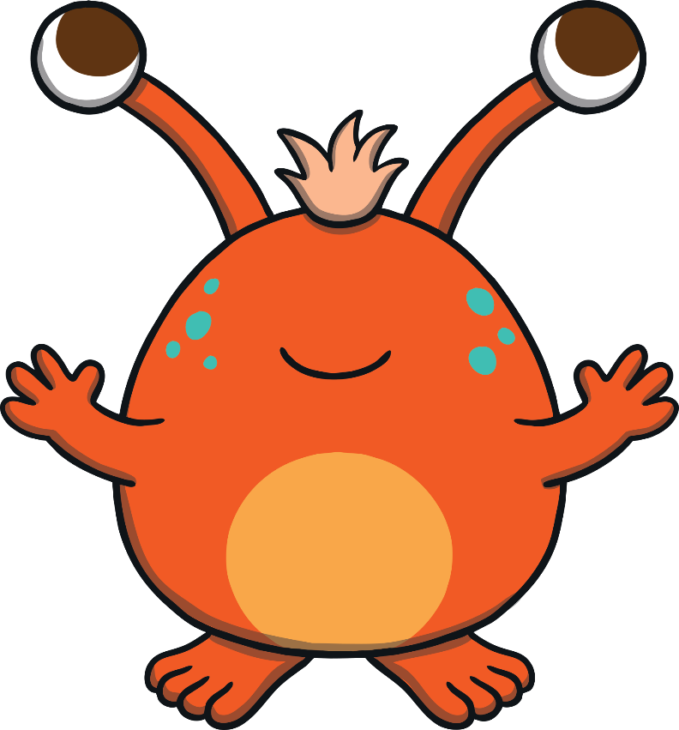
vay

Slide 11
play

Slide 12
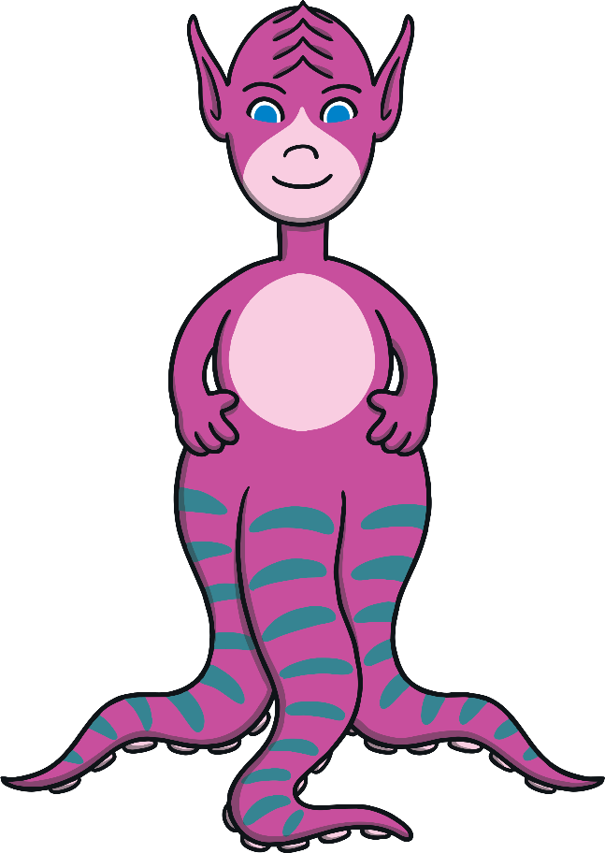
zay

Slide 13
may

Slide 14
hay

Slide 15
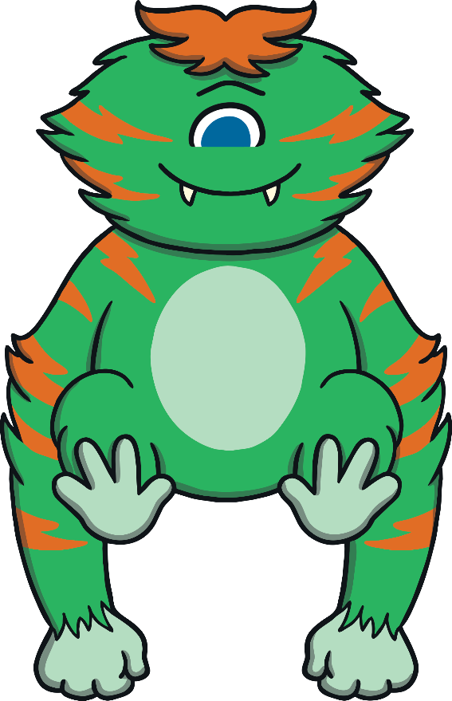
chay

Slide 16
today

Slide 17

shray

Slide 18
tray

Slide 19
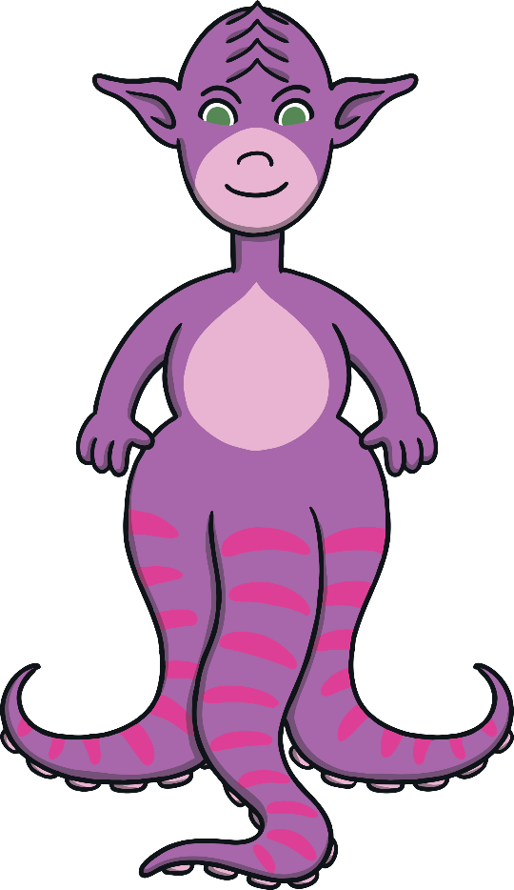
tay

Slide 20
toy

Slide 21
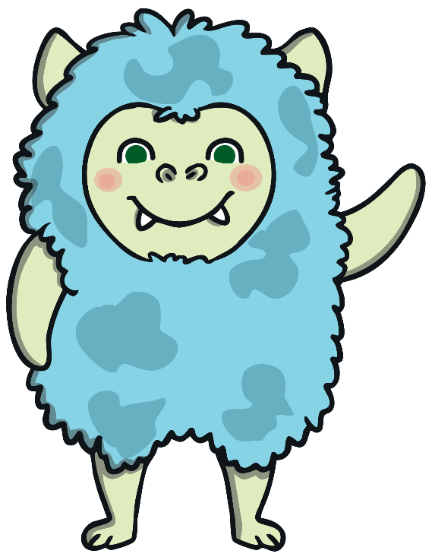
scroy

Slide 22
boy

Slide 23
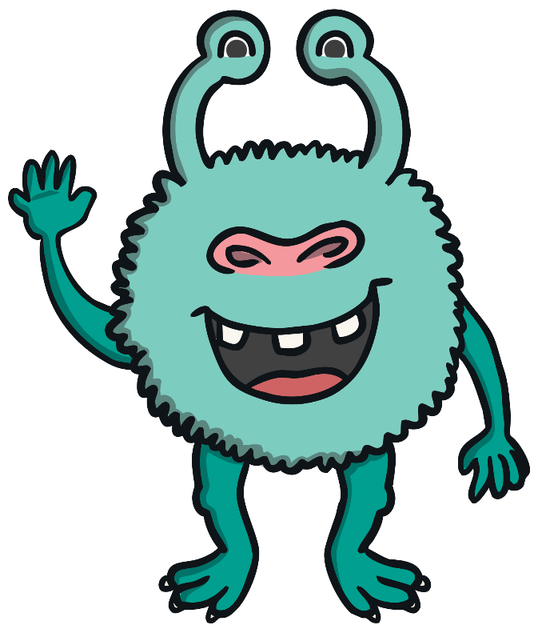
poy

Slide 24
joy

Slide 25

zoy

Slide 26
enjoy

Slide 27

proy

Slide 28
oyster

Slide 29
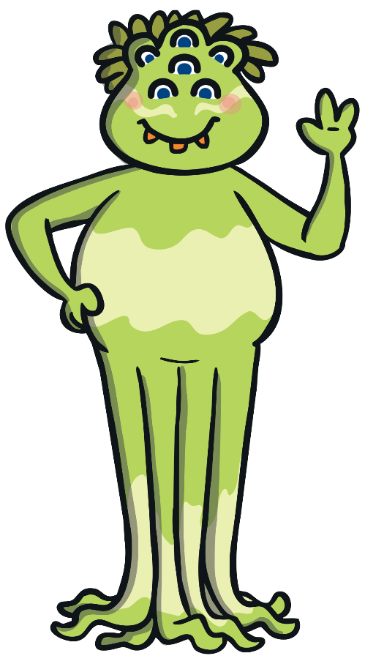
shoy

Slide 30
annoy

Slide 31
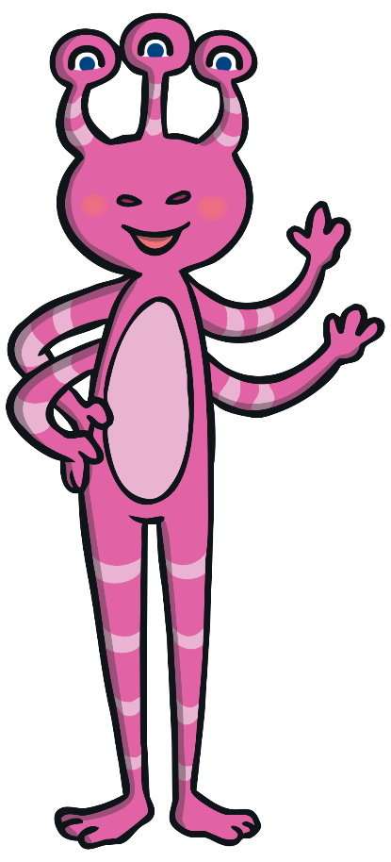
thoy

Slide 32
employ

Slide 33

loy

Slide 34
foy

Slide 35
pie

Slide 36
blies

Slide 37
lied

Slide 38
zied

Slide 39
tie

Slide 40
shries

Slide 41
applied

Slide 42
jie

Slide 43
flies

Slide 44
zies

Slide 45
tried

Slide 46
spied

Slide 47
bries

Slide 48
dried

Slide 49
treats

Slide 50
weaf

Slide 51
reaching

Slide 52
keam

Slide 53
feast

Slide 54
zeat

Slide 55
vout

Slide 56
seat

Slide 57
jead

Slide 58
scream

Slide 59
fream

Slide 60
heating

Slide 61
heaf

Slide 62
least

Slide 63
gleat

Slide 64
pleads

Slide 65
preal

Slide 66
name

Slide 67
zale

Slide 68
shape

Slide 69
strabe

Slide 70
slate

Slide 71
tabe

Slide 72
snake

Slide 73
glame

Slide 74
amaze

Slide 75
shrale

Slide 76
escape

Slide 77

thrape

Slide 78
take

Slide 79
tave

Slide 80
cake

Slide 81
lape

Slide 82
shine

Slide 83
stribe

Slide 84
reptiles

Slide 85
splote

Slide 86
stroke

Slide 87
pobe

Slide 88
scribe

Slide 89
glope

Slide 90
home

Slide 91
chove

Slide 92
beehive

Slide 93
hibe

Slide 94
mode

Slide 95
crive

Slide 96
alone

Slide 97
blife

Slide 98
flute

Slide 99
meve

Slide 100
rude

Slide 101
spreme

Slide 102
use

Slide 103
lete

Slide 104
compute

Slide 105
peme

Slide 106
these

Slide 107
trume

Slide 108
even

Slide 109
zute

Slide 110
complete

Slide 111
thube

Slide 112
extreme

Slide 113
yune

Slide 114
loudest

Slide 115
fout

Slide 116
sound

Slide 117
houd

Slide 118
sprout

Slide 119
poud

Slide 120
about

Slide 121
vout

Slide 122
proud

Slide 123
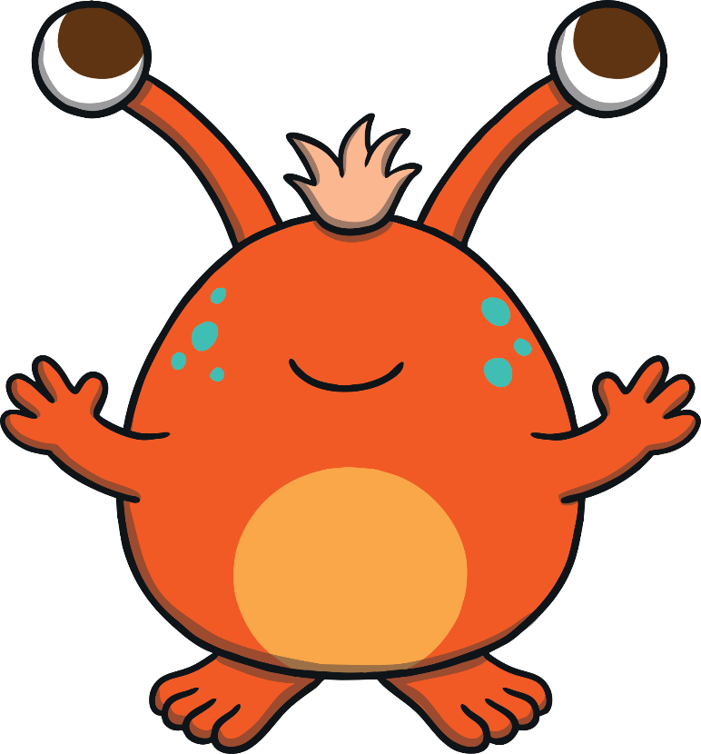
goud

Slide 124
ground

Slide 125
chout

Slide 126
found

Slide 127
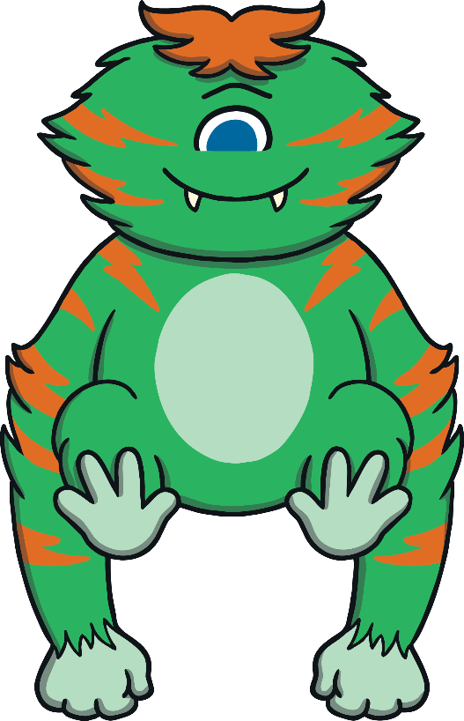
sploud

Slide 128
mount

Slide 129
blout

Slide 130
bacon

Slide 131
kind

Slide 132
grind

Slide 133
gold

Slide 134
post

Slide 135
unit

