Slide 1
Signs of winter
Seasonal changes: autumn and winter

Slide 2
How our teaching resources are designed for the classroom

Slide 3
I can describe changes in winter.

Slide 4
season
Seasons are periods of similar weather. In the UK, there are four seasons (spring, summer, autumn and winter).
winter
Winter is the coldest season of the year. It is between autumn and spring.
deciduous
Trees that lose their leaves once a year are deciduous.
evergreen
Trees and bushes that do not lose their leaves in winter are evergreen.
observe
To observe is to look very closely and use other senses too.

Slide 5

Signs of winter
Winter
Signs of winter

Slide 6



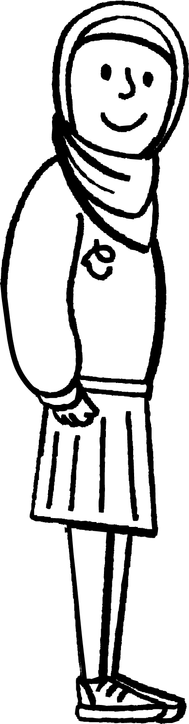
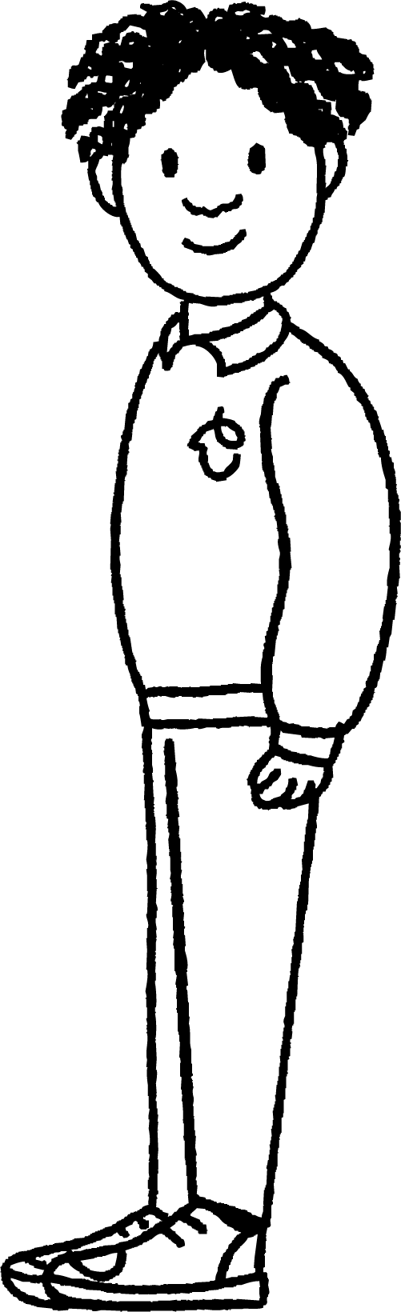
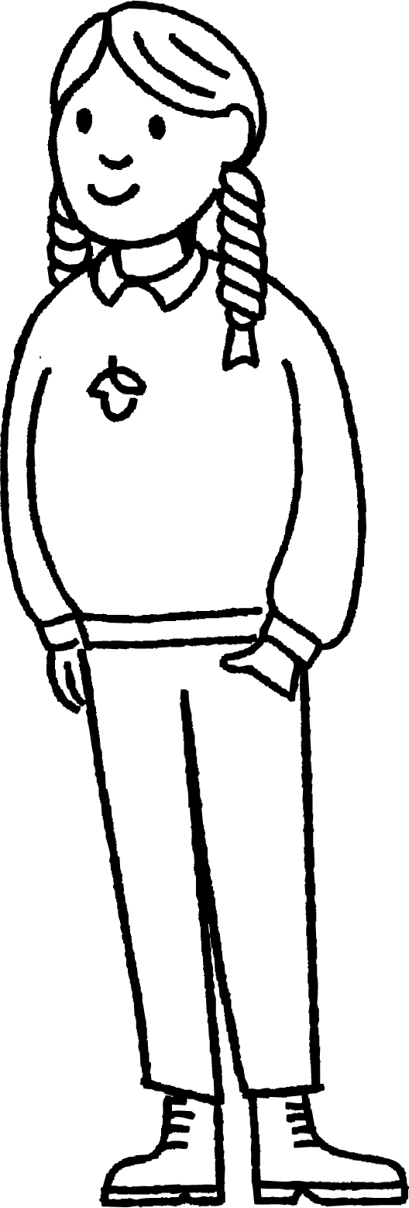
Winter
Aisha is celebrating her birthday and wonders how long it will be until the next one.
My mum says I will have to wait a whole year until my next birthday.
How many months will that be?
How many months are in one year?
Aisha
Jacob
Laura

Slide 7
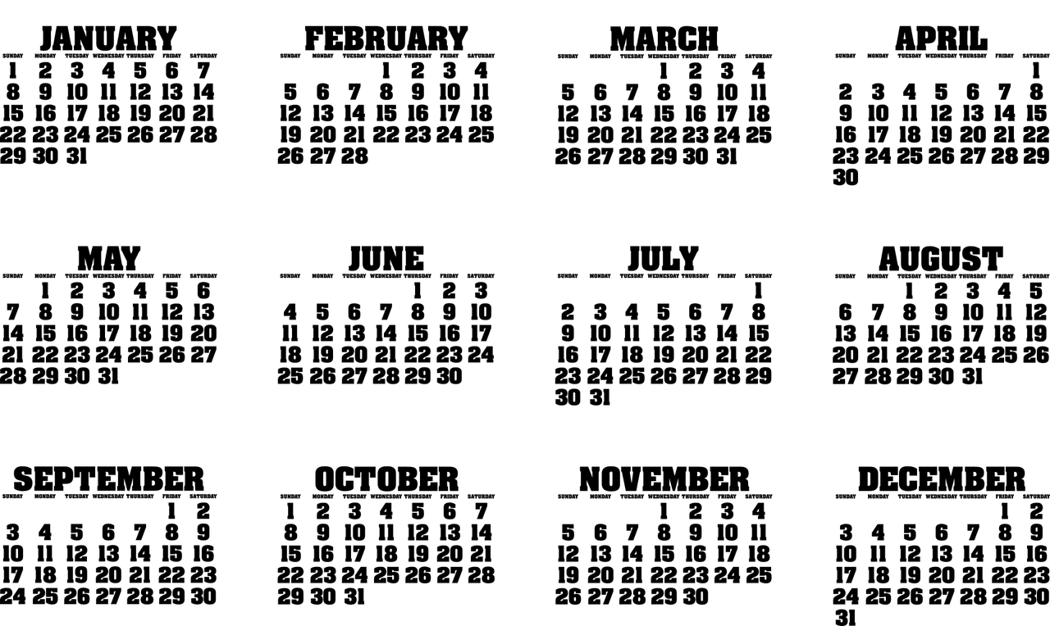
Winter
Aisha counts how many months are in one year.
Aisha’s birthday
Wow! That is a lot of months for me to wait!
calendar
There are twelve months in one year.
Aisha

Slide 8

Winter
How many months are there in one year?
four
seven
twelve

Slide 9
Winter
I wonder how many seasons that will be.
calendar
Aisha
Do you know?

Slide 10
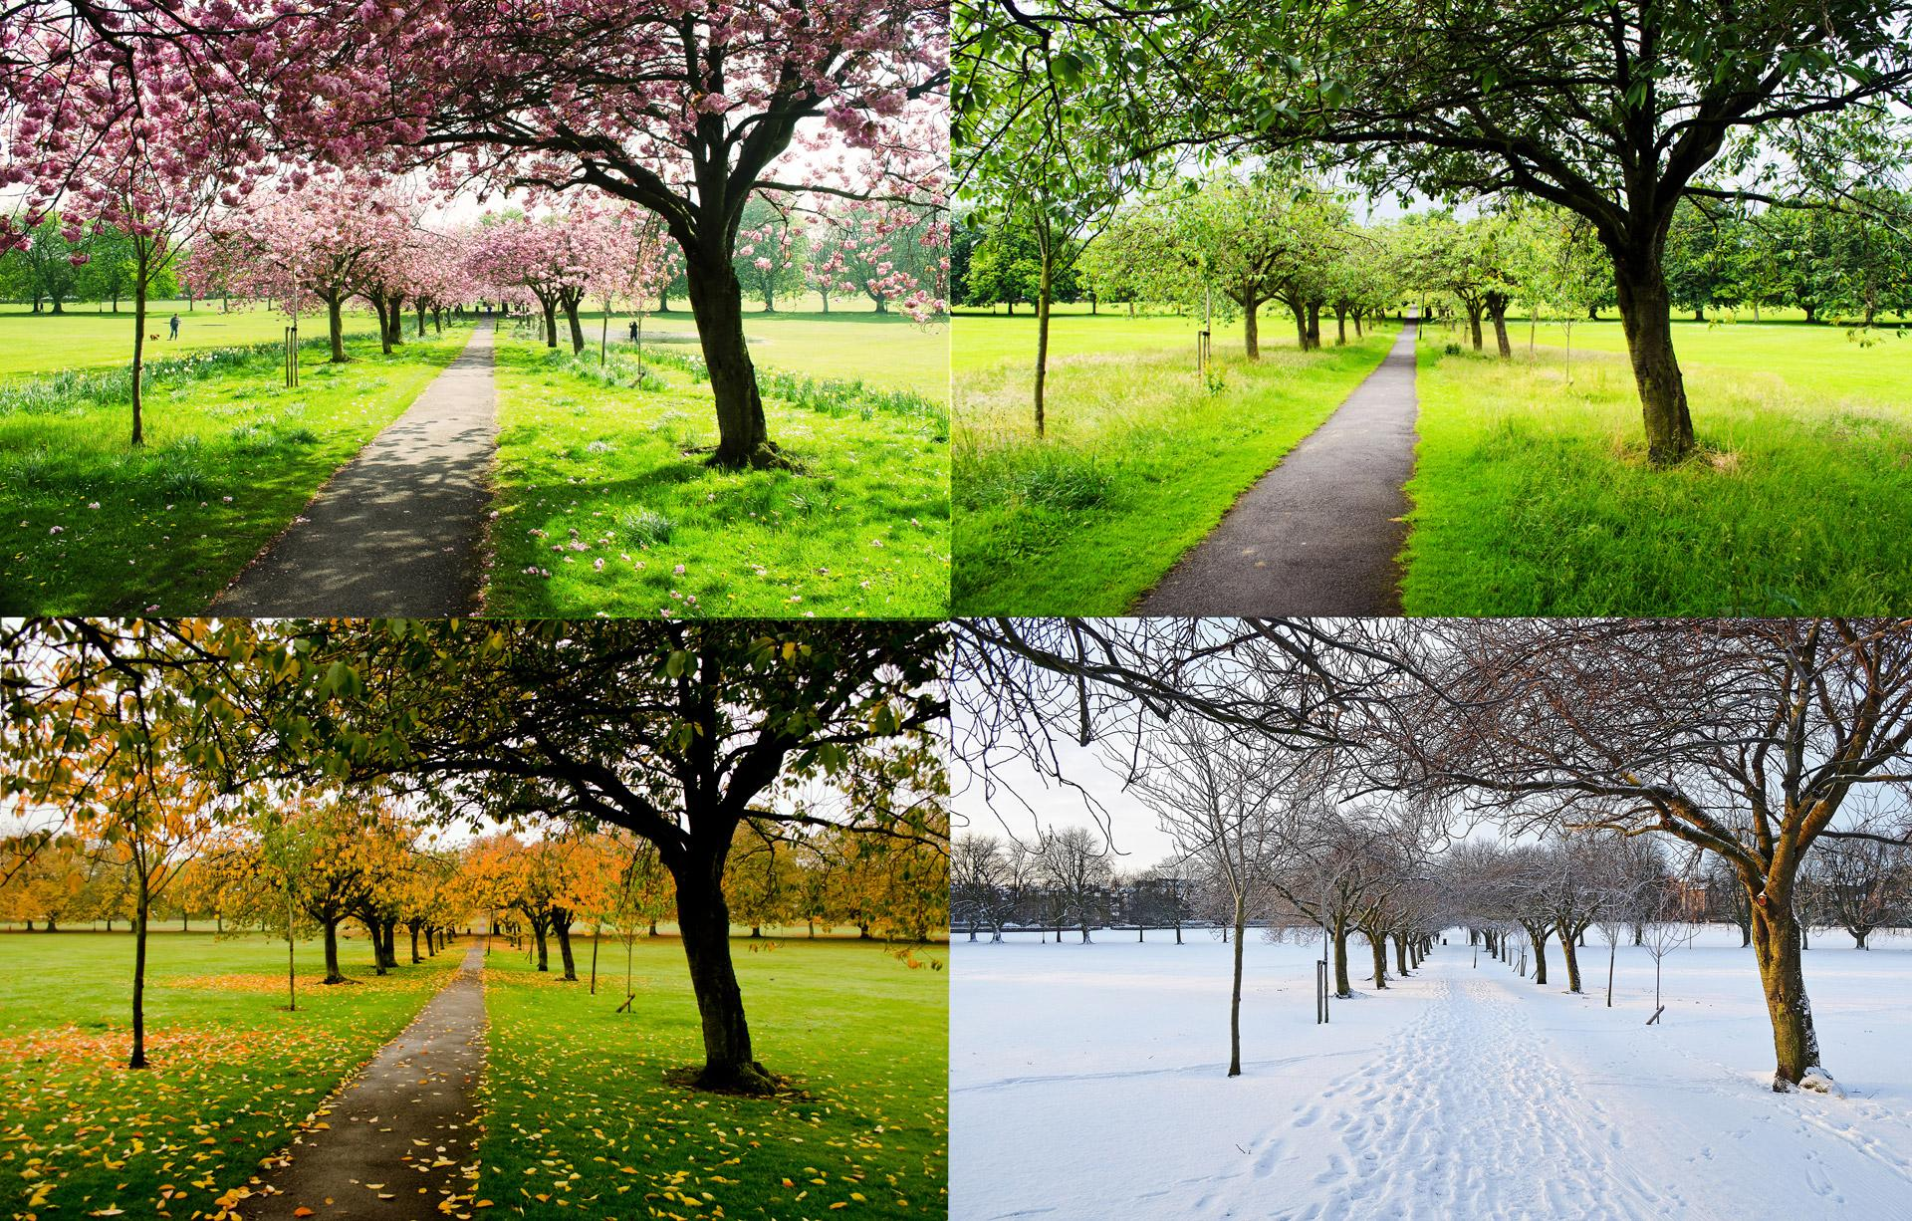
Winter
A year can be split into four different seasons.
Do you know the names of any seasons?
four seasons
Laura

Slide 11

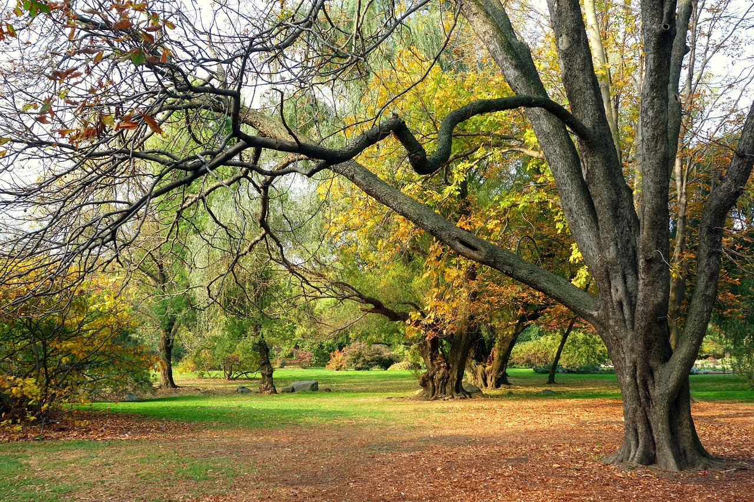

Winter
I know that autumn is one of the seasons. That’s when leaves on some trees change colour. Also, some trees start to lose their leaves and the weather often becomes colder and wetter.
autumn
Alex

Slide 12
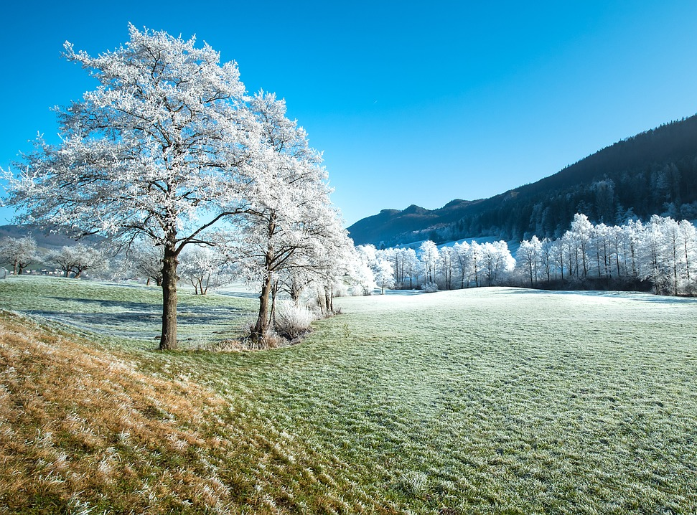
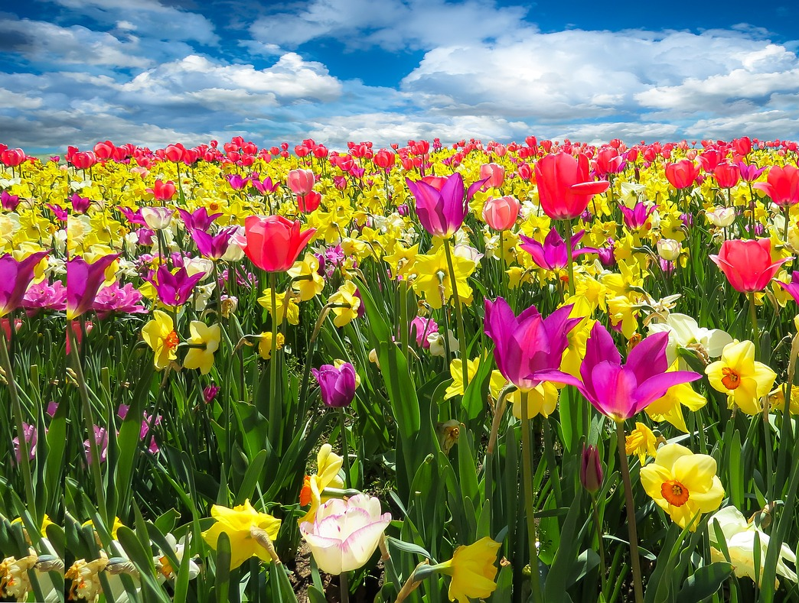

Winter
The other seasons are:
winter
spring
summer

Slide 13



Winter
Who do you agree with?
The four seasons are autumn, winter, spring and summer.
The four seasons are March, April, May and June.
The four seasons are Thursday, Friday, Saturday and Sunday.
Lucas
Sam
Andeep

Slide 14
Winter
Do you know which season Aisha’s birthday is in?
Aisha’s birthday month
calendar
Aisha
Aisha’s birthday is in winter.

Slide 15
Winter
The season of winter occurs in December, January and February.
calendar

Slide 16
Winter
When is the season of winter?
September, October and November.
December, January and February.
March, April and May.

Slide 17
Winter
Create a birthday display. Write your name and birthday on a strip of card. Who has a birthday in the season of winter?
September, October and November | December, January and February
March, April and May | June, July and August

Slide 18
Winter
Create a birthday display. Who has a birthday in winter?
September, October and November | December, January and February
March, April and May | June, July and August
Jun, 8th September
Aisha, 13th January
Laura, 21st November
Alex, 16th February
Sofia, 12th April
Andeep, 25th June
Izzy, 18th May
Sam, 17th August
Aisha and Alex have their birthdays in the season of winter.

Slide 19
Signs of winter
Winter
Signs of winter

Slide 20
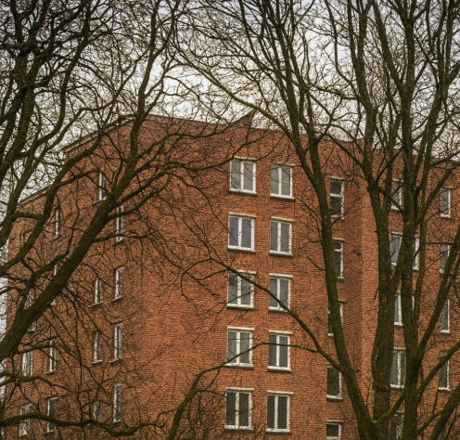

Signs of winter
It is winter and Jun is looking out of the window at home.
A few weeks ago, I could not see where my friend Jacob lives but I can now.
Jacob’s building
Why do you think this is?
Jun

Slide 21
Signs of winter
Jun can only see Jacob’s building in winter because of what has happened to the leaves on some trees.
I don’t remember seeing his building in the summer.
Jun
Jacob’s building
What happens to the leaves on some trees through autumn and into winter?

Slide 22
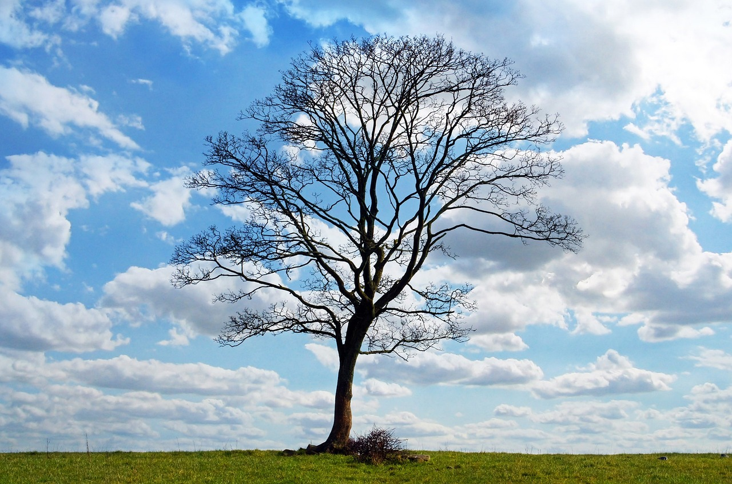
Signs of winter
Some trees lose their leaves in autumn, so when we observe them in winter they have no leaves or hardly any leaves left.
Jun
tree in winter

Slide 23
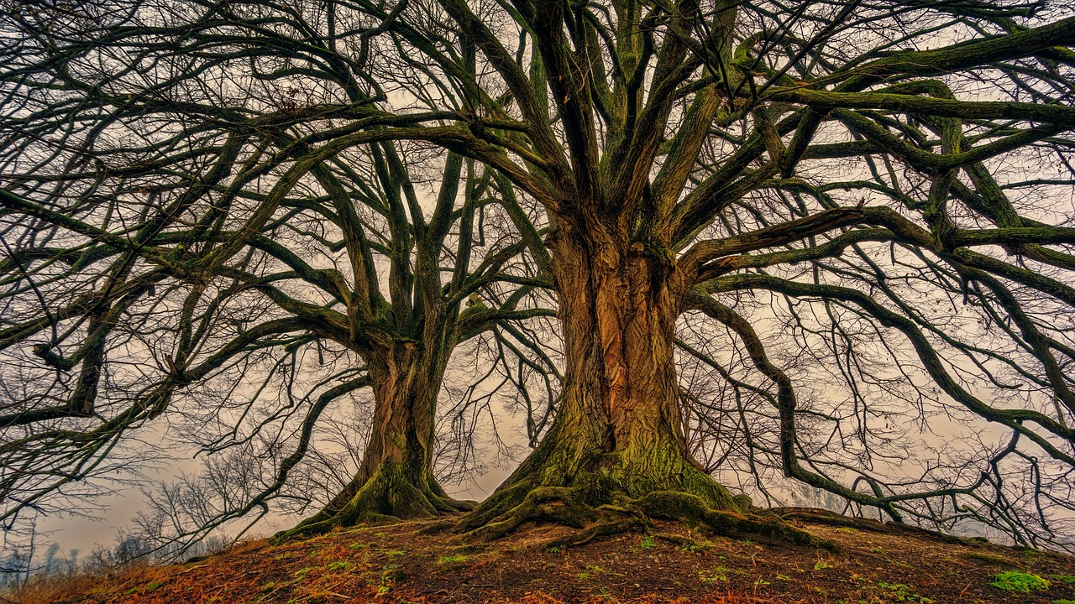
Signs of winter
Do you know the name for trees that lose their leaves once a year?
Trees that lose their leaves each year are called deciduous trees.
Can you see any deciduous trees from where you are now?
deciduous trees in winter

Slide 24
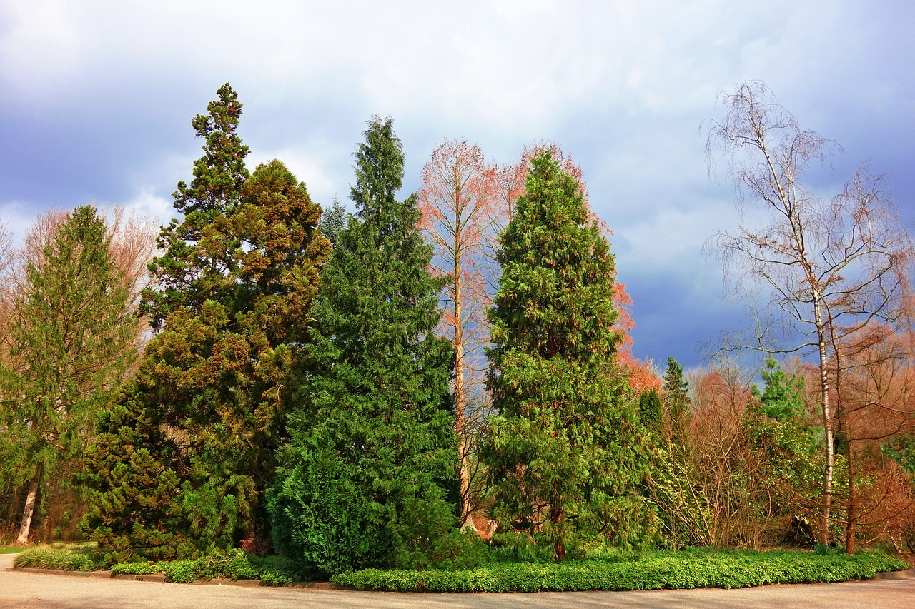
Signs of winter
Jun observes that some of the other trees still look green and have kept their leaves.
Some of the trees have not lost their leaves.
Jun
trees in winter
Do you know the name for trees that do not lose their leaves in winter?

Slide 25
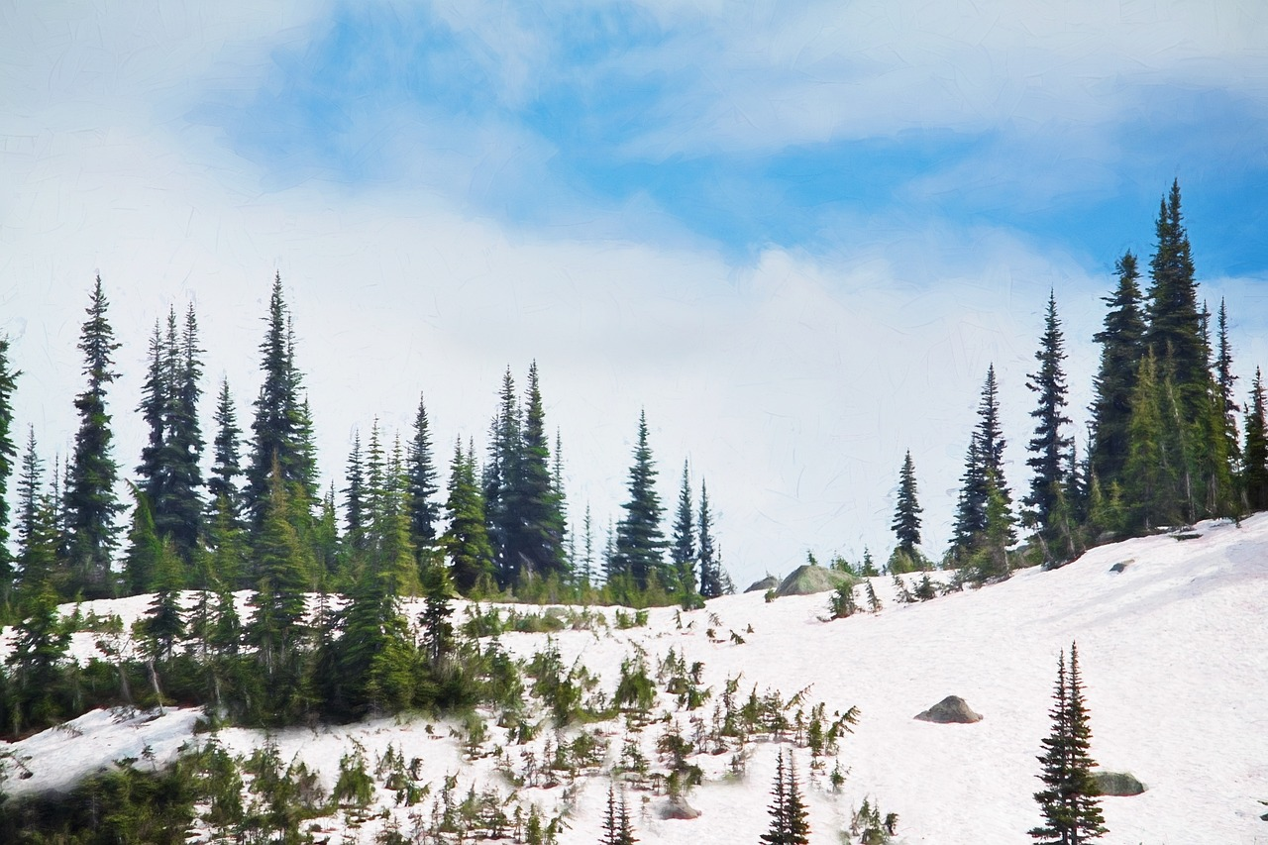
Signs of winter
Plants and trees that keep their leaves in winter are called evergreen.
I remember the word evergreen because evergreen trees don’t change colour. They have green leaves in ‘every’ season.
evergreen trees in winter
Jun

Slide 26


Signs of winter
True or false?
All trees have no leaves or very few leaves in winter.
T
True
F
False
I think this because …
trees keep their leaves all year round.
a
only deciduous trees have no leaves in winter.
b

Slide 27
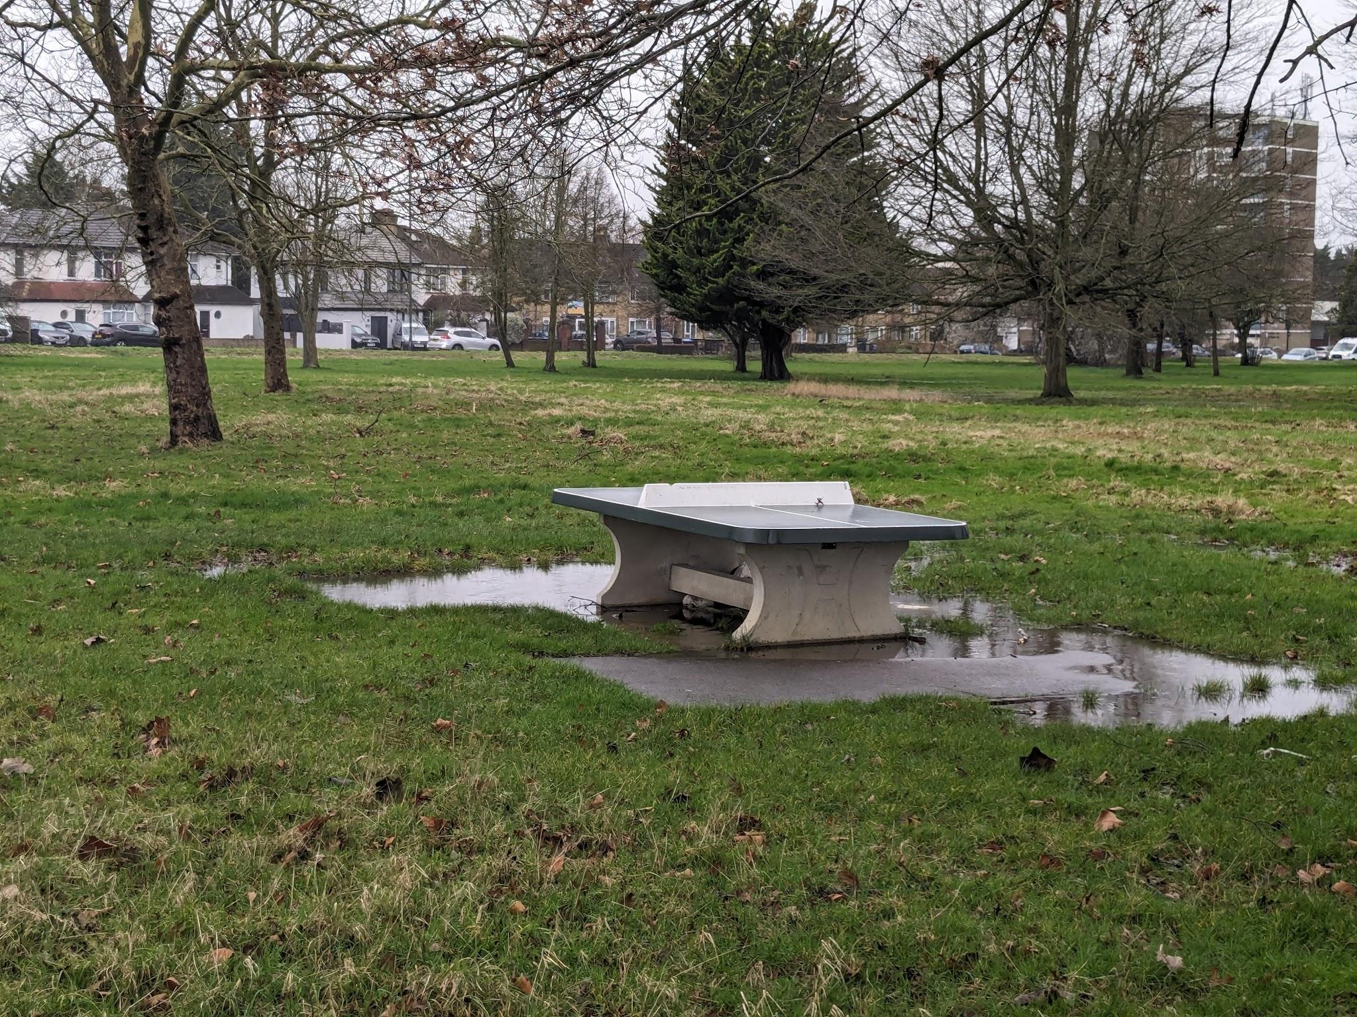
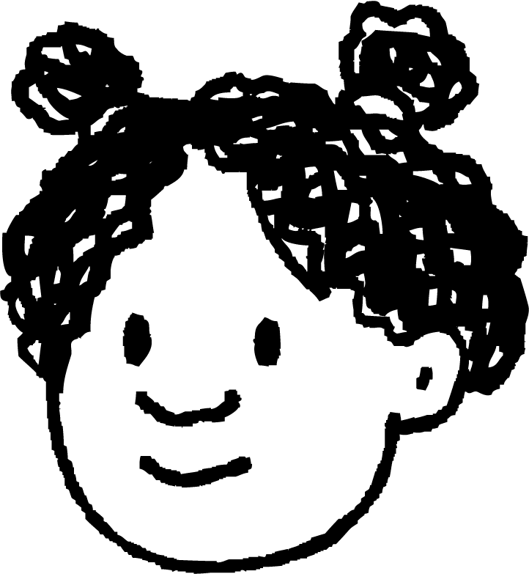
Signs of winter
Jun and his friends go for a winter walk near their school. They describe what they see.
This tree still looks green.
I notice that some of the trees have no leaves.
Jun
Izzy
outdoors in winter

Slide 28
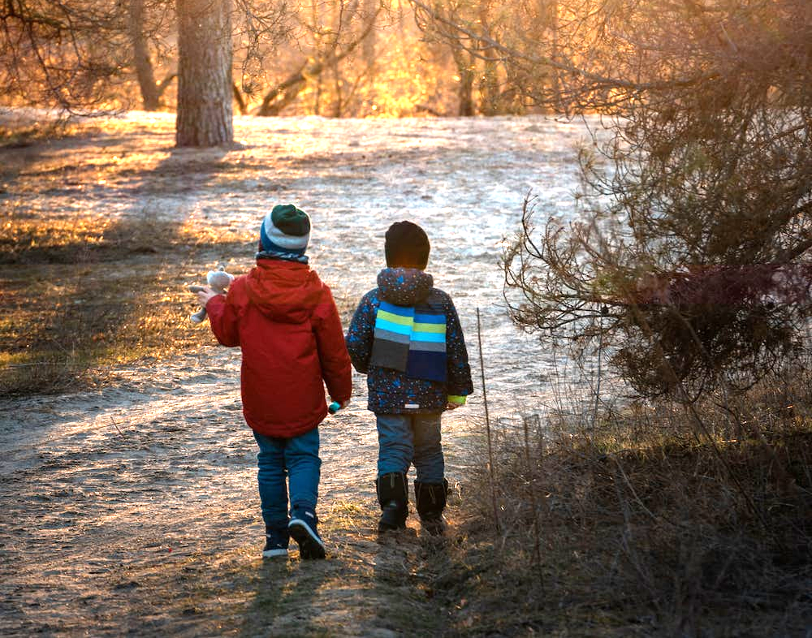
Signs of winter
Jun and his friends are looking closely at the things they see around them.
winter walk
Which skills are Jun and his friends using?

Slide 29

Signs of winter
Jun and his friends are using their observation skills.
observing leaves
When we observe something, we look very closely and use our other senses too.

Slide 30

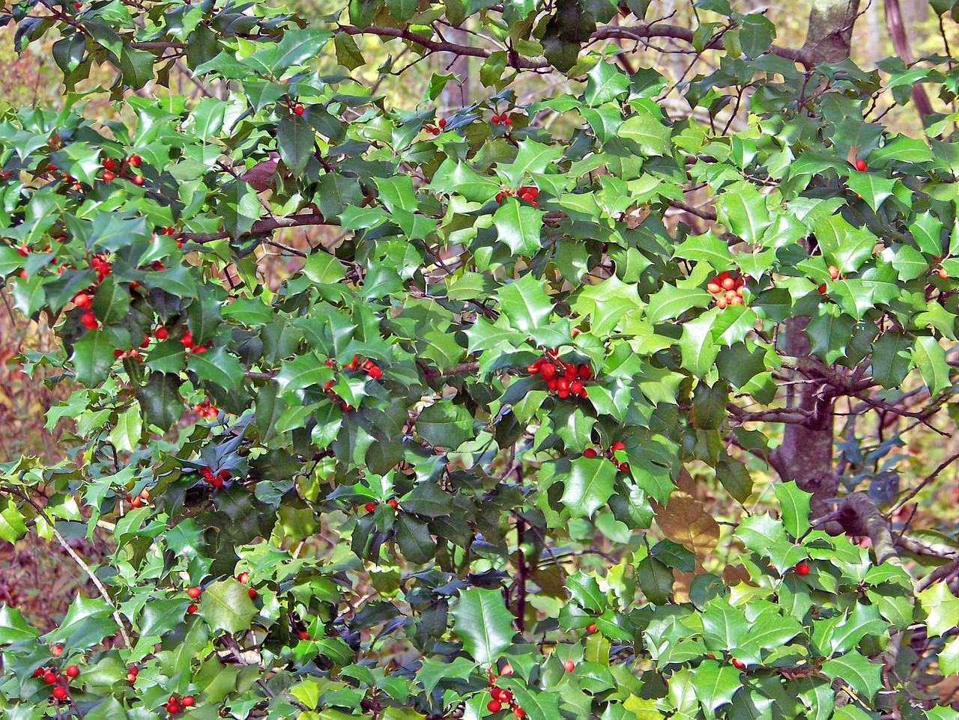
Signs of winter
When we observe something carefully, we can describe what we notice.
I spotted a deciduous tree with no leaves.
I spotted a holly plant with green spiky leaves and red berries.
I can see a bird’s nest in a tree.
Izzy
Sofia
Jun
holly

Slide 31
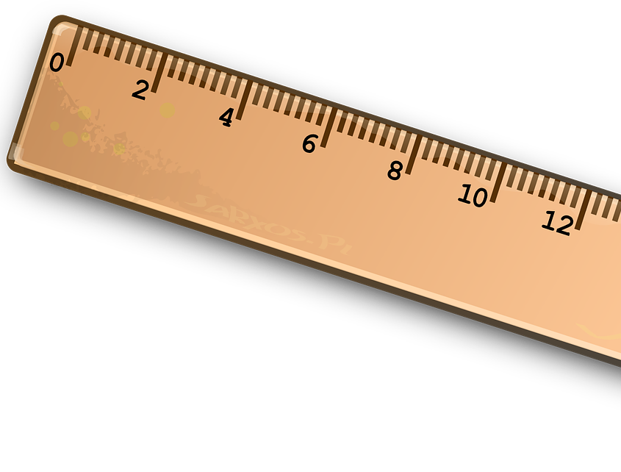
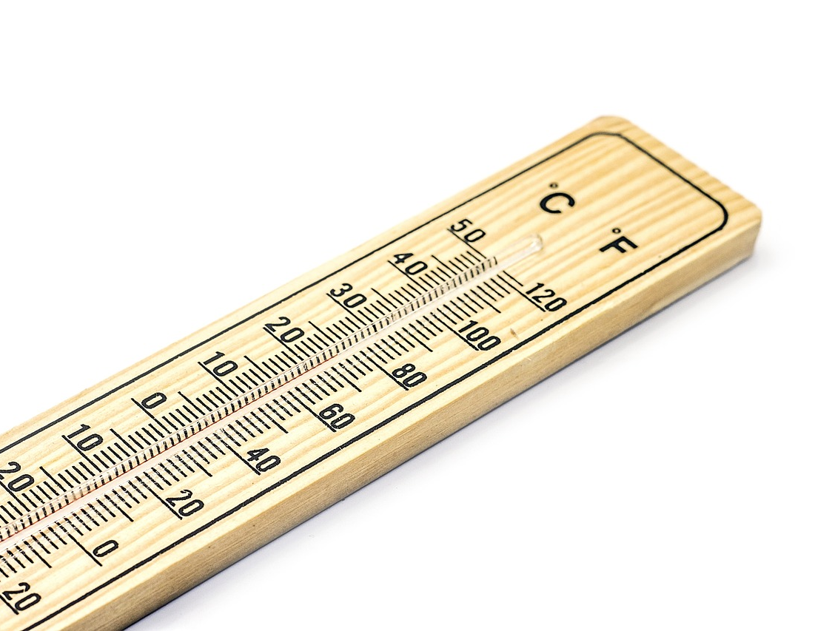
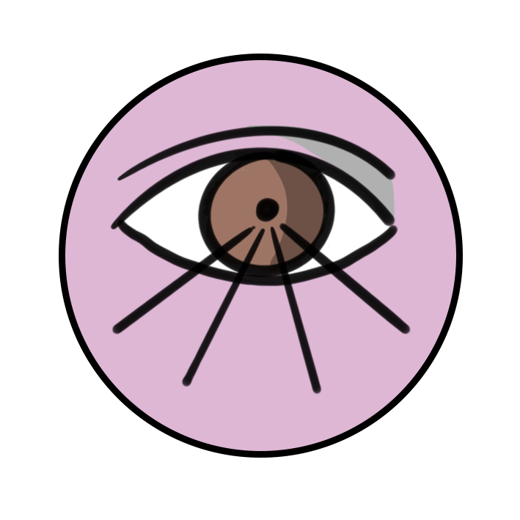
Signs of winter
What can help us to observe signs of winter?
a ruler
a thermometer
our senses

Slide 32
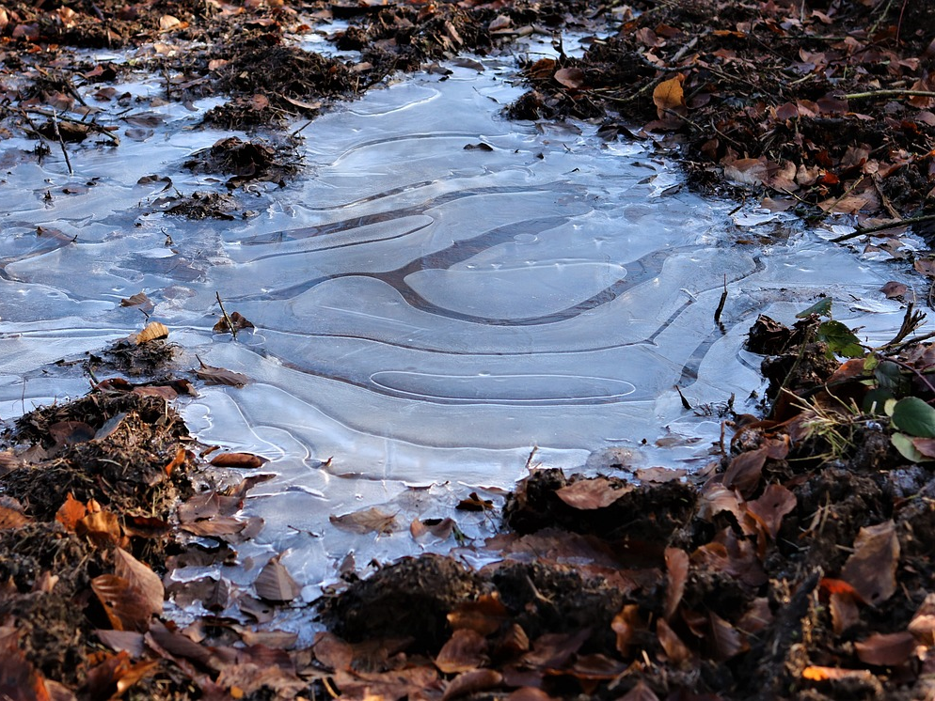
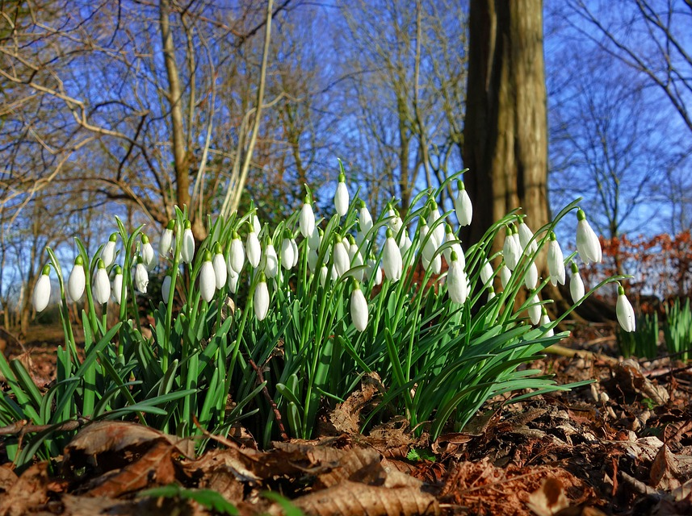
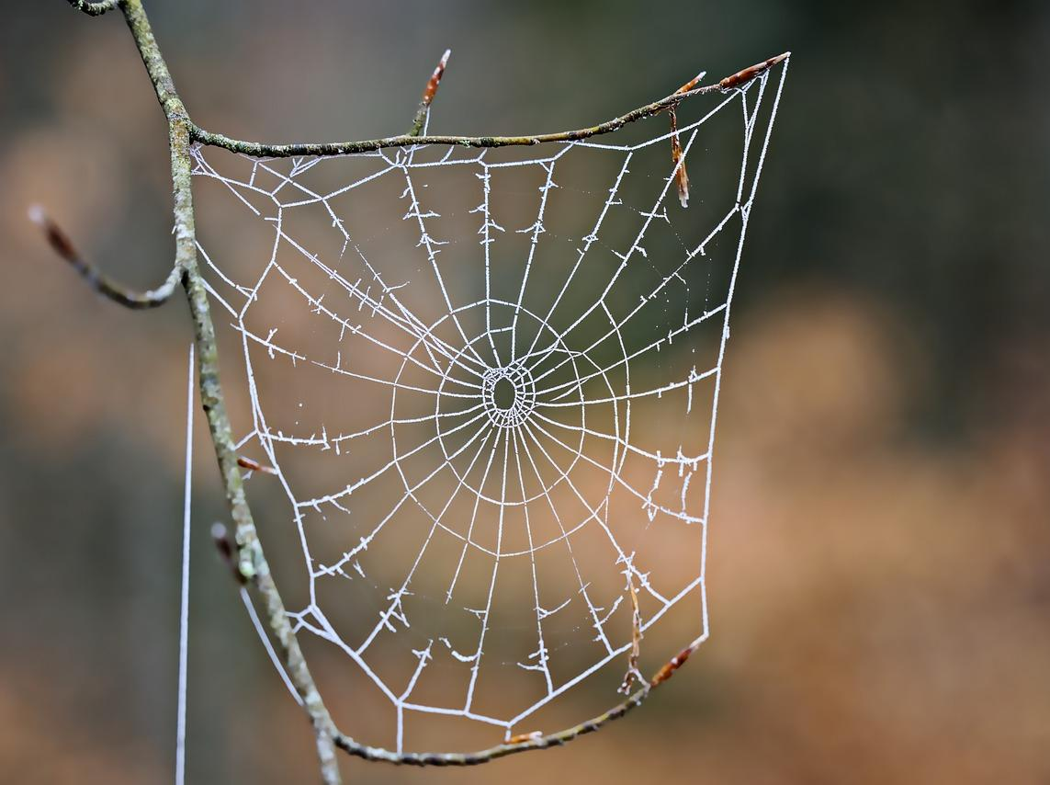
Signs of winter
Go on a winter walk or use the image on the following slide to spot these signs of winter.
a deciduous tree with no leaves
a frozen puddle
snowdrops
a frozen cobweb
Record other things that you observe on your winter walk.

Slide 33
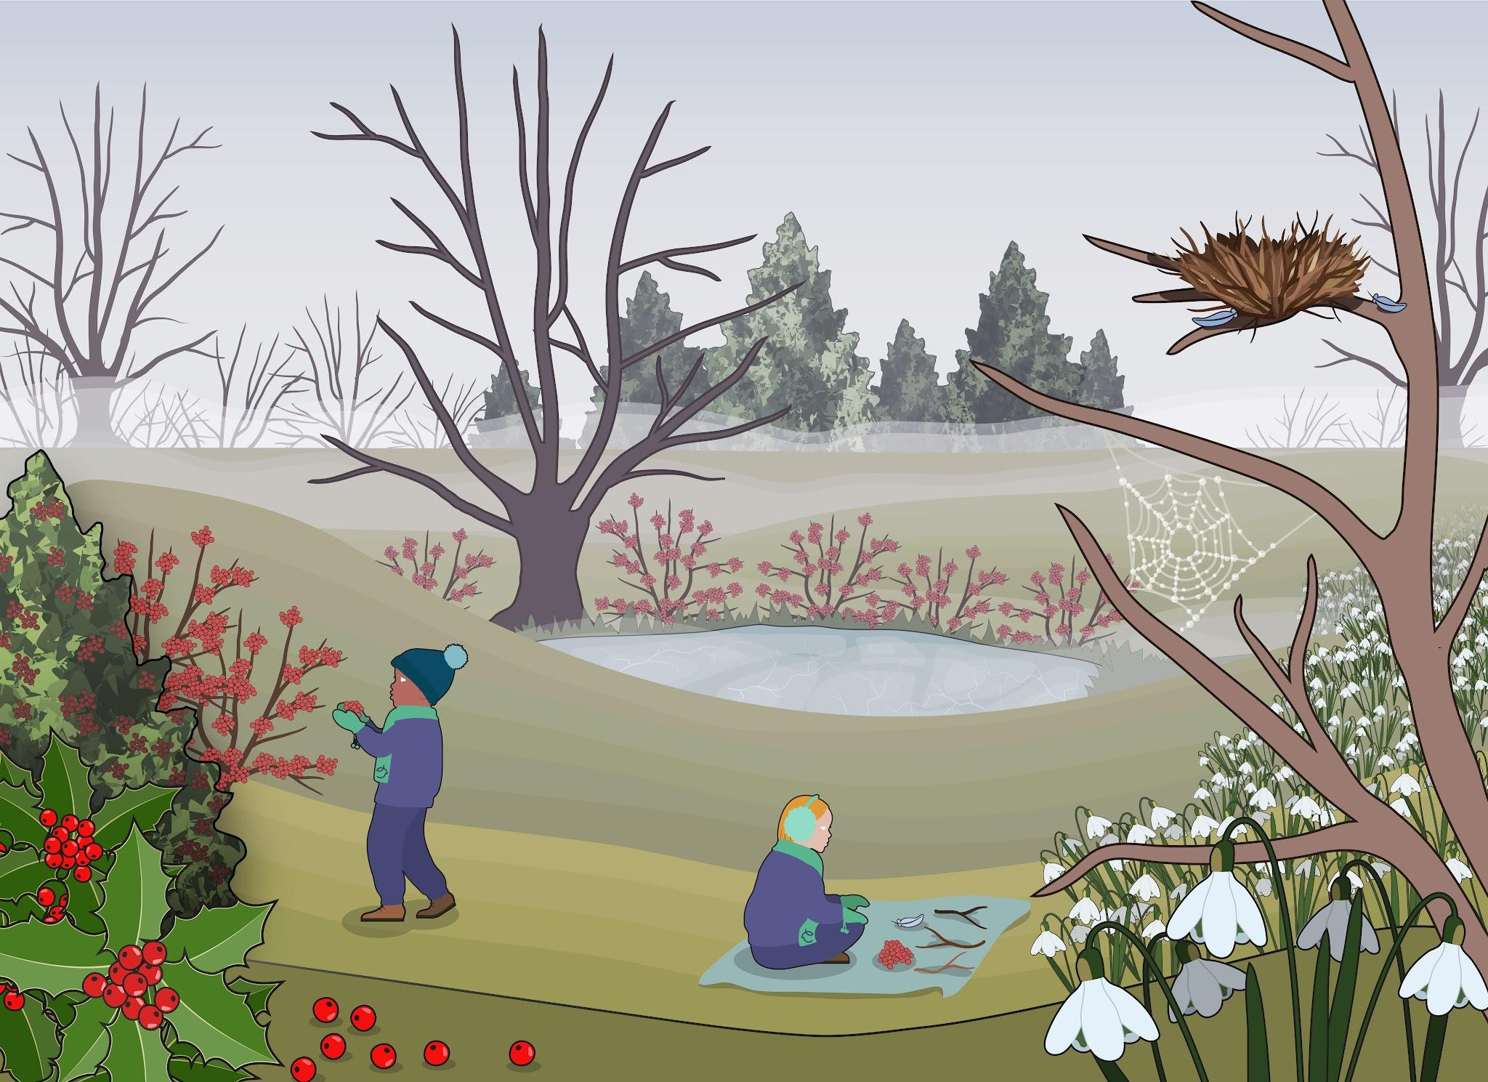
Signs of winter

Slide 34
Signs of winter
Go on a winter walk or use the image provided to spot these signs of winter.
a deciduous tree with no leaves
a frozen puddle
snowdrops
a frozen cobweb
What other things did you record that you observed on your winter walk?

Slide 35
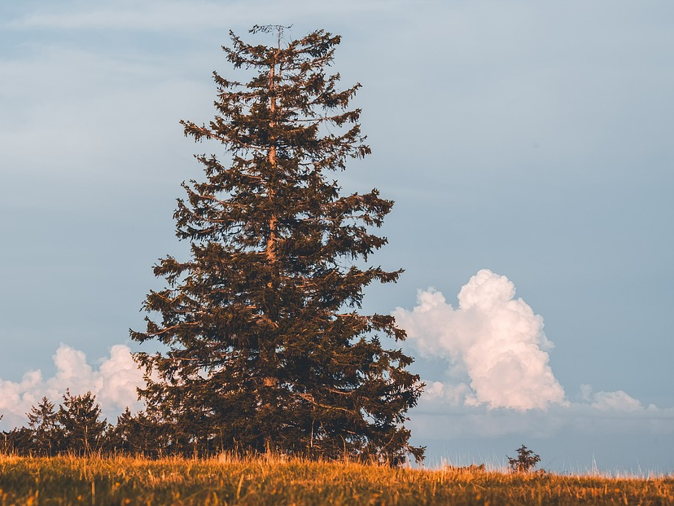
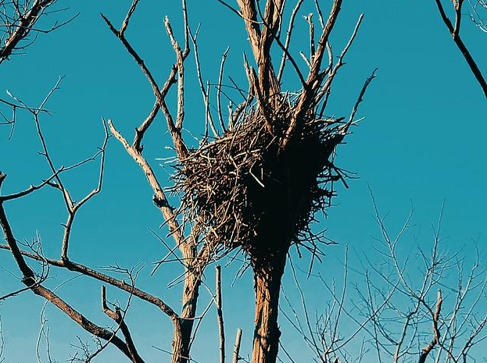
Signs of winter
Go on a winter walk or use the image provided to spot signs of winter.
I spotted an evergreen tree. They don’t lose their leaves so they look green all year round, even in winter.
I can see a bird’s nest in a tree because all of its leaves have fallen off. It must be in a deciduous tree.
an evergreen tree
a bird’s nest
Jun
Izzy

Slide 36
Signs of winter
Go on a winter walk or use the image provided to spot signs of winter.
I observed a holly tree. It has spiky green leaves all year round and in the winter it also has red berries.
holly
Andeep

Slide 37
Signs of winter
evergreen trees
deciduous trees with no leaves
bird’s nest on bare branch
frozen pond
frozen cobweb
berries
holly
snowdrops

Slide 38
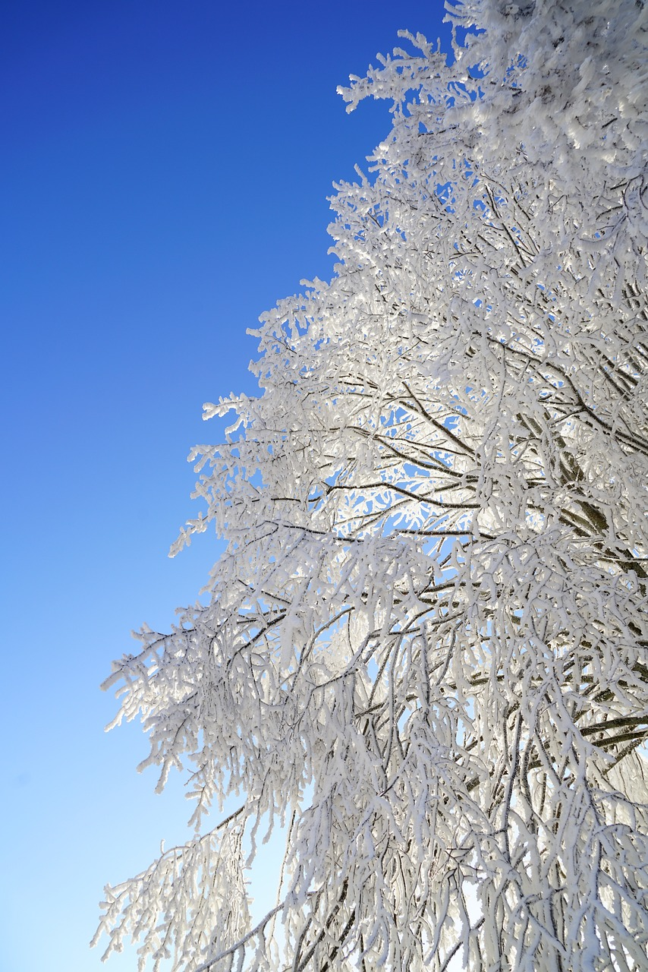
Signs of winter
There are twelve months in one year.
Winter, spring, summer and autumn are the four seasons.
The season of winter happens in December, January and February.
Deciduous trees have no leaves or very few leaves in winter.
We can use observing skills to describe changes in winter.
winter frost

Slide 39

© Oak National Academy 2024.
Produced in partnership with Centre for Industry Education Collaboration.
Licensed on the Open Government Licence v3.0, except where otherwise stated. See Oak terms and conditions.

