Slide 1
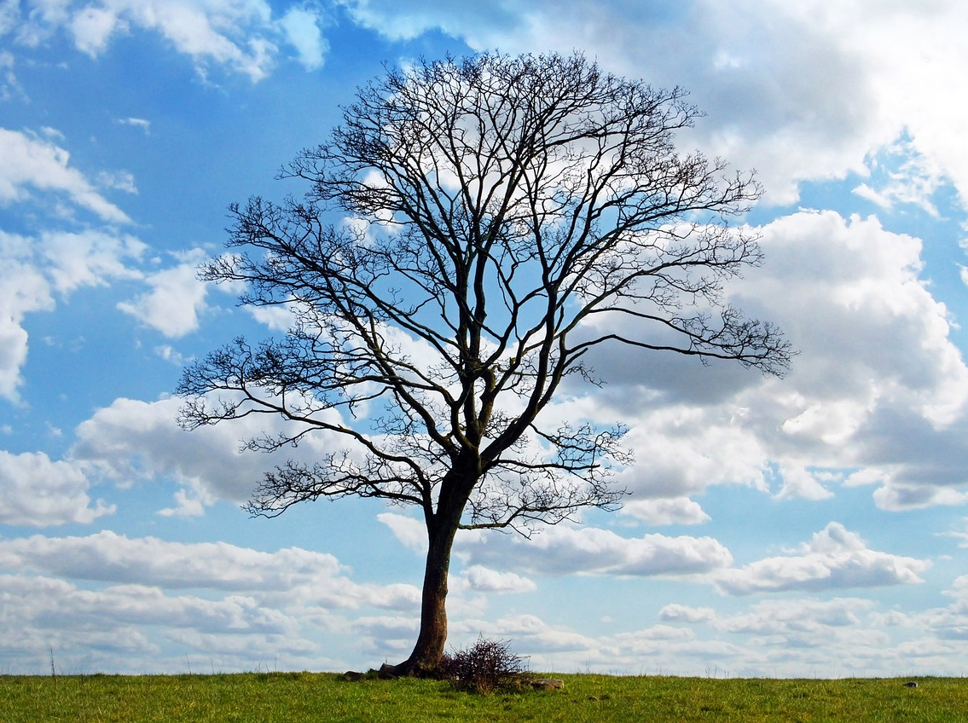
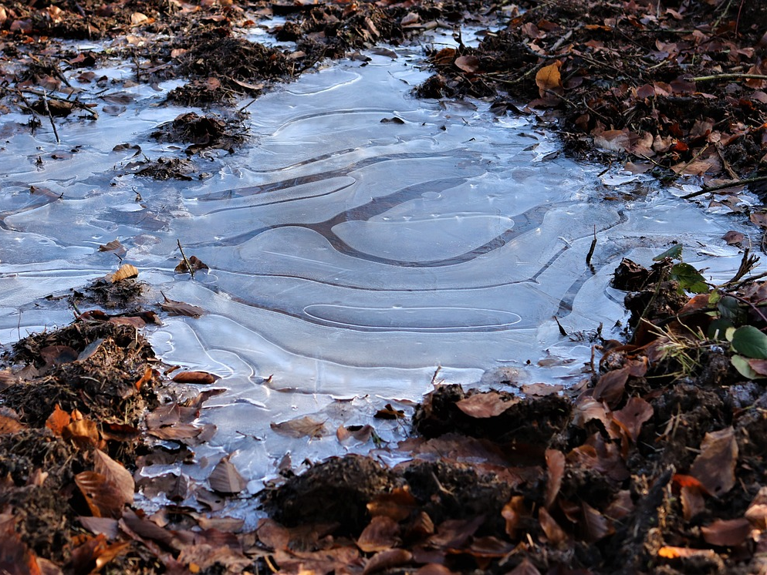
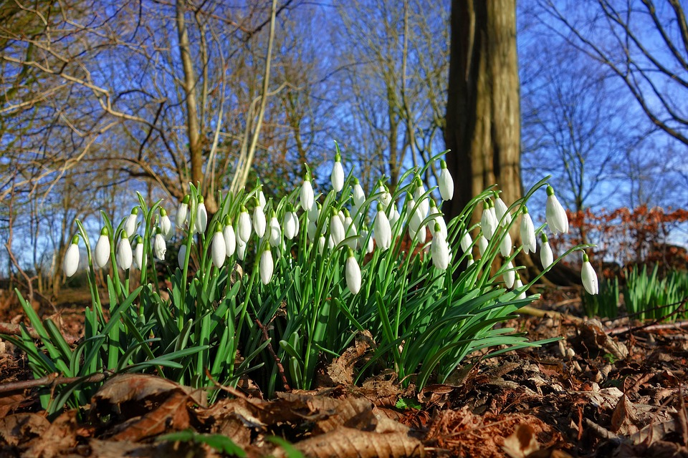
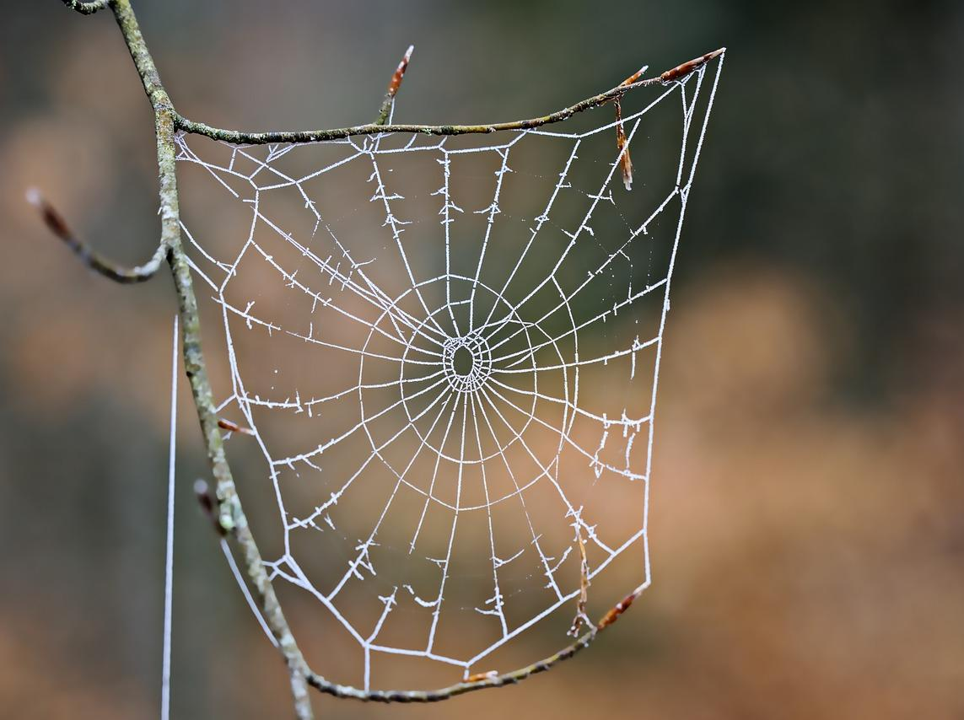
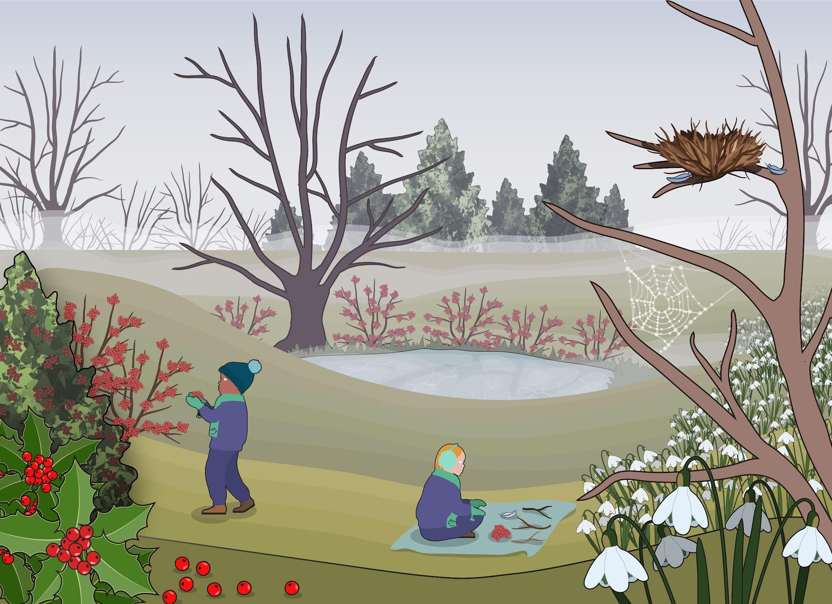
Signs of winter
Task: Signs of winter
Go on a winter walk or use the image below to spot these signs of winter.
a deciduous tree with no leaves
a frozen puddle
snowdrops
a frozen cobweb
Record other things that you observe on your winter walk.
Centre for Industry Education Collaboration.
v2.3

