Slide 1
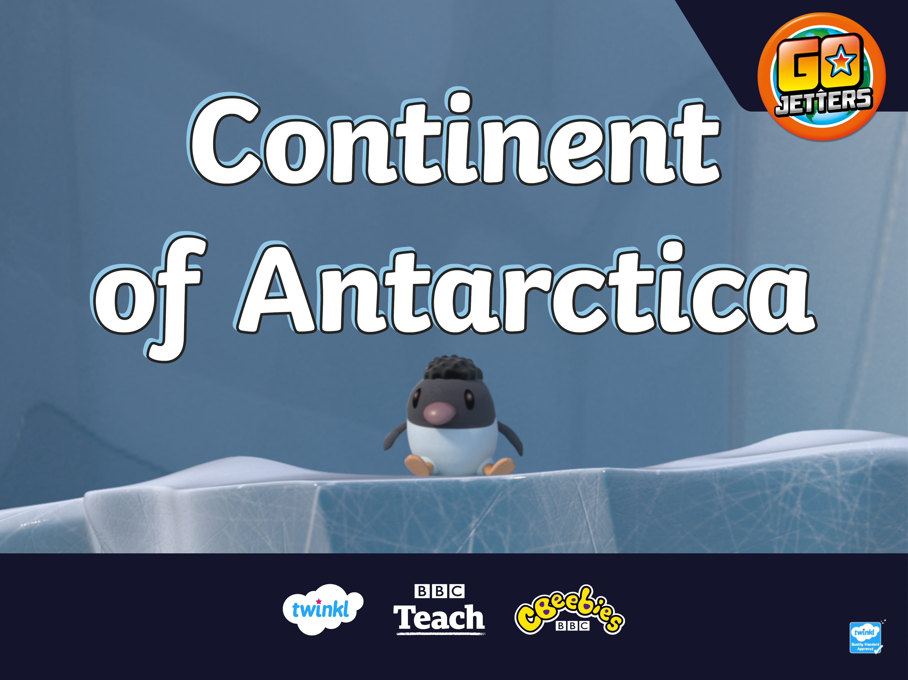

Slide 2
Guess the Word
I’ve tricked those No Jetters!
I’ve taken away letters from this word.
I’m sure you won’t be able to guess what it is!
C_n_i_e_t

Slide 3
Guess the Word
I’ve tricked those No Jetters!
I’ve taken away letters from this word.
I’m sure you won’t be able to guess what it is!
Continent

Slide 4
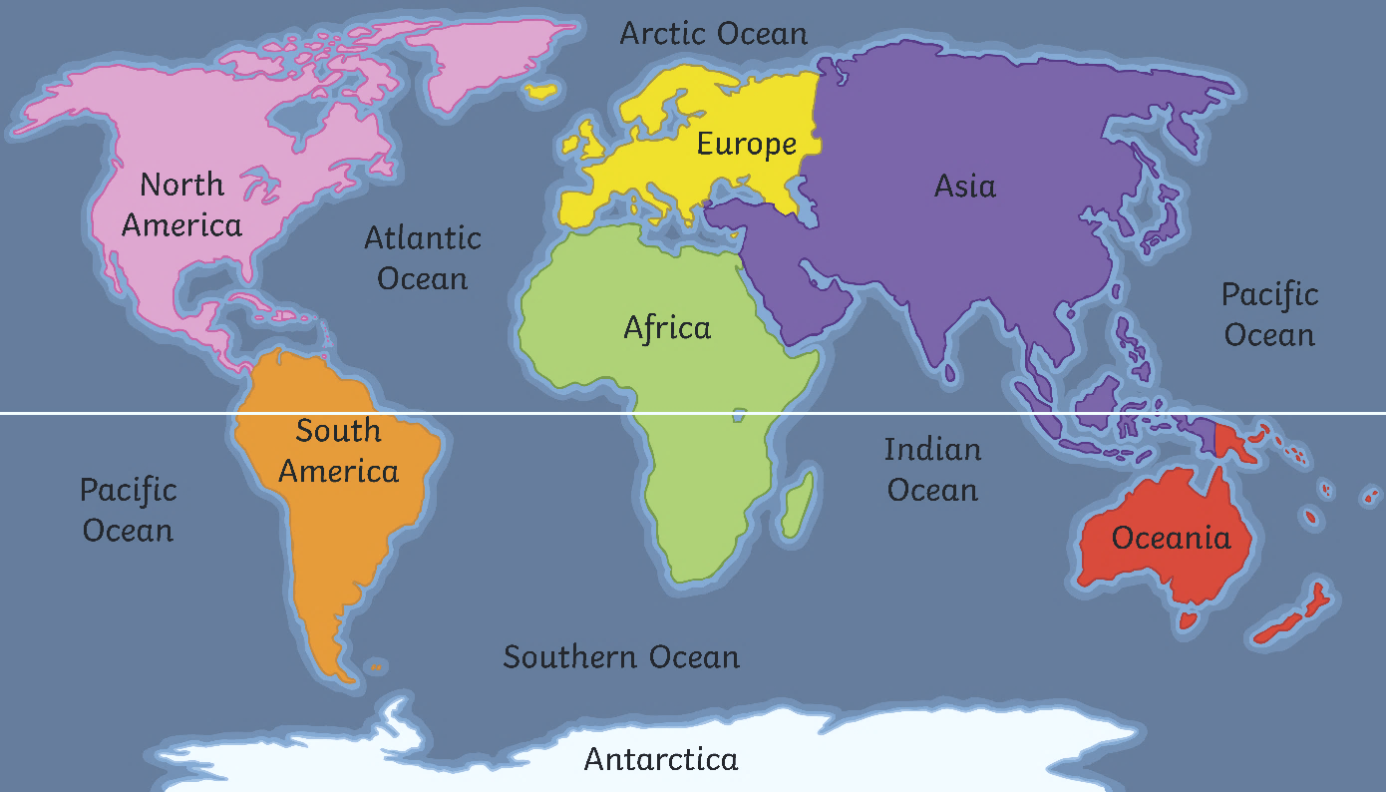
Continents
Great job,
Go Jet Cadets!
You weren’t tricked by Grandmaster Glitch.
A continent is a large piece of land often separated from other land by things like water or mountains.
Earth has seven continents.
Equator

Slide 5
Antarctica
Equator
Can you find the continent of Antarctica on the map?
On lots of maps and globes, Antarctica is white. Why do you think that is?

Slide 6
Hot and Cold Places
Geographic! Some places are cold all of the time. These places are at the top and bottom of the Earth. Other places are hot nearly all the time. These places are in the middle of the Earth.
Equator

Slide 7

Hot and Cold Places
The middle of the Earth is called the Equator. Most places at the Equator are very warm. However, if a location near the Equator is on very high ground, like on a mountain top, then it might still be cold.

Slide 8
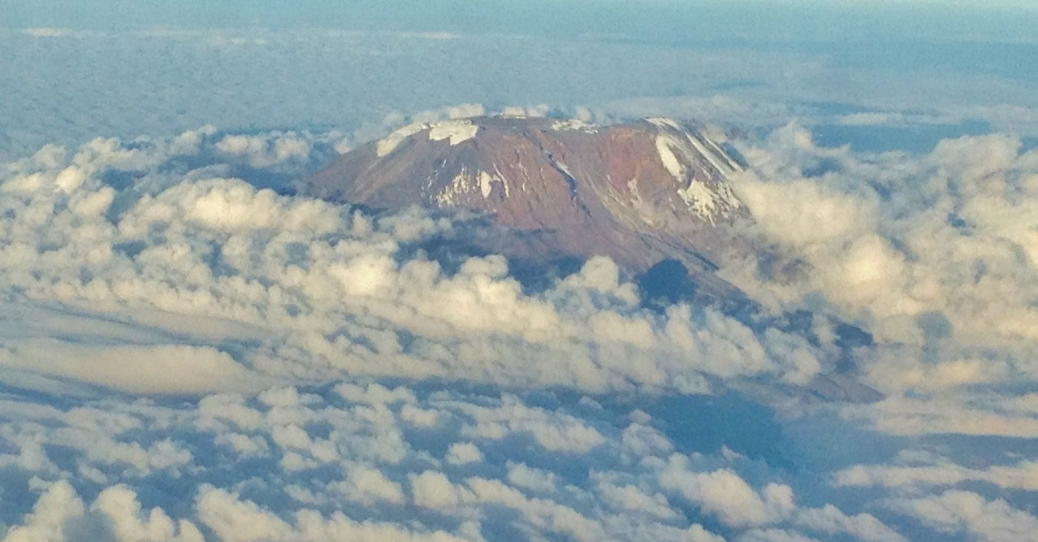
Hot and Cold Places
This is Mount Kilimanjaro in Tanzania in Africa. Can you see the snow on it?

Slide 9

North and South
north
west
east
south
This is a compass and it explains the direction things are in. Today, we are going to be thinking about north and south.

Slide 10
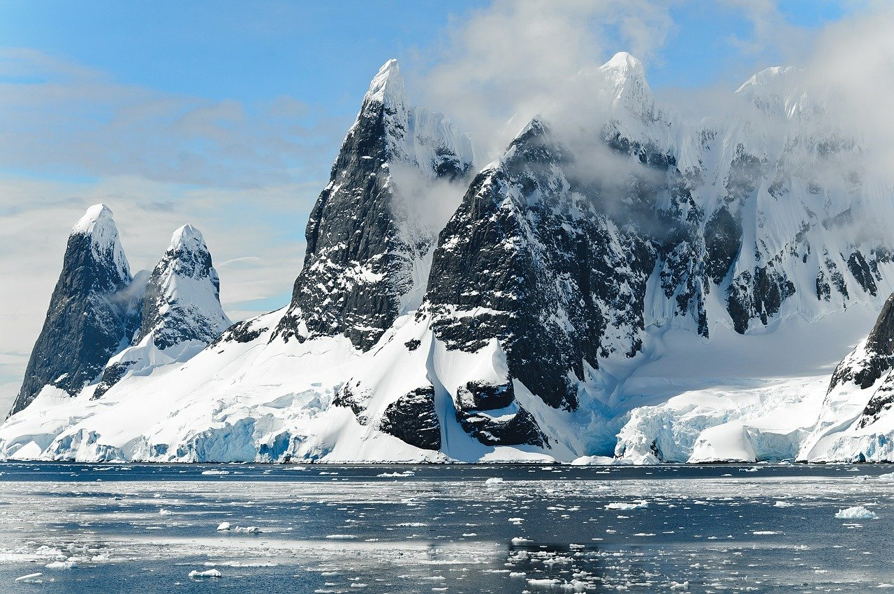
North Pole and South Pole
The areas around both the North and South Poles are sometimes called polar regions.
The North Pole is in an area called the Arctic. The Arctic is an area of frozen ocean.
The South Pole is in an area called the Antarctic or Antarctica. Antarctica is an area of frozen land.
Both places are very cold all the time.

Slide 11
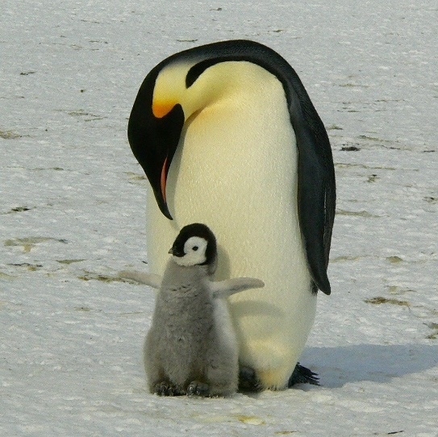
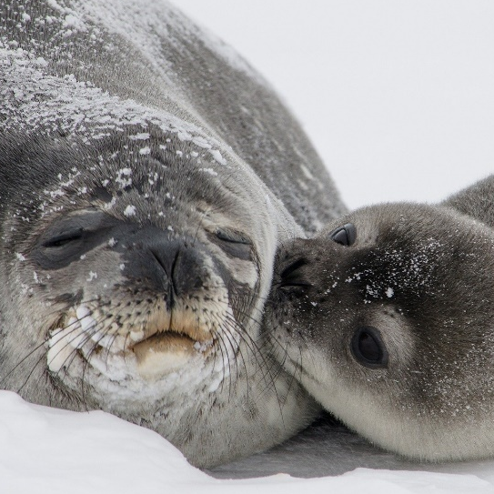
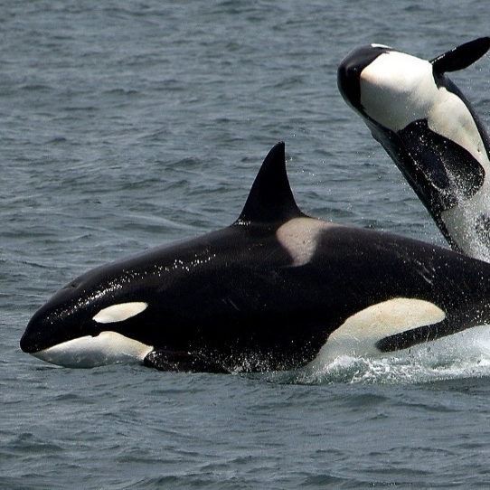
Animals From Antarctica
Although it’s freezing in Antarctica, lots of animals live there. Here are some of them.
emperor penguin
seal
orca
Can you create your own funky facts about them and other animals that live in Antarctica?

Slide 12
